Slide 1
VISION TRANSFORMER
Revolutionizing Image Processing with Deep Learning
Group Members:
P. Jayanth (AP22110020130)
P. Sudeep Reddy (AP22110020104)
S. Azaz (AP22110020087)

Slide 2
Introduction to Vision Transformers
What are Vision Transformers?
Vision Transformers are deep learning models that apply the Transformer architecture (originally designed for NLP) to image processing. Instead of using convolutional layers like CNNs, ViTs split images into patches and process them as a sequence of tokens using self-attention mechanisms.
Key advantages
No Need for Convolutions
Works Well with Large Datasets
Flexible & Scalable
Used in Advanced AI Research
More Accurate with Enough Data

Slide 3
Vision Transformer (ViT) Architecture
1️⃣ Patch Embedding Layer
Converts an image into fixed-size patches.
Uses a Conv2D layer to embed patches into a sequence of vectors.
2️⃣ Positional Encoding
Since Transformers do not have spatial information like CNNs, positional embeddings are added to patch embeddings.
3️⃣ Transformer Encoder Blocks
Each block consists of:
Multi-Head Self-Attention – Finds relationships between patches.
Feed-Forward Neural Network – Processes attention outputs.
Layer Normalization & Residual Connections – Stabilizes training.

Slide 4
4️⃣ Class Token
A special trainable token is added to the input sequence to represent the whole image.
5️⃣ Final Classification Layer
The class token output is passed through a fully connected layer to make predictions.

Slide 5
How Vision Transformers Work
Image is divided into fixed-size patches (e.g., 16×16 pixels).
Each patch is flattened and linearly projected into an embedding vector.
A special token is added to represent the entire image.
Positional encodings are added to retain spatial relationships.
The sequence of embeddings is passed through Transformer Encoder layers.
Multi-Head Self-Attention captures global dependencies across patches.
Feed-Forward Networks refine the learned features after self-attention.
The final token output is passed to a classifier for image prediction.

Slide 6
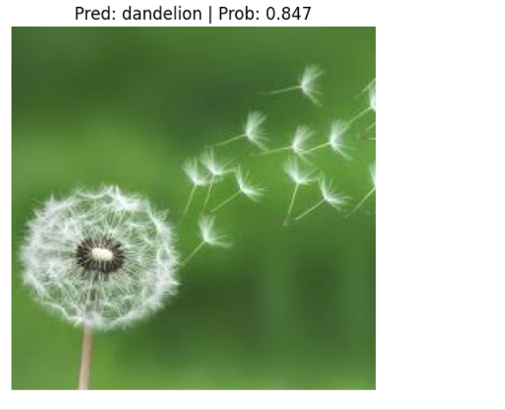
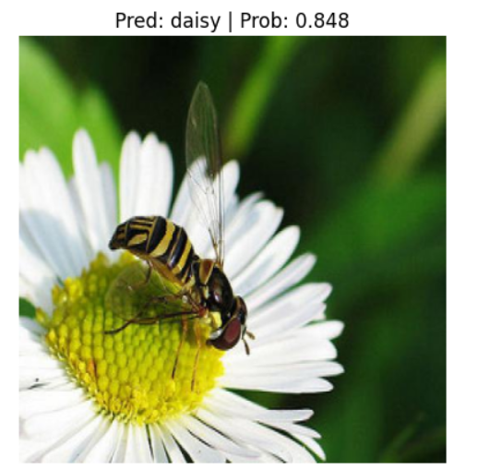
Conclusion & Future Scope
ViTs offer a powerful alternative to CNNs for vision tasks.
Their strength lies in global attention, scalability, and flexibility.
Challenges: Data-hungry, computational cost.
Future: Hybrid models (CNN + ViT), optimized ViT variants, real-time applications.

Slide 7
Applications of Vision Transformers
Image Classification
Object Detection & Segmentation
Medical Image Analysis
Autonomous Vehicles
Facial Recognition
Text-to-Image Generation

Slide 8
THANK YOU

