Slide 1





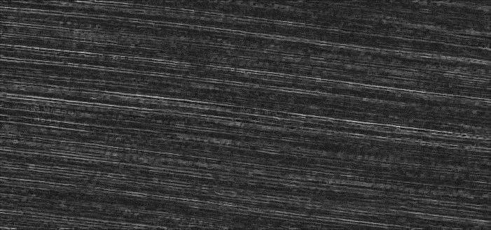






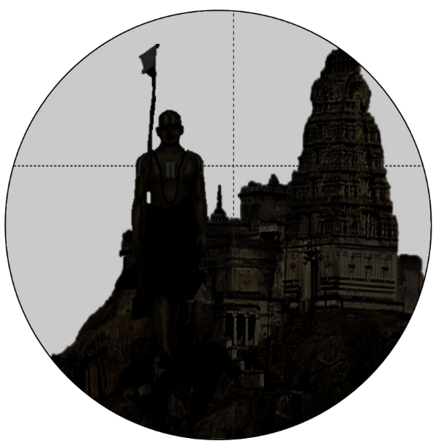





Slide 2
मा
शुच:

Slide 3
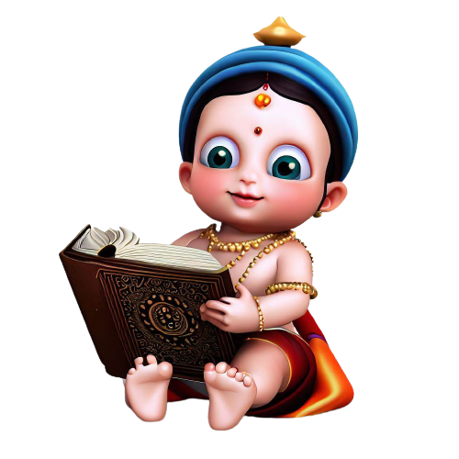
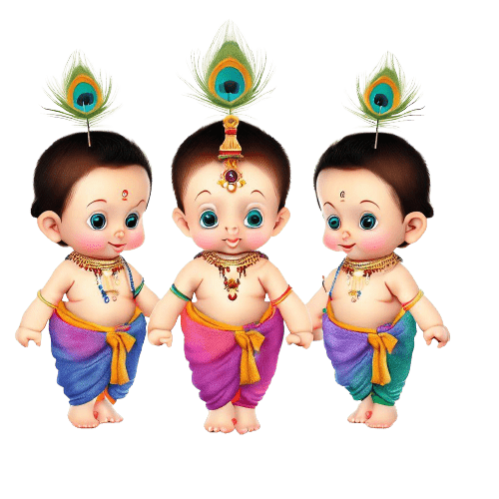
look Once
listen Again

Slide 4


















Chapter icons

Slide 5





Paste as pic,
set transparent,
Save picture as
Vector graphics
श्री
[ShrI]

Slide 7
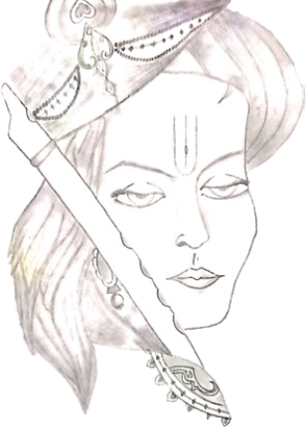

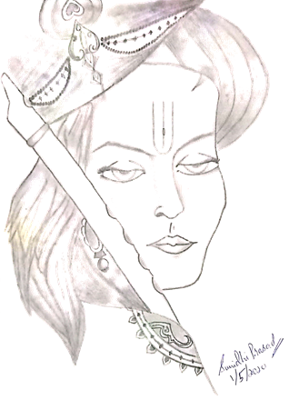
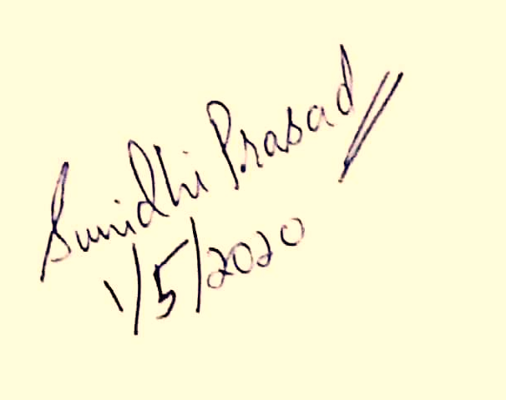

Slide 8


Slide 9

मा
शुच:
Don’t
Worry

