Slide 1




Slide 2
मा
शुच:

Slide 3





Paste as pic,
set transparent,
Save picture as
Vector graphics
श्री
[ShrI]

Slide 5
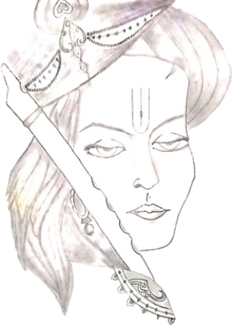

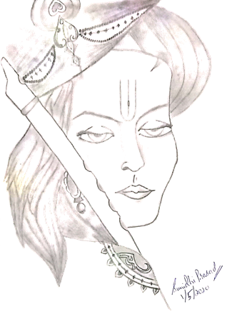
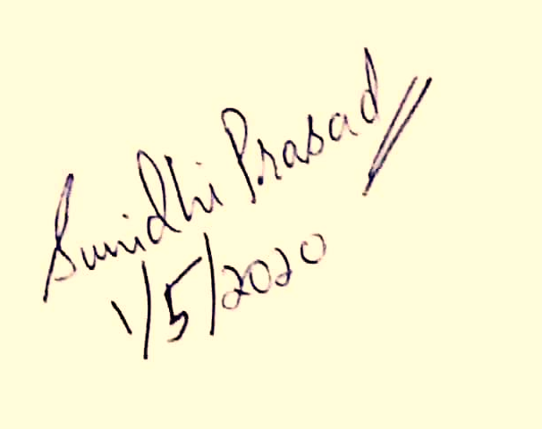

Slide 6


Slide 7

मा
शुच:
Don’t
Worry

