Slide 1

Kotlin
Member: Sudeep Subedi
Li Qiyuan
Daniel Song
Yixiao Jiang
4/11 2022

Slide 2
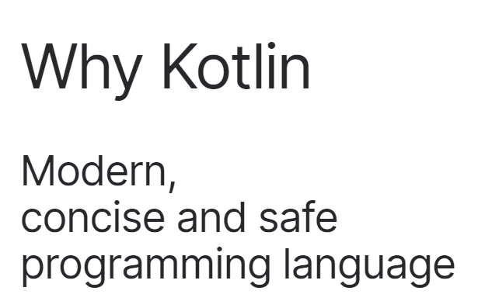
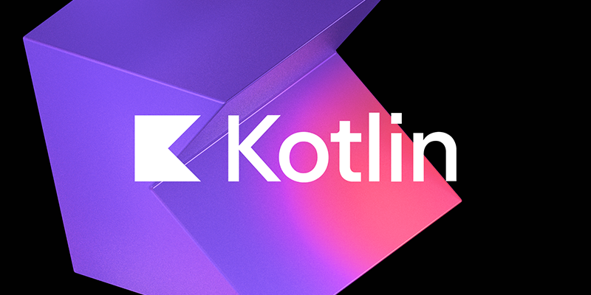
1. Evaluation Criteria
Usage
Community
Learning materials
Employability
Domains
Programming Paradigms
Performance

Slide 3
2. Evaluation
Usage
Learning materials: measured by:
Amazon Books: Number of Books returned by search term “xxx programming language” on Amazon
 | Kotlin | Java | C | Python | C++
Amazon Books | 528 | >7,000 | >5,000 | >4,000 | >2,000

Slide 4
2. Evaluation
Usage
Community: measured by:
Github: available repositories in last year
Stackoverflow: Most Loved, Dreaded, and Wanted Languages
 | Kotlin | Java | C | Python | C++
Github | 72,304 | 627,838 | 108,672 | 745,537 | 166,547
Stackoverflow | 72.6% | 53.4% | 42.5% | 73.1% | 52%

Slide 5
2. Evaluation
Usage
Employability: measured by: number of impressions of “xxx developer” on popular job sites
Linkedin
Handshake
 | Kotlin | Java | C | Python | C++
Linkedin | 15,971 | 850,173 | 321,678 | 888,875 | 771,098
Handshake | 37 | 828 | 27.6k | 1.6k | 27.6k

Slide 6
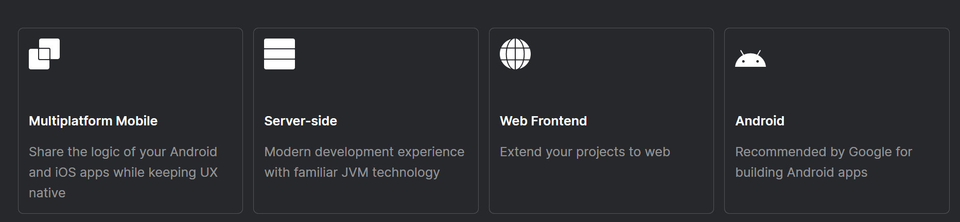
2. Evaluation
Domains
Different domains popular language
AI: (popular):Python,Java,C++,R,Prolog
Ml: (popular): Python, R, Javascript, Java
Applications: Python, Java, Kotlin, Swift
Applications(Kotlin): desktop, web, android..
Notes:
Kotlin has several applications and can be used for desktop applications, web applications, android applications, and server-side application development

Slide 7
2. Evaluation
Programming Paradigms
Object Oriented Paradigm
Class
Inheritance
 | Kotlin | Java | C | Python | C++
Class | yes | yes | no | yes | yes
Inheritance | yes | yes | no | yes | yes

Slide 8
2. Evaluation
Performance
Readability, writability, reliability
 | Readability | Writability | Reliability
Simplicity | improve | improve | improve
Data types | improve | improve | improve
Syntax design | improve | improve | improve
Support for abstraction |  | improve | improve
Exception handling |  |  | improve

Slide 9
2. Evaluation
Performance
Based on Android APP Development
Java
an object-oriented programming language
java is slowly lagging behind in speed and safety which is crucial
Kotlin
a modern, statically typed programming language
not only lightweight and explicit code, null-safety, data classes, and coroutines but also writing less code, no runtime overhead and more safety
includes all existing Java frameworks & libraries

Slide 10
Project
Description: Timetable app for classes (Possibly provide the list of classes you can take)
Constraints: Only for M.S in Computer Science students at GW and only for android mobile phones
Features:
Builds the time table according to your class
Displays information about the course like professor’s name, location and course description.
Displays error if there is conflict in the schedule
(Enter your past classes and you’ll be provided with the list of classes you can take this semester)
Technology Used: Kotlin and Android Studio. Target device: Android mobile phone
Where the project can be applied: GWU M.S in C.S students
Note: The italicized features will be implemented if permitted by time.

Slide 11
Project
Functions:
Display class timetable
Allows to add and delete classes to the
schedule
Start
Add from list
Timetable
Description

Slide 12
Thank you
4/11 2022

