Slide 1
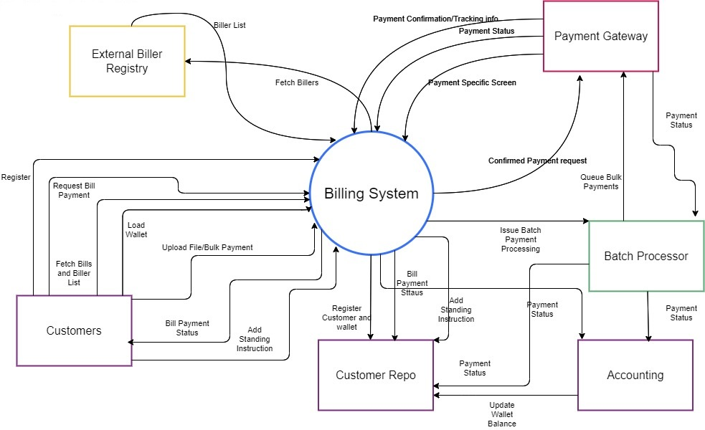
Billing System Context Diagram

