Slide 1
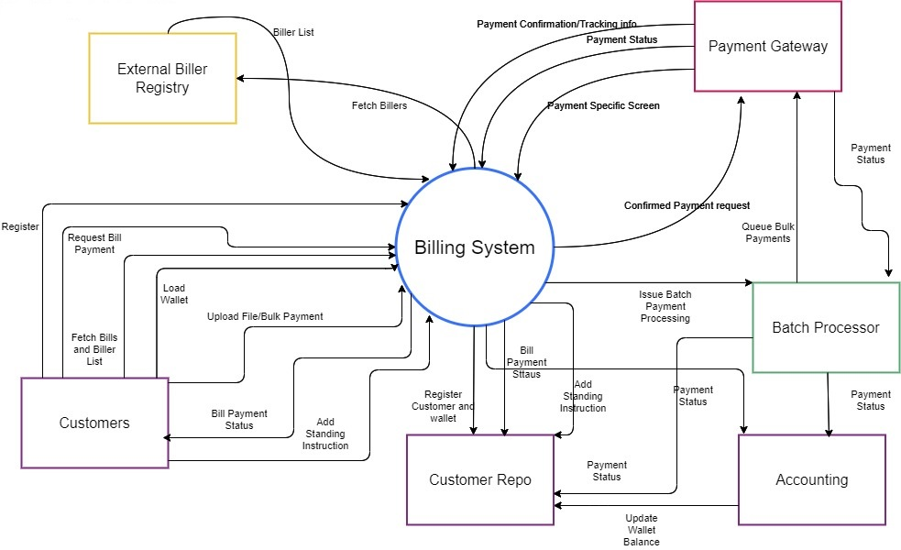
Billing System Context Diagram

Slide 2
Billing System Ecosystem
Subsystems | Technology Landscape | Description
Billing System | Java Based Microservices, REST API | Distributed microservices to provide the following functions: 1. Register Customer 2. Fetch Billers and Bills 3. Create Customer Wallet 4. Online Bill Payment 5. Interface with Payment Gateway to pay Biller 6. Load Customer Wallet 7. Update Customer Wallet 8. Process Bulk Payment (File Upload) 9. Register standing instruction for Offline Payment 10. Log Customer interactions
 | Springboot with Hibernate
 | Openshift Containerized
Customer Facing WebApp | ReactJS | ReactJS based UI interfacing with Customers for performing all the operations
Customer Repo | RDBMS (MySQL) | Stores the following entities: 1. Customer 2. Customer Wallet 3. Customer Transactions 4. Customer Standing Instructions
Batch Processor | Java Based Microservices, REST API | Distributed microservices to provide the following functions: 1. Offline Bill Payment - based on queue, asynchronous. 2. Update Customer Wallet
 | RabbitMQ
 | Openshift Containerized
Accounting | Java Based Microservices, REST API | Distributed microservices to provide the following functions: 1. Manage transaction Logs 2. Update Customer Wallet 3. Reporting 4. Generate Alert for insufficient balance

Slide 3
Billing System Ecosystem
External Interfaces | Technology Landscape | Description
Payment Gateway | External System | Payment Gateway connecting to different Payment Systems/Banks depending on the payment type. Currently, payment only comes from Customer Wallet. But possible to extend it to other payment types like UPI/Credit Card/Net Banking etc.
External Biller Registry | External System | A register of Billers and the bills for a customer. Interface available to pull bills applicable for a customer identified by email Id.
OTP Generator | External System | Used for two factor authentication. Customer enters the email Id and the MFA generates an OTP and sends it to the email.

Slide 4
Subsystems | Microservices | Consumer | Interface
Billing System | Register Customer | WebApp | Customer Repo
 | Fetch Bills | WebApp | Biller Registry
 | Create Customer | WebApp | Customer Repo
 | Create Wallet | Billing System | Customer Repo
 | Load Wallet | WebApp | Customer Repo, Accounting
 | Update Wallet | WebApp | Customer Repo, Accounting
 | Customer Login | WebApp | OTP System
 | Pay Bill | WebApp | Payment Gateway, Customer Repo, Accounting
 | Upload File | WebApp | Customer Repo
 | Pay Bulk Bills | Billing System | Batch Processor, Customer Repo, Accounting
 | Register SI | WebApp | Customer Repo
 | Trigger Offline Payment | Billing System | Batch Processor, Customer Repo, Accounting
 | Log Transactions | Billing System | Customer Repo
Batch Processor | Pay Bulk Bills | Billing System | Payment Gateway, Accounting
 | Update Wallet |  | Customer Repo, Accounting
 | Log Transactions | Batch Processor | Customer Repo
Accounting | Update Wallet |  | Billing System, Batch processor
 | Update Biller Account |  | Billing System, Batch processor
 | Manage Transaction Log |  | Billing System, Batch processor

