Slide 1
WEB TEMPLATING
A mini project presentation
Guided by:
Mr. Harish G
Assoc. Prof., Dept of CSE
Dr. AIT
Prepared by:
SUHAS K R [1DA15CS145]
SUDEEPTH P [1DA15CS143]

Slide 2
INTRODUCTION
First, you have to know the basic definition of a website template. You can say that website templates are well-designed tools which are used to separate the content from other sections in the design of a website. Website templates play an important role in the creation of a website.
Without website templates, your website will not have an attractive look. You have to understand that without website template, it is not possible to create a well-designed website. If you are a web-designer then you also know that creation of website is based on some important steps. Being a web-designer, you must know all the steps which are involved in the design of a website. Selection of website template is also one of the steps which are essential for the creation of a website. According to different web-designers, website template is the basic building block of a website. At this stage, you have to know that website templates are used to create any type of website.

Slide 3
OBJECTIVE
The main objectives of this project work are that:
To provide consistent and quality service to the end user
To use quality standards and maintenance
To reduce dependency on web developers and other developers
Provide more self-serve feature
To help the user expand his business/brand through the services we provide from our web page
Use of color-picker helps the user to alter the web pages according to his needs

Slide 4
LITERATURE SURVEY
Web:
A web project is the process of developing and creating a Web site, activities in a network which are aimed at a pre-defined goal. The network can be both accessible for everyone, as in the Internet, or only for certain people, as an intranet. The goal of Web projects is the transfer of static and dynamic content - both directly to end users, as well as indirectly through means of various kinds of interfaces. Web projects are based on TCP/IP technology and concern the transfer of static and dynamic content
HTML:
Hypertext Mark-up Language (HTML) is the standard mark-up language for creating web pages and web applications. With Cascading Style Sheets (CSS) and JavaScript it forms a triad of cornerstone technologies for the World Wide Web. Browsers receive HTML documents from a webserver or from local storage and render them into multimedia web pages. HTML describes the structure of a web page semantically and originally included cues for the appearance of the document. HTML elements are the building blocks of HTML pages. With HTML constructs, images and other objects, such as forms, may be embedded into the rendered page.

Slide 5
CSS:
Cascading Style Sheets (CSS) is a style sheet language used for describing the presentation of a document written in a mark-up language. Although most often used to set the visual style of web pages and user interfaces written in HTML and XHTML, the language can be applied to any XML document, including plain XML, SVG and XUL, and is applicable to rendering in speech, or on other media. Along with HTML and JavaScript, CSS is a cornerstone technology used by most websites to create visually engaging webpages, user interfaces for web applications, and user interfaces for many mobile applications.
JS:
JavaScript often abbreviated as JS, is a high-level, interpreted programming language. It is a language which is also characterized as dynamic, weakly typed, prototype-based and multi-paradigm.
Alongside HTML and CSS, JavaScript is one of the three core technologies of the World Wide Web. It is used to make dynamic webpages interactive and provide online programs, including video games. The majority of websites employ it, and all modern web browsers support it without the need for plug-ins by means of a built-in JavaScript engine. Each of the many JavaScript engines represent a different implementation of JavaScript, all based on the ECMAScript specification, with some engines not supporting the spec fully, and with many engines supporting additional features beyond ECMA.

Slide 6
REQUIREMENT SPECIFICATION
HARDWARE REQUIREMENTS
Optional for accelerated emulator: Intel® processor with support for Intel® VT-x, Intel® EM64T (Intel® 64), and Execute Disable (XD) Bit functionality.
Minimum: 2GB RAM, Recommended: 4 GB RAM.
SOFTWARE REQUIREMENTS
Microsoft® Windows® 8/7/Vista/2003 (32 or 64-bit)
WampServer includes Apache Server, MySQL and PHP
Compatible Web Browser

Slide 7

SNAPSHOTS

Slide 8
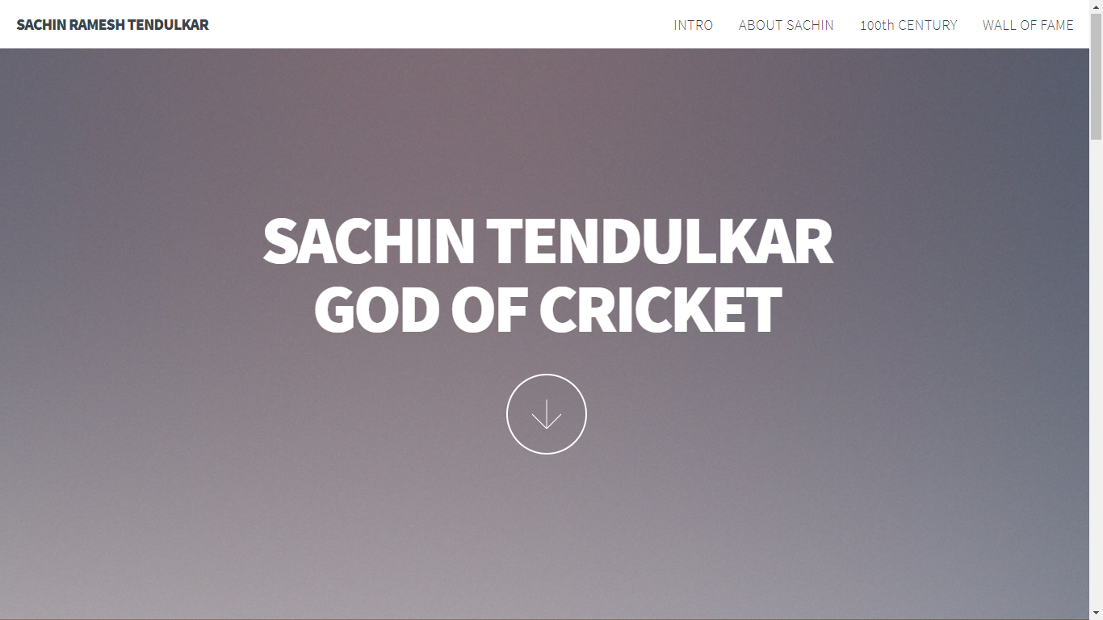

Slide 9
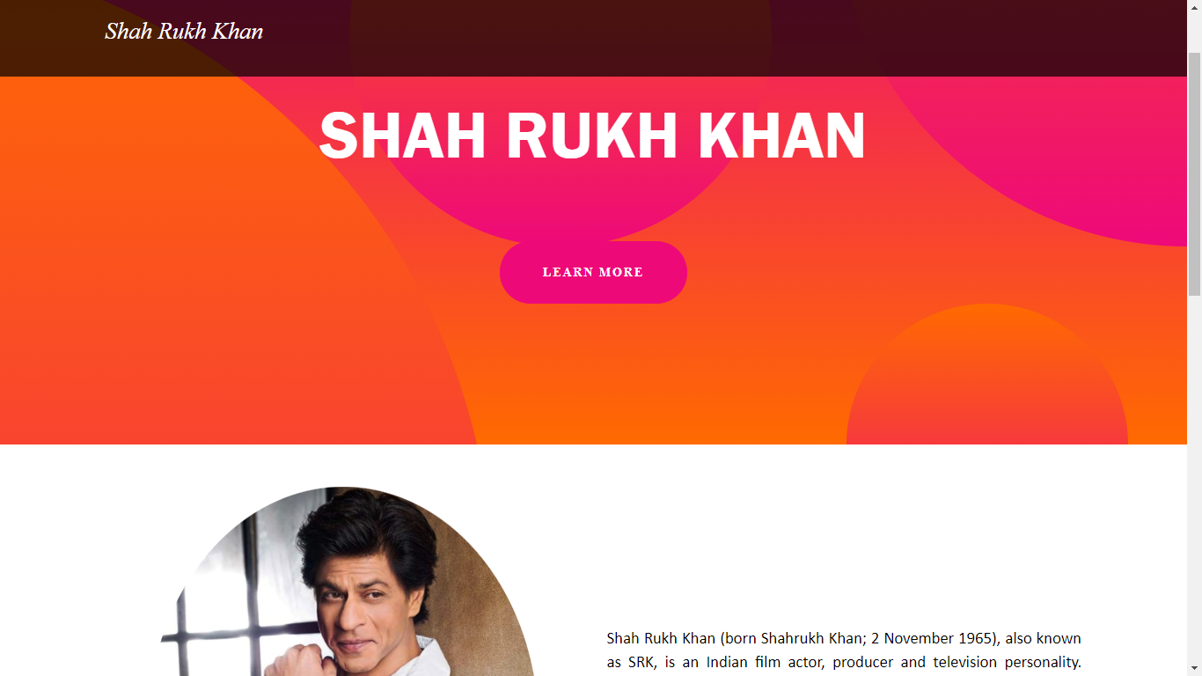

Slide 10
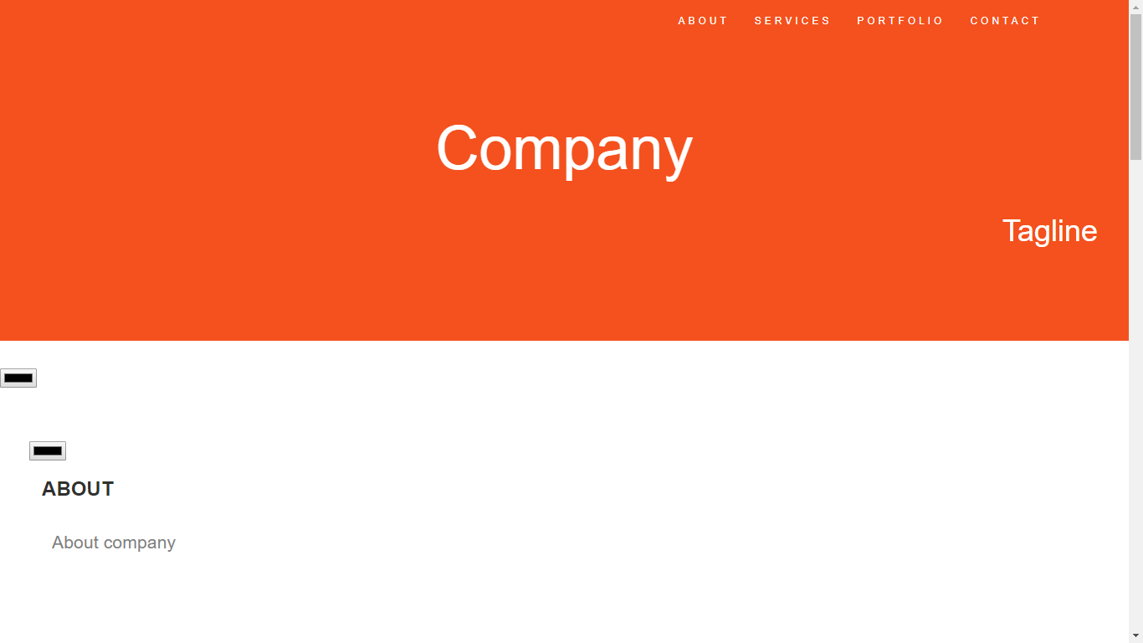

Slide 11
APPLICATIONS
The template approach uses only generic tools such as a text editor and a Web browser; it works equally well on PC or Mac platforms and does not depend on any specific commercial Web editor which would have to be purchased and learned and which might become obsolete.
The emphasis remains on the content, not on the decorative design of the site; using a Web editor encourages students to focus too much on the cosmetic aspects.

Slide 12
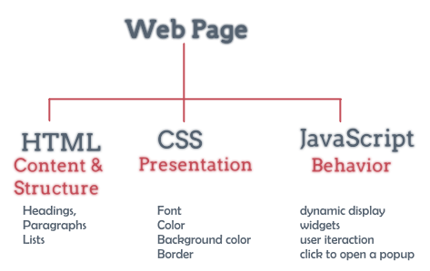
DESIGN

Slide 13
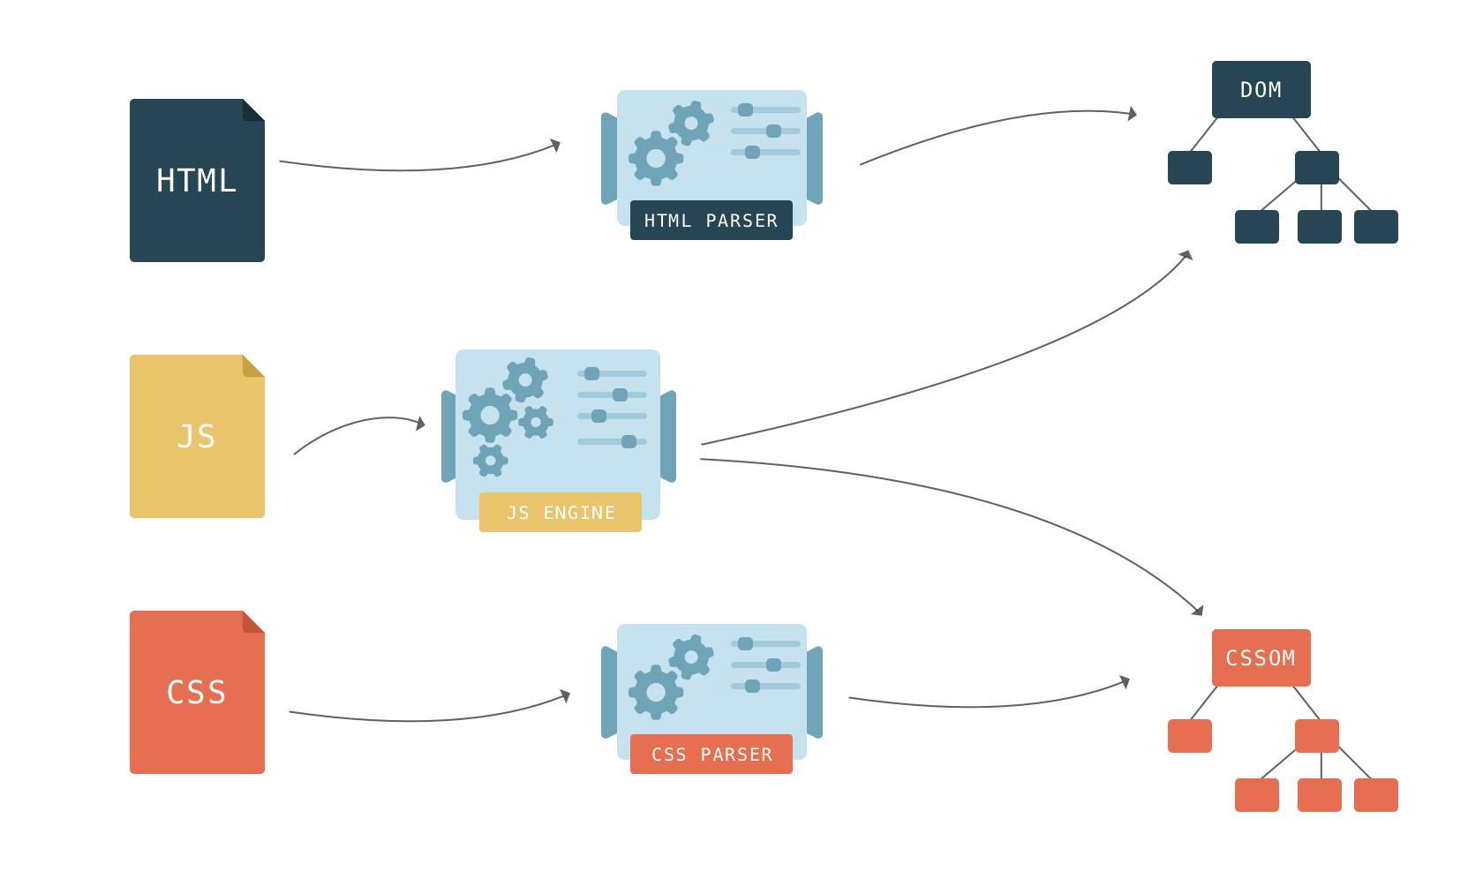

Slide 14
CONCLUSION
There are many reasons building a webpage, requires are to obtain the right tools and resources.
Standardization is one factor, Use the right tools, and assure that the pages would be in the right standard and is acceptable to every client.
Using the right resources for web designing jobs will make our webpage contemporary. They can easily integrate into current technologies and software. All the users would derive added value from webpages and contribute to its growth.
The right resources also make it easy. The standard tools that we have used for creating the website will ensure that things such as navigation, menus and layout conform to current practices with which every web user is familiar with according to our template requirement

Slide 15
THANK YOU

