Slide 1

Project Title Seasonal Agriculture Performance Analysis
Name: SUDEEPTHI
College Name: AJ Institute of Engineering and Technology Mangaluru
AICTE STU ID : STU6a66195853d111785076056

Slide 2
PROBLEM STATEMENT
Agricultural activities are influenced by seasonal variations in environmental conditions, farming practices, resource availability and market conditions. As a result, agricultural performance may differ from one season to another. However, raw agricultural data does not clearly explain how agricultural performance changes across seasons or what patterns can be observed in different seasonal conditions. The problem is to analyze the given agricultural dataset and investigate seasonal differences in agricultural performance by identifying meaningful patterns, trends, relationships and variations within the available data.

Slide 3
Project Description
Seasonal Agriculture Performance Analysis is a data analytics project that studies agricultural activities across different seasons, geographical regions and farming conditions.
The project uses agricultural data containing information about:
Crop and season
Geographical location
Rainfall and temperature
Soil conditions
Fertilizer and pesticide usage
Irrigation methods
Crop yield and production
Cost, revenue and profit
Water usage and efficiency
Disease and pest risk
The dataset is cleaned and analyzed using Python to identify differences between seasons and discover relationships between environmental conditions, resource usage and agricultural outcomes.
The final analysis provides visualizations, statistical findings, conclusions and data-driven recommendations.
This is consistent with the dataset description and project objective

Slide 4
Objective
The primary objective of this project is to analyze agricultural data from different seasons and identify meaningful patterns, trends, relationships and differences in agricultural performance. Students should independently:
Explore and understand the dataset.
Clean and prepare the data for analysis.
Examine how agricultural performance varies across seasons.
Identify important seasonal patterns and trends.
Investigate relationships between seasonal conditions and agricultural outcomes.
Compare relevant groups within different seasons.
Identify significant differences or unusual patterns.
Apply appropriate statistical and visualization techniques.
Interpret findings based on evidence from the dataset.
Develop meaningful conclusions and data-driven recommendations.

Slide 5

WHO ARE THE END USERS?
1. Farmers
Understand seasonal crop performance.
Support better crop and resource planning.
2. Agricultural Planners
Compare agricultural performance across seasons and regions.
Support seasonal planning decisions.
3. Agricultural Researchers
Study relationships between environmental conditions and crop outcomes.
4. Government / Agricultural Departments
Use data-driven insights for agricultural planning and resource management.
5. Data Analysts
Use the dataset for agricultural trend and performance analysis.

Slide 6
Technology Used
Programming Language :Python
Libraries: Pandas, NumPy, Matplotlib, Seaborn, SciPy
Development Environment: Jupyter Notebook
Dataset: seasonal_agriculture_performance_dataset.CSV
Technology | Purpose
Python | Data Analysis
Pandas | Data loading, cleaning and manipulation
NumPy | Numerical operations
Matplotlib | Data visualization
Seaborn | Statistical visualization
Scipy | Statistical analysis
Jupyter Notebook | Complete project documentation

Slide 7
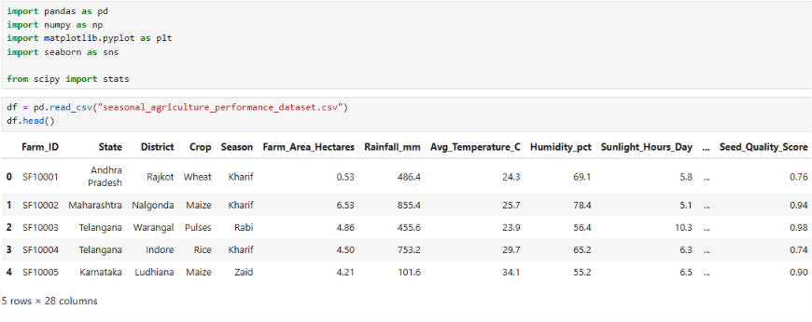
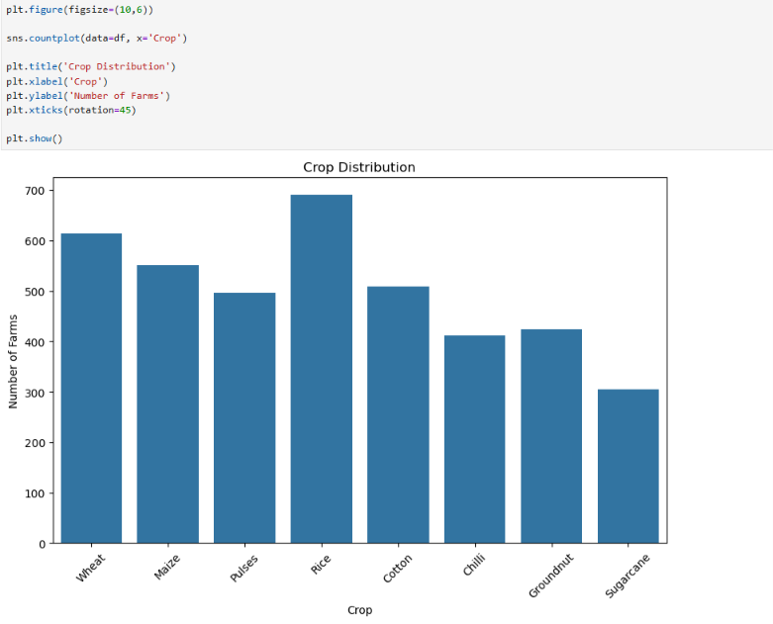
RESULTS

Slide 8
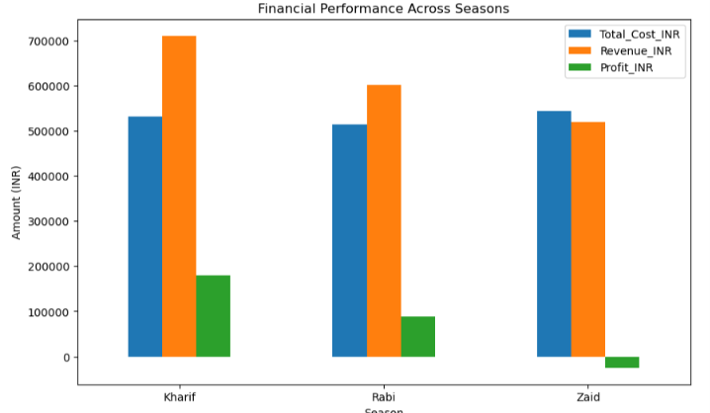
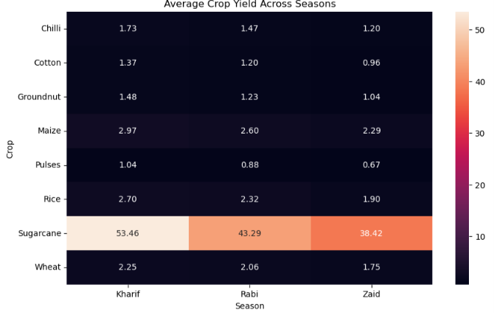

Slide 9
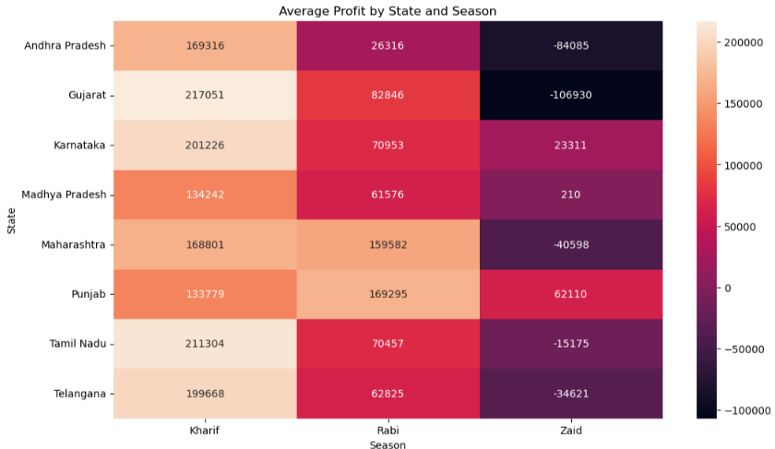

Slide 10
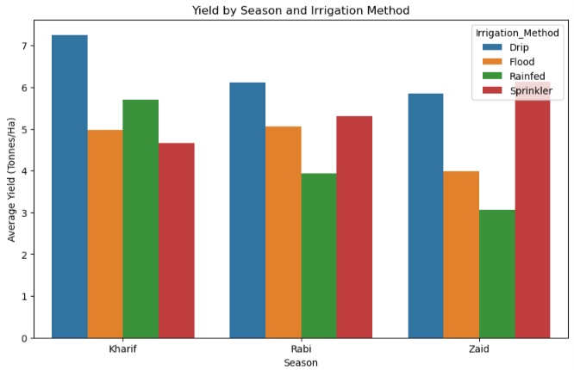

Slide 11
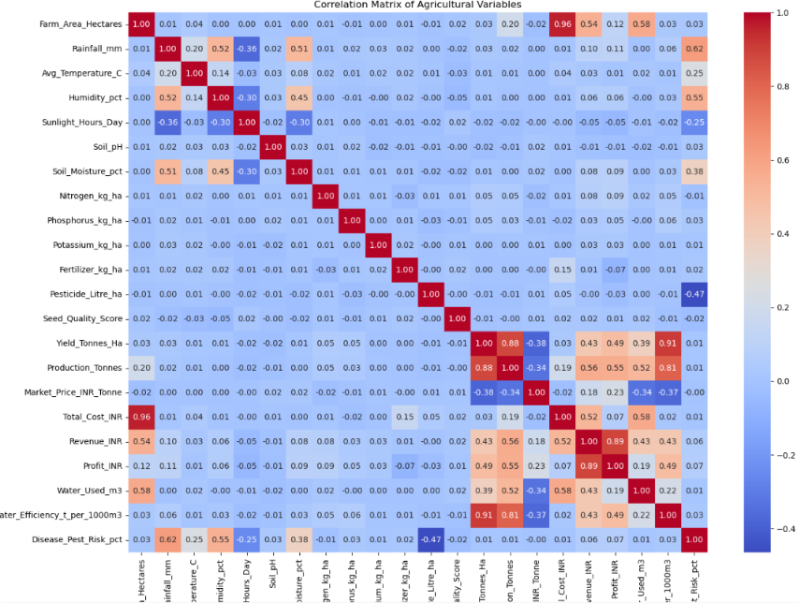

Slide 12
Future scope
The project can be extended by:
Integrating real-time weather data.
Using larger agricultural datasets.
Developing predictive models for crop yield.
Forecasting seasonal agricultural performance.
Developing an interactive dashboard using Power BI or Streamlit.
Applying machine learning to predict yield and profit.
Developing a recommendation system for crop and seasonal planning.
Integrating real-time market price information.

Slide 13
GitHub Link
https://github.com/sudeepthi0530/Data_analysis_Major_project

Slide 14
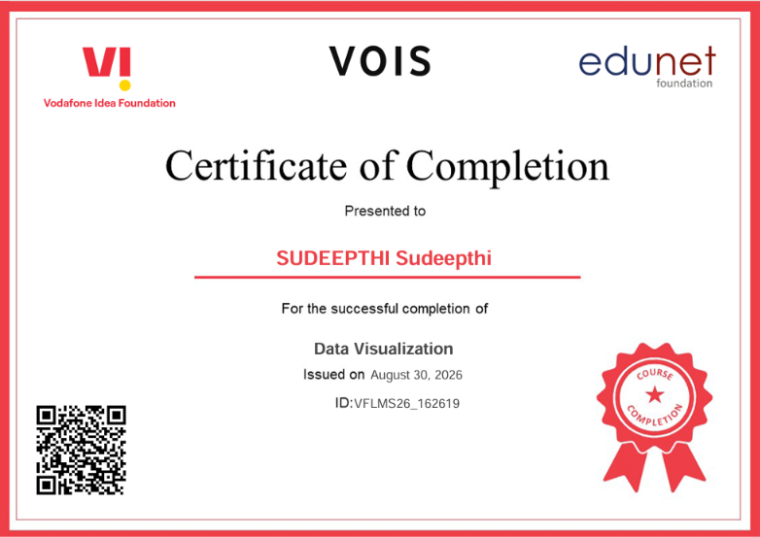
VOIS Course completion certificate - Course name- Data Visualization

Slide 15
Thank you
.
.

