Slide 1
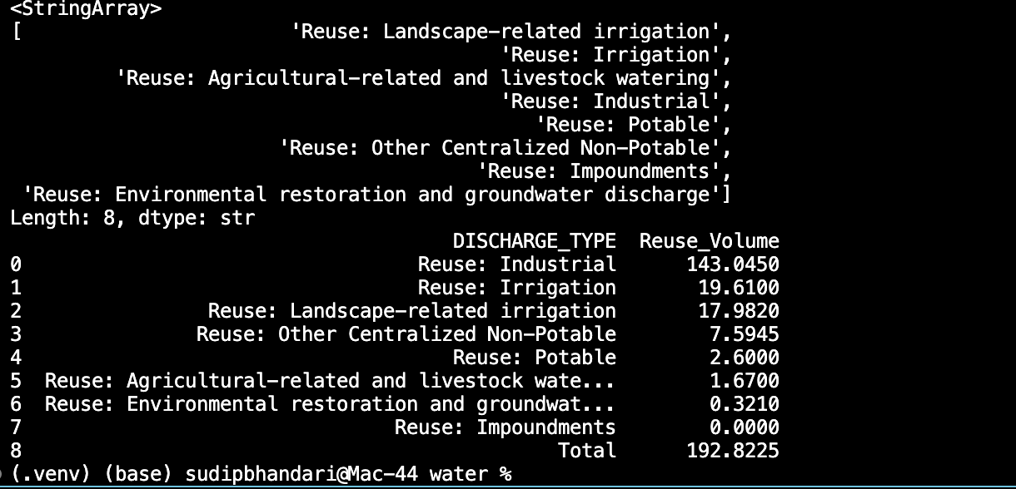
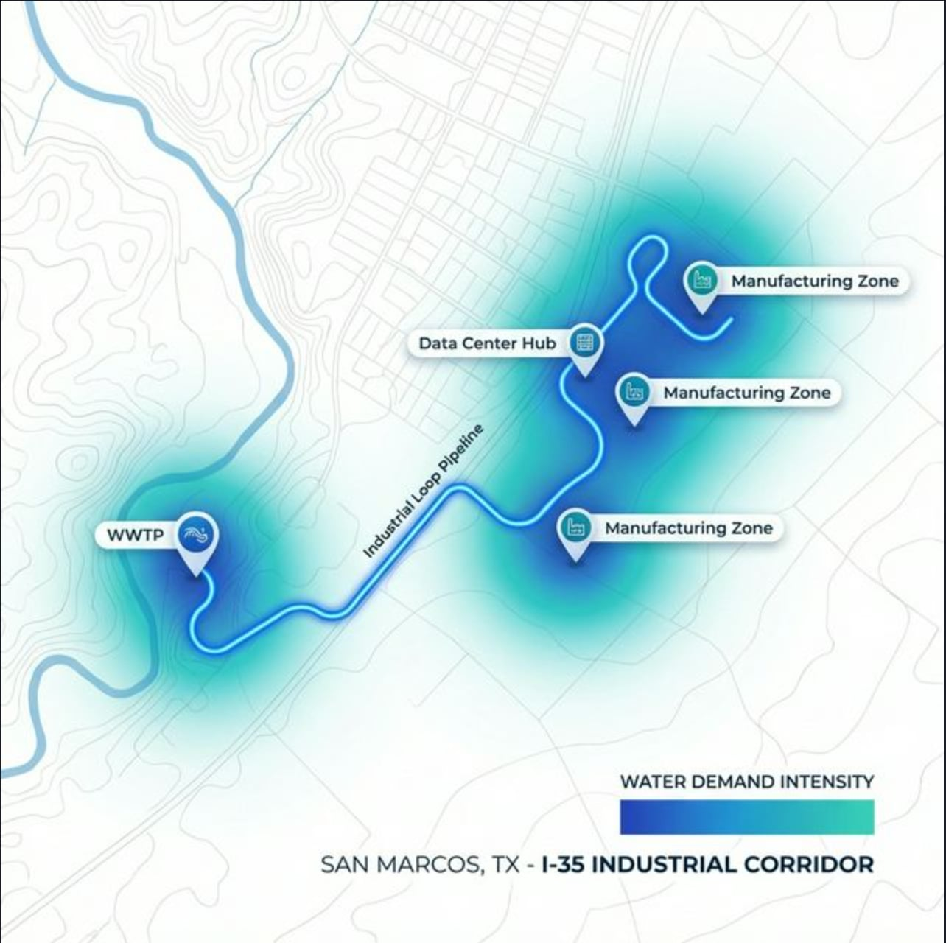
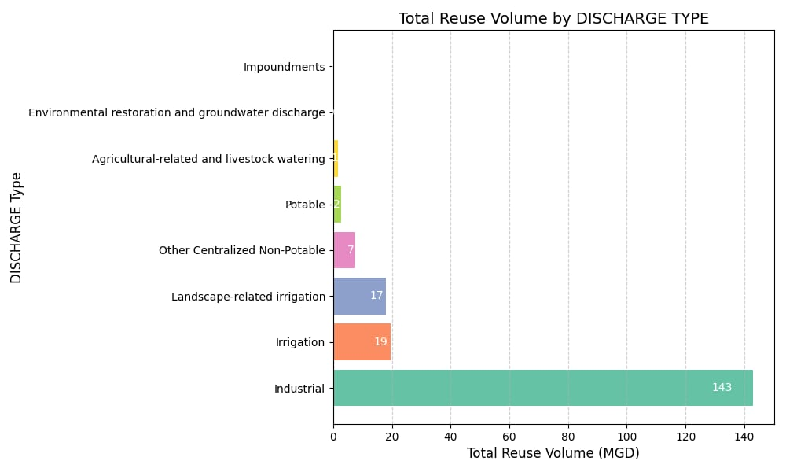
The San Marcos Industrial Water Loop
DataPie: Sudip Bhandari, Kumar Timalsina, Sabin Khatiwada
McCoy College of Business, College Of Science & Engineering, Ingram School of Engineering
Question:
How can San Marcos utilize open data from the EPA Clean Watersheds Needs
Survey (CWNS) 2022 to implement a "Closed-Loop" Industrial Water System that protects the Edwards
Aquifer while supporting rapid industrial growth?
The Challenge:
San Marcos is currently under Stage 4 Drought restrictions, yet it is one of the
fastest-growing industrial corridors in the nation. How do we provide millions of gallons for data centers
and manufacturing without draining the city's drinking water?
Findings
• The "Lost Asset": San Marcos currently discharges 100% of its treated wastewater (~17.8 MGD)
back into surface waters. This water is currently a "lost asset" that does not contribute to droughtresilience.
• The State Leader: Texas leads in Industrial Water Reuse, which accounts for 143.04 MGD (over
70% of all reuse in the state). This proves that industry is the most efficient target for large-scale
recycling.
• The Spatial Gap: Geospatial analysis shows that major industrial candidates (Noveon, CFAN, and
the new $1.5B Highlander Data Center) are clustered along the I-35 corridor, less than 5 miles from the
San Marcos WWTP, making a "Loop" pipeline physically viable.
Header
Subheader
Content goes here: Totat ullaborernam harci cus, cuscidendit lat et as eum explit apicaboria am que vendent inullup tatur? Quia voluptat ut prae. Qui blatibu saecture, ut volor as a audae es elenti quis qui tessum faccuptatet odignisim eatur, sincia nusdantent estem haruntiatint idit rem ulpa et exped que provitatatur seque pro idi nos quid quo vent.
Suggested format for numbered list:
Ossus volupicabore et iminciae nitati
Omnihil et, occulpa venient ab ilibusam volectes
Tori sitius inciis net voluptatiis
Auditius dem venimus
Ium eatius dolupta
Ossus volupicabore et iminciae nitati diaeculpa cumquo omnihil et, occulpa venient ab ilibusam volectes vellic tori sitiusam inciis net voluptatiis auditius dem venimus.
The San Marcos Industrial Loop (Concept Map)
A geospatial infographic showing the "Blue Line" pipeline route from the WWTP to the industrial corridor.
Results (Scaling the Loop)
By Implementing "The San Marcos Industrial Loop," the city can achieve the following:
• Potable Water Savings: Converting 50% of the city's current discharge to industrial reuse saves ~9
Million Gallons of Fresh Water EVERY DAY.
• The Impact: This is enough to fill 14 Olympic-sized swimming pools every 24 hours.
• Economic Resilience: The loop provides "drought-proof" water to anchor tenants like Highlander
Data Centers and Noveon Magnetics, ensuring they never have to shut down during Stage 4
restrictions.
• Sustainability: Reduces the withdrawal pressure on the San Marcos River and the Edwards Aquifer,
protecting local ecosystems while enabling economic expansion.
Methology:
To solve this, we performed a multi-stage data analysis of the EPA CWNS 2022 Dataset:
1. Data Extraction & Cleaning:
• Processed `FLOW.csv` and `DISCHARGES.csv` using Python scripts to filter for Texas-based
facilities.
• Cleaned facility IDs and combined flow types to isolate "Total Flow" vs "Reuse" percentages.
2. State-Wide Analysis:
• Calculated total water reuse volumes across Texas by joining discharge types with design flow
capacities.
• Segmented reuse into four categories: Industrial, Irrigation, Potable, and Agricultural.
3. Local Identification:
• Triangulated San Marcos specific facility data using CWNS IDs `48008029001` and `48008029002`.
• Identified existing industrial "Significant Industrial Users" (SIUs) via the San Marcos Industrial
Pretreatment Program (IPP).
4. Case Study Validation:
• Benchmarked the proposed San Marcos loop against the successful "40 Acre" Industrial WWTP
(GCA) in Texas City.
Texas Water Reuse Breakdown
This chart highlights the massive volume of Industrial Reuse compared to all other types, justifying our focus on factories and data centers.

