Slide 1
Ethereum wallet behaviour is best treated as layered
- Goal: segment Ethereum EOA wallets into defensible behavioural roles.
- Main result: static roles, temporal rhythms, activity states, and network position overlap but do not collapse into one taxonomy.
- Academic contribution: a validation workflow, not just a clustering output.

Slide 2
The project moved from application idea to empirical foundation
- Initial idea: AI-governed crypto-bank simulator with agents and explainable decisions.
- Pivot: real Ethereum wallet behaviour needed to be understood before simulation assumptions could be trusted.
- Final direction: derive behavioural roles from data, then validate them with independent evidence.

Slide 3
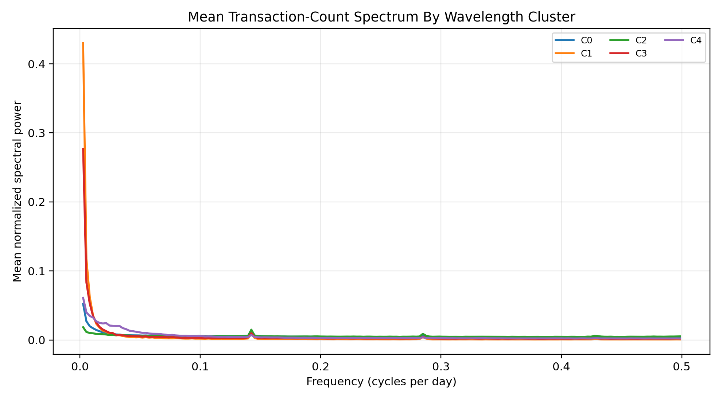
Temporal signal analysis adds a second evidence layer
- Built daily 2022 wallet signals for a 10,000-wallet edge-aware sample.
- Frequency-domain features capture rhythms in transaction and flow activity.
- Time-domain features capture active days, inactive gaps, bursts, streaks, and switching.

Slide 4
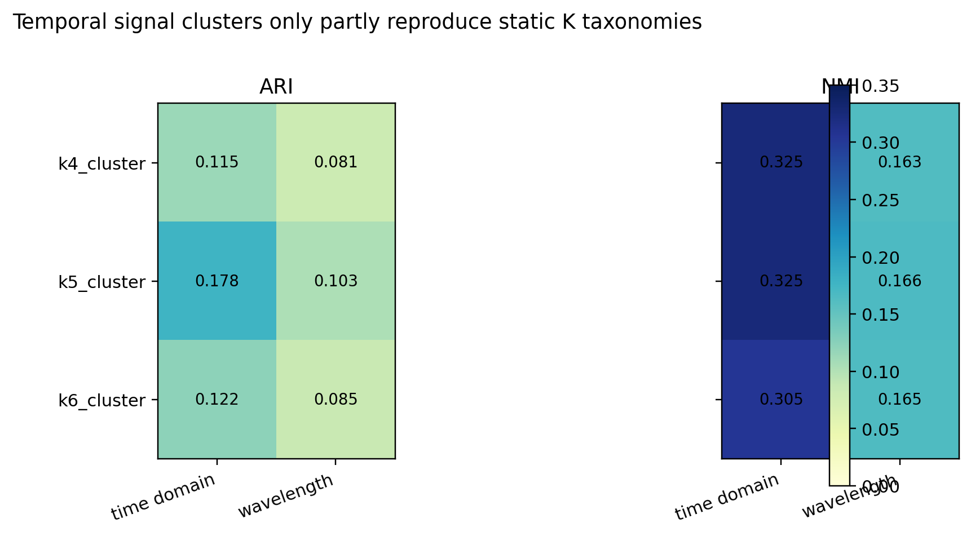
Signal clusters are structured but do not simply reproduce K5
- K5 has the highest correspondence with signal clusters among K4/K5/K6.
- The agreement remains low to moderate, so the signal layer is not a duplicate of static roles.
- This gives the paper a stronger layered-behaviour argument.

Slide 5
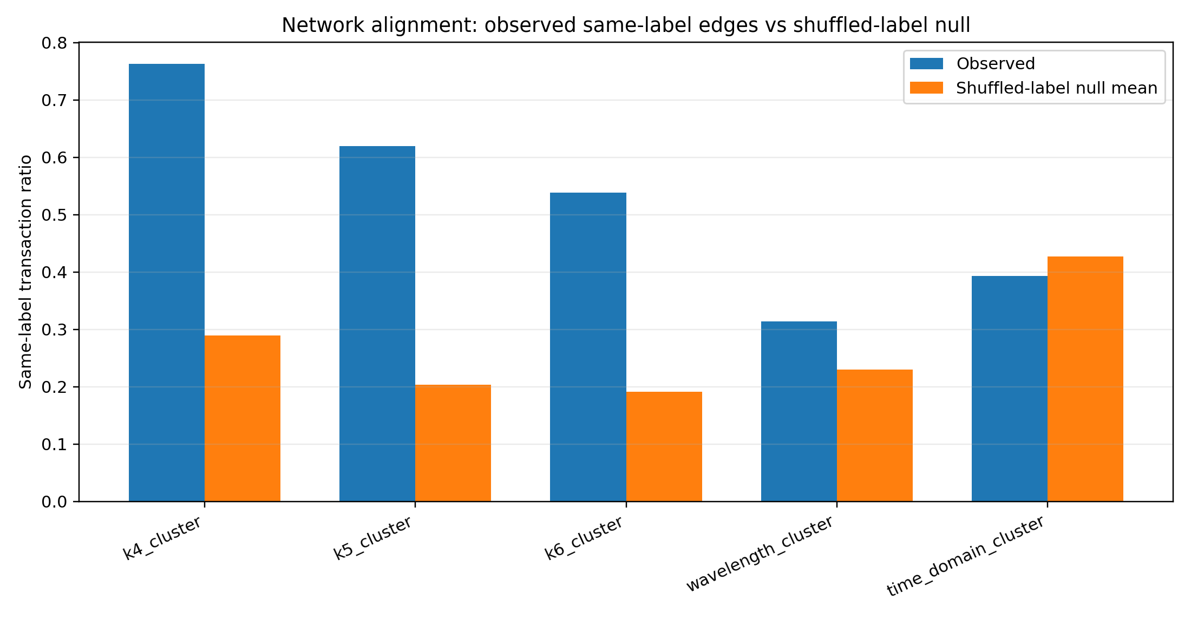
Network validation separates stronger and weaker claims
- Static K taxonomies show strong same-label transaction concentration.
- Wavelength clusters also exceed the shuffled-label null.
- Time-domain clusters do not exceed the null in the 10k test, so that claim must be cautious.

Slide 6
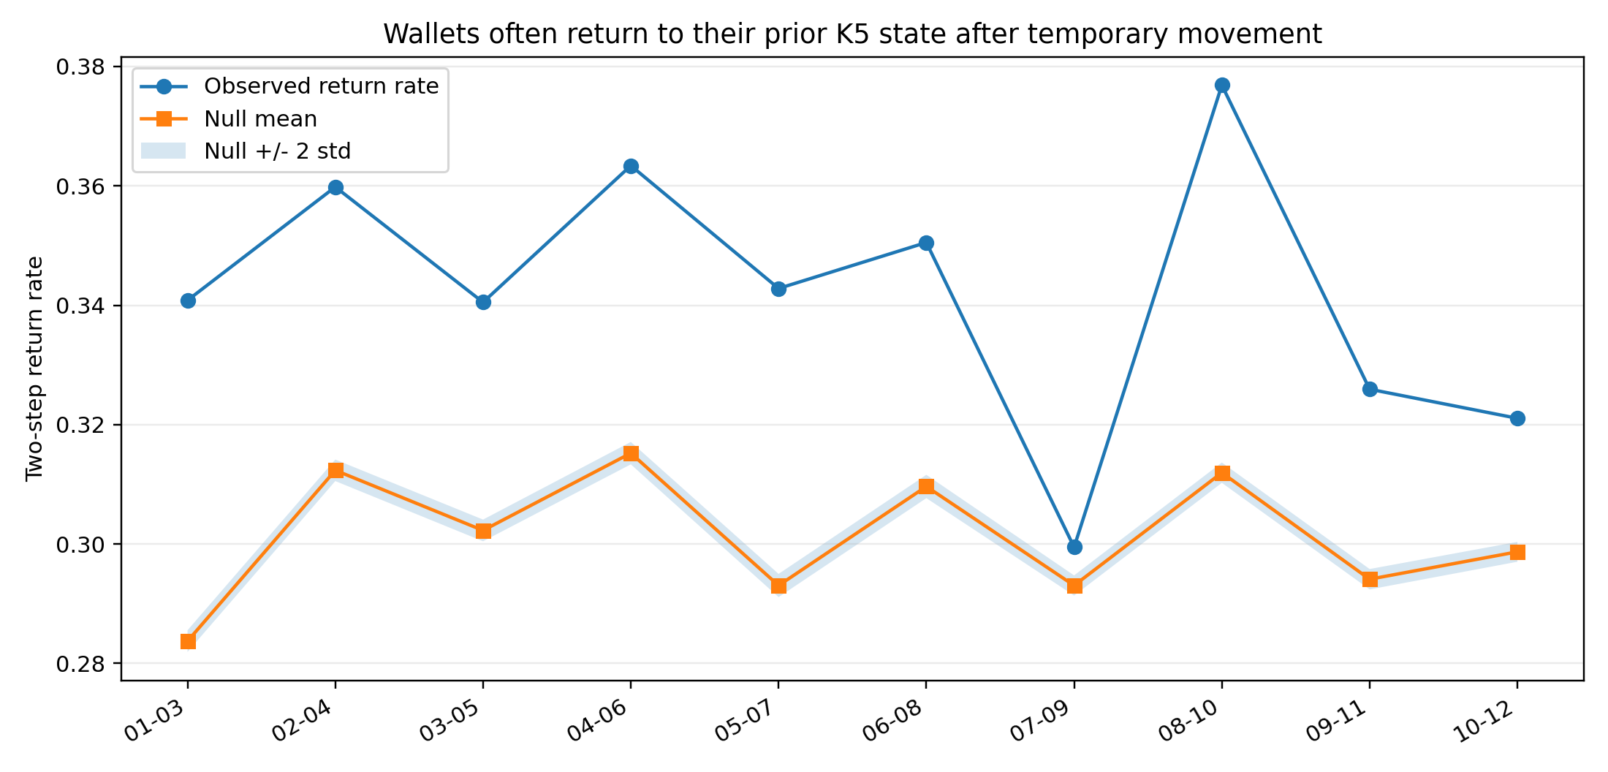
Temporal transitions show temporary movement and return
- Monthly K5 transitions show moderate persistence rather than fixed identities.
- Two-step return rates are consistently above null expectations.
- Wallets may temporarily leave a state and later return, but we do not infer intent.

Slide 7
The paper contribution is a validation framework
- Layer 1: static aggregate roles from EOA wallet features.
- Layer 2: temporal rhythms from frequency-domain signals.
- Layer 3: burst/gap/persistence states from time-domain signals.
- Layer 4: transaction-network evidence through shuffled-label null tests.
- Layer 5: temporal stability through transition and two-step return tests.

Slide 8
Next work should strengthen claims, not multiply outputs
- Finalize paper figures from the audited figure pack.
- Manually review role labels before writing final public descriptions.
- Use formal event-study methods if causal event language is desired.
- Scale temporal signal assignment beyond the sample if compute budget allows.

