Slide 1
Ethereum Wallet Behaviour Segmentation
Detailed final presentation: data pipeline, role discovery, validation evidence, stability tests, and findings
Sena Kahya, Sude Tıraş | Supervisor: Selim Balcısoy
2.74M
6
0.932
8.13M
wallets processed
interpretable wallet roles
network assortativity
wallet-month transition pairs
Final Project Presentation
01

Slide 2
ACADEMIC FRAMING
What question does the project answer?
Research Question
Why it matters
Can Ethereum wallets be organized into behavioural roles that are meaningful beyond a clustering algorithm?
Blockchain data is public but difficult to interpret at wallet scale.
Many studies describe activity, but fewer validate behavioural roles across multiple evidence types.
Meaningful means that roles should be interpretable, visible in the transaction network, and reasonably stable across time and feature choices.
A simulator or risk model needs realistic agent types, not assumed personas.
The focus is not only the final segmentation, but how each result was tested and validated.
02

Slide 3
PROJECT EVOLUTION
From simulator idea to empirical wallet roles
Initial approach
Final direction
AI-governed crypto-bank simulator
Real Ethereum behaviour first
Simulated depositors, borrowers, treasury, and loan pool.
Instead of assuming agents, discover wallet types from transaction data.
AI-assisted credit scoring, risk analysis, governance, and explanations.
Validate the roles with network evidence, statistics, and time.
Goal was an application prototype with interpretable decisions.
Use the empirical roles as a stronger foundation for future simulation.
03

Slide 4
METHOD
Completed analysis pipeline
1
Transaction data
2
Feature engineering
Read daily Ethereum transaction records and isolate wallet-level activity.
Convert raw transactions into activity, value-flow, directionality, volatility, and concentration features.
3
Role discovery
4
Network validation
Run KMeans clustering and interpret six wallet roles from normalized behavioural profiles.
Test whether feature-based roles also organize transaction-network structure.
5
Temporal analysis
6
Robustness checks
Assign monthly wallet states and measure role retention and transition pathways.
Add correspondence, permutation, feature-set, and observation-density tests.
Output: a validated behavioural segmentation framework for Ethereum wallets.
04

Slide 5
DATA AND FEATURES
From raw transactions to wallet-level behaviour
83.5M
46.2M
2.74M
33
daily rows read
matched rows used
wallets in final output
numeric behavioural features
Feature families
Activity intensity: how often wallets transact and how persistent their activity is.
Value flow: how much value wallets send and receive.
Directionality: whether behaviour is sender-oriented, receiver-oriented, or mixed.
Volatility and concentration: whether activity is steady, bursty, broad, or focused.
Finding from this stage: the dataset was large enough to support wallet-level modelling, but sparse enough that stability had to be tested explicitly.
05

Slide 6
ROLE DISCOVERY
Six behavioural wallet roles
C2
Interpretation principle
low-activity / baseline wallets
805,252
C4
The labels were not manually assigned before clustering. They were interpreted after comparing cluster feature profiles, network position, and temporal behaviour.
receiver-oriented wallets
790,194
C0
moderate general activity
616,169
C1
sender or hub-oriented wallets
281,978
C3
This gives the project a behavioural vocabulary for millions of addresses.
bridge-like or mixed interaction wallets
209,578
C5
small specialized activity pattern
35,072
06

Slide 7
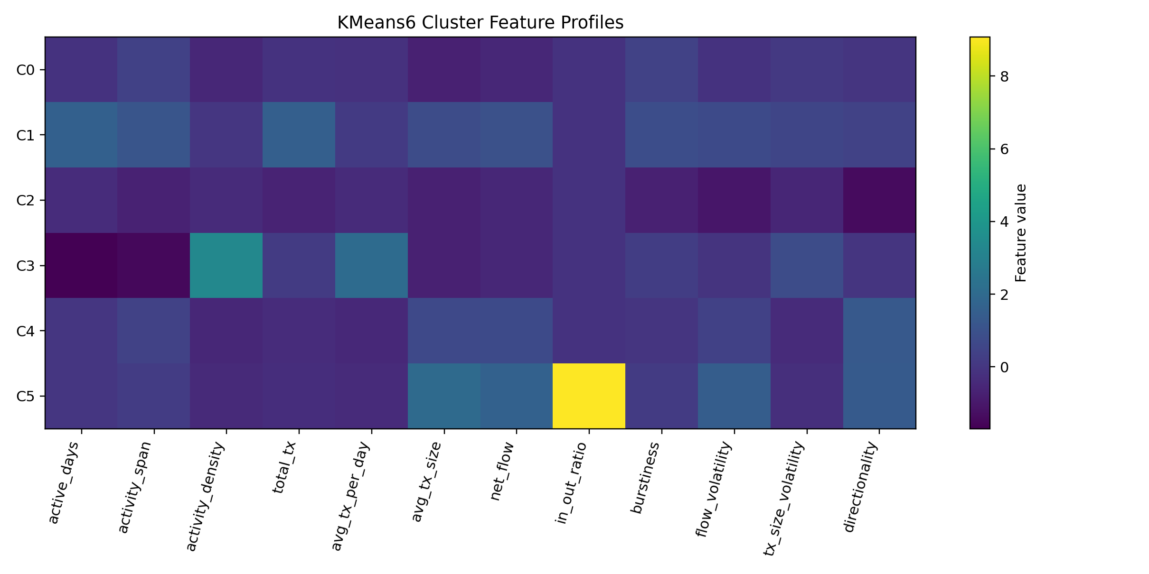
INTERPRETABILITY
What separates the roles?
Reading the heatmap
Rows are wallet roles.
Columns are normalized behavioural features.
Color differences show which behaviours distinguish each role.
The clusters become explainable profiles rather than black-box labels.
07

Slide 8
NETWORK VALIDATION
Do the roles organize the transaction graph?
23,755
80,596
0.777
0.932
nodes in network summary
transaction edges
modularity
assortativity
Modularity, simply
Assortativity, simply
If wallets in the same role form clear communities in the network, modularity is high. Here it suggests strong community structure.
If wallets connect more often to wallets with the same role, assortativity is high. Here it shows strong role-to-role organization.
Random-label comparison: real same-role structure was about 5.66 times stronger than random.
Empirical p-value: 0.000999.
08

Slide 9
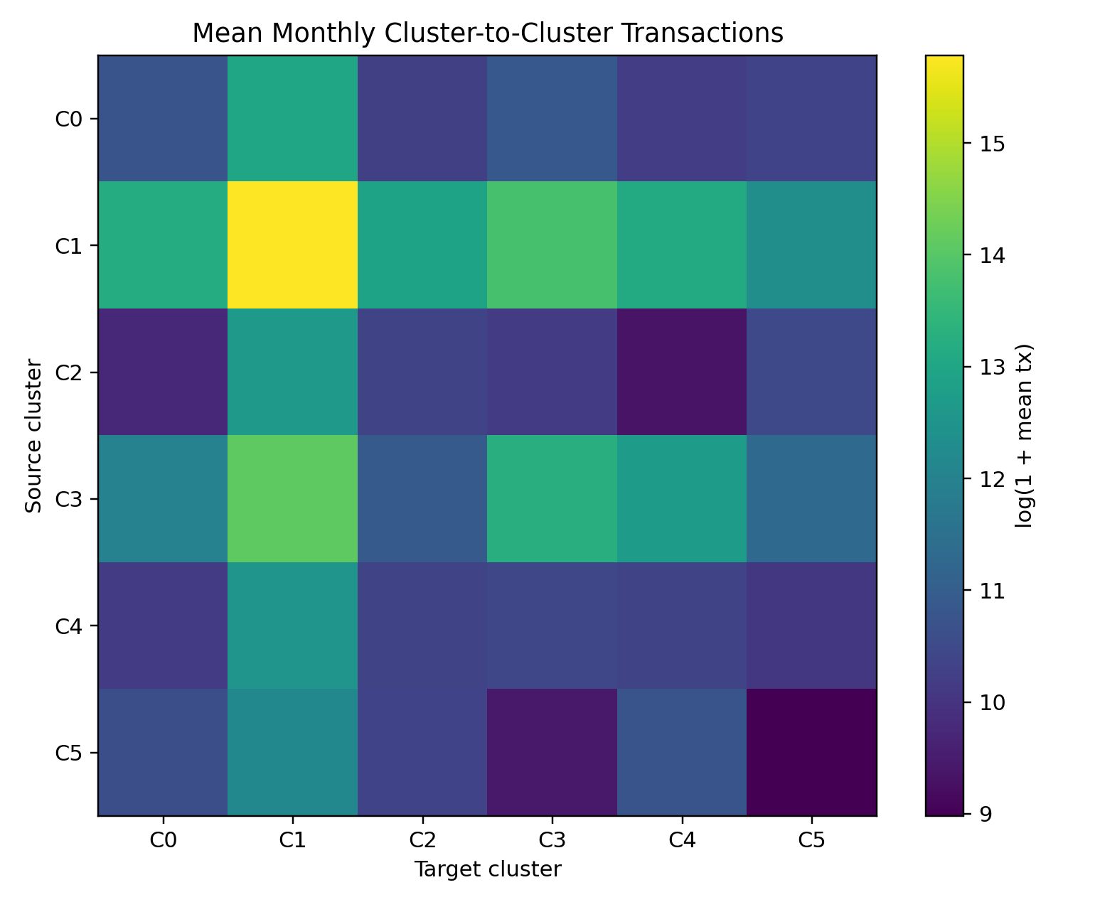
ROLE INTERACTIONS
How wallet roles transact with each other
Main reading
Transactions are not evenly distributed across roles.
Some roles interact strongly inside their own category.
Hub-like and bridge-like roles help connect otherwise different wallet populations.
This supports the idea that roles are part of the network structure, not only feature-space clusters.
09

Slide 10
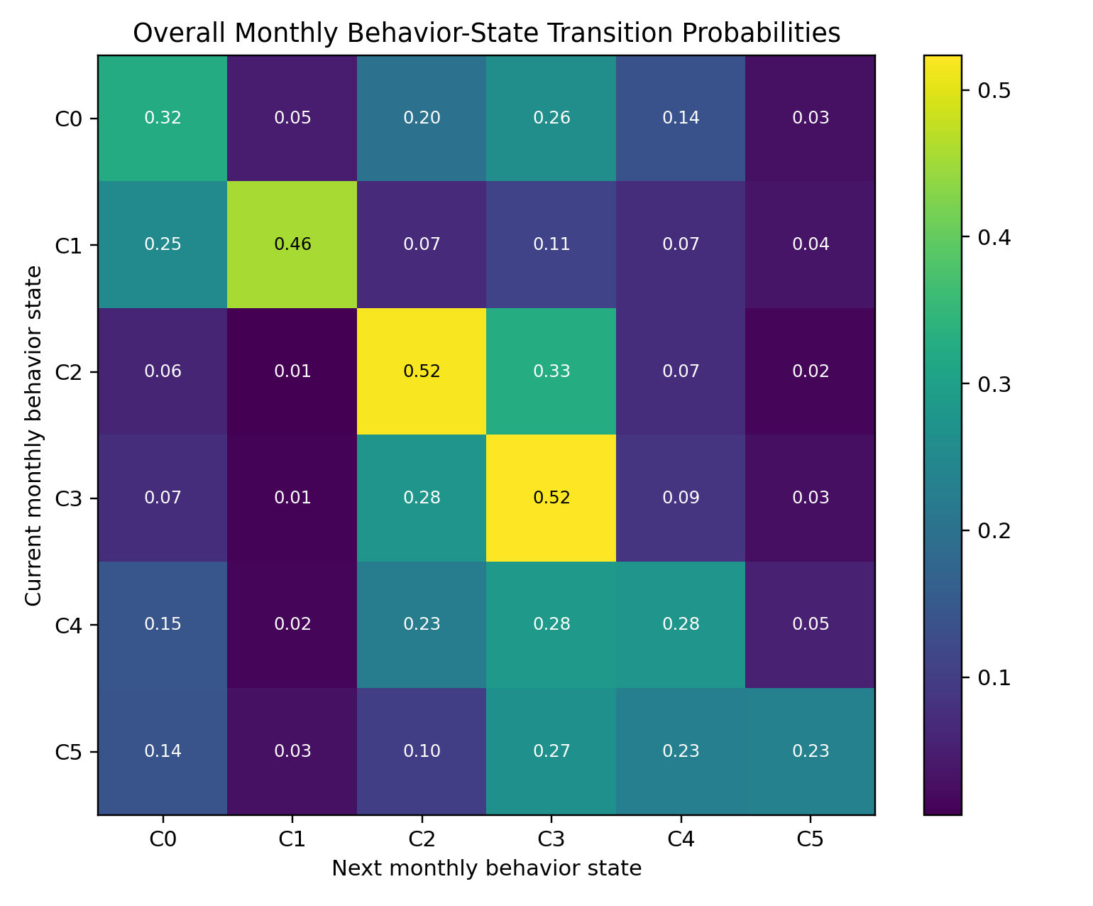
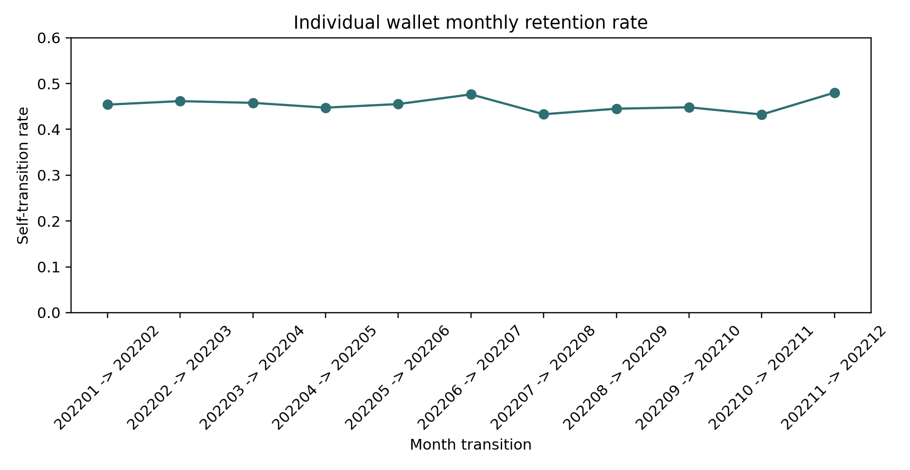
TEMPORAL DYNAMICS
Wallet behaviour changes, but not randomly
11 month-to-month transitions; 8,130,751 consecutive wallet-month pairs.
Mean monthly self-transition rate: 0.4538, with monthly values from 0.4324 to 0.4802.
C3 was the most stable state; C5 was the least stable.
10

Slide 11
FINDINGS MAP
What evidence supports the six-role result?
Feature evidence
Statistical evidence
Network evidence
The heatmap showed distinct normalized behavioural profiles. This gave each cluster an interpretable role description instead of only a numeric label.
Non-parametric tests and Cliff's delta showed that major cluster differences were not only statistically significant, but also practically large.
The same labels produced high modularity, high assortativity, and much stronger same-role interaction than random labels.
Temporal evidence
Robustness evidence
Interpretation evidence
Monthly transition matrices showed moderate retention, common transition pathways, and state-specific differences in persistence.
Additional checks tested correspondence across analysis variants, feature-set redundancy, permutation significance, and observation density.
Internal subcluster analysis suggested that the six-role solution is a useful top-level vocabulary, with finer patterns inside some roles.
This is the central logic of the project: discover roles first, then test them from several independent angles.
11

Slide 12
MODEL CHOICE
Why the six-cluster solution was kept
Why KMeans6
What we checked
It produced roles that were understandable from the feature profiles.
Alternative-k diagnostics suggested that more clusters can reveal additional fine-grained structure.
It aligned well with the transaction-network validation results.
Internal subcluster tests showed that some main roles contain meaningful subtypes.
It gave a practical top-level role vocabulary for millions of wallets.
Because the goal was an interpretable role layer, we treated KMeans6 as the main segmentation and subclusters as secondary detail.
It connected naturally to the original simulator goal: realistic agent types.
Finding: six clusters are not the only possible partition, but they are a defensible high-level behavioural layer.
12

Slide 13
STATISTICAL VALIDATION
Are the clusters actually separated?
Tests used
Main finding
Kruskal-Wallis tests to check whether feature distributions differ across clusters.
The strongest separated pair was C1 versus C2 across 33 features, with mean absolute Cliff's delta around 0.741 and maximum around 0.990.
Mann-Whitney pairwise comparisons for cluster-to-cluster differences.
Cliff's delta to measure practical effect size, not only statistical significance.
This means the clusters were not just numerically different; several differences were large enough to be behaviourally meaningful.
Methodological implication: we used both significance and effect size so the claims do not depend only on large sample size.
13

Slide 14
GRAPH PROOF DETAILS
Checking feature clusters against communities
What we built
Network metrics
Random-label result
A transaction network where nodes are wallets and edges represent observed transfers.
23,755 nodes
80,596 edges
0.777 modularity
0.932 assortativity
The real labels produced much stronger same-role structure than random labels.
A role-level network summary to study how clusters connect.
Same-role structure was about 5.66 times stronger than the random comparison, with p = 0.000999.
Random-label baselines to test whether the same pattern appears by chance.
High modularity means clear communities. High assortativity means wallets tend to connect to wallets with similar roles.
Finding: the behavioural roles are visible in the transaction graph, not only in the engineered feature table.
14

Slide 15
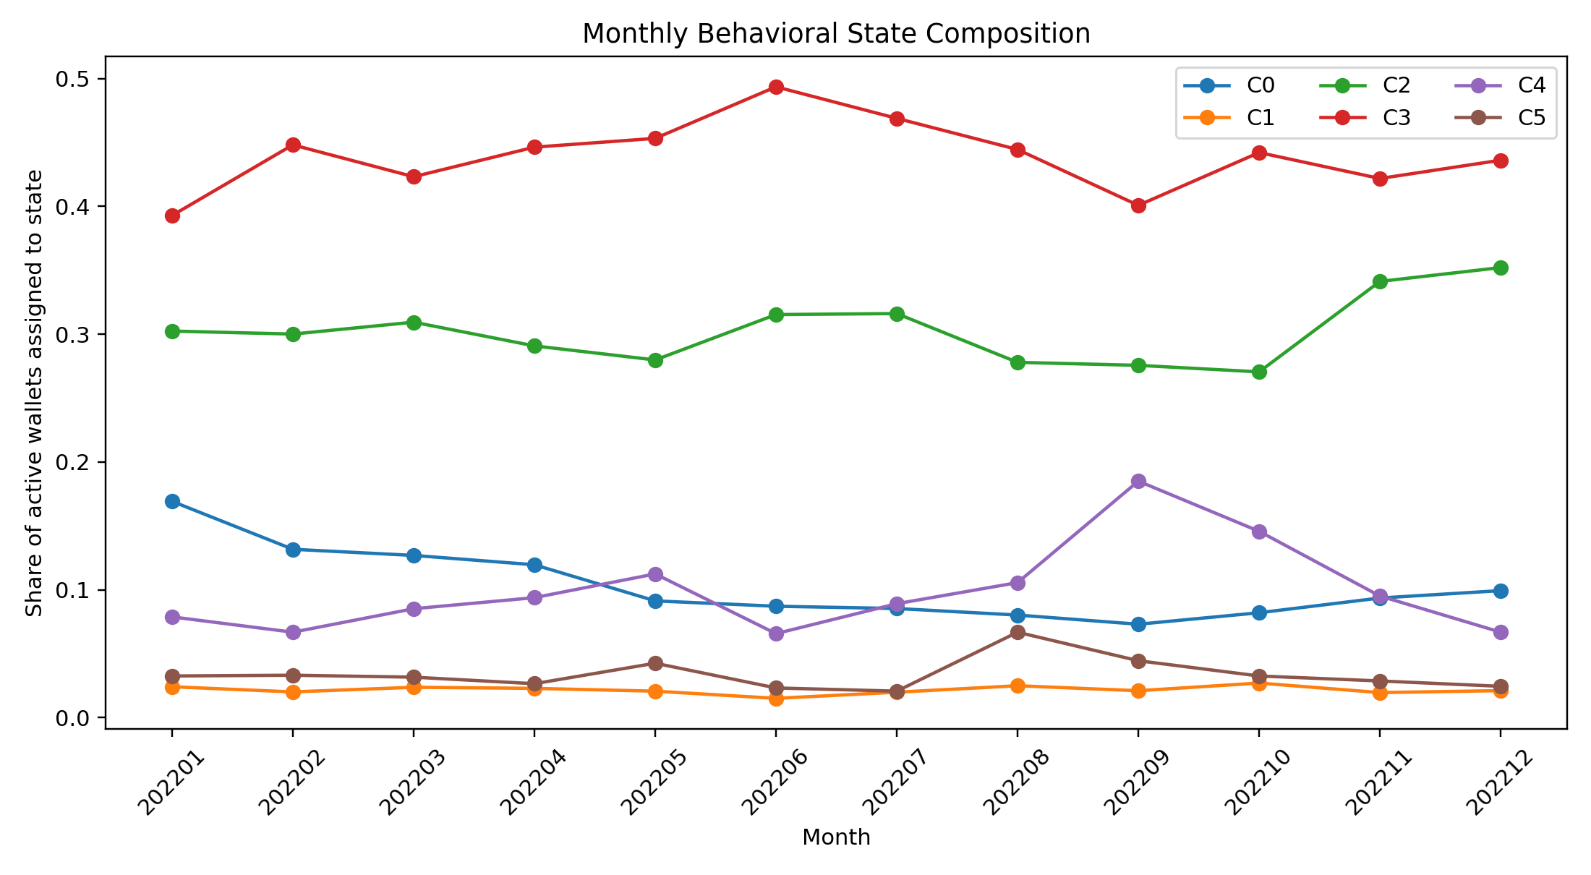
BEHAVIOUR OVER TIME
What we found from monthly state transitions
Temporal findings
Wallets do move between roles, so roles are behavioural states rather than permanent identities.
The system is structured: mean self-transition was 0.4538 across 11 month-to-month transitions.
C3 showed the strongest retention at 0.5237, while C5 was the least stable at 0.2340.
Off-diagonal transitions show likely pathways between low-activity, receiver, hub, and bridge-like behaviour.
Finding: stability is moderate, not absolute. That is useful because it captures both persistent roles and behavioural change.
15

Slide 16
CROSS-ANALYSIS CORRESPONDENCE
Did similar roles appear across analysis variants?
Permutation test summary
Formal matching rule
Observed overlap
Random null mean
We compared cluster profiles using four metrics: cosine, weighted Euclidean, Mahalanobis, and Wasserstein.
0.3952
0.2539
Hungarian matching was used to align clusters rather than comparing labels by name.
Difference
Empirical p-value
Five cluster pairs appeared as core correspondences under at least three of four metrics.
+0.1413
0.000999
Two pairs appeared under all four metrics: 2->2 and 4->1.
Interpretation: alignment between roles across analyses was stronger than expected from randomized labels.
Finding: role structure is partly reproducible across analysis variants, but label-overlap and profile-distance correspondence are separate results.
16

Slide 17
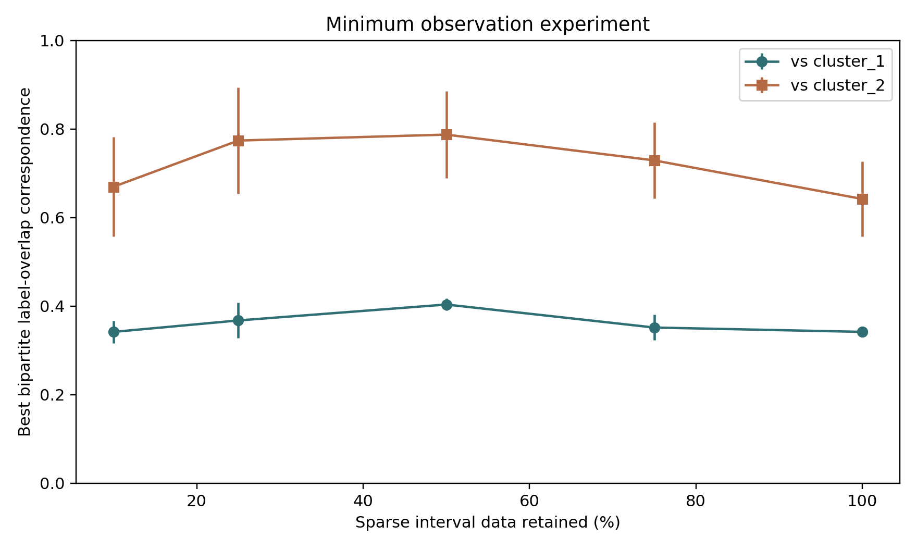
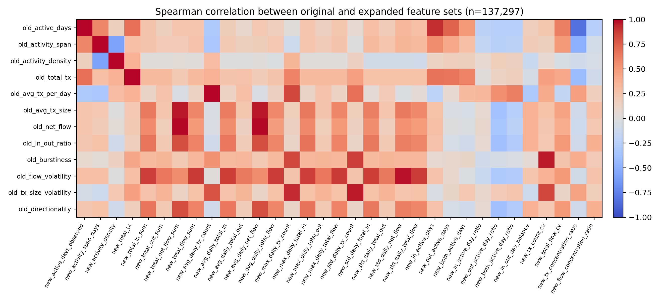
ROBUSTNESS AND DATA SUFFICIENCY
Are the findings caused by duplicate features or too much data?
Feature-set check: sampled 137,297 overlapping wallets. Median absolute Spearman correlation was 0.2612; only 8.08 percent of pairs were at least 0.8.
Observation-density check: repeated KMeans on 10, 25, 50, 75, and 100 percent subsamples showed recoverable core structure, but should not be overclaimed as a universal threshold.
Finding 1: expanded features are related to the original features, but not redundant.
Finding 2: core roles can reappear under reduced observation, while rare or specialized roles are more data-sensitive.
17

Slide 18
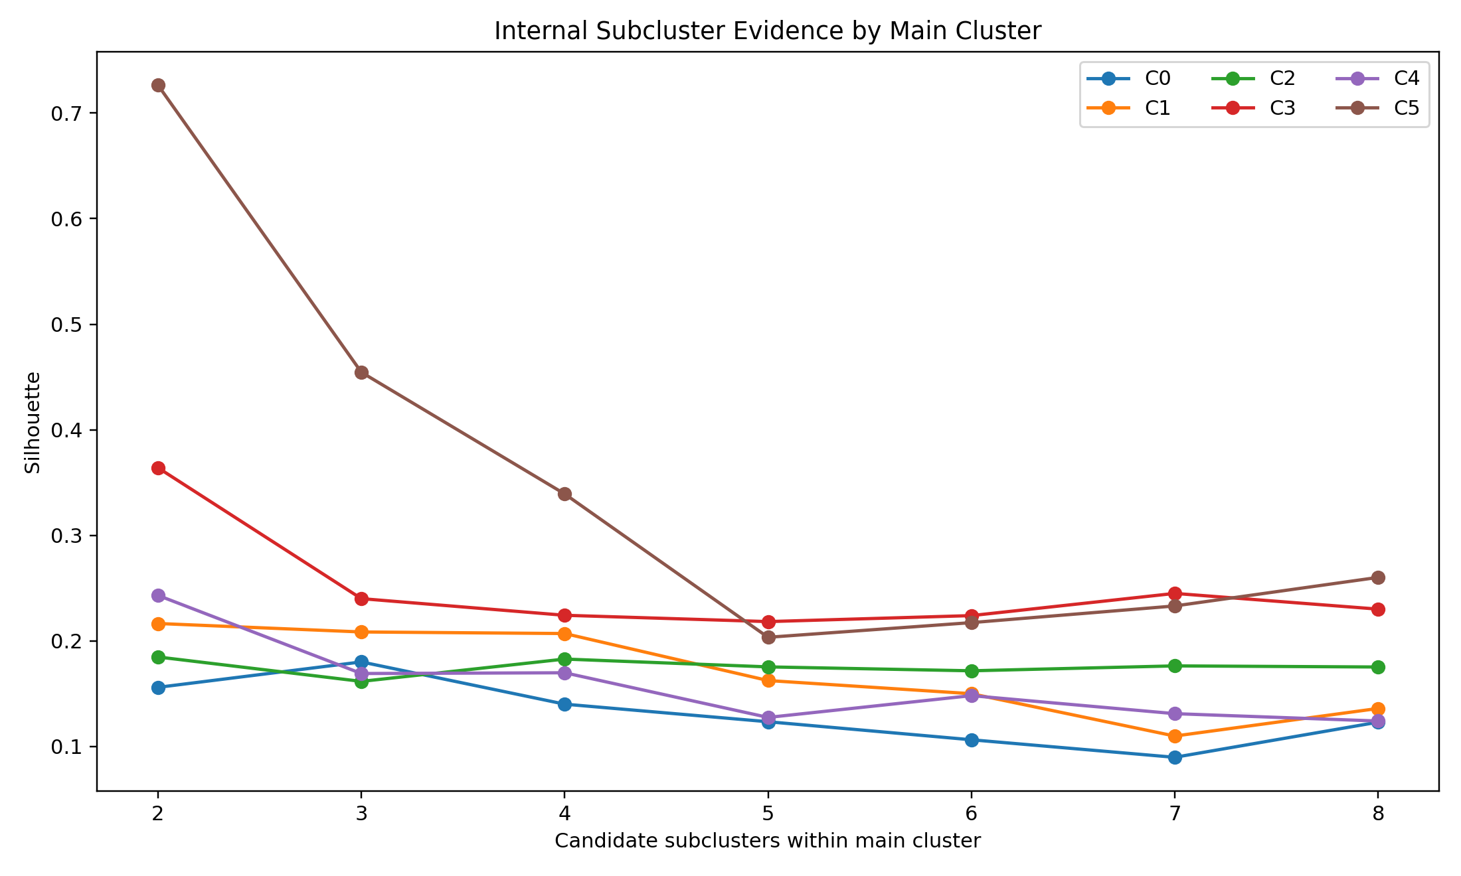
INTERNAL STRUCTURE
The six roles are the top layer, not the whole story
What this showed
We tested whether each main role contains finer behavioural subtypes.
C5 had the strongest internal subcluster signal, with silhouette around 0.726.
C3 also showed meaningful bridge-like internal structure.
This suggests KMeans6 is useful as a high-level role layer, but some roles contain important sub-roles.
Finding: the final system can support both a coarse role vocabulary and finer agent-type modelling later.
18

Slide 19
WHAT WE ACCOMPLISHED
Chronological summary of the project work
ENS 491
Core build
Final stage
Started with an AI-governed crypto-bank simulator concept.
Built wallet-level feature pipeline from raw Ethereum transactions.
Validated roles with graph structure, statistical separation, and temporal transitions.
Defined motivation around interpretable blockchain finance behaviour.
Clustered 2.74M wallets into six interpretable roles.
Added correspondence, permutation, feature-redundancy, and observation-density checks.
Identified that realistic agent types were missing.
Interpreted roles using feature profiles and cluster sizes.
Added feature redundancy and observation-density experiments.
The project moved from engineering a simulator to academically validating the behavioural foundation such a simulator would need.
19

Slide 20
FINAL INTERPRETATION
What we can claim, and what we should be careful about
Strong claims supported
Careful wording needed
Wallet roles are interpretable from engineered behavioural features.
Roles are behavioural states, not verified real-world identities.
Roles align strongly with transaction-network structure.
Subsampling results show recovery in this dataset, not a universal minimum-data threshold.
Wallet behaviour has moderate temporal persistence.
Distance-metric correspondence and wallet-label overlap are different validation results.
Cross-analysis checks show non-random role correspondence.
Future work should replicate across more time windows and external datasets.
20

