Slide 1

COMMUNICATION NETWORKS LAB
Dynamic Traffic-Aware Network
Routing and Self-Healing System
using Dijkstra's Algorithm
Dept. of Electronics and Communication | Manipal Institute of Technology, Manipal
Sudeep Sharma
Reg. No. 230907340 | sudeep.mitmpl2023@learner.manipal.edu
Prakhar Singh
Reg. No. 230907450 | prakhar5.mitmpl2023@learner.manipal.edu
Sudeep Sharma, Prakhar Singh Reg. No. 230907340 & 230907450, ECE, MIT.

Slide 2
COMMUNICATION NETWORKS LAB
AGENDA
Problem Statement
Objectives
Key Contributions & Novelty
System Model
Methodology — Five-Phase Architecture
Phase-wise Breakdown
Routing Engine — Dijkstra Algorithm
Dynamic Network Behavior
MATLAB Implementation
Results & Scenario Analysis
Performance Metrics
Static vs. Dynamic Comparison
Key Insights & Practical Implications
Limitations
Future Scope
Conclusion
Sudeep Sharma, Prakhar Singh Reg. No. 230907340 & 230907450, ECE, MIT.

Slide 3
COMMUNICATION NETWORKS LAB
Problem Statement
Limitations of Static Routing
Fixed routes defined at configuration time
No runtime awareness of congestion or failures
Inefficient bandwidth utilization
Single-point failure risk
Recovery requires manual administrator intervention
Response time: minutes to hours — not milliseconds
OSPF dead-interval: 40 seconds before re-convergence
Real-World Demand
IoT devices projected to exceed 29 billion by 2030
Cloud computing: unpredictable traffic surges
High-availability apps need millisecond-scale recovery
Modern networks: heterogeneous, distributed, dynamic
Static protocols cannot respond to traffic volatility
Critical gap: autonomous, real-time adaptive routing
Sudeep Sharma, Prakhar Singh Reg. No. 230907340 & 230907450, ECE, MIT.

Slide 4
COMMUNICATION NETWORKS LAB
Objectives
01 Dynamic Routing
Real-time path recomputation in response to network congestion or failure
02 Autonomous Self-Healing
Automatic rerouting upon link or node failures — zero human intervention
03 Dual-Metric Optimization
Simultaneous optimization for link cost and bottleneck bandwidth
04 Sub-Millisecond Convergence
Re-convergence averaging 0.54 ms — over 4 orders of magnitude faster than OSPF
Sudeep Sharma, Prakhar Singh Reg. No. 230907340 & 230907450, ECE, MIT.

Slide 5
COMMUNICATION NETWORKS LAB
Key Contributions & Novelty
What Exists
RIP/OSPF: fixed topology, no runtime adaptability
SDN controllers: overhead & single-point-of-failure
ML approaches: large training data, high compute
Our Contribution
MATLAB simulator: randomized topology + dual-metric evaluation
Interactive failure injection + autonomous self-healing
All capabilities unified in a single accessible tool
Real-Time Weight Updates
Dual Metric Cost + Bandwidth
Sub-ms Re-Convergence
MATLAB Simulation
Interactive Stress Testing
Sudeep Sharma, Prakhar Singh Reg. No. 230907340 & 230907450, ECE, MIT.

Slide 6
COMMUNICATION NETWORKS LAB
System Model
Network Graph G = (V, E, W, B)
V
Set of routers (nodes)
E ⊆ V×V
Set of communication links (edges)
W : E → ℝ⁺
Cost function — latency/distance ∈ [1, 50]
B : E → ℝ⁺
Bandwidth function ∈ {10, 100, 1000} Mbps
Failure Models
Link Failure
w(u,v) ← ∞ — edge removed from graph
Node Failure
∀v' ∈ N(v): w(v,v') ← ∞
All incident edges invalidated
Key Equations
Path Cost: C(P) = Σ w(u,v) for all (u,v) ∈ P
Bottleneck BW: BW(P) = min b(u,v) for all (u,v) ∈ P
Sudeep Sharma, Prakhar Singh Reg. No. 230907340 & 230907450, ECE, MIT.

Slide 7
COMMUNICATION NETWORKS LAB
Methodology — Five-Phase Architecture
1
2
3
4
5
Topology Generator
Routing Engine
Congestion Simulation
Failure Recovery
Performance Evaluation
DijkstraSimMain.m Spanning tree + random mesh p = 0.30 cross-link probability
customDijkstraPQ.m Min-priority-queue Dijkstra O((V+E) log V)
DijkstraSimMain.m (Opt 1) Weight injection Immediate re-convergence
DijkstraSimMain.m (Opts 2,4) Link/Node removal → ∞ Self-healing bypass
tic/toc timers + BW analysis Convergence timing Bottleneck BW measurement
Sudeep Sharma, Prakhar Singh Reg. No. 230907340 & 230907450, ECE, MIT.

Slide 8
COMMUNICATION NETWORKS LAB
Phase-wise Breakdown
01 Topology Generation
N nodes defined at runtime by user
Spanning tree ensures full connectivity (N−1 edges)
Cross-links added with probability p = 0.30
Cost w ∈ [1,50]; BW b ∈ {10, 100, 1000} Mbps
02 Routing Engine
Min-priority-queue Dijkstra implementation
Stale queue entries discarded without reprocessing
Path reconstruction via previous[] backtracking
Runtime well under 1 ms on 10–25 node networks
03 Congestion Simulation
Weight injection on selected link (e.g., 10 → 200)
Simulates heavy traffic load on that path
Engine re-converges; detour selected automatically
Congested link highlighted; new path reported
04 Failure Recovery
Link failure: w(u,v) ← ∞; edge removed
Node failure: all incident edge costs set to ∞
Dijkstra re-runs; healed path reported
Partition alert raised if no valid path exists
Sudeep Sharma, Prakhar Singh Reg. No. 230907340 & 230907450, ECE, MIT.

Slide 9
COMMUNICATION NETWORKS LAB
Routing Engine — Priority-Queue Dijkstra
INPUT: adjMatrix, startNode s, endNode t
OUTPUT: optimalPath P*, totalCost C*
distances[v] ← ∞ for all v; distances[s] ← 0
pq ← { (0, s) } // priority queue
WHILE pq is not empty:
sort pq by cost (ascending)
extract front (currentDist, u)
IF currentDist > distances[u] → SKIP // stale
IF u == t → BREAK // destination reached
FOR each neighbor v:
alt ← distances[u] + w(u,v)
IF alt < distances[v]:
distances[v] ← alt; push (alt,v) to pq
RECONSTRUCT via backtracking through previous[]
RETURN P*, C*
Key Optimizations
Priority Queue
Sorted matrix via sortrows; O(k log k) per iteration
Stale Entry Discard
Outdated entries skipped without reprocessing — preserves correctness
Early Termination
Loop breaks upon reaching destination node t
Complexity
O((V+E) log V) — efficient for 10–25 node networks
Sudeep Sharma, Prakhar Singh Reg. No. 230907340 & 230907450, ECE, MIT.

Slide 10
COMMUNICATION NETWORKS LAB
Dynamic Network Behavior
Congestion Handling
User injects high cost on target link (e.g., 10 → 200)
Cost matrix updated; routing engine re-triggered
Alternate lower-cost path selected automatically
Longer geometrically but cheaper — cost-aware routing
Link Failure
w(u,v) ← ∞ — link removed from active graph
Dijkstra re-executes; valid alternate route found
End-to-end connectivity maintained autonomously
No administrator input required
Node Failure (Router Crash)
All cost matrix entries for failed node set to ∞
Node rendered with dashed former connections
Dijkstra computes bypass through surviving topology
Convergence time reported via tic/toc
Self-Healing Sequence
① Detect: state change in cost matrix
② Update: affected entries set to ∞
③ Recompute: Dijkstra re-executed from source
④ Recover: new path reported OR partition alert raised
Visualization: Green = Optimal/Healed Path Red/Dashed = Failed Link or Crashed Node Blue = Active Links
Sudeep Sharma, Prakhar Singh Reg. No. 230907340 & 230907450, ECE, MIT.

Slide 11
COMMUNICATION NETWORKS LAB
MATLAB Implementation
% Node Failure — Remove all edges
costMatrix(fNode, :) = inf;
costMatrix(:, fNode) = inf;
% Self-Healing — Trigger & time
tic;
[newPath, newCost] = customDijkstraPQ(...);
convTime = toc * 1000;
% Bottleneck BW Extraction
pathBWs = arrayfun(@(i) bwMatrix(
newPath(i), newPath(i+1)),
1:length(newPath)-1);
min(pathBWs)
Modular Structure
customDijkstraPQ.m
Routing Engine
Priority-queue Dijkstra; path reconstruction; inf sentinel for failed/absent links
DijkstraSimMain.m
Simulation Driver
Topology generation; interactive 5-option menu; self-healing trigger loop; visualization
Menu: 0=Exit 1=Congestion 2=Link Fail 3=Src-Dst 4=Node Fail
Sudeep Sharma, Prakhar Singh Reg. No. 230907340 & 230907450, ECE, MIT.

Slide 12
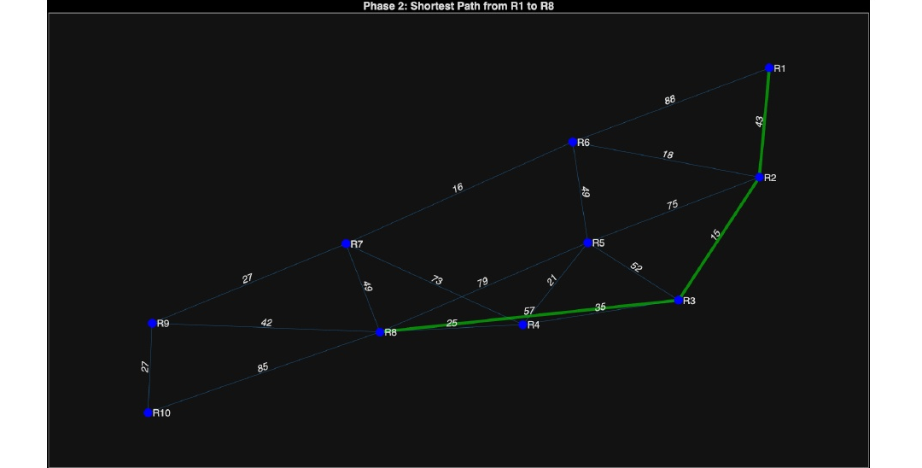
COMMUNICATION NETWORKS LAB
Results — Shortest Path Computation (R1 → R8)
Baseline Routing
10-node randomly generated topology
Spanning tree + 30% mesh cross-links
Minimum cumulative-cost path computed
Globally optimal under baseline conditions
Green-highlighted path on MATLAB visualization
No congestion or failure active
Tested with networks of 10, 15, 20, and 25 nodes. All convergence times < 1 ms.
Sudeep Sharma, Prakhar Singh Reg. No. 230907340 & 230907450, ECE, MIT.

Slide 13
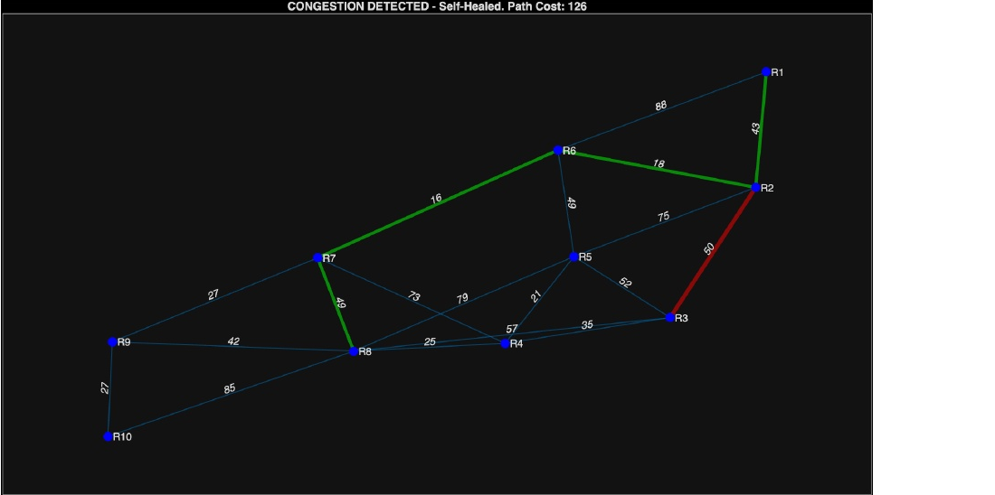
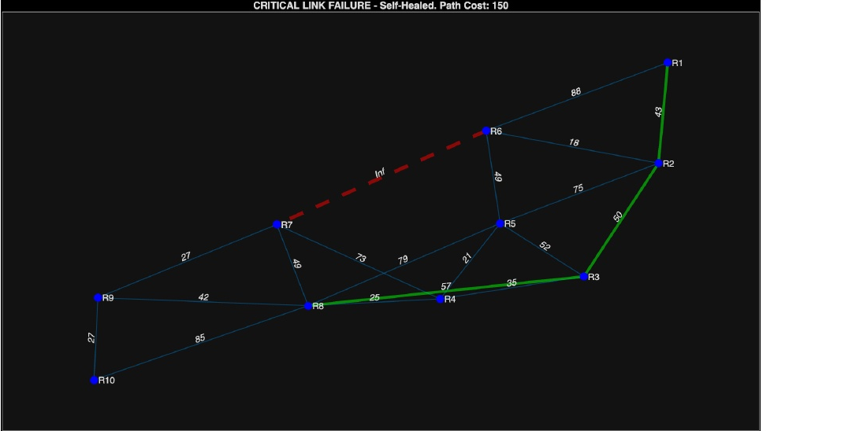
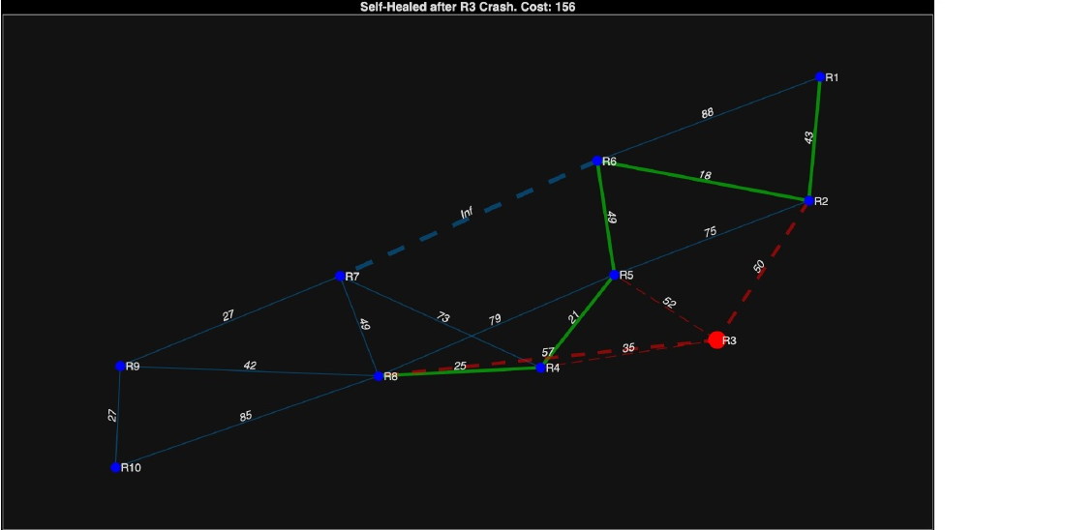
COMMUNICATION NETWORKS LAB
Scenario Analysis
Congestion — R3–R5
Link Failure — R2–R6
Node Failure — Router R4
Weight raised 12 → 200
Engine re-converges; detour selected
Geometrically longer, lower total cost
Cost set to ∞; link removed
Valid alternate route found
Zero admin input required
All R4 edges → ∞
Bypass path computed instantly
Full self-healing confirmed
All three failure modes handled autonomously with sub-millisecond recovery — no manual intervention
Sudeep Sharma, Prakhar Singh Reg. No. 230907340 & 230907450, ECE, MIT.

Slide 14
COMMUNICATION NETWORKS LAB
Performance Metrics
Convergence Time (ms) by Network Size & Failure Type
0.54 ms
Peak convergence (25 nodes, node failure)
Nodes (N)
Congestion
Link Failure
Node Failure
10
0.21 ms
0.28 ms
0.35 ms
15
0.31 ms
0.38 ms
0.44 ms
< 1 ms
All scenarios — all network sizes
20
0.40 ms
0.47 ms
0.51 ms
25
0.46 ms
0.50 ms
0.54 ms ★
Bottleneck Bandwidth on Self-Healed Path (10-Node Network)
Scenario
Baseline BW
Healed Path BW
10 Mbps
Min bottleneck BW (node failure)
Congestion (R3–R5)
100 Mbps
100 Mbps
Link Failure (R2–R6)
1000 Mbps
100 Mbps
Node Failure (R4)
100 Mbps
10 Mbps
Sudeep Sharma, Prakhar Singh Reg. No. 230907340 & 230907450, ECE, MIT.

Slide 15
COMMUNICATION NETWORKS LAB
Static Routing vs. Proposed Dynamic System
Parameter
Static Routing
Proposed Dynamic System
Path Update
Manual reconfiguration
Automatic (real-time)
Congestion
None
Weight injection + reroute
Link Failure
Manual fix required
Autonomous (<1 ms)
Node Failure
Network outage
Self-healing bypass
Convergence
Minutes (manual)
~0.54 ms average
Metric
Hop count / fixed cost
Cost + Bottleneck BW
Redundancy
Static, pre-set
Dynamic, on-demand
Scalability
Low
O((V+E) log V)
Visualization
None
Real-time color-coded
Sudeep Sharma, Prakhar Singh Reg. No. 230907340 & 230907450, ECE, MIT.

Slide 16
COMMUNICATION NETWORKS LAB
Conclusion
Dynamic self-healing routing system fully demonstrated on MATLAB platform
Handles congestion, link failure, and node failure with fully autonomous recovery
Convergence averaging 0.54 ms — outperforms OSPF by over 4 orders of magnitude
Dual-metric model (cost + bottleneck BW) provides richer path quality assessment than single-metric approaches
Five-phase architecture: rigorous, extensible platform for network resilience research
This framework establishes a practical foundation for next-generation traffic-aware,
self-healing network infrastructure — responsive at the millisecond scale where static protocols fail.
Sudeep Sharma, Prakhar Singh Reg. No. 230907340 & 230907450, ECE, MIT.

