Slide 1

Textual Analysis of Stock Market Prediction Using Financial News Articles
CMPE 275
Fan Ieong, Harini Kasturi, Stuti Vora
Sudershan Malpani, Vidushi Desai

Slide 2
Goal
To understand and apply the Component Based architecture and concepts to real world problems
By applying these concepts to real world problems, understanding the needs for large datasets
Come up with correlations between types of news (classification) and stock movements

Slide 3
Scope of data
Training data: Archived historical data from Yahoo! Finance
Testing data: Archived news articles from Reuters
Real time* Finance News RSS Feed from Yahoo! Finance
Real time* stock quotes from Yahoo! Finance
* Real time in the sense that it is live data with a limited amount of delays

Slide 4
System design
Client Entering a Query for Stock Trend analysis
Stock Trend
Analyzer
Predictive and Baseline analysis of the requested Stock

Slide 5
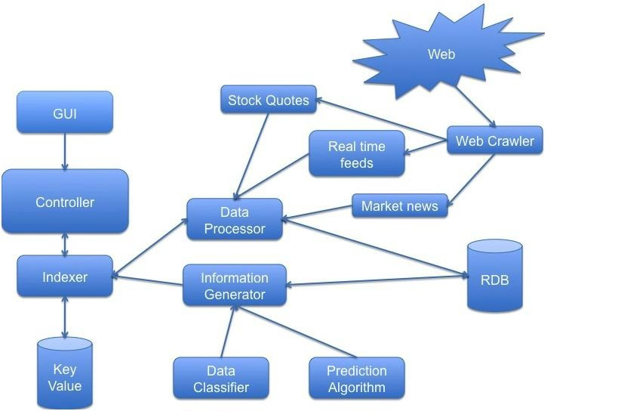
System Components

Slide 6
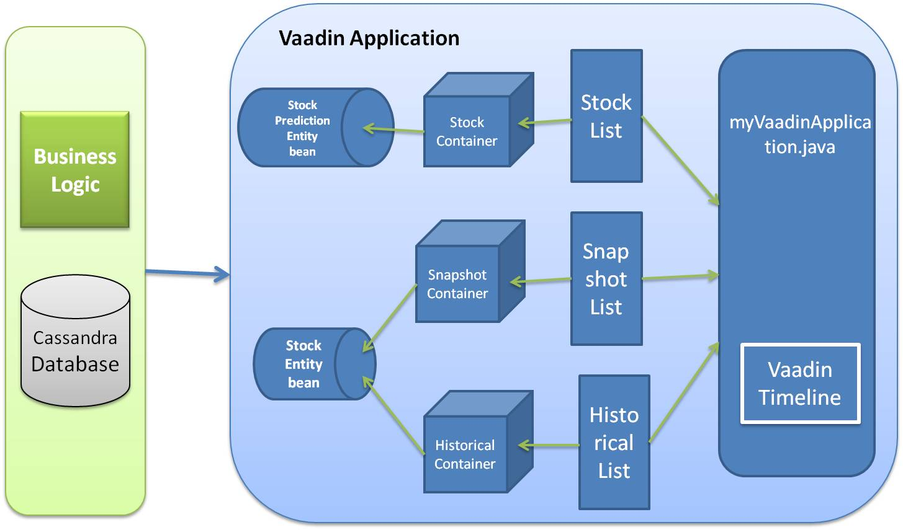
system architecture

Slide 7
Technologies explored
Vaadin
KEA (Keyword Extraction Algorithm
Yarfraw
Jsoup
Cassandra

Slide 8
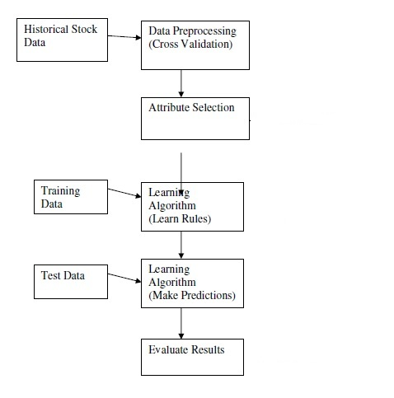
Prediction algorithm

Slide 9
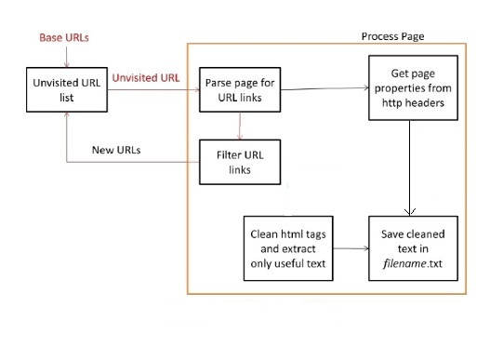
Web crawler – yarfraw + jsoup

Slide 10
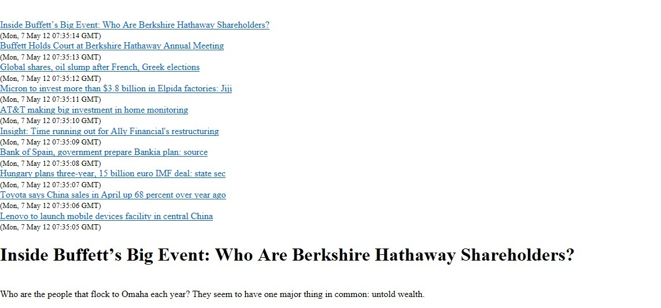

Slide 11
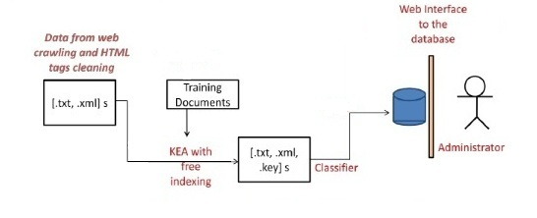
Data classifier – Keyphrase Extraction Algorithm

Slide 12
Keywords extraction
Keywords | Word Counts
universal entertainment | 57
counterclaim | 58
yen | 59
jgbs | 60
thomson | 61
edt | 62
omnicell | 63
nasdaq | 64
adjusted ebitda | 65
ebitda | 66
prior year | 67
prior year period | 68
sim city | 69

Slide 13
Keywords weighting
foreach (article in training set)
foreach (word in article)
word relevance = Sum over paragraphs
end foreach
Total relevance = Sum over all words in article (word relevance)
Multiple each word's relevance by (daily % change for stock / Total relevance)
Add each word relevance to total score for word
end foreach
foreach (word in data)
normalize - divide word's score by number of articles word has appeared in, to get an average score per article
end foreach

Slide 14
Prediction algorithm
It is an algorithm used to assign a ‘weight’ to each news category. When making a prediction on a test article, the algorithm is:
score = 0
foreach (word in article)
score += (word score) * Sum over paragraphs (word count for paragraphs)
endforeach

Slide 15
Ibm stock trending
Date | Symbol | Prediction
2012-03-01 | IBM | -2.3
2012-03-02 | IBM | 0.5
2012-03-05 | IBM | -1.3
2012-03-06 | IBM | -1.4
2012-03-07 | IBM | 0.9
2012-03-08 | IBM | 2.5
2012-03-09 | IBM | 1.6

Slide 16
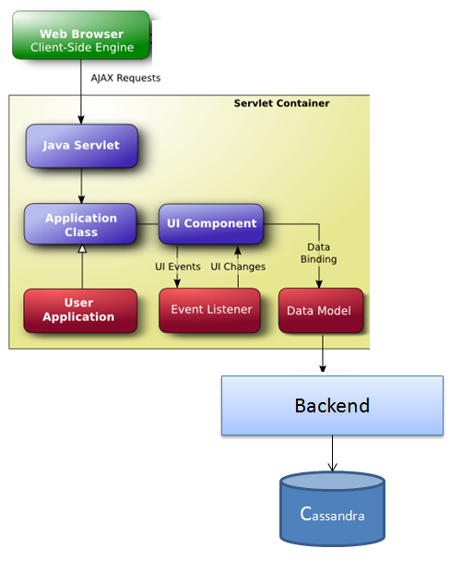
vaadin

Slide 17
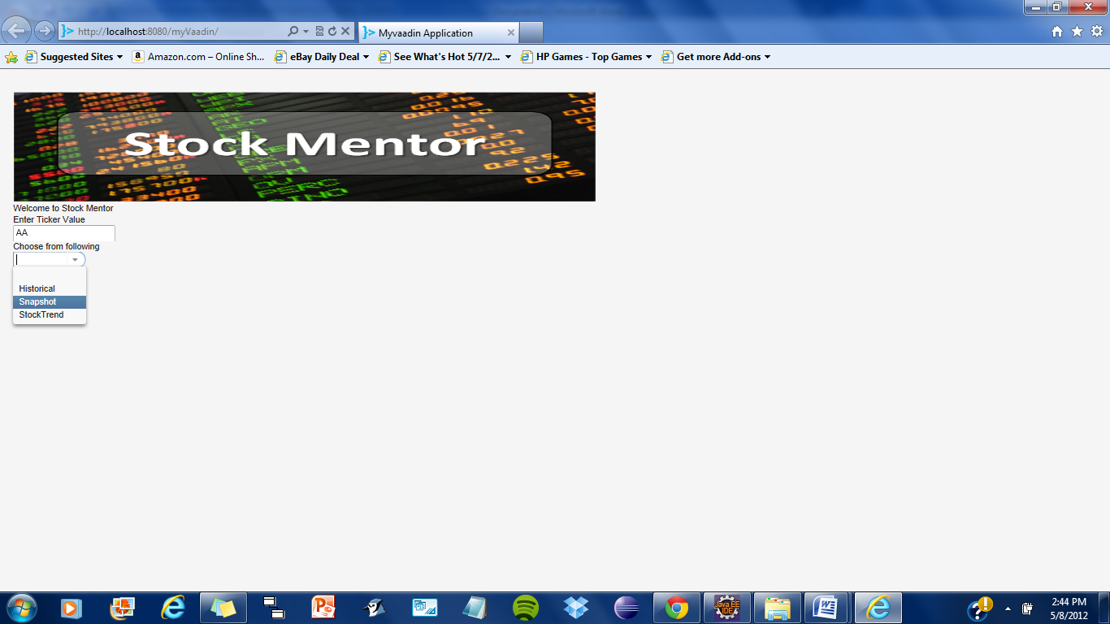
Screen shots

Slide 18
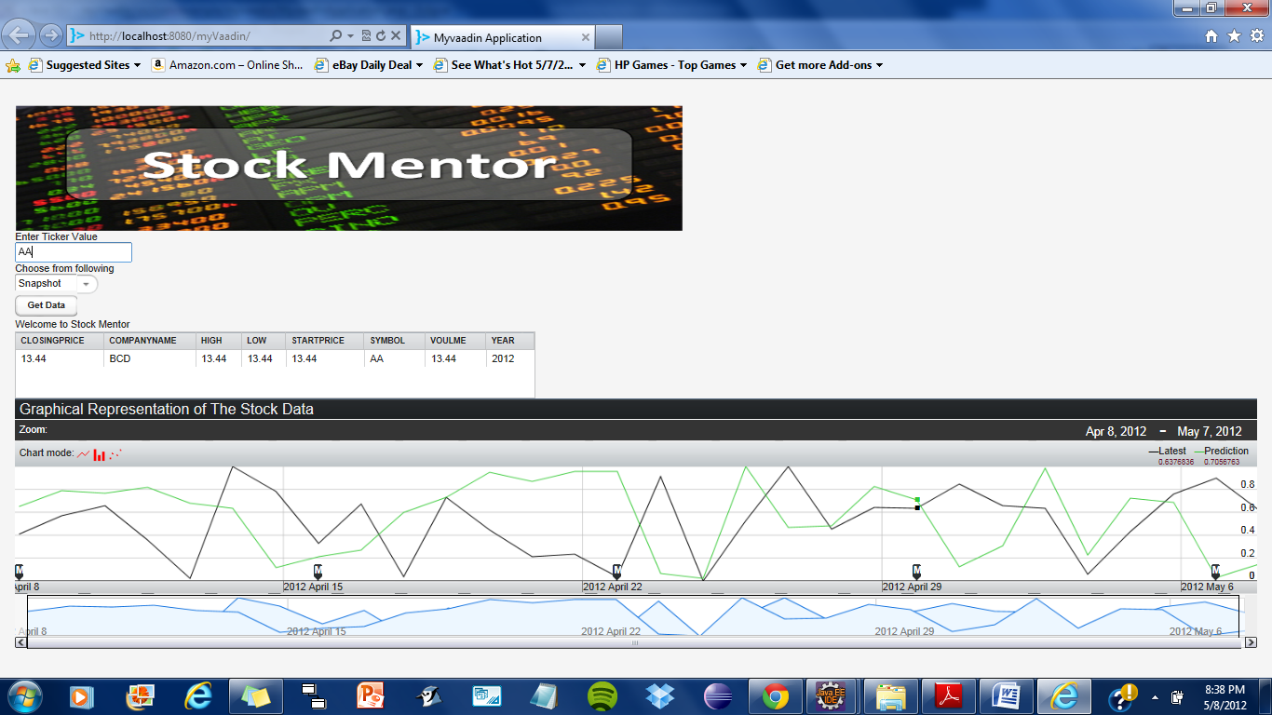
Screen shots

Slide 19
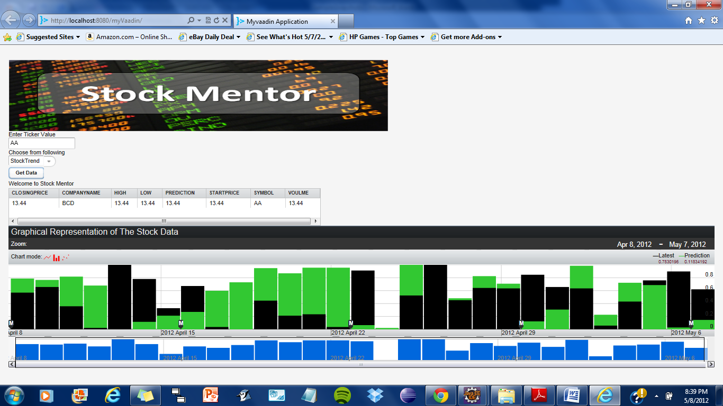
Screen shots

Slide 20
Other discussions
Scalability
Performance

Slide 21
Future enhancements
Improve prediction algorithm based on operational data
Support for analysis/prediction using more than one machine learning algorithms
Support for analysis based on news categories

Slide 22
Questions??
Thank you!!!

