Slide 1
How Does the ASAP Affect Abnormal Returns After Air Disasters

Slide 2

George Pachantouris/Getty Images

Slide 3
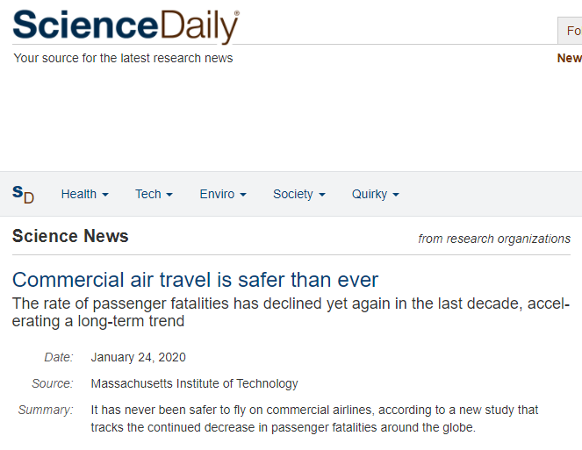

Slide 4
1 in 2.7 mil (1998-2007)
TO
1 in 7.9 mil (2008-2017)
Rate of passenger mortality

Slide 5
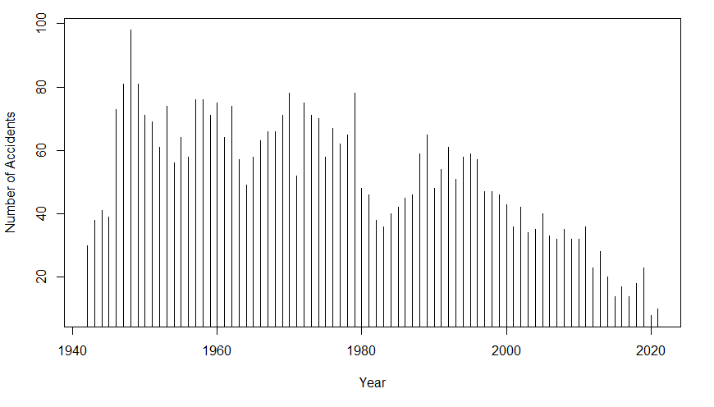
Aviation Safety Network (2021)

Slide 6

JethuynhCan/Getty Images

Slide 7
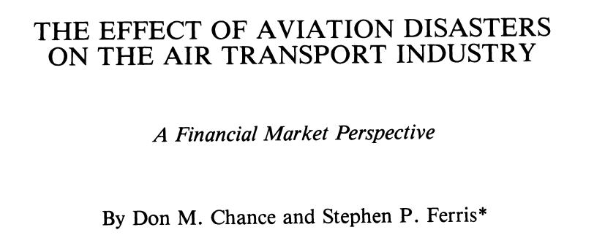

Slide 8


Slide 9
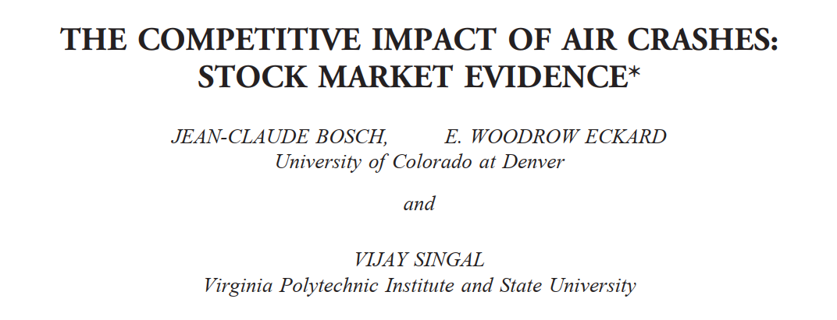

Slide 10
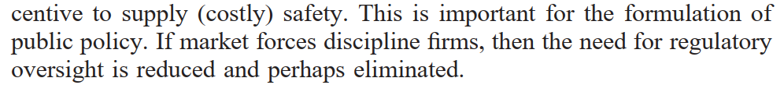

Slide 11
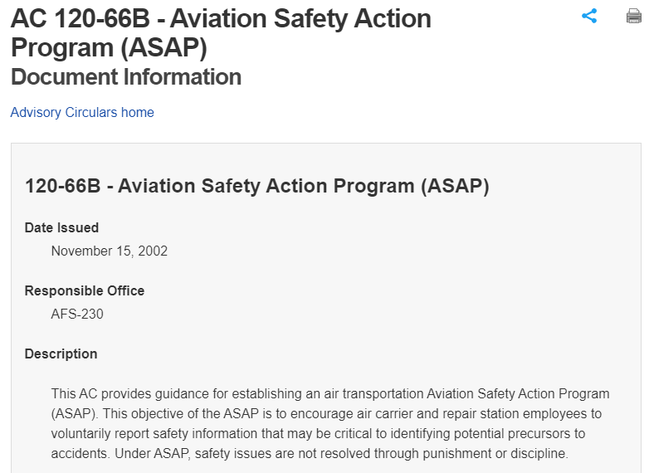

Slide 12


Public sentiment to punish the companies more
Lesser fine → Less effect on income

Slide 13
How Does the ASAP Affect Abnormal Returns After Air Disasters

Slide 14
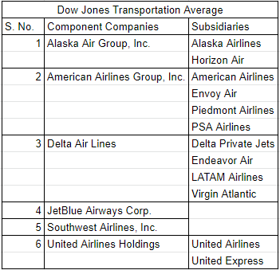

Slide 15
Methodology
Dataset 1 - All flight crashes from 1982 to 1997
Dataset 2 - All flight crashes from 1997 to 2012
Find abnormal returns
Compute Cumulative Average Abnormal Returns for each dataset
Compare CAARs

Slide 17
References
Aviation Safety Network. (2021, November 10). Retrieved from https://aviation-safety.net/statistics/period/stats.php?cat=A1.
Bosch, J., Eckard, E. W., & Singal, V. (1998). The Competitive Impact of Air Crashes: Stock Market Evidence. The Journal of Law & Economics, 41(2), 503-519.
Chance, D. M., & Ferris, S. P. (1987). The Effect of Aviation Disasters on the Air Transport Industry: A Financial Market Perspective. Journal of Transport Economics and Policy, 21(2), 151-165.
FAA. (2002, November 15). Aviation Safety Action Program Document Information. Retrieved from https://www.faa.gov/regulations_policies/advisory_circulars/index.cfm/go/document.information/documentid/23207

