Slide 1
Vehicular Accident Analysis
Dataset: person.csv

Slide 2
Introduction
National Highway Traffic Safety Administration (NHTSA) of the US Department of Transportation in 2018
Includes:
Injury Severity
Age
Gender
Objective:
Understand Data
Discover Patterns
Establish Relationships Between Data Elements
Source: https://www.nhtsa.gov/file-downloads?p=nhtsa/downloads/CRSS/
Notes:
We utilize the dataset that contains the crash report managed by the National Highway Traffic Safety Administration (NHTSA) of the US Department of Transportation in 2019. This dataset includes information such as the injury severity, the age & gender of persons involved, the vehicle information, and the accident time and location by US region.
We use visualization method and summary statistics to explore the data analytics. The objective is to understand the data, discover patterns, and to establish the relationships between the data elements.

Slide 3

Data Analysis
Data Analysis with Python and pandas using Jupyter Notebook
Filtered and cleaned the data to only use driver information
Created and counted age groups using .loc and len() functions
Stacked horizontal bar plots using matplotlib library

Slide 4

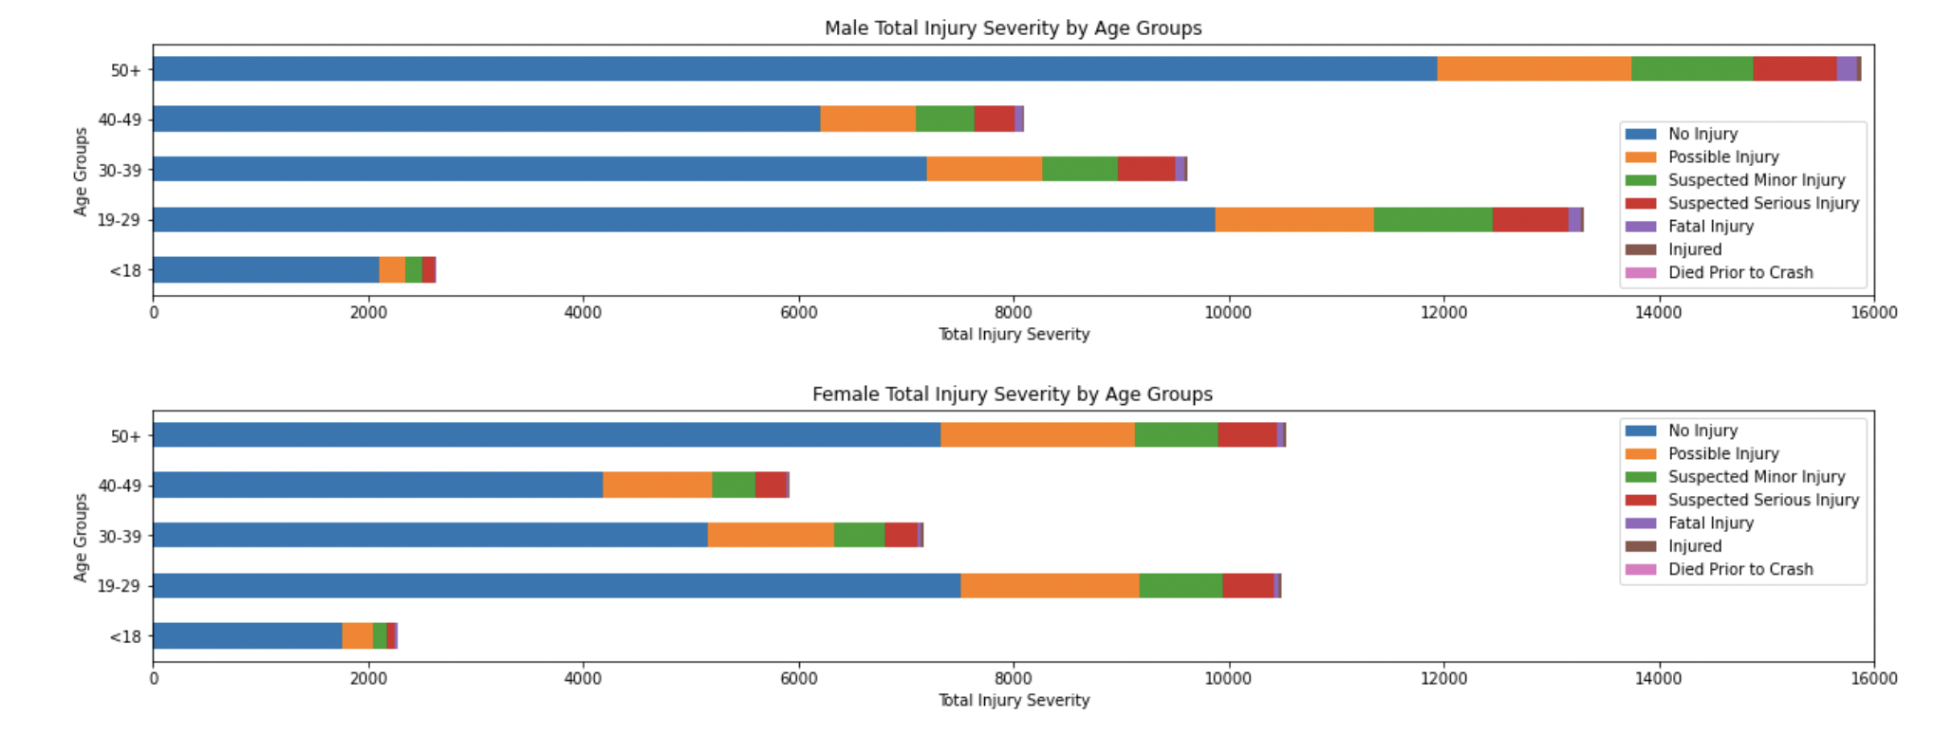



Notes:
As shown in the visualizations below, it can be inferred that Males tend to drive more recklessly than Females.
Fatal Injuries tend to occur in Male Senior Drivers than any other Age Group.
Male adults aged 50 and up tend to have much more total accidents than both the <18 and 19-29 age groups combined.
Surprisingly, the <18 age group has significantly less accidents than every other age group, which could be caused by teens delaying getting a driver license or a stricter rules imposed by local authorities.
Although many accidents occur each year, over half of them, regardless of gender or age, result in No Injury.

