Slide 1
Project Name: Used Car Price Predictor by WHUPL
Members: Arnold Wamulanga, Ellis Purwanto, Ryan Hulett, Shreya Udeshi, Thomas Lawless

Slide 2
Table of Contents 🗒️
Introduction
Tableau Visualizations
Machine Learning
Final Deployment App
Requirements
Flask App
Extract, Clean, Transform and Load
HTML and CSS

Slide 3
Introduction 📖
A consolidated car auction and sales report was released by several used car dealers
Evaluated 14 car makes: Acura, Audi, BMW, Honda, Hyundai, KIA, Land Rover, Lexus, Lincoln, Maserati, Mercedes, Porsche, Toyota and Volkswagen by their model, color, sale price, condition grade, mileage etc.
Goal: Deploy a Heroku app that works as a used car recommendation system. A user can enter the vehicle make, model, color, mileage, and price range, and the system will provide pricing predictions based on the relevant parameters..
Source of Data: Kaggle

Slide 4
Requirements 👩🏻‍💻
Notebook: Jupyter Notebook, Google Collab
Scripting: Python Scripting
Libraries Used: pandas, sklearn.model_selection, sklearn.preprocessing, NumPy, TensorFlow, nltk, sys, flask
RDBMS: PostgreSQL
Visualizations: Tableau Desktop
Web Framework: Flask App, HTML, CSS
Deployment App: Heroku

Slide 5
Extract, Clean, Transform and Load
Extracted data from Kaggle using pandas DF
Cleaned the data using Jupyter Notebook
Transformed the data on PostgreSQL
Loaded the data on Tableau, Heroku, PostgreSQL for Flask App

Slide 6
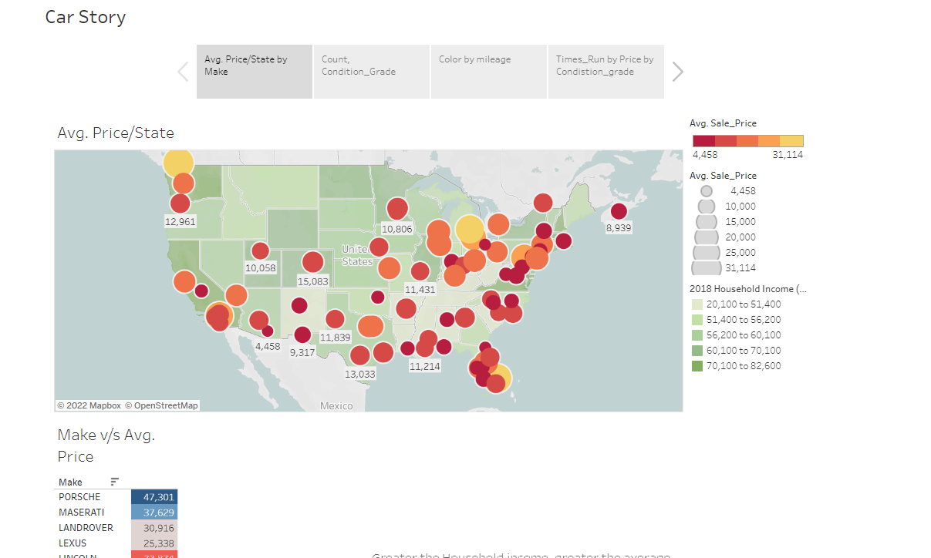
Tableau Visualizations📊
Link to Tableau Visualizations: https://public.tableau.com/app/profile/shreya2793/viz/WHUPL/CarStory

Slide 7
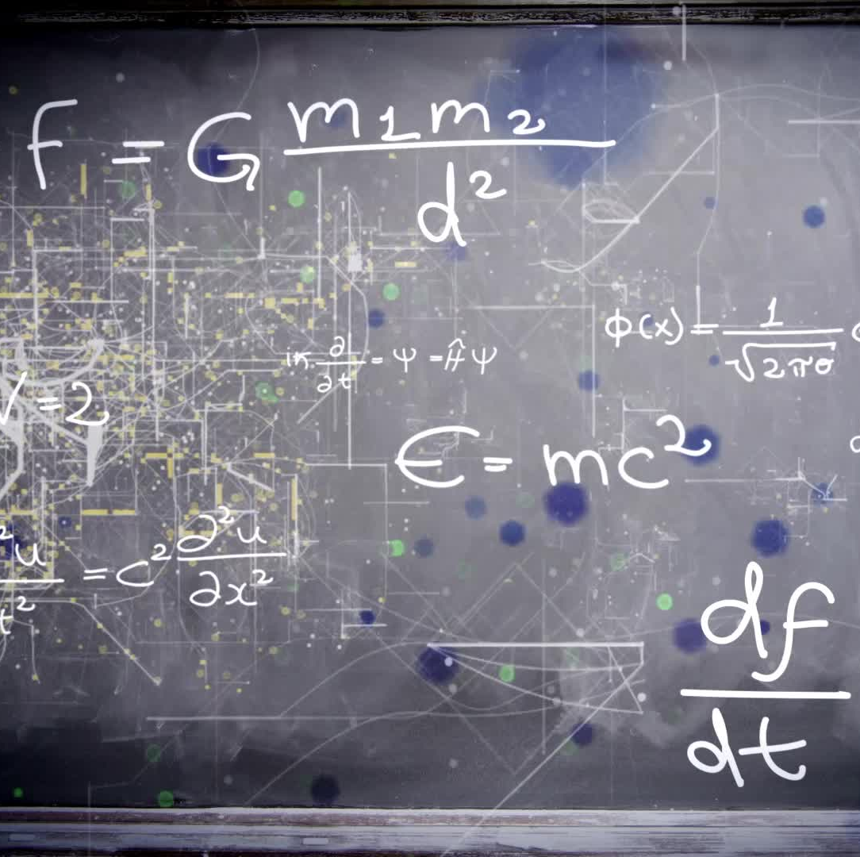
Machine Learning 💻
Retrieve the data
Preprocess the data
Convert categorical data to numerical data
Split Data – Train and Test
Scale the data
Consider the models: Linear Regression, KNeighborsRegressor, RandomForestRegressor, ExtraTreesRegressor, AdaBoostRegressor, SVR
Fit the Model
And the winner is: SVR🎊

Slide 8
Flask App, HTML, CSS
Connected the Heroku PostgreSQL DB to the Flask App
Created cascading dropdown filter menu with JavaScript
- Used car year, make, model, subseries, color, condition grade and mileage
Applied Machine Learning to selected values
Deploy the Flask app on Heroku

Slide 10
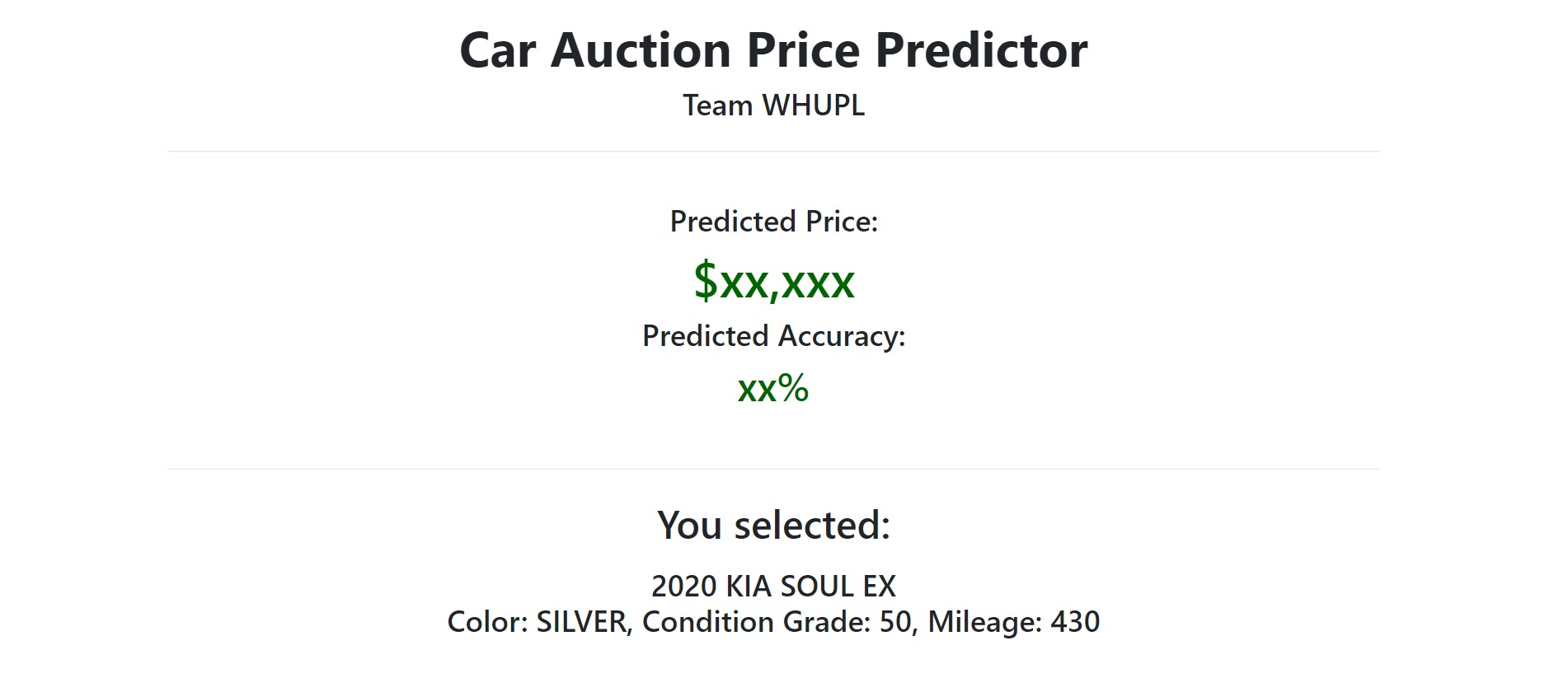
Final App 😮

Slide 11


