Slide 1
WELL-BEING
CSY4010 Computing Dissertation Project Interim Presentation 2021
- A teletherapy website by Sudeshna Pandey (19436749)

Slide 2
TABLE OF CONTENTS
1. Introduction 3
2. Project area 4
3. Aims 5
4. Objectives 6
5. Dissertation methodology 7
5.1 Requirements engineering 8
5.2 Problem domain investigation and findings 14
5.3 Requirements solution specification 18
5.4 System analysis and design 27
5.6 System construction 39
5.7 System testing 46
5.8 System evaluation 46
6. Outline of the plan project 47
7. References 48

Slide 3
INTRODUCTION

Slide 4
PROJECT AREA
A telemedicine web application software system.
Planned to provide a talk space
Set appointments with therapist
Identify one’s illness
Buy available and necessary resources
Keep track of their thoughts and progress.

Slide 5
AIMS
Improve the condition of an individual
Tracking and keeping record
Diagnosing
Prepare human resources
Provision of resources feasible
Increase awareness

Slide 6
OBJECTIVES/ FEATURES
take a test and check the condition,
video sessions and text messages for direct consultation,
blogs,
keep track of the condition and progresses,
diary,
taking appointments,
buy medication after the consultation with doctors.

Slide 7
DISSERTATION METHODOLOGY
Requirements engineering
Problem domain investigation and findings
Requirements solution specification
System analysis and design
System construction
System testing
System evaluation

Slide 8
REQUIREMENTS ENGINEERING
Literature Review
Q/A sessions with the experts
Discussions
Comparable system

Slide 9
LITERATURE REVIEW
Article 1: Detecting and Treating Mental Illness on Social Networks
Author: Akkapon Wongkoblap, Miguel A. Vadillo, Vasa Curcin
Published Date: 2017
Article 2: Mobile Mental Health: A Review of Applications for Depression Assistance
Author: Ariel Teles, Ivan Rodrigues, Davi Viana, Francisco Silva, Luciano Coutinho, Markus Endler, Ricardo Rabelo
Published Date: 2019

Slide 10
Article 3: Using Information Technology to Improve the Mental Health Education of University Students
Author: Ak Guoying Wang, Wei Zhou, Yunsheng Zhang
Published Date: 2016
Article 4: A Chatbot for Psychiatric Counseling in Mental Healthcare Service Based on Emotional Dialogue Analysis and Sentence Generation
Author: Kyo-Joong Oh, DongKun Lee, ByungSoo Ko, Ho-Jin Choi
Published Date: 2017

Slide 11
Q/A SESSIONS WITH THE EXPERTS

Slide 12
DISCUSSIONS

Slide 13
COMPARABLE SYSTEM
Doxy.me
welistennepal.org
verywellmind.com

Slide 14
PROBLEM DOMAIN INVESTIGATION AND FINDINGS/ SOLUTION

Slide 15
PROBLEM STATEMENT AND IMPACT
Factors affecting the process of getting treatment:
Lack of sufficient resources
Financial restrictions
Lack of proper communication
Due to fear, stigmas and existing false information
Impact:
Death/suicides

Slide 16
SOLUTION
Proper communication and consultations
Knowledge and awareness
Medications

Slide 17
PROJECT PRIMARY FEATURES
Analysation of the user state according to the user input in the questionnaires provided by the system.
Video sessions for the consultation/ therapy or for taking appointments
Blog post to create awareness and increase the knowledge related to mental health topics
Charts, calendar, diary, medication to keep track of their progress and thoughts

Slide 18
REQUIREMENTS SOLUTION SPECIFICATION

Slide 19
SOLUTION VIA SYSTEM
Request Management
User Management
Meetings Management
Questions and Answer Management
Appointments Management
Experience Management
Announcement Management
Category Management
Blog Management
Medication Management

Slide 20
USERS
Admin
Doctor
Patient
Blogger
Non-login User

Slide 21
ACCESS LEVEL – FIVE LEVELS OF ACCESSES
Admin level
Doctor level
Patient level
Blogger level
Non-login User level

Slide 22
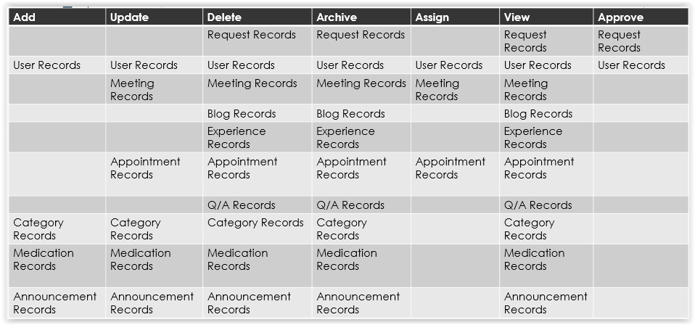
ADMINISTRATION LEVEL

Slide 23
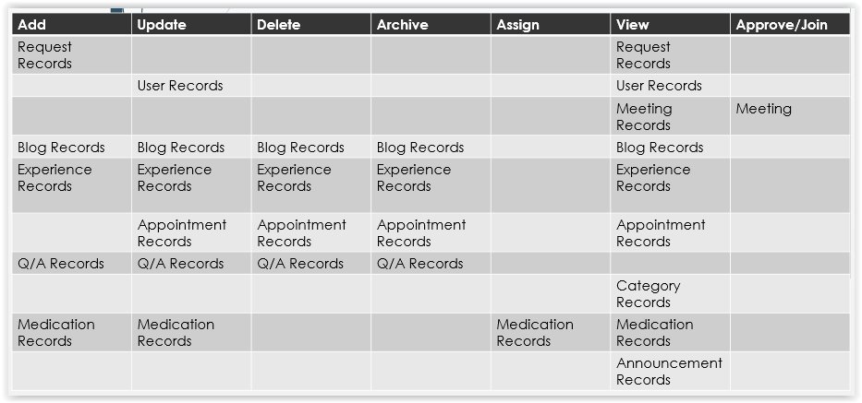
DOCTOR LEVEL

Slide 24
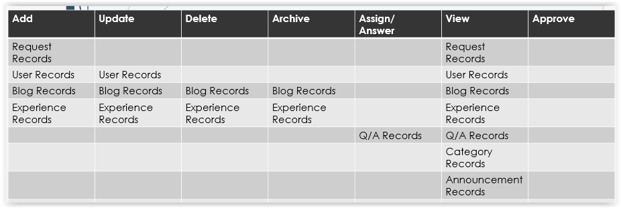
BLOGGER LEVEL

Slide 25
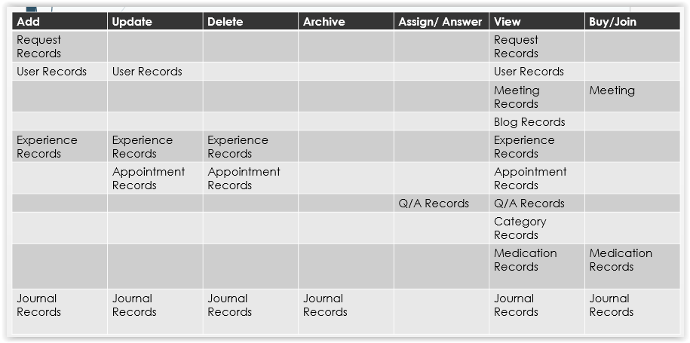
PATIENT LEVEL

Slide 26
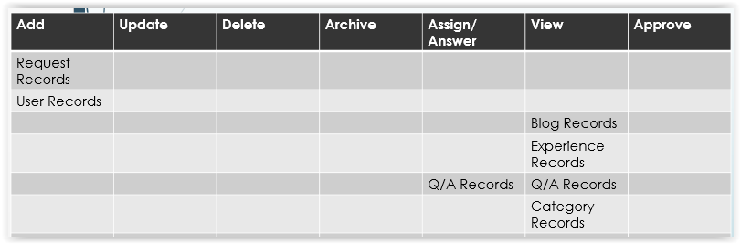
NON-LOGIN USER LEVEL

Slide 27
SYSTEM ANALYSIS AND DESIGN

Slide 28
SYSTEM ANALYSIS
Use case diagram and class diagram
Database design

Slide 29
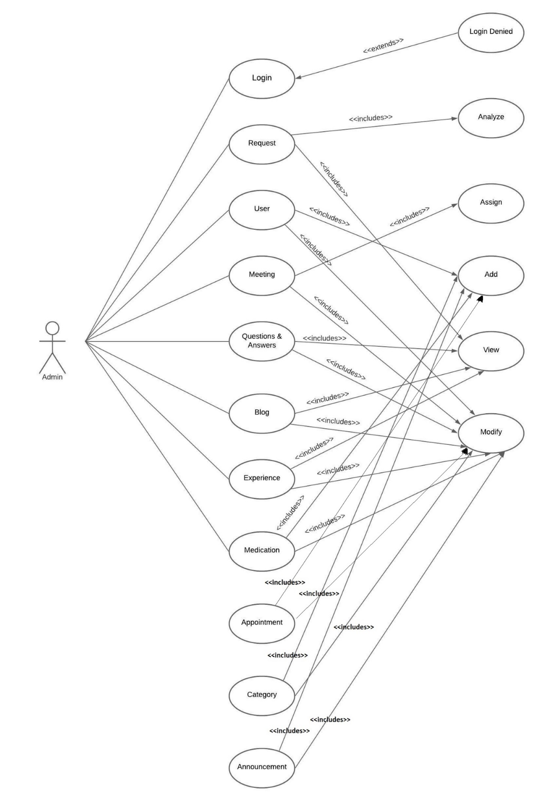
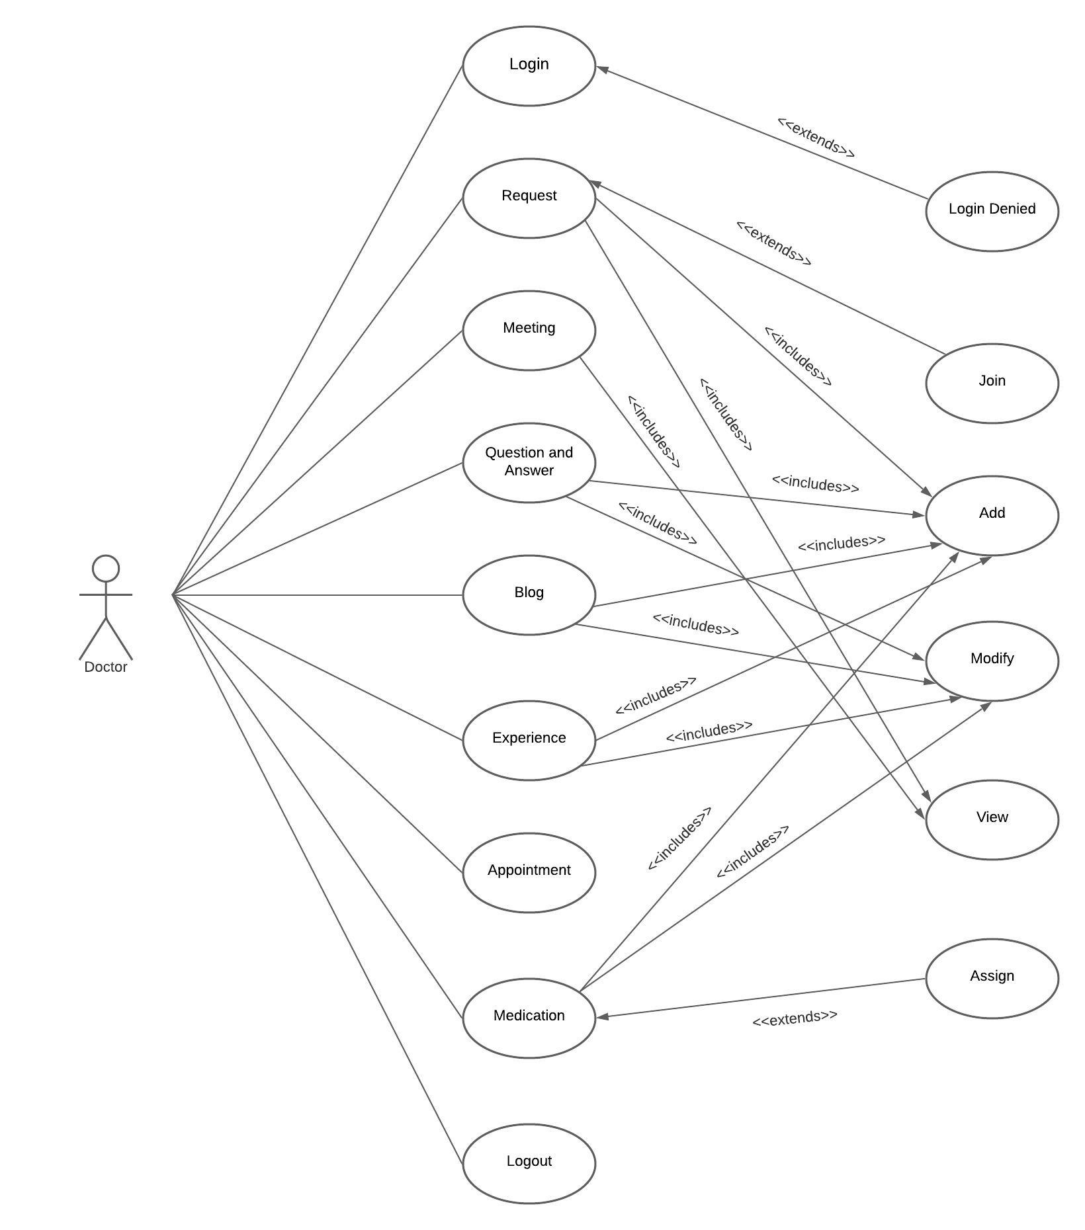
USE-CASE DIAGRAM

Slide 30
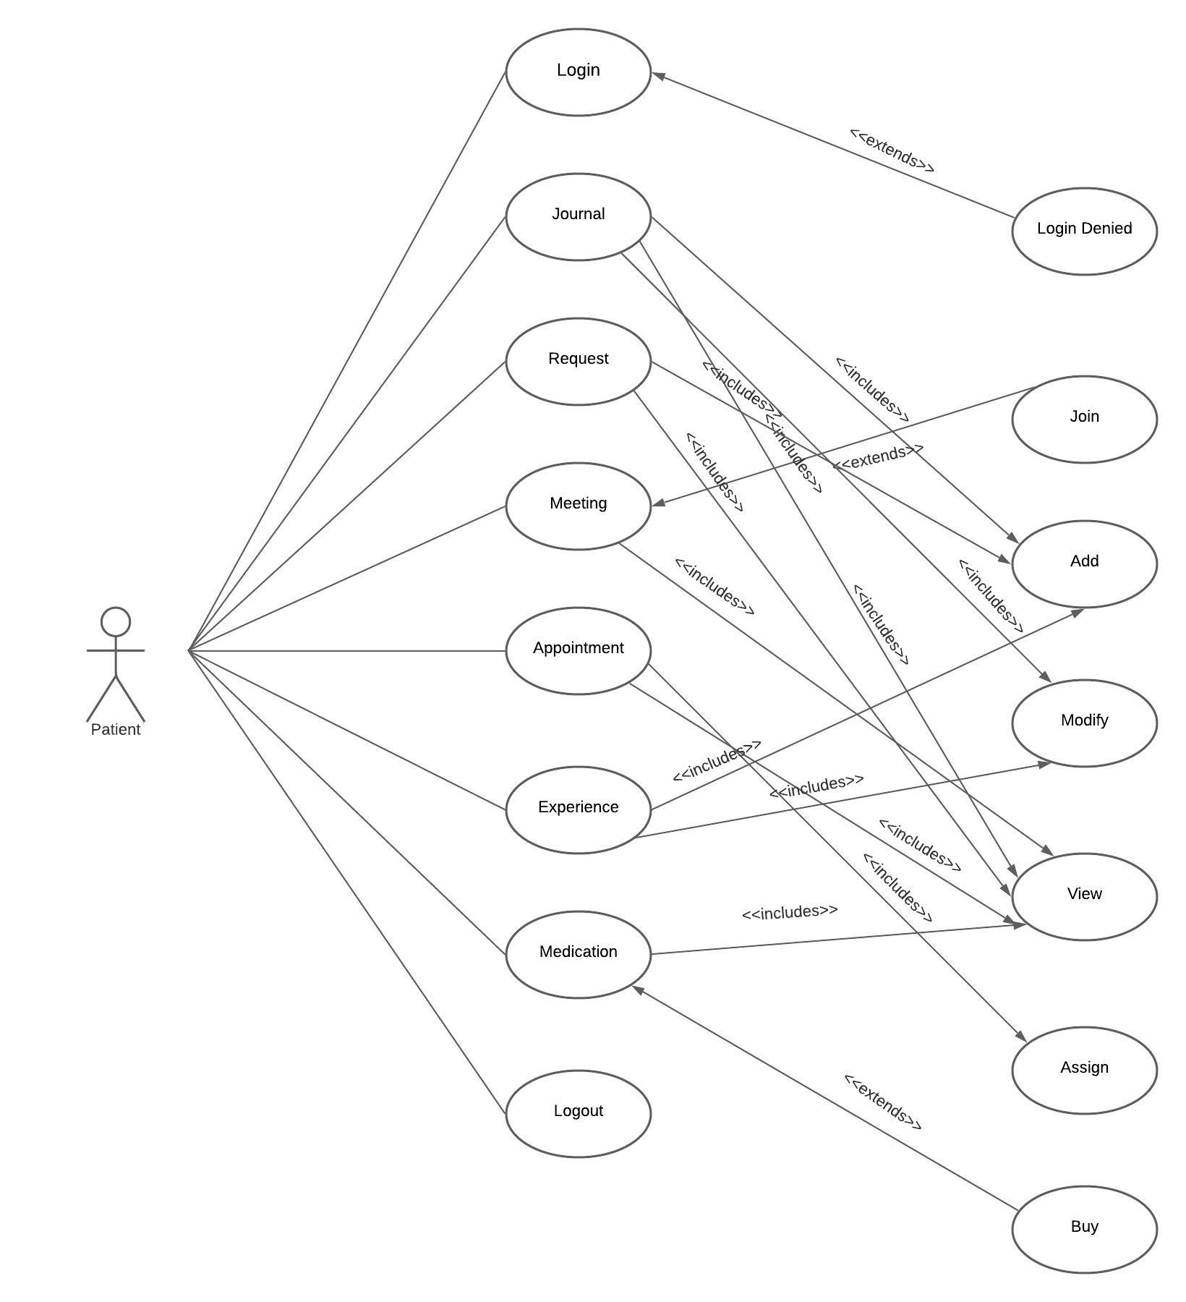
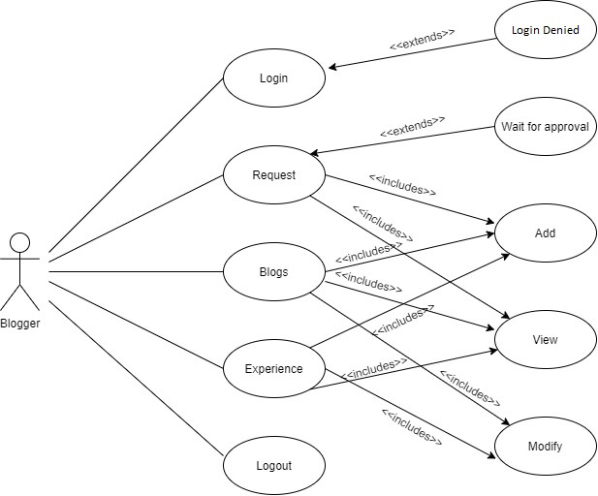

Slide 31
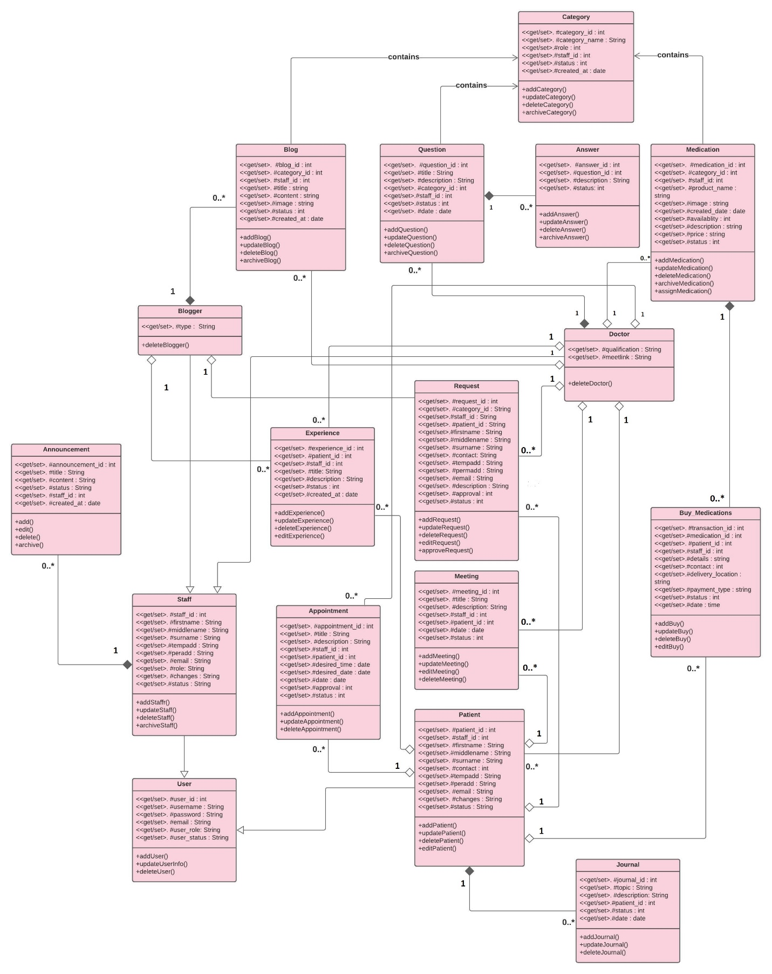
CLASS DIAGRAM

Slide 32
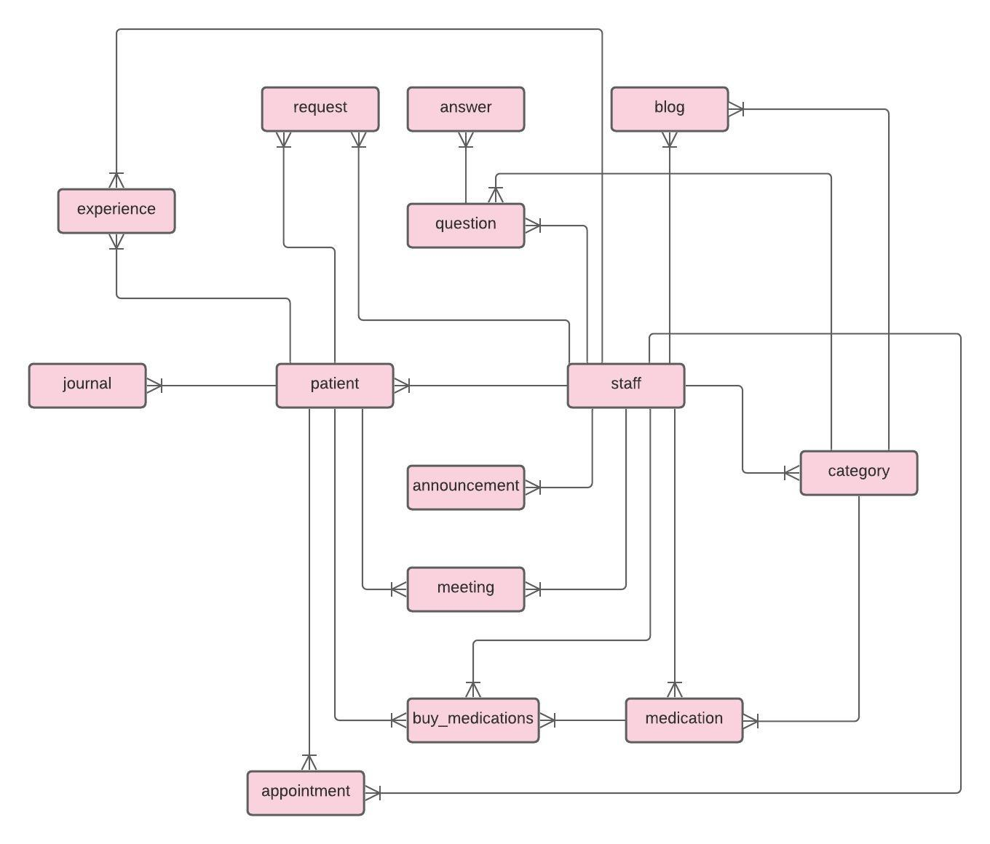
DATABASE DESIGN – ER MODEL

Slide 33
DATABASE DESIGN – ATTRIBUTE LISTINGS

Slide 34
SYSTEM DESIGN
Interface design: wireframes and mock-ups
Event diagrams

Slide 35
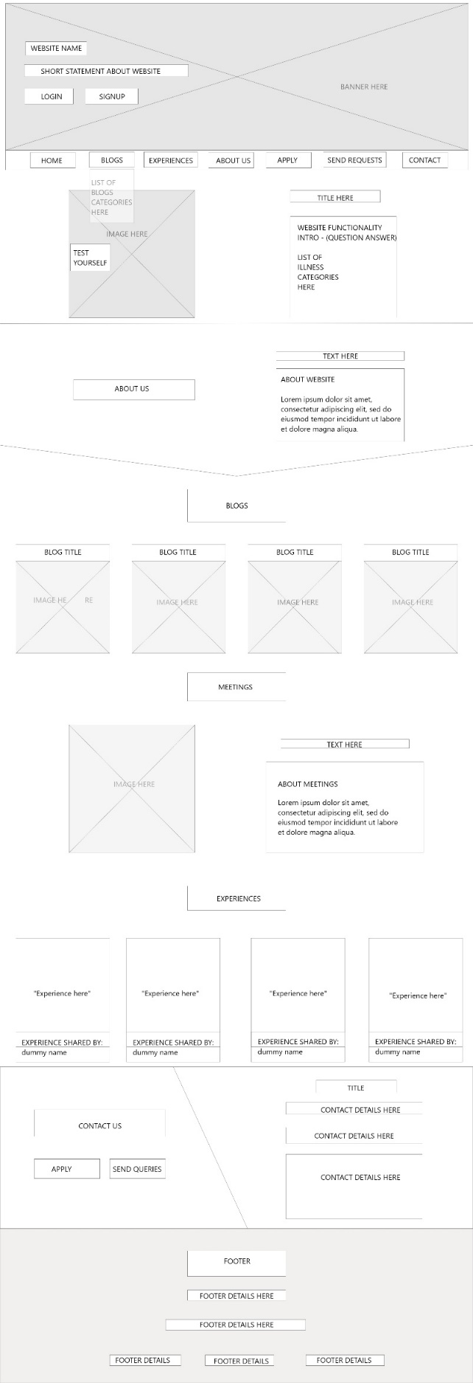
INTERFACE DESIGN – WIREFRAMES HOME PAGE

Slide 36
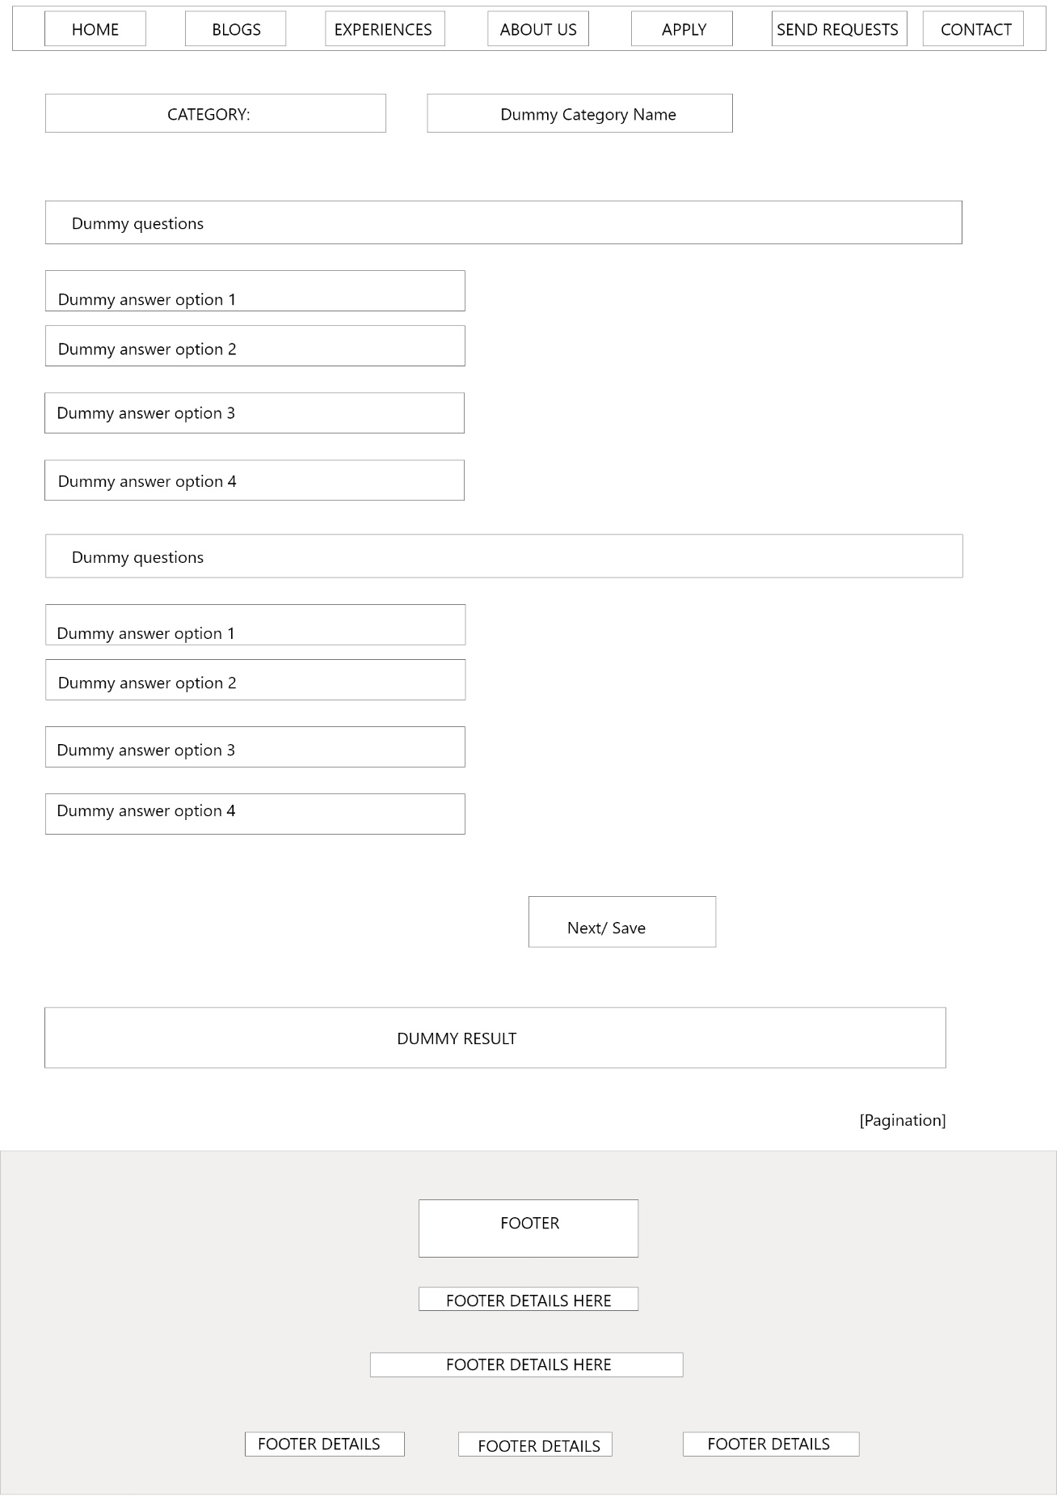
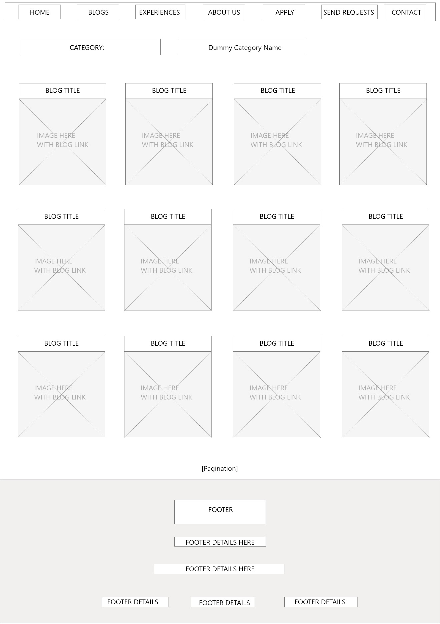
BLOG PAGE QUESTION/ANSWER PAGE

Slide 37
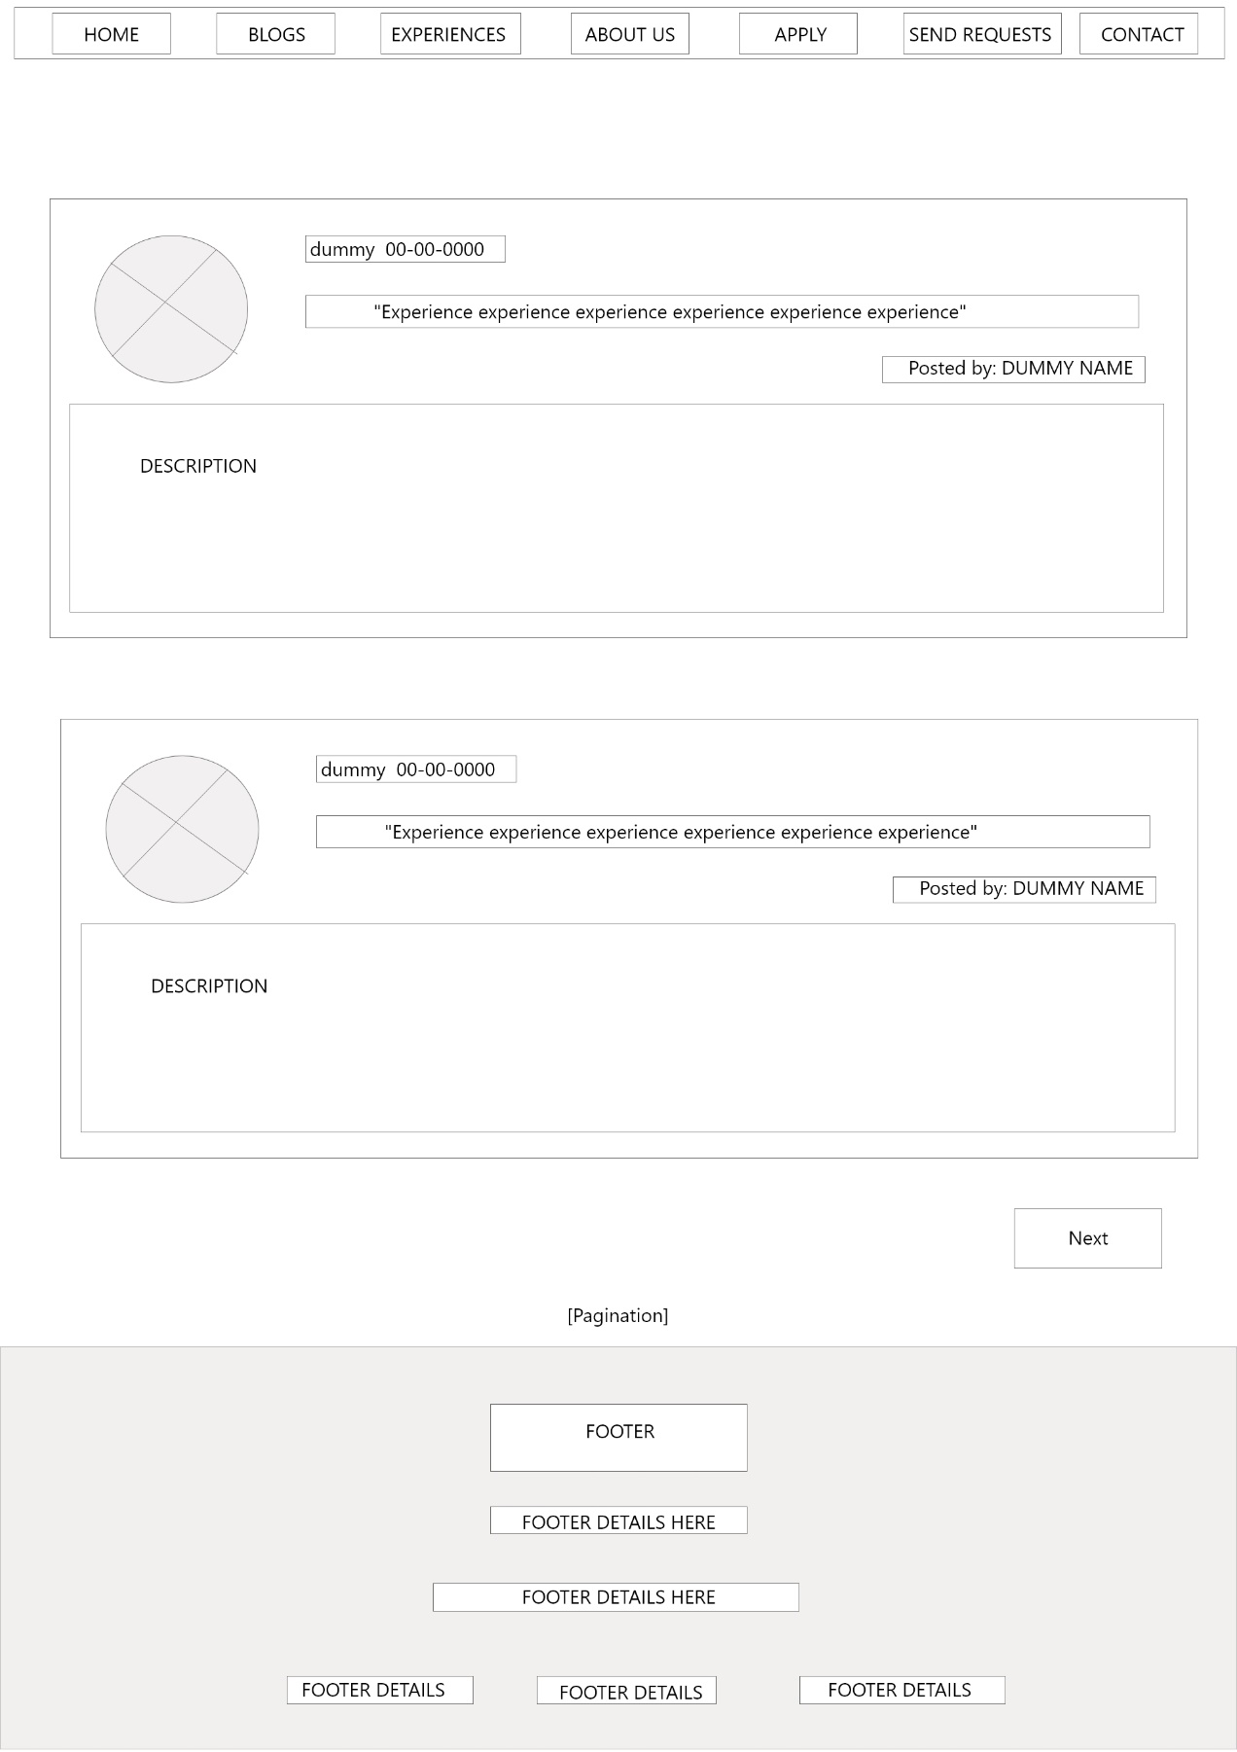
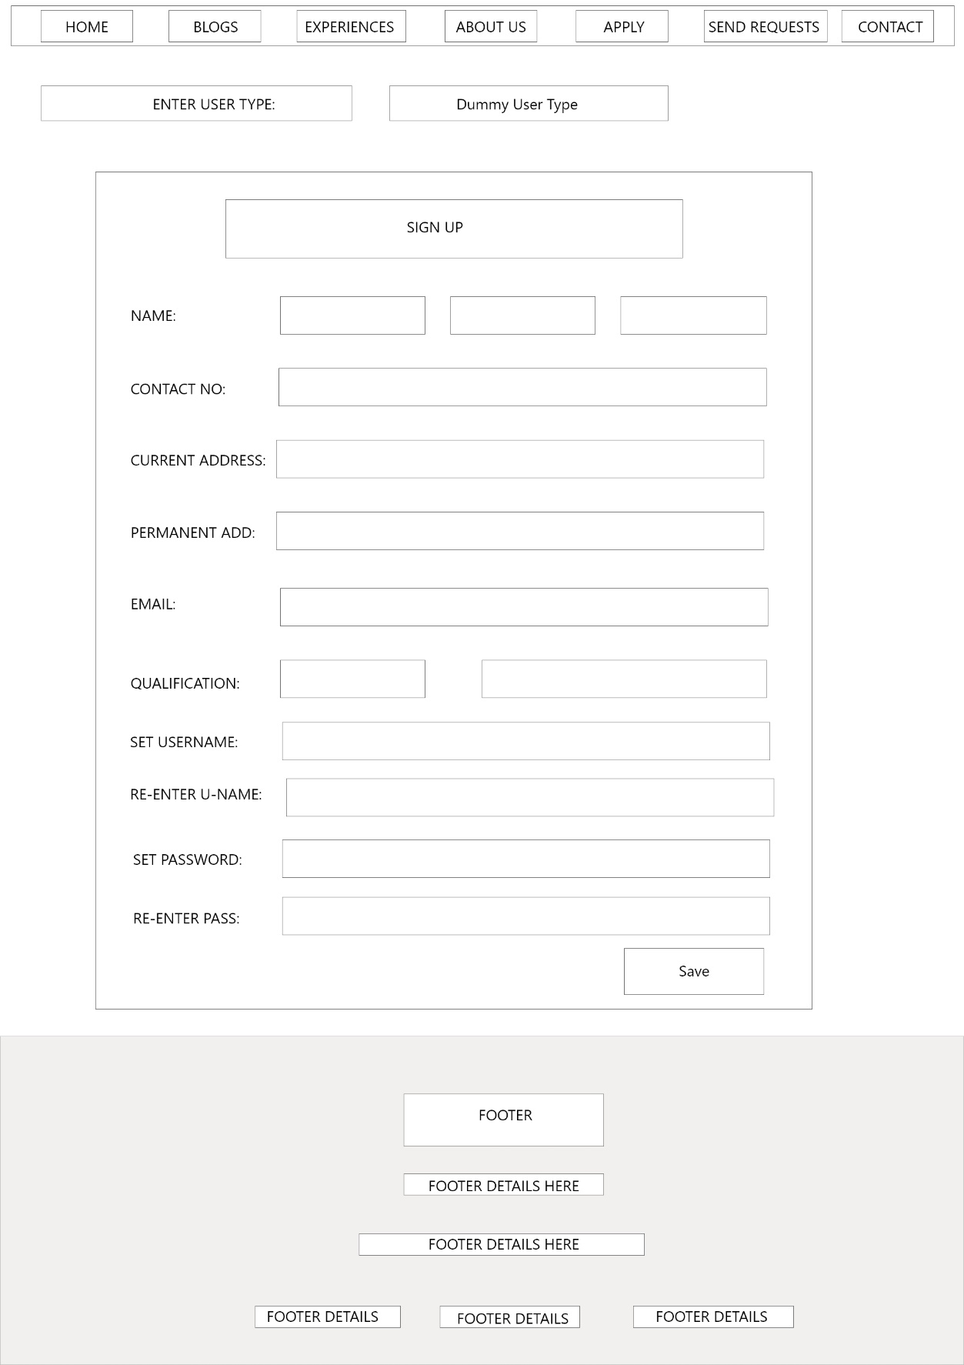
EXPERIENCE PAGE SIGN UP PAGE

Slide 38
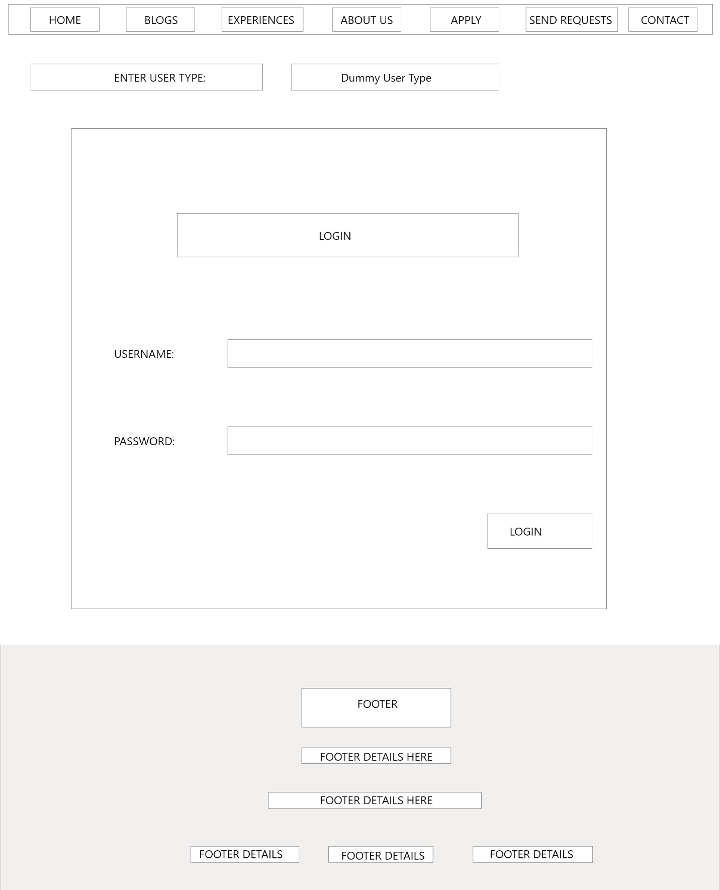
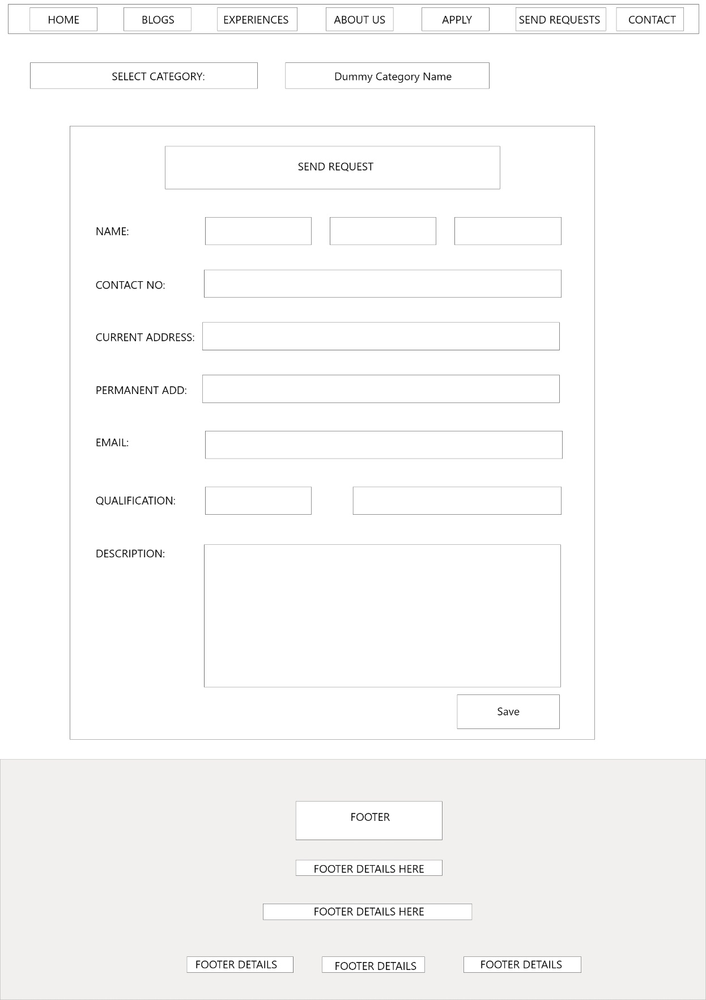
LOGIN PAGE REQUEST PAGE

Slide 39
SYSTEM CONSTRUCTION
Front-end :
HTML
CSS
Bootstrap
JavaScript
Back-end:
Python – Django framework

Slide 40
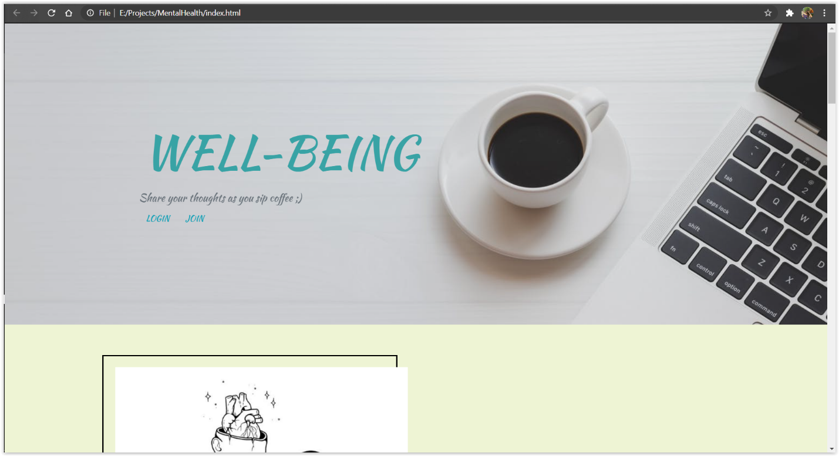
CURRENT DRAFT UI

Slide 41
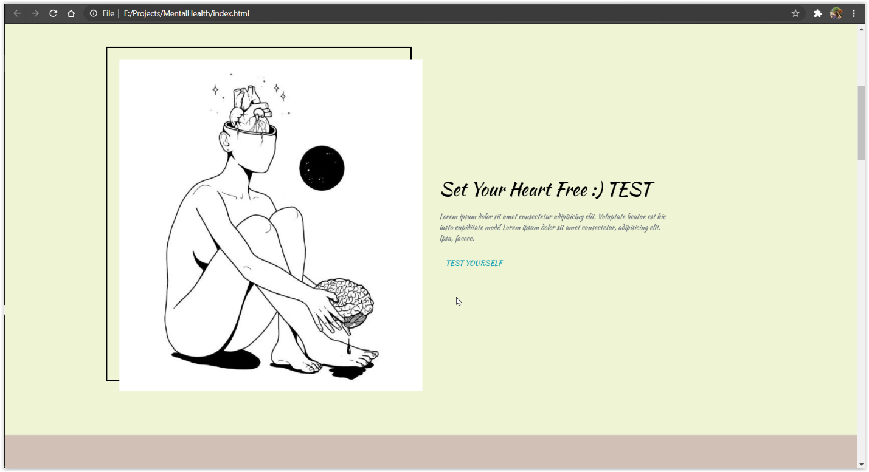

Slide 42
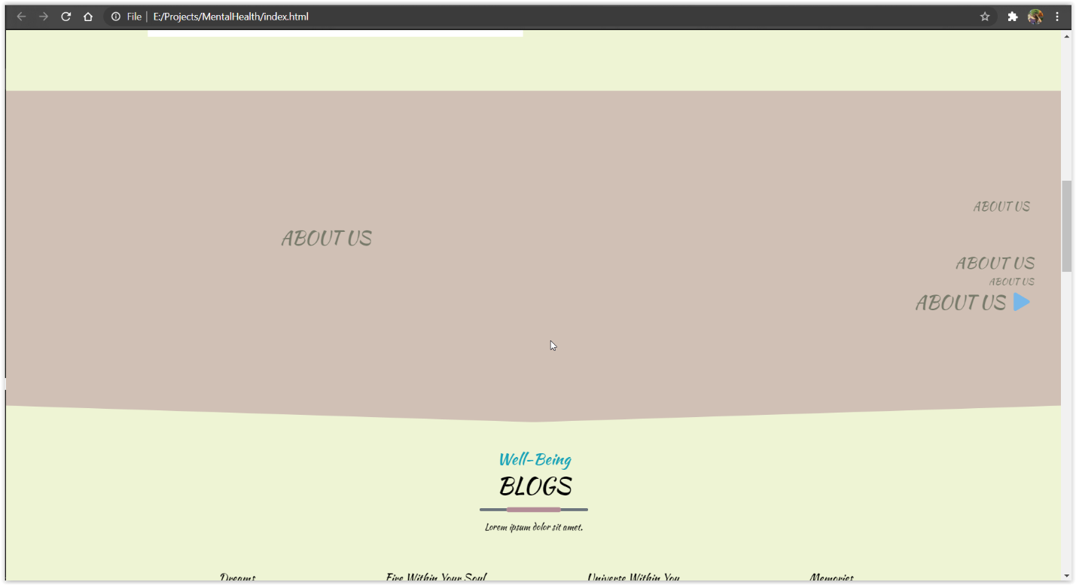

Slide 43
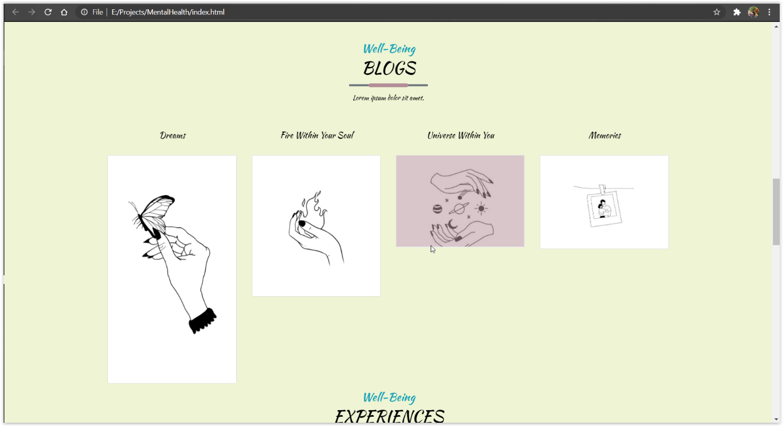

Slide 44
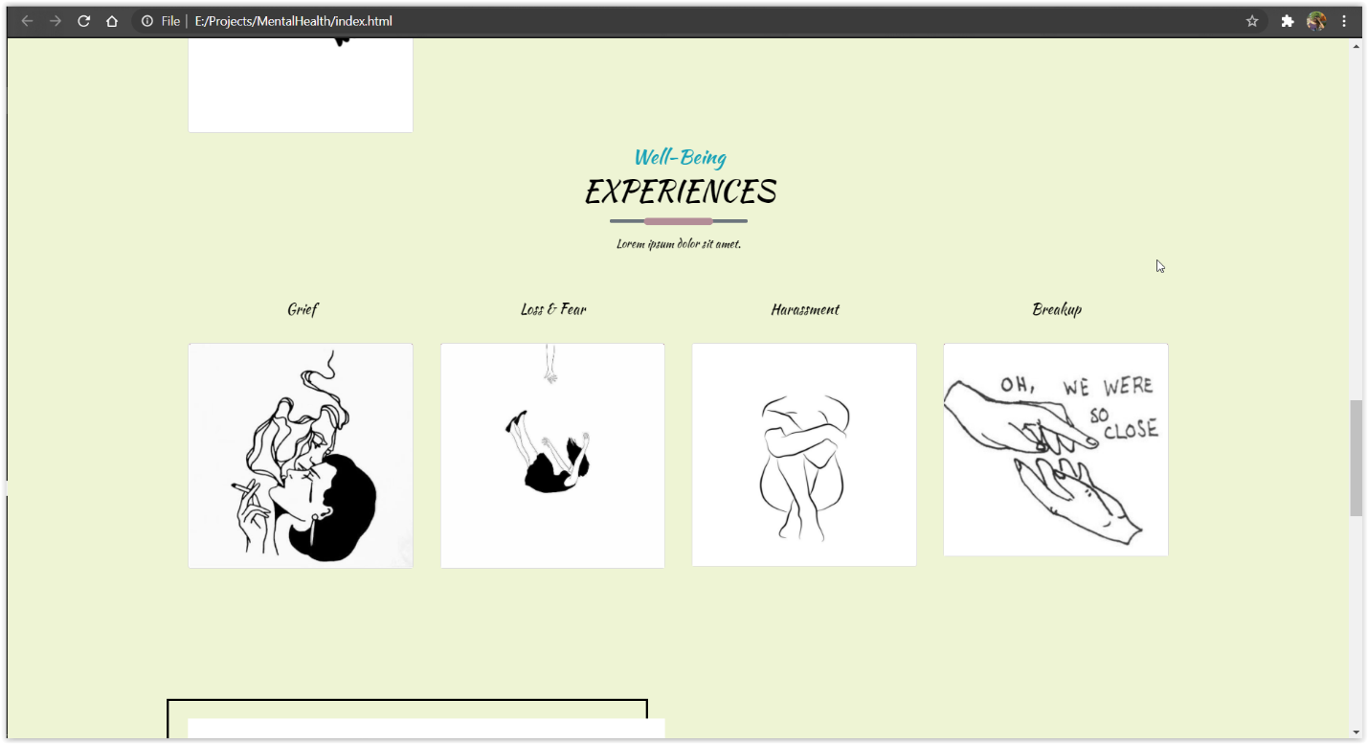

Slide 45
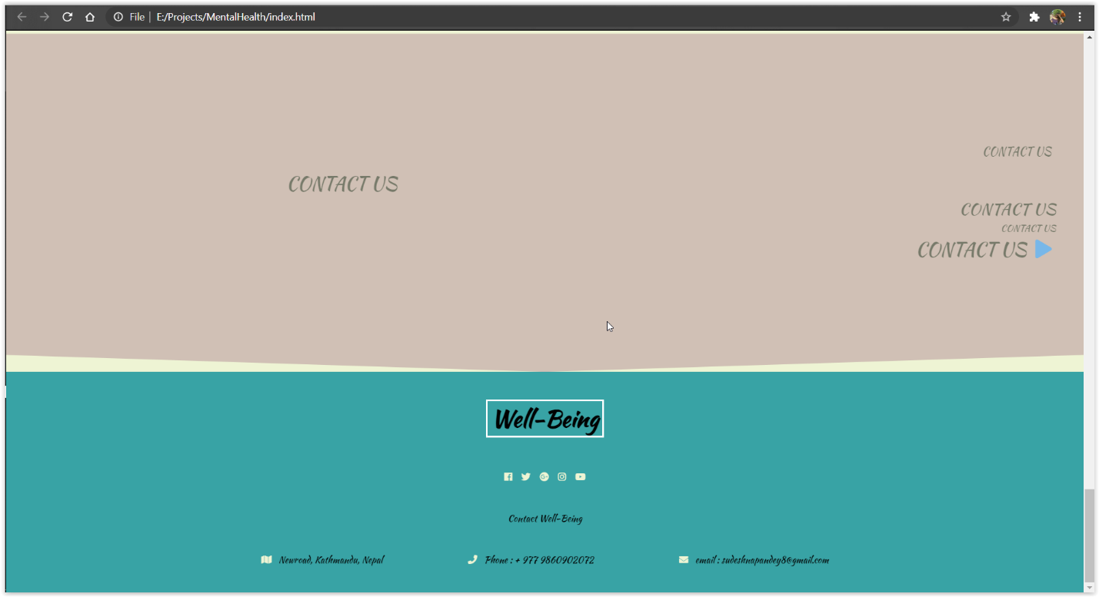

Slide 46
SYSTEM TESTING AND EVALUATION
Testing:
Black box testing
Unit testing
Evaluation:
Fulfillment of the requirements

Slide 47
OUTLINE OF THE PLAN PROJECT
Analysation of the user state according to the user input in the questionnaires provided by the system.
Video sessions for the consultation/ therapy or for taking appointments
Blog post to create awareness and increase the knowledge related to mental health topics
Charts, medication, calendar, diary to keep track of their progress and thoughts
Further developing into mobile application by implementing additional features.

Slide 48
REFERENCES
Verywell Mind. 2020. Know More. Live Brighter.. [online] Available at: <https://www.verywellmind.com/> [Accessed 4 December 2020].
Welistennepal.org. 2020. Home. [online] Available at: <https://welistennepal.org/> [Accessed 4 December 2020].
doxy.me. 2020. The Simple, Free, And Secure Telemedicine Solution | Doxy.Me. [online] Available at: <https://doxy.me/> [Accessed 4 December 2020].
World Economic Forum. 2020. 5 Things To Know About Mental Health Across The World. [online] Available at: <https://www.weforum.org/agenda/2020/10/mental-health-day-covid19-coronavirus-global/> [Accessed 4 December 2020].
Assets.publishing.service.gov.uk. 2020. [online] Available at: <https://assets.publishing.service.gov.uk/government/uploads/system/uploads/attachment_data/file/665576/A_framework_for_mental_health_research.pdf> [Accessed 4 December 2020].
World Bank. 2020. Mental Health. [online] Available at: <https://www.worldbank.org/en/topic/mental-health> [Accessed 4 December 2020].
Who.int. 2020. [online] Available at: <https://www.who.int/mental_health/evidence/nepal_who_aims_report.pdf?ua=1> [Accessed 4 December 2020]. 2020. [online] Available at: <https://www.singlecare.com/> [Accessed 4 December 2020].
Healthypeople.gov. 2020. Mental Health And Mental Disorders | Healthy People 2020. [online] Available at: <https://www.healthypeople.gov/2020/topics-objectives/topic/mental-health-and-mental-disorders/objectives> [Accessed 4 December 2020].
Who.int. 2020. [online] Available at: <https://www.who.int/mental_health/evidence/en/promoting_mhh.pdf> [Accessed 4 December 2020]
MHT. 2020. Communication Key Ingredient In Mental Health Recovery | MHT. [online] Available at: <https://www.mentalhealthtoday.co.uk/blog/therapy/communication-is-a-key-ingredient-in-mental-health-recovery> [Accessed 4 December 2020].
2020. [online] Available at: <https://www.researchgate.net/publication/265339587_Mental_Health_Apps_Innovations_Risks_and_Ethical_Considerations> [Accessed 4 December 2020].

Slide 49
ANY QUESTIONS?

Slide 50
THANK YOU!

