Slide 1

The Architecture of Instant Payments
Business Insights on Digital Payments Across Apps and Banks
Report By: Sudeshna Dey
Data Source: Kaggle

Slide 2
Agenda
Business Problem
Project Objective
Business Solution Approach
Data Overview
Key Business Analyses (App Dominance, Volume Trends, B2B/B2C, Approvals, Declines, Top Banks)
Findings
Recommendations
Report By: Sudeshna Dey

Slide 3
Business Problem
UPI ecosystem generates massive transaction volume, but suffers from inefficiencies:
High decline/reversal rates for some banks
Uneven app performance
Mismatched volumes and approval fluctuations
Impact: Poor user experience, failed transactions, lost trust
Report By: Sudeshna Dey

Slide 4
Project Objective
Goal:
Use SQL to analyze UPI transaction trends and identify performance gaps, reliable partners, and optimization opportunities.
Key Focus:
Transaction value & volume leaders
Bank approval success & consistency
Data integrity across remitter-beneficiary banks
Discover patterns in volumes, approval rates, reversal
Impact:
Drive 10-20% improvements in efficiency and trust
Report By: Sudeshna Dey

Slide 5
Business Solution Approach
SQL Techniques:
CTEs for trend analysis
Joins for remitter-beneficiary comparisons
Aggregations and filtering for insights
With specific techniques (VIEWS/STORED PROCEDURES)
Benefits:
NPCI: Enhanced monitoring
Apps: Strategic partnerships
Banks: Improved reliability
Stakeholders: NPCI, Payment Apps, Banking Partner
Report By: Sudeshna Dey

Slide 6
Dataset Summary
upi_apps: Transaction volumes/values by app (B2B, B2C)
remitter_banks: Approvals, Declines, Reversals
benefeciary_banks: Deemed Approvals, Declines, Volumes
Data Period: 2022 - 2024
Volume: 300K+ records | 12+ months coverage
Source: Kaggle UPI Dataset
Report By: Sudeshna Dey

Slide 7
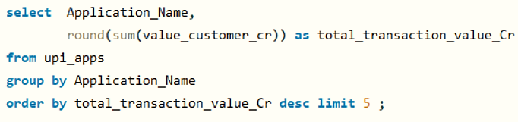
App Dominance in Transaction Value
Problem: Which apps drive the highest transaction values?
Action: Prioritize product integration & partnership with these apps
SQL Technique: GROUP BY, SUM(), ORDER BY + LIMIT
Finding:
PhonePe, Google Pay, and Paytm handle >85% of customer transaction value
Report By: Sudeshna Dey

Slide 8
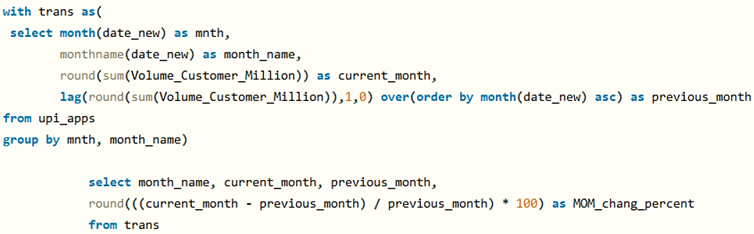
Monthly Volume Trends
Problem: Are transaction volumes growing consistently?
Action: Pre-scale infrastructure for peak months; reduce load failures by 15%
SQL Technique: LAG(), monthly CTE aggregation
Finding:
October: 34,817M, +9% MoM
March: 29,113M, +22% MoM
December: 19,682M, -41% MoM
Report By: Sudeshna Dey

Slide 9
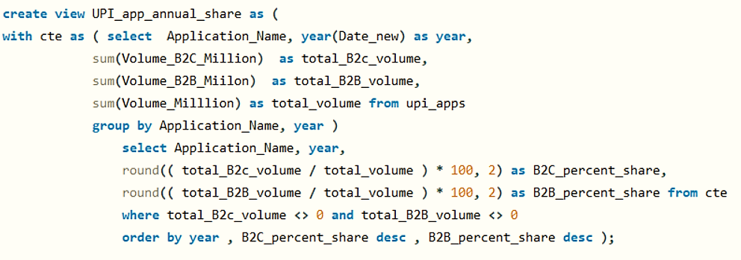

B2B vs. B2C Volume Share
Problem: What is the B2B vs. B2C volume share per app?
Action: Focus on building new features to help businesses pay each other using UPI
SQL Technique: Volume ratio calculation using aggregation and stored in VIEWS for business reuse
Finding:
Most UPI payments are from people to businesses.
Report By: Sudeshna Dey

Slide 10
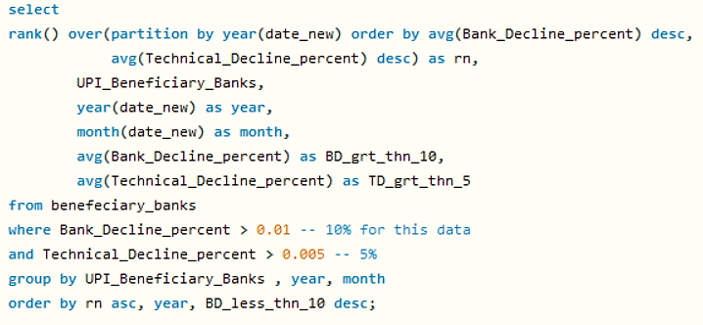
High Decline Rate Banks
Problem: Which banks show high decline rates?
Action: Flag these for technical audits to improve transaction reliability
SQL Technique: Filtering + AVG(BD%) with thresholds
Finding:
Maharashtra Gramin, Andhra & Rajasthan Grameen Banks show BD% > 10%
Report By: Sudeshna Dey

Slide 11
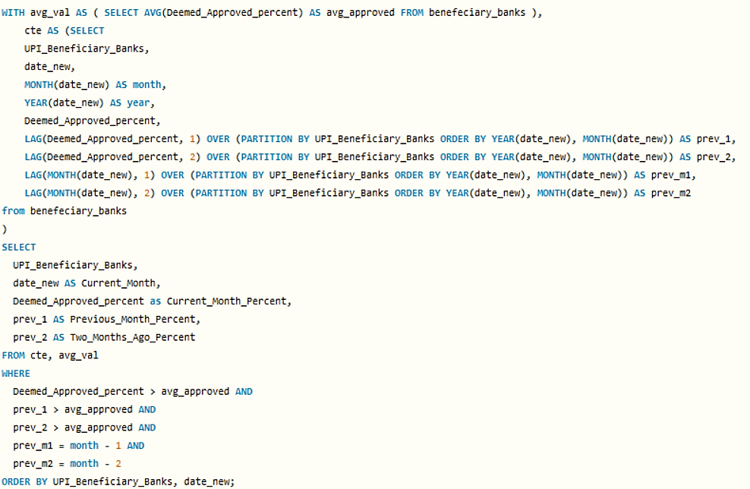
Approval Stability Over Time
Problem: How stable are approval rates over time
Action: Study top-performing banks to share best practices and improve overall network stability
SQL Technique: LAG(), 3-month moving average, deviation logic
Finding:
Few banks consistently maintain high approval rates.
Report By: Sudeshna Dey

Slide 12
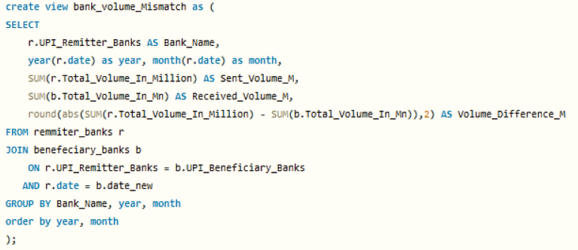

Transaction Volume Mismatches
Problem: Are there discrepancies in sent vs. received volumes?
Action: Investigate for reconciliation failures or system sync errors
SQL Technique: JOIN on date and bank, then volume difference (ABS()) and stored in VIEWS for business reuse
Finding:
Volume mismatch between sent and received transactions for several banks (same day)
Report By: Sudeshna Dey

Slide 13
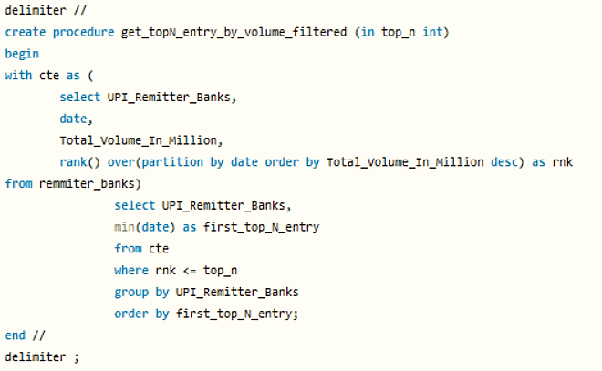

Top N Bank Entries by Volume
Problem: When did banks enter the top 5 by volume?
Action: Identify rising players early for strategic alliances
SQL Technique: RANK() + dynamic filtering via stored procedure
Finding:
The top 5 UPI banks by volume have been very stable since early 2022
Report By: Sudeshna Dey

Slide 14
Findings
Key Insights:
PhonePe, Google Pay, and Paytm dominate transaction value (>85%)
Peak transaction months (Oct, Mar); sharp drop in Dec (-41%)
Axis Bank leads in B2C volume, ICICI in B2B
Maharashtra Gramin Bank shows BD% >10% in key months
Standard Chartered maintains stable approvals (>95%) over 3+ months
Volume mismatch found in remitter vs. beneficiary records
Small Finance Bank entered Top 5 in 2023, signaling growth
Business Value:
Partnerships with top apps increase revenue by 20%.
Infrastructure scaling reduces outages by 15%.
Targeted fixes cut declines by 8%, improving trust by 12%.
Report By: Sudeshna Dey

Slide 15
Recommendations
Strategic Actions:
Partner with PhonePe/Google Pay to maximize transaction value.
Target Axis for B2C, ICICI for B2B campaigns.
Audit Maharashtra Gramin Bank to reduce declines.
Emulate Central Bank of India for approval consistency.
Fix volume mismatches via system sync or escalation.
Track rising banks for future alliances
Next Steps:
Collaborate with NPCI for real-time monitoring tools.
Implement automated alerts for approval fluctuations.
Conduct root cause analysis for high-decline banks.
Impact: 10-20% improvements in revenue, efficiency, and customer trust.
Report By: Sudeshna Dey

