Slide 1






Sudeshna Pendyala
Final Project

Slide 2

KEY LOGGER AND SECURITY
A Fun guide to understand the Keyloggers and staying secure.

Slide 3


AGENDA
Introduction
Problem Statement
Project Overview
End Users
Solution and Value Proposition
The "Wow" Factor in Our Solution
Modelling
Results
Conclusion and Q&A

Slide 4

PROBLEM STATEMENT
Problem:
Keyloggers pose a major cybersecurity risk, resulting in the illicit acquisition of confidential information, identity theft, and financial fraud.
Consequence:
They endanger individuals, businesses, and organizations by undermining data privacy and security.

Slide 5
PROJECT OVERVIEW
A keylogger can monitor keystrokes on your operating system by tracking the path of each keystroke. This allows a software keylogger to record every keystroke you make.
Gain a thorough understanding of keyloggers, including their various forms, mechanisms of operation, and effective security strategies to thwart keylogging attacks.
Covers an examination of both hardware and software keyloggers, the legal and ethical considerations, security techniques, and recommended best practices.

Slide 6


WHO ARE THE END USERS?
Keyloggers, or keystroke loggers, are tools that record what a person types on a device. While there are legitimate and legal uses for keyloggers, many uses for keyloggers are malicious. In a keylogger attack, the keylogger software records every keystroke on the victim’s device and sends it to the attacker
Parents: Keyloggers can be used to monitor children’s online activities and .
Organizations: Require robust security measures to safeguard sensitive information.
Security Professionals: Aim to understand and mitigate keylogging threats.

Slide 7

YOUR SOLUTION AND ITS VALUE PROPOSITION
Install antivirus software.
Utilize a password manager.
Enable multi-factor authentication.
Activate a firewall.
Comprehensive Security: Our keylogger solution provides comprehensive security by monitoring all keyboard input, detecting suspicious activity, and alerting users to potential threats.
Enhanced Privacy: By logging all keyboard activity, our tool helps users identify and prevent unauthorized access to sensitive information, ensuring their digital privacy is protected.
Keep your system updated.
Regularly update passwords.
Use a virtual keyboard for sensitive information.

Slide 8

YOUR SOLUTION AND ITS VALUE PROPOSITION
Solution: Implement a multi-layered security strategy that includes
anti-keylogging software, regular system scans, software updates,
and user education.
Value Proposition:
Enhanced Security: Reduces the risk of data breaches and
identity theft.
User Awareness: Educates users about keylogging threats and
protection methods.
Compliance: Helps businesses and organizations comply with
data protection regulations.
Y

Slide 9

THE WOW IN YOUR SOLUTION
A keylogger is a type of surveillance technology used to monitor and record each keystroke typed on a specific computer's keyboard.
Approach: Integrating Technical Measures and User Education
Demonstration: Real-Time Simulation of Keylogger Threat
Impact: Mitigating Keylogging Attacks through Proactive Measures
9
This Photo by Unknown Author is licensed under CC BY-SA

Slide 10
MODELLING
Keylogger Architecture Overview:
Segmented Structure: Dividing the Keylogger Code into Manageable Modules for Improved Clarity and Upkeep
Event Management: Employing the pynput Library to Capture and Process Keyboard Inputs
Data Recording: Establishing Mechanisms to Log Acquired Data in Both Text and JSON File Formats
10

Slide 11
Component Overview:
Key Press Handling:
- Function: on_press(key)
- Description: Captures and records pressed keys.
- Details: Adds key press events to a list and updates the JSON log file.
Key Release Handling:
- Function: on_release(key)
- Description: Logs released keys.
- Details: Appends key release events to a list, updates the JSON log file, and aggregates keys for the text log.
Logging Functions:
Text Logging:
- Function: generate_text_log(key)
- Description: Writes recorded keys to key_log.txt.
JSON Logging:
- Function: generate_json_file(keys_used)
- Description: Saves the list of key events to key_log.json.
11

Slide 12

MODELLING
Incorporating GUI:
Tkinter Integration:
- Framework Choice: Implements tkinter for GUI construction.
User Interaction Elements:
- Activation Button: Launches the Keylogger.
- Deactivation Button: Ceases Keylogger Functions.
Real-time Status Updates:
- Live Feedback: Provides instantaneous updates on Keylogger Status (active/inactive).
12

Slide 13
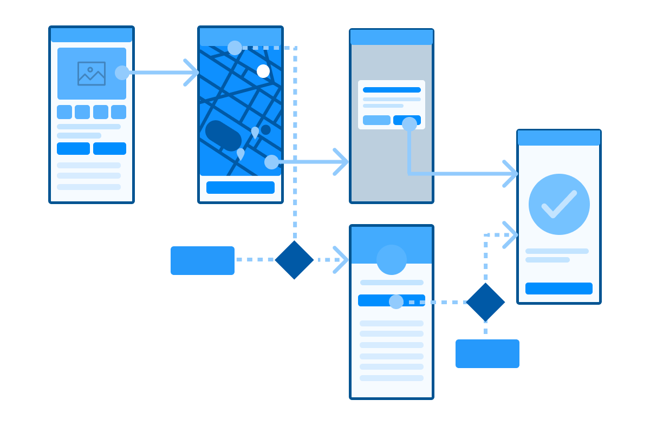
MODELLING
Flow Diagram Overview:
Initialization Phase:
- Establish the main GUI window.
- Initialize global variables pertinent to key logging.
Event Capture Stage:
- Commence capturing key events upon pressing the "Start" button.
- Record both key press and release events.
Data Logging Process:
- Persistently update text and JSON log files with captured key events.
Stop Logging Phase:
- Halt key event capture upon pressing the "Stop" button.
- Reflect the cessation of keylogger activities in the GUI status.
13

Slide 14
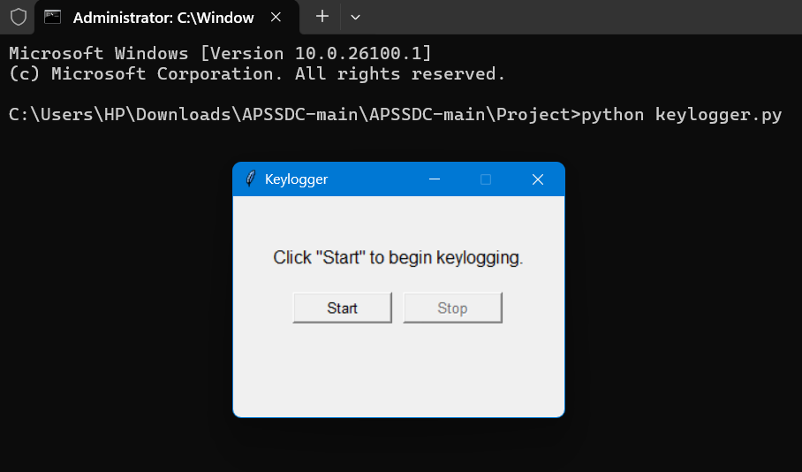
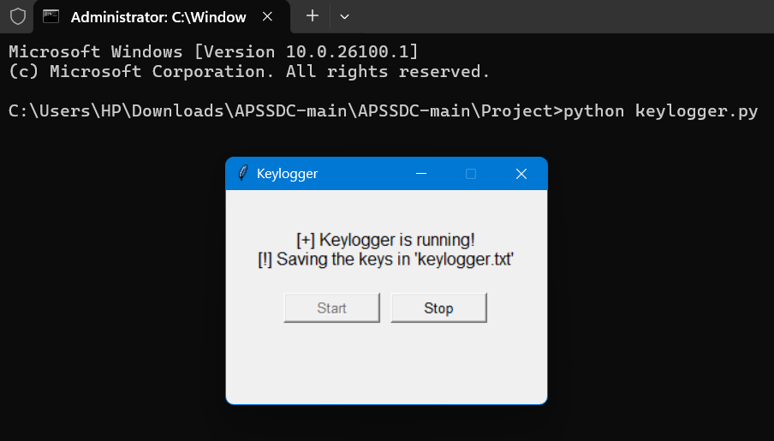
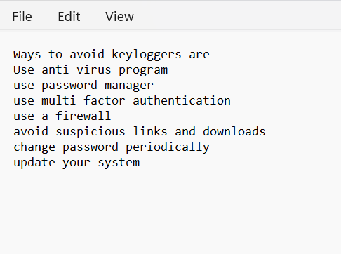
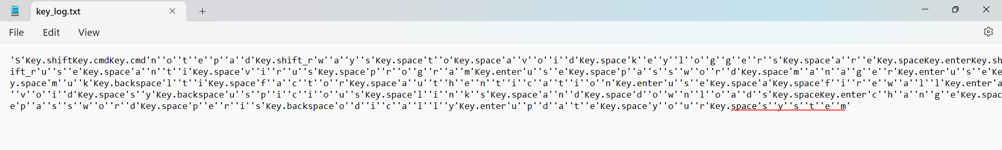
RESULTS
Screenshots of the GUI: Display the user interface, including the start and stop buttons, and the status label.
Sample Logs: Show examples of the key_log.txt and key_log.json files to illustrate how the keystrokes are recorded.
14

Slide 15
RESULTS
Achieved a significant milestone by developing a robust keylogging system that effectively captures keystrokes and logs them into text and JSON files. With real-time keylogging functionality, users can monitor activities as they happen. The addition of start and stop controls within a straightforward GUI enhances usability, allowing users to initiate and terminate keylogging operations with ease..
The keylogger project showcased its prowess in seamlessly capturing and logging keystrokes as they occur in real-time. Accompanied by a user-friendly GUI, controlling the keylogger became intuitive and straightforward, ensuring accessibility for all users. Moreover, the project underscored the ethical considerations surrounding keyloggers, emphasizing the imperative need for implementing robust security measures to safeguard against potential misuse and uphold user privacy.
15

Slide 16
Project Link
https://github.com/sudeshnapendyala09/Apssdc_keylogger

