Slide 1

COMPRESSIBLE LATTICE BOLTZMANN SOLVER CPU BENCHMARK
MuCoSim WS 2023/24
PHASE: 2
Sudesh Rathnayake

Slide 2
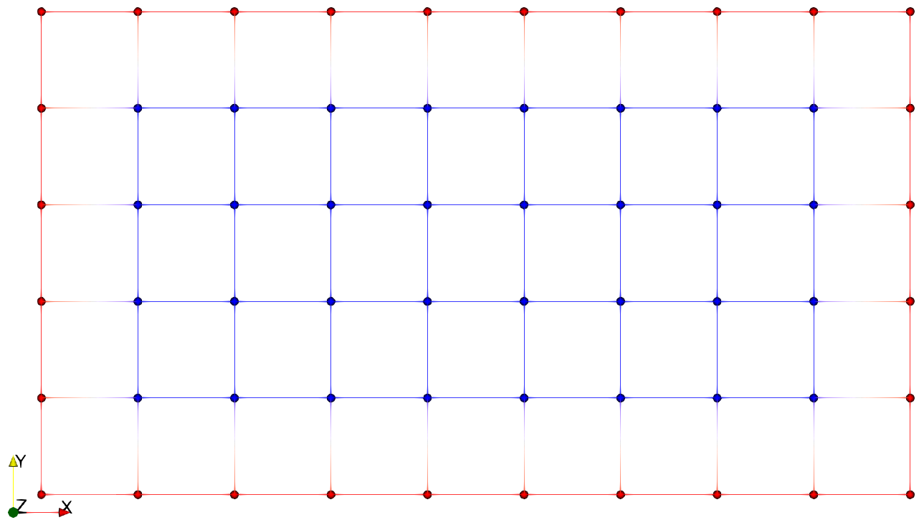
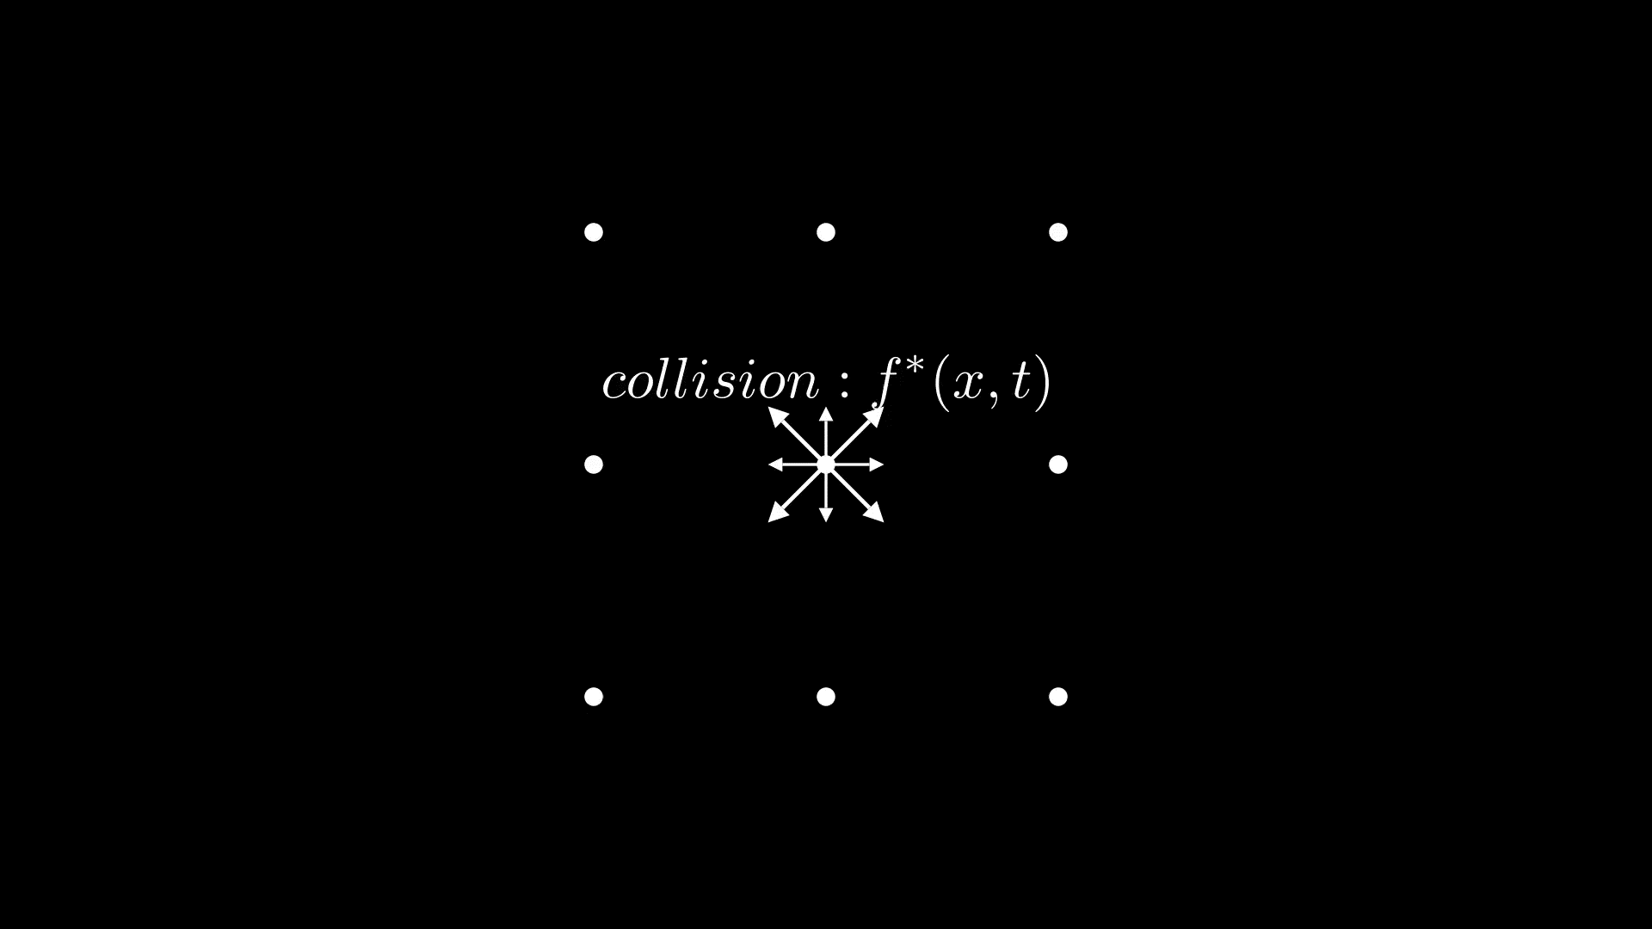
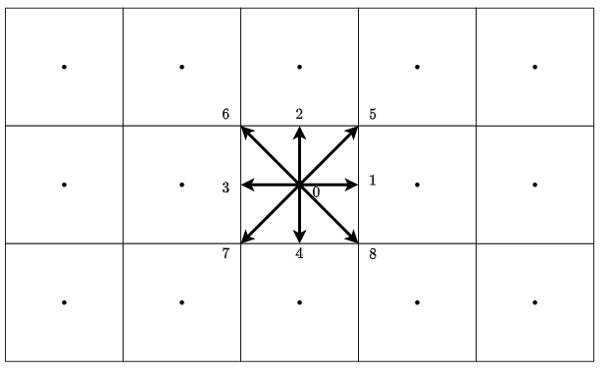
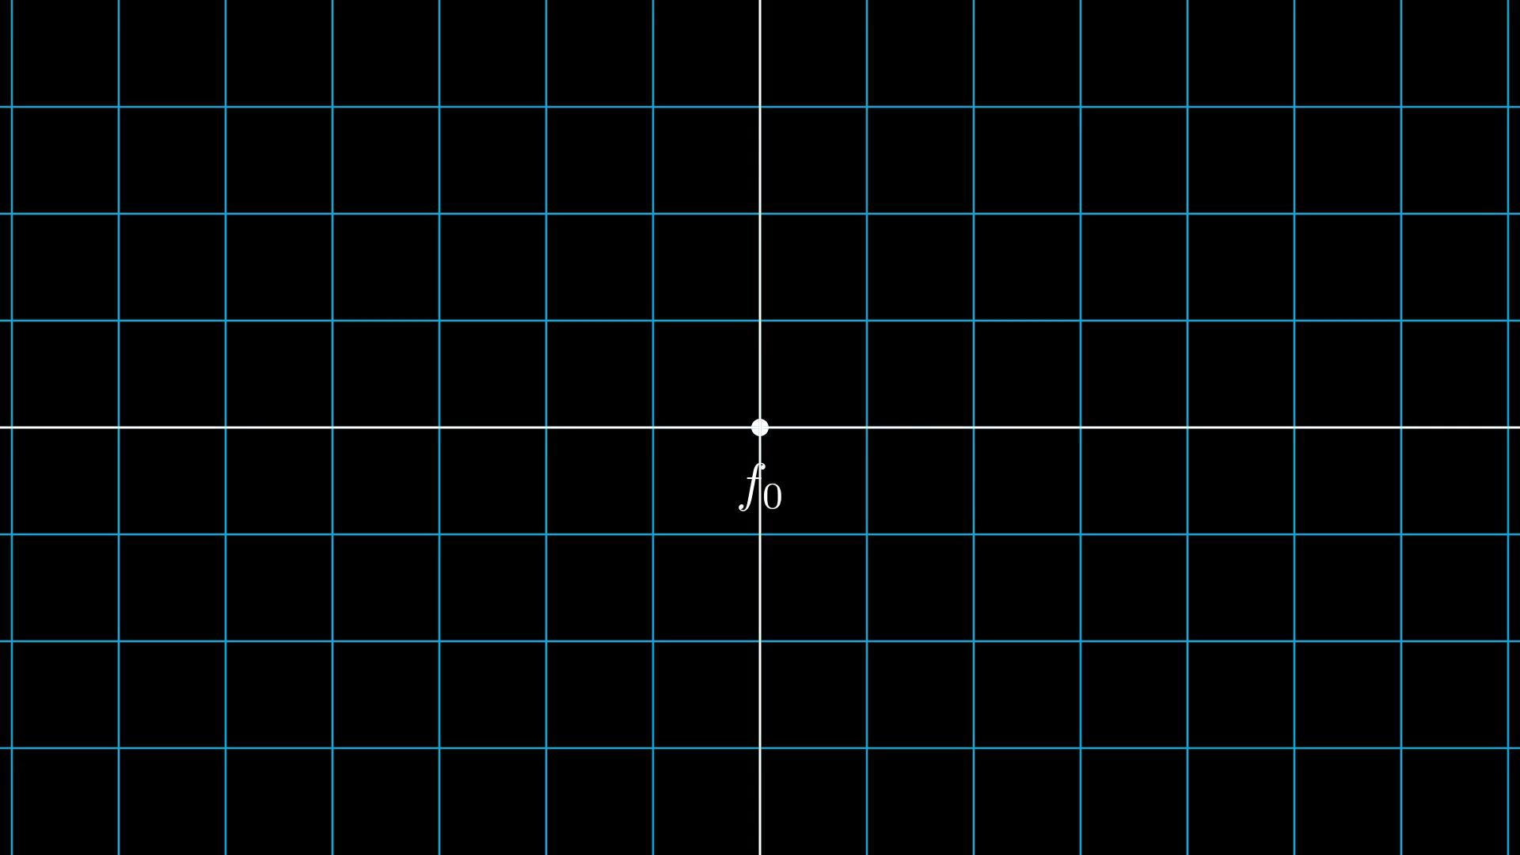



Introduction: Summary
Lattice Boltzmann Method(LBM) commonly adopt a structured grid in practice.
Naturally adapted to parallel processes computing. [3].
The “Collide and Stream” algorithms.
Compressible LBM
2 populations to integrate energy equation
apart from the mass, and momentum equations.
The present solver based on Entropic Lattice Boltzmann
Method (ELBM)
“Represented by a regular grid; points on grid are conceptually updated together. It has high spatial locality”’[1]
Figure 1: Exemplary structured grid
$$f_{i}^{∗}(x,t)=f_{i}\left(x,t\right)+ Ω_{i}(x,t)$$
$$f_{i}\left(x+c_{i}∆t, t+∆t\right)=f_{i}^{∗}(x,t)$$
$f_{i}^{eq}$ using discreate entropy function by formulating a
minimization problem.
Figure 02: Collide and Stream
Figure 04:Lattice with D2Q9 stencil
Figure 03: f and g populations in a lattice node
git@gitlab.cs.fau.de:yh54ojyn/mucosim.git

Slide 3
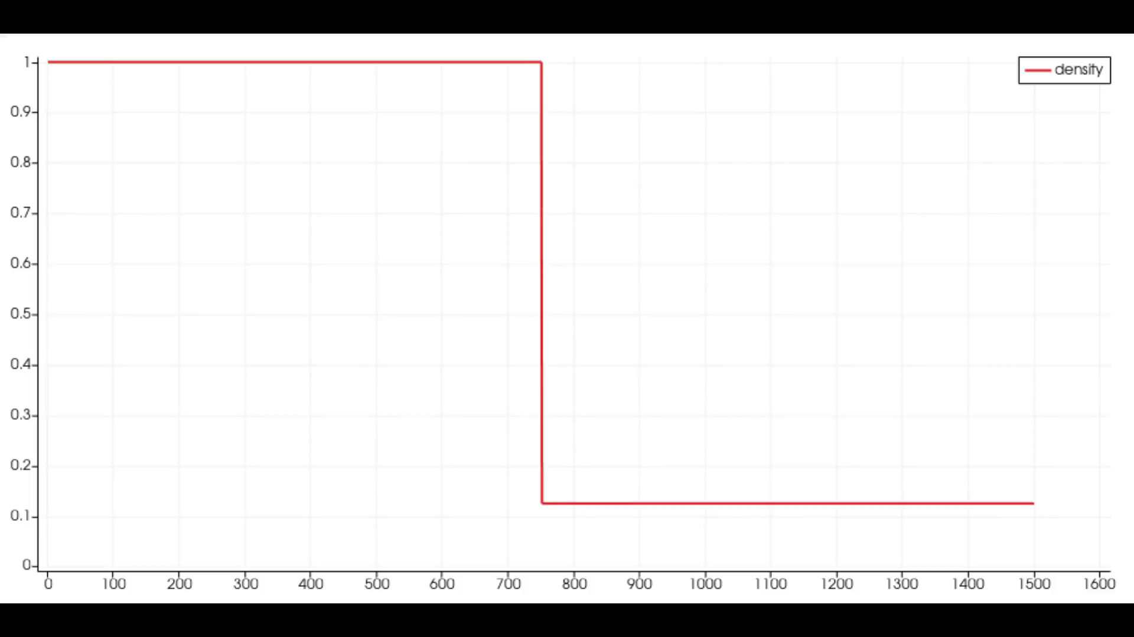
Test system & CLBM solver
Algorithm
Solver is based on C++ with OpenMP and build using Cmake 3.23.1.
Input parameter file defines the simulation properties.
For benchmarking, a 2D shock tube simulation is considered.
Stencil configuration : D2Q9 (D2Q9 X 2 in one LB node)
Figure 05: Results for density variation of air inside a 2D shock tube using CLBM solver
Test system
Tools
LIKWID version : 5.3.0
LIKWID flags : likwid-perfctr -g MEM/ENERGY/MEM_DP
: likwid-topology
Name | Fritz
Processor | Intel Xeon Platinum 8360Y
Micro architecture | Icelake
Frequency [GHz] | 2.4
Cores | 72
Sockets | 2 (No SMT)
NUMA domains | 4
Main memory [GB] | 256
Thermal design power [W] | 250
Compiler
GNU g++
compiler flags : -O3 –march=native –mavx –ftree-vectorize

Slide 4
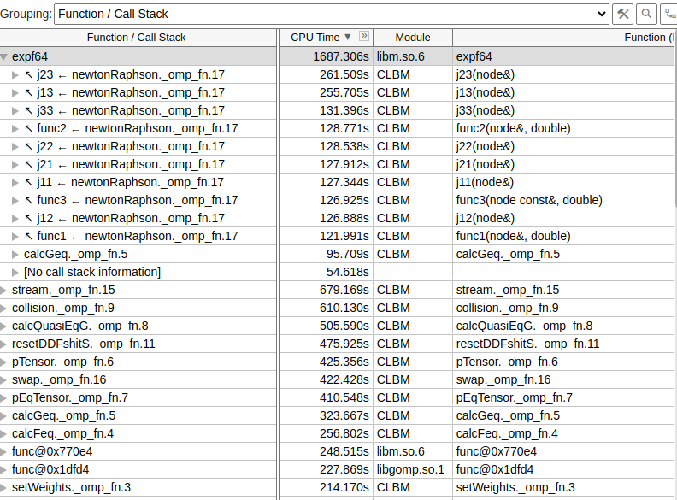
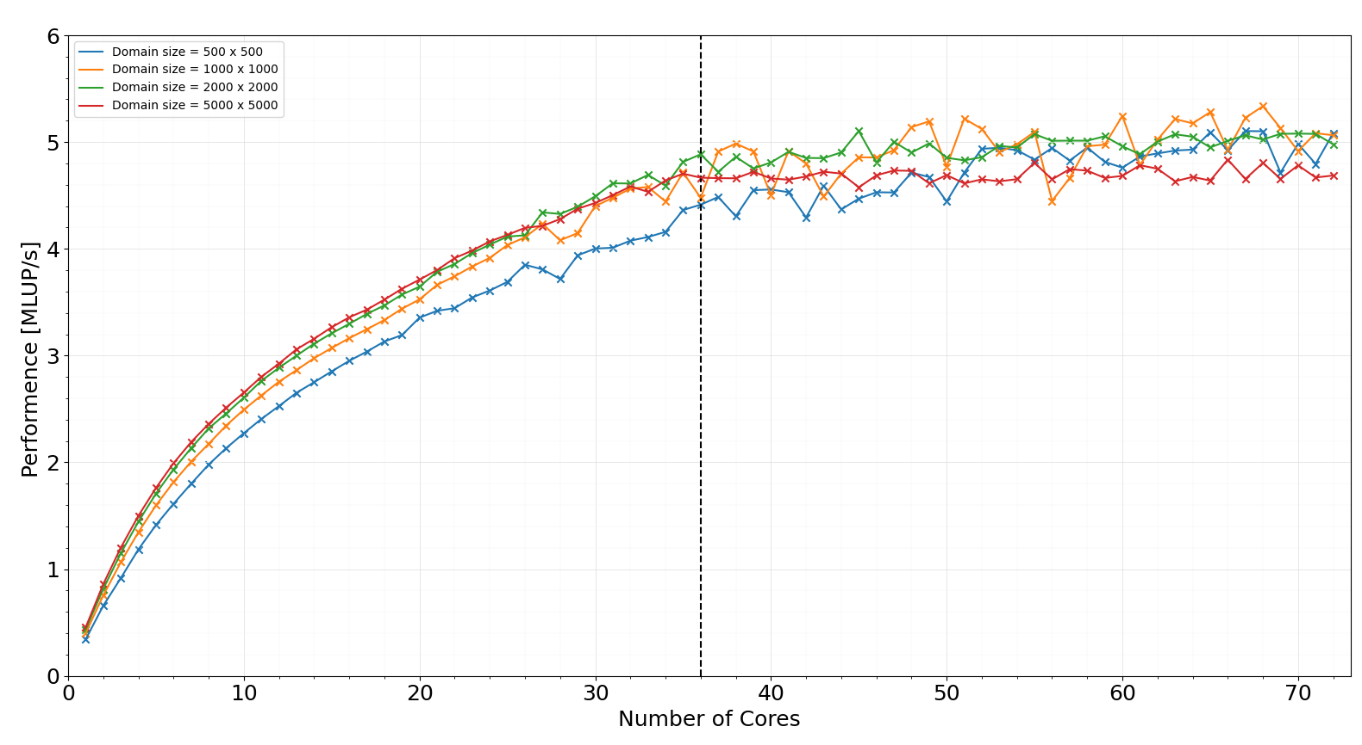
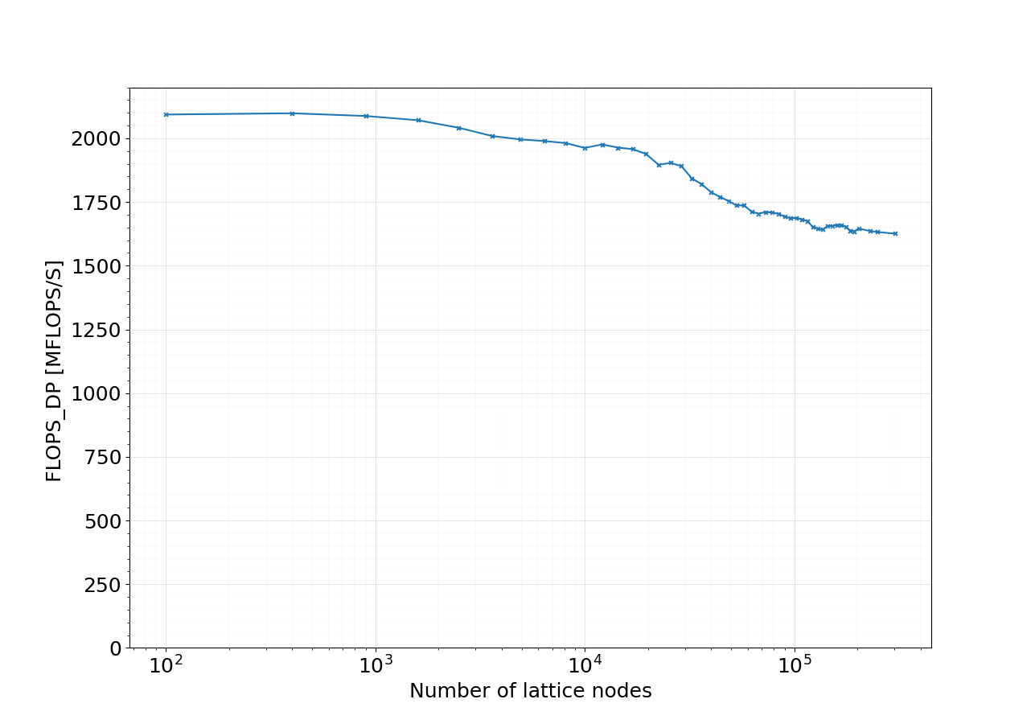
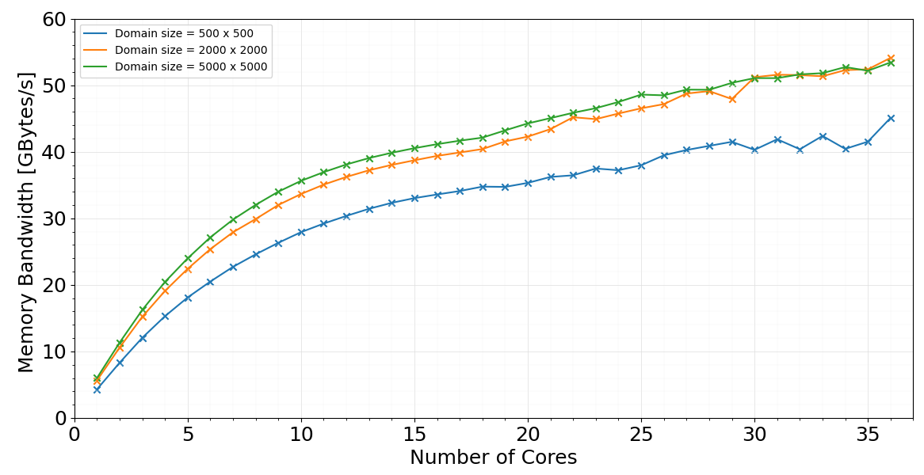
Issues: Phase01
According to single core performance doamin size of 500x500 fits to L3 cache.
Bad scaling behaviour after the second socket.
Total memory bandwidth and performance has a saturating trend in 1st NUMA domain.
expf4; calculation of exponential function using math.h library is critical inside the newtonRaphson kernel.
S0
S1
Figure 6: Vtune hotspot results..
BAD IMPLEMENTATION?
NEED CODE OPTIMIZATIONS?
OpenMP sheduling?
Figure 6: Performance saturation in one node. (phase:01)
Figure 7: single core performance for fixed 2.4GHz.
Figure 8: Memory bandwidth saturation in one node. (phase:01)

Slide 5
Issues: Phase01
According to the initial profiling results; investigated possible issues in newtonRaphson kernel.
Repeated calls for expf4 unnecessarily.
Since it’s the hotpost, investigated the possible code optimizations.
Therefore, modifiedthe newtonRapson subroutines.
Further, experimented OpenMP sheduling chunk size.
High OpenMP overhead for small domain sizes.
Tried performance vs chunk size investigations
Use the static sheduling.
Found out that peformance is better in default settings compared to settings with chunk size.
Ready for phase to tests.

Slide 6
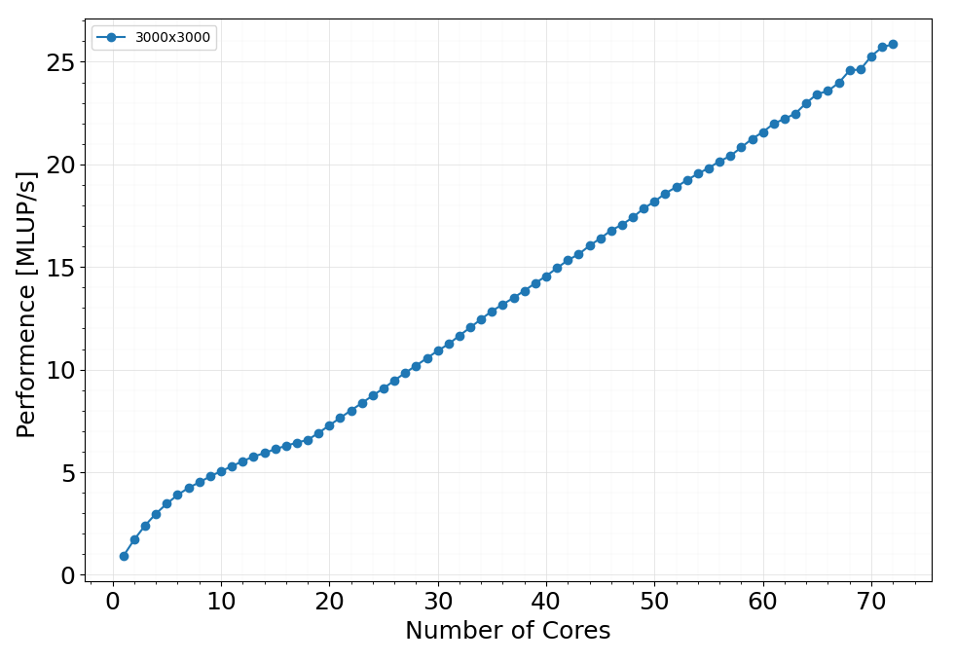
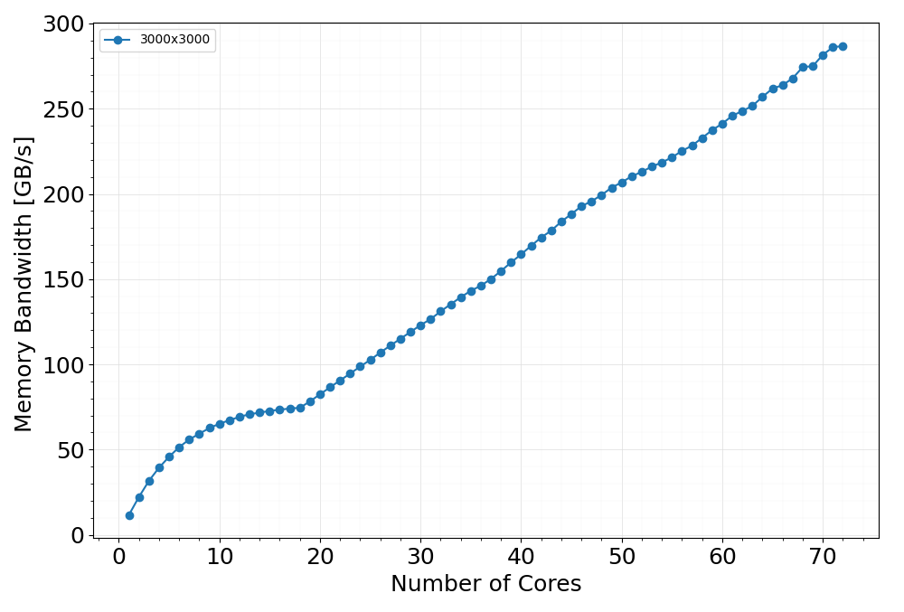
Strong scaling.
Better strong scaling results compared to phase 01
Performance saturation in 1st NUMA domain.
Maximum performance of ~26 MLUP/S with using full node.
Figure 7: Performance measurements in one node at 2.4 GHz
Memory Bandwidth also saturates in 1st NUMA domain. (74.5 GB/s).
single core performance is ~2x compared to phase 01.
Figure 8: Memory bandwidth measurements in one node at 2.4 GHz

Slide 7
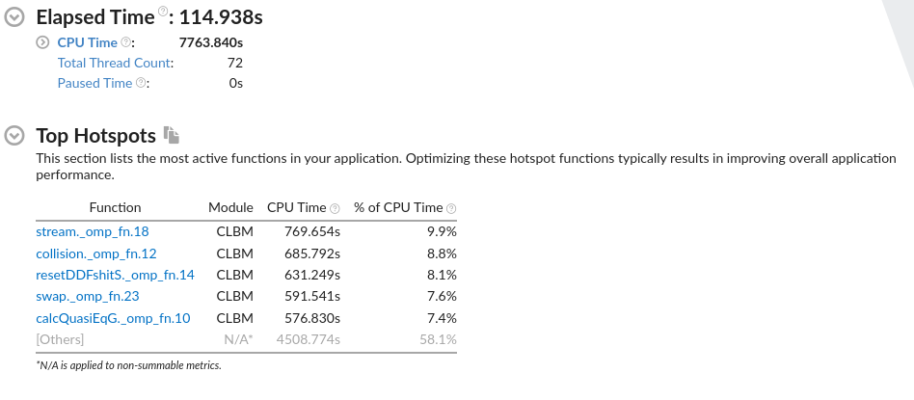
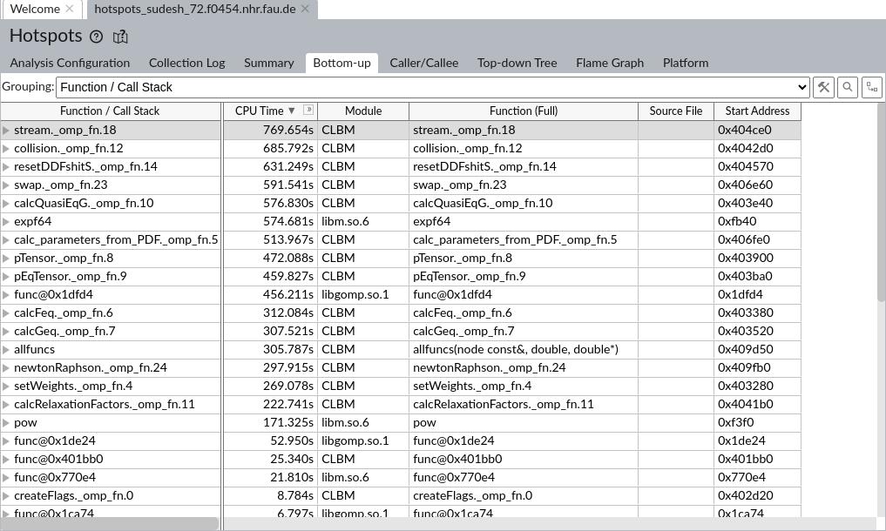
Profiling
Focused kernels considering energy measurements
Stream
Collision
calcQuasiEqG
newtonRaphson
Figure 9: Vtune Hotspot results.
Now the stream and collision kernels plays a critical role as in standard LBM schemes.
According to literature there was a strong focus for the root finding scheme considering compressible LBM performance [4].
Figure 10: Vtune call stack

Slide 8
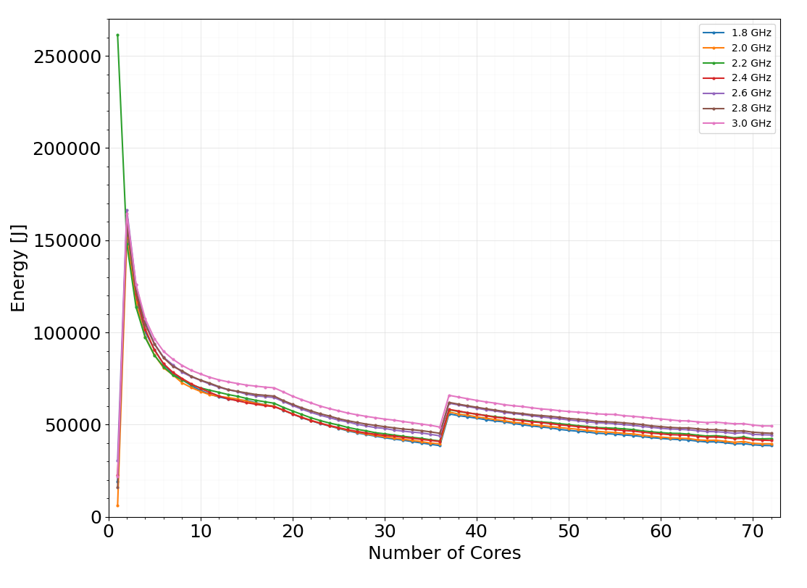
Energy and power measurements; main
An unusual behaviour can be observed at single core power measurment.
This behaviour persists for serveral data samples
However, for 2.2 GHz the intended energy measurements can be obtained.
The energy values have a saturating optimum point at 1st NUMA domain before it reaches second optimum point at 1st socket.
Sudden energy jump when moving to second socket before decrase in a quite linear fashion in second socket.
The frequencies (GHz) 1.8, 2.0, 2.2 and 2.4 shows the lowest CPU energy measurements in first socket.
Figure 10: Energy measurements in one node

Slide 9
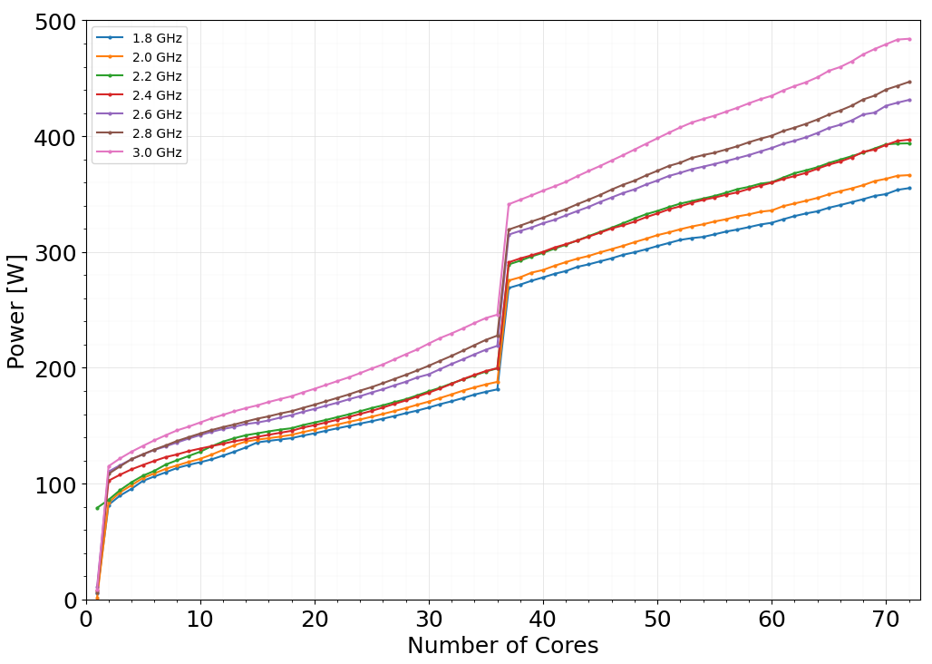
Energy and power measurements; main
An unusual behaviour also can be observed at first core power measurment.
LIKWID-POWERMETER also produced the same results.
Sudden power jump when moving to second socket.
Figure 10: Power measurements in one node

Slide 10
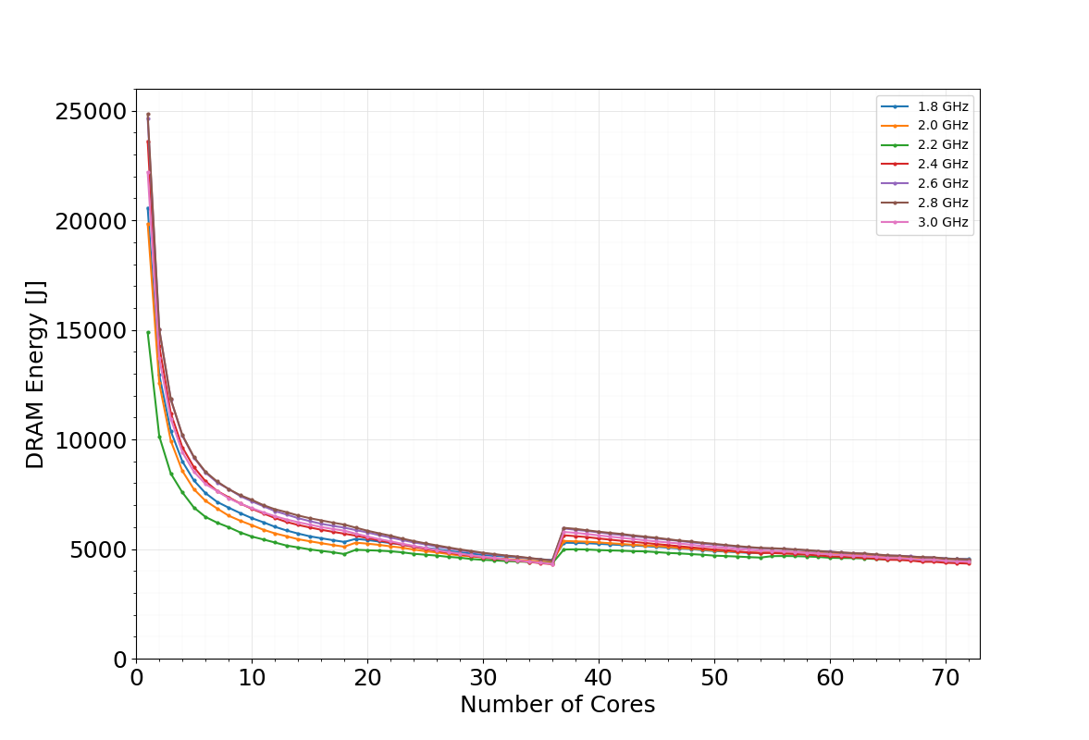
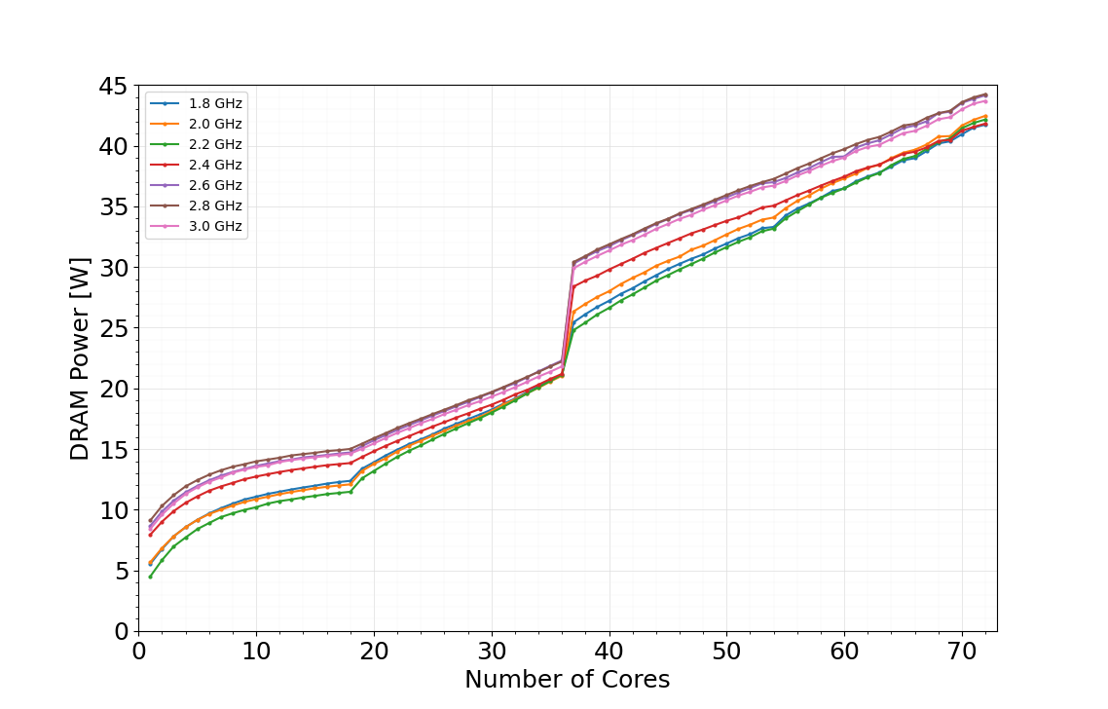
Energy and power measurements; main
DRAM energy measurements do not show an unexpected behaviour at single core measurements all the time.
2.2 GHz seems to be the lowset energy curve for a wider domain.
The DRAM energy contribution to the total energy is in the range of 5%-11%.
Figure 11: DRAM Energy measurements in one node
First NUMA domain there is a saturating trend considering DRAM power.
Figure 11: DRAM Power measurements in one node

Slide 11
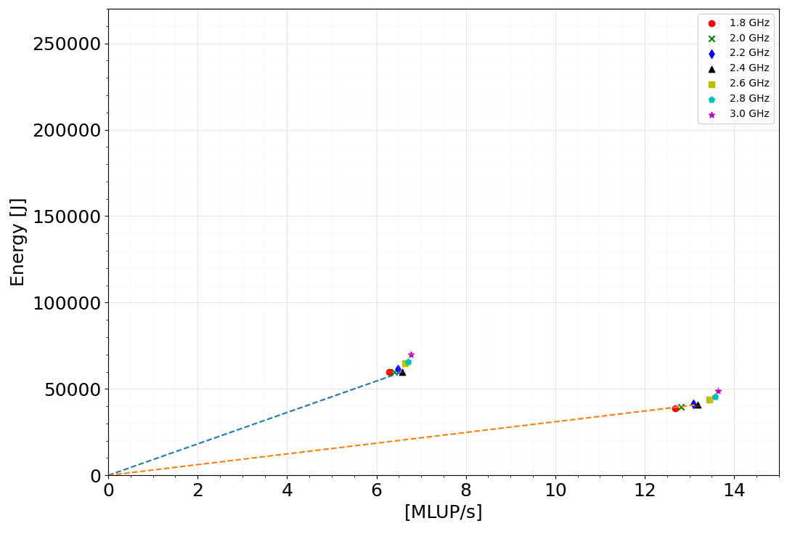
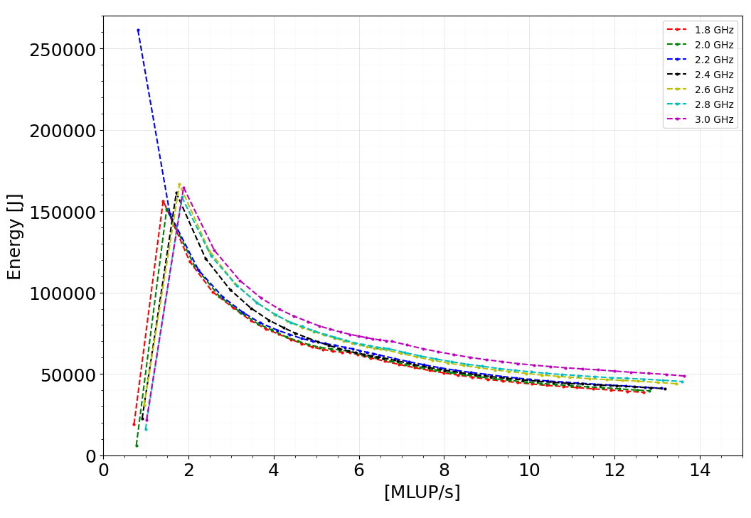
Energy Delay Product(EDP)
Z-plot considers dissipated energy versus any suitable performance metric for a given program[5][6].
EDP is the gradient of a line passing through in z-plot.
First socket measurements is taken for the Z-plot.
9093.62 Js/MLUP
3104.28 Js/MLUP
Figure 12: EDP related to 18 and 36 cores at 2.4 GHz
This verifies the earlier point relating energy with first four frequencies.
Figure 11: Z-plot considering one socket.

Slide 12
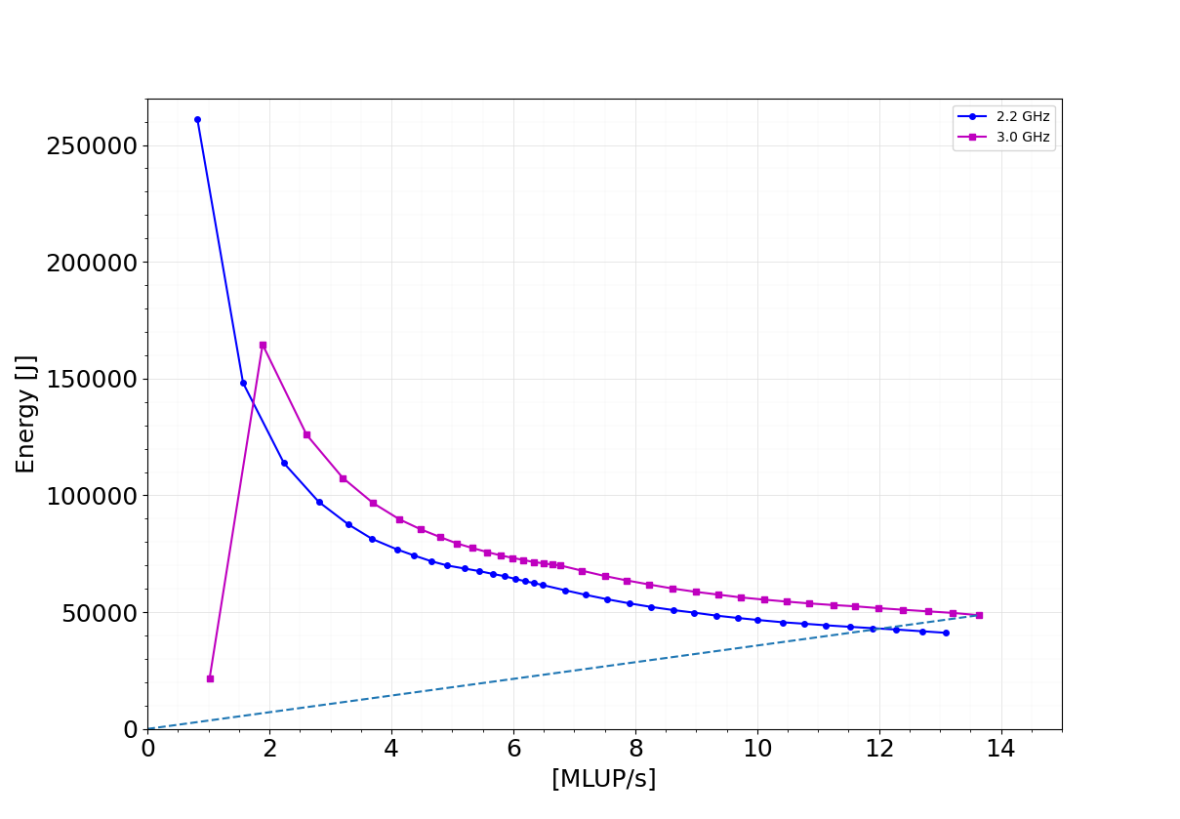
Energy Delay Product(EDP)...
With EDP the trade of between energy and performance can be discribed.
Considering EDP it is vissible that
33 cores @ 2.2 GHz have the same energy efficiency as the 36 cores @ 3.0 GHz.
But, performance wise it loose nearly 10%.
3570.48 Js/MLUP
Figure 11: Energy and performance trae-off

Slide 13
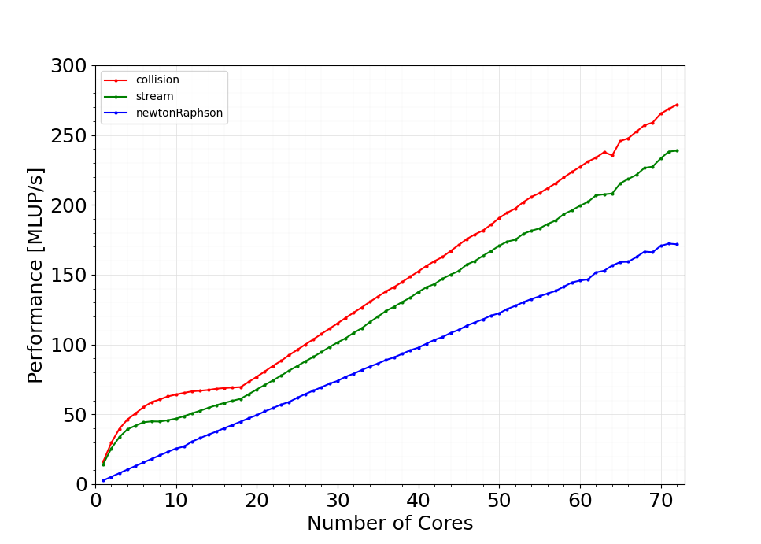
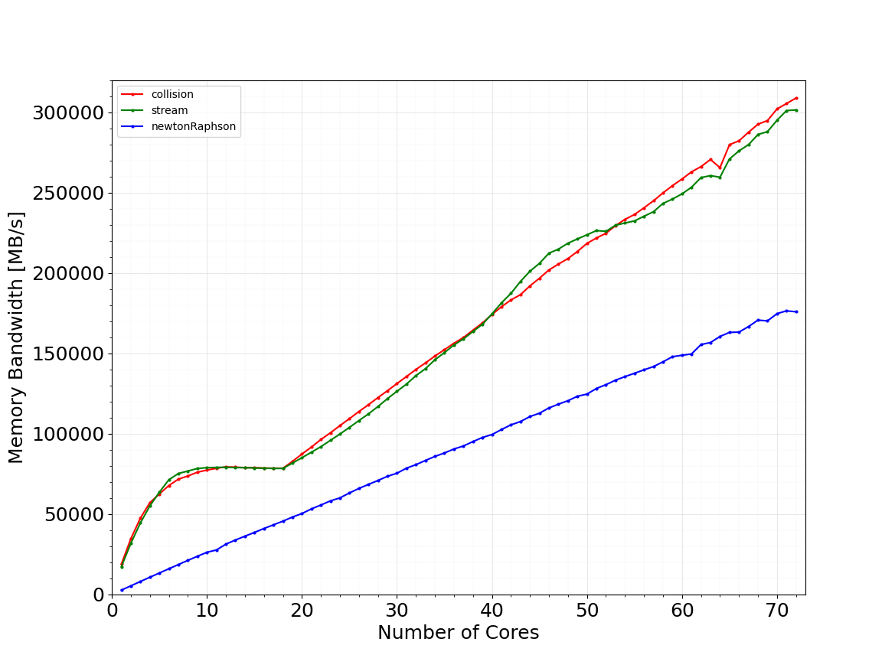
Hotspot measurements
Considered the stream, coliision and newtonRaphson kernels.
Observed the performance, memory bandwidth saturations and energy contributions.
Figure 11: Performance vs. core count
Figure 11: Memory bandwidth vs. core count
newtonRaphson kernel does not show any saturation in full node.
collision and streaming shows the sathrating trend inside the first NUMA doamin.

Slide 14
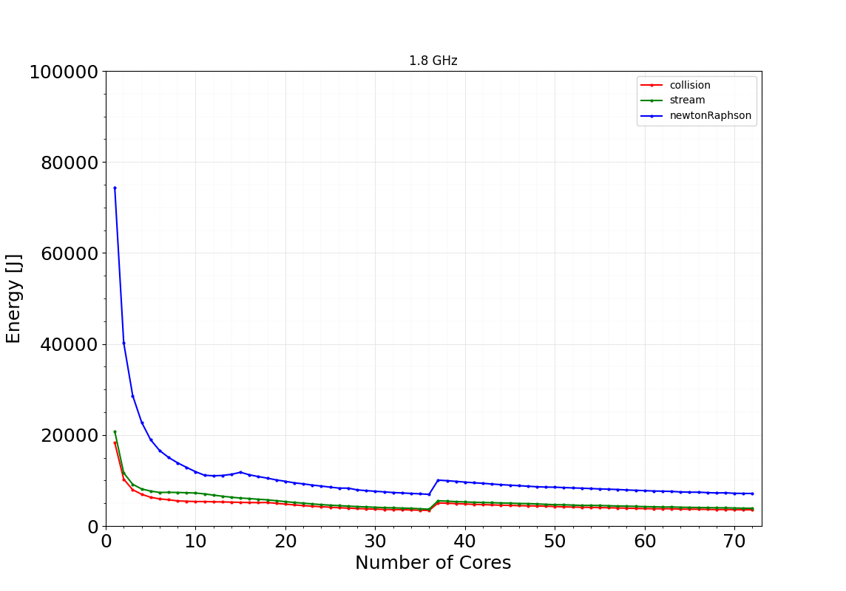
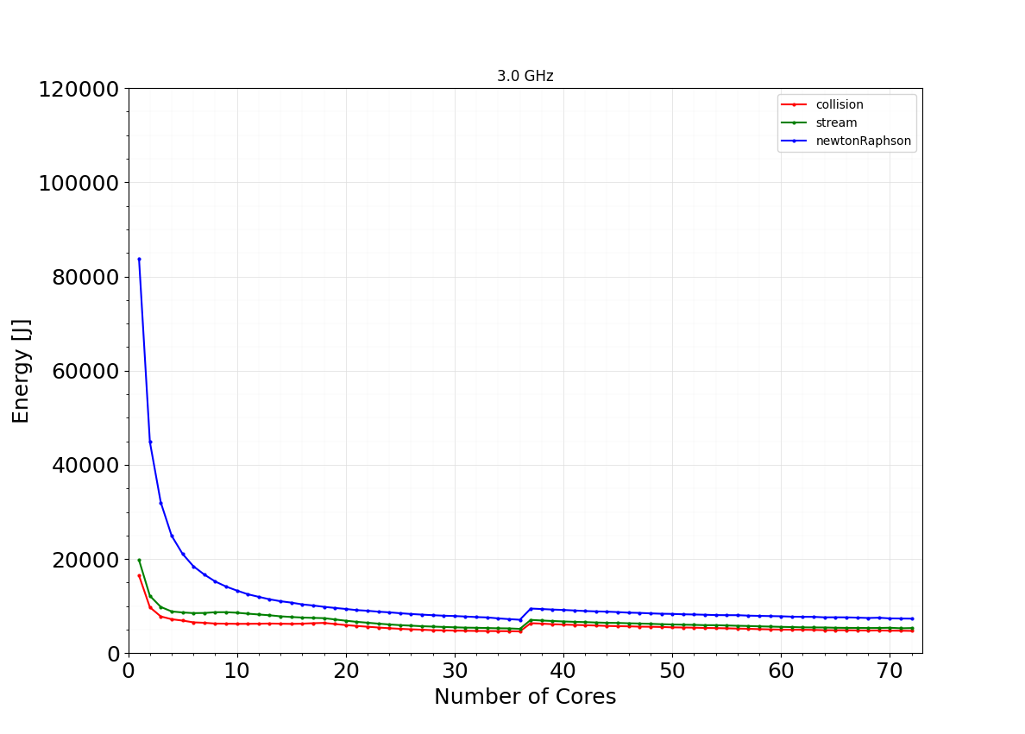
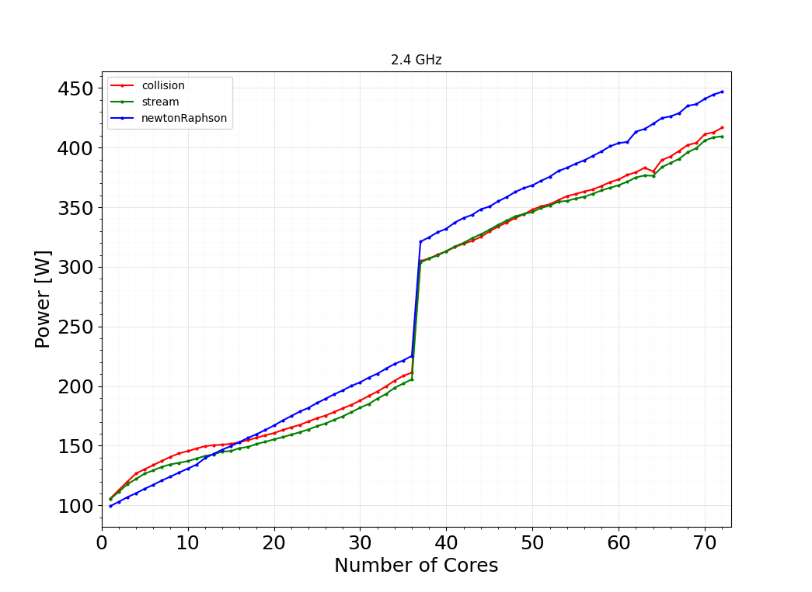
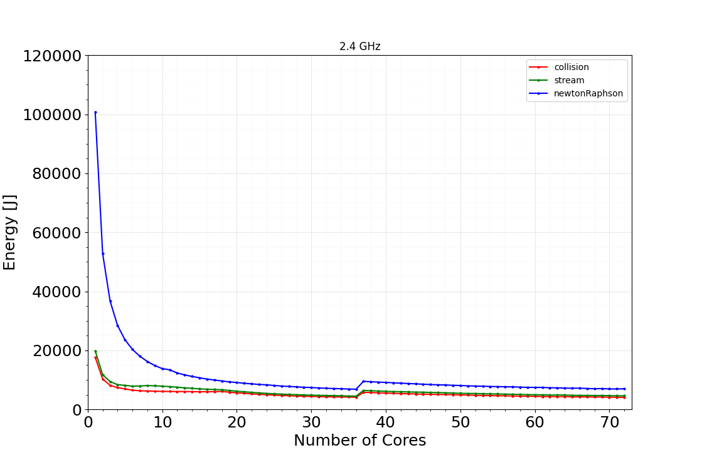
Hotspot measurements...
The previously observed, unexpected measurement point at single cores does not appear in energy plots .
Figure 11: Energy vs. core count
Figure 11:Power vs. core count
All three kernels contributes 9% - 16% to the main energy measurements.
newtonRaphson has the highest contribution while showing a scalable performance within the node.
Bothe the highest hotspot ranks seems to be have similiar variation in terms of power and energy.

Slide 15
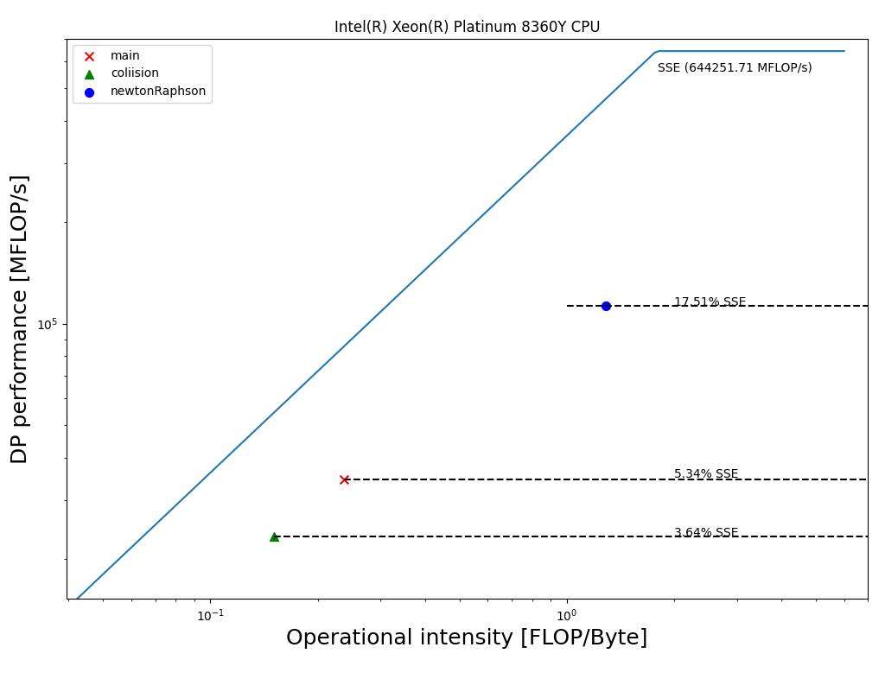
Roofline modelling
LIKWID-bench tool is utilized to construct the
empherical roofline diagram [7].
Maximum performance is related to the SSE FLOPS.
Maximum data throughput is related to the likwid-bench load_sse
Here the performance metric is double precision performance.
Stream kernal does not have any flops.
CLBM application is close to memory bound.
Figure 11: Roofline diagram.

Slide 16
Remarks.
This is the first kind of benchmarking effort considering LBM in compressible supersonic flow.
CLBM 2D test application shows scalable performance.
Solver is close to memory bound.
Optimal energy can be observed at the first socket in fritz node considering 1.8 GHz, 2.0 GHz, 2.2 GHz and 2.4 GHz
EDP results verified the point above.
DRAM energy contribution to the total energy is 5%-11%.
Investigation of optimal energy point for the present implementation.
According to the roofline analysis the application has arbitrary horizontal roofs.
Thers is more room for code optimization.
Root finding scheme has less significance interms of performance, even though root finding algorithm was the highlight in previous literature regarding , this LBM regime.

Slide 17
Reference
The Landscape of Parallel Computing Research A View from Berkeley, 2006 Electrical Engineering and Computer Sciences, University of California at Berkeley, Electrical Engineering and Computer Sciences, University of California at Berkeley,
A. A. Mohamad. Lattice Boltzmann Method Fundamentals and Engineering Applications with Computer Codes. Springer, 2019
Timm Krüger, Halim Kusumaatmaja, Alexandr Kuzmin, Orest Shardt, Goncalo Silva, and Erlend Magnus Viggen. The Lattice Boltzmann Method. Springer International Publishing, 2017.
Jonas Latt, Christophe Coreixas, Joël Beny, and Andrea Parmigiani. Efficient supersonic flow simulations using lattice boltzmann methods based on numerical equilibria. Philosoph_x0002_ical Transactions of the Royal Society A:Mathematical, Physical and Engineering Sciences,378(2175):20190559, jun 2020.
https://blogs.fau.de/hager/archives/tag/energy
Ayesha Afzal,Georg Hager,Gerhard Wellein,SPEChpc 2021 Benchmarks on Ice Lake and Sapphire Rapids Infiniband Clusters: A Performance and Energy Case Study, SC-W '23: Proceedings of the SC '23 Workshops of The International Conference on High Performance Computing, Network, Storage, and Analysis,November 2023, Pages 245–1254, https://doi.org/10.1145/3624062.3624197
https://github.com/RRZE-HPC/likwid/wiki/Tutorial:-Empirical-Roofline-Model

