Slide 1

COMPRESSIBLE LATTICE BOLTZMANN SOLVER CPU BENCHMARK
MuCoSim WS 2023/24
PHASE: 1
Sudesh Rathnayake

Slide 2
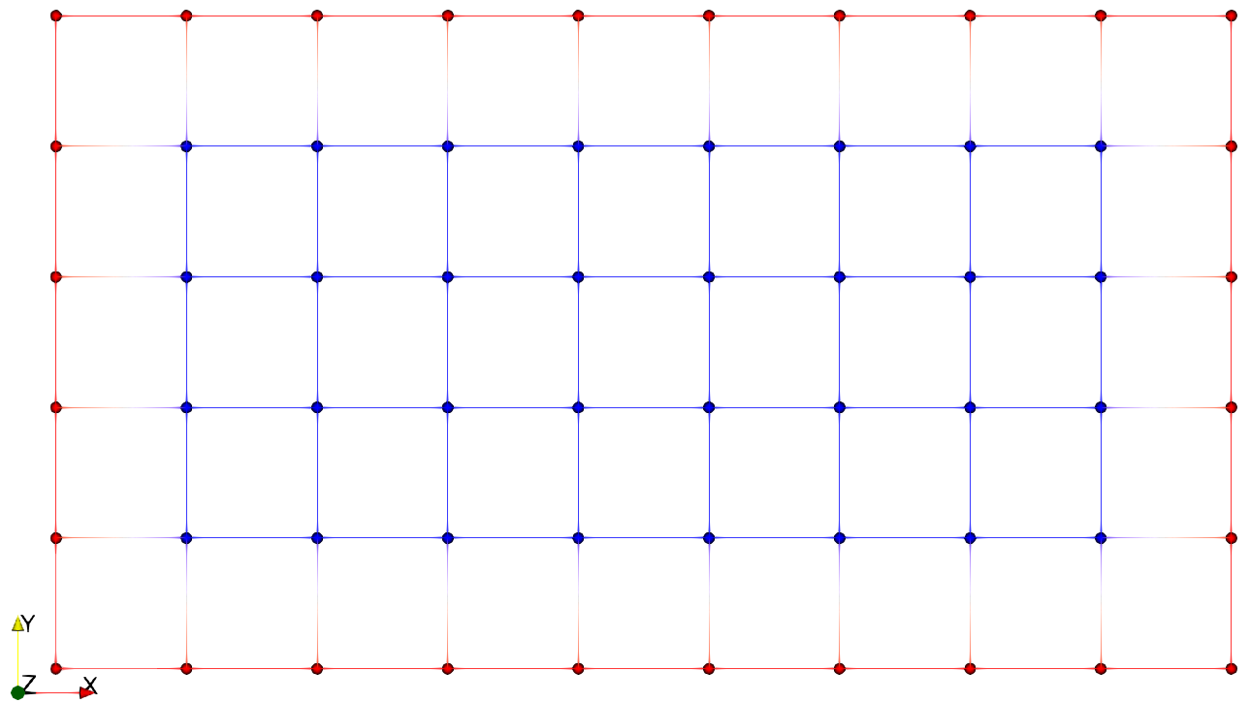
Introduction
Performance analysis of a OpenMP parallelize compressible lattice Boltzmann solver.
Dwarfs “Capture a pattern of computation and communication common to a class of important applications”[1]
Seven Dwarfs
Dense Linear Algebra.
Sparse Linear Algebra.
Spectral Methods.
N-Body Methods.
Structured Grids.
Unstructured Grids.
Monte Carlo.
Lattice Boltzmann Method(LBM) Commonly, LBM adopt a structured grid in practice.
Figure 1: Exemplary structured grid
“Represented by a regular grid; points on grid are conceptually updated together. It has high spatial locality”’[1]

Slide 3
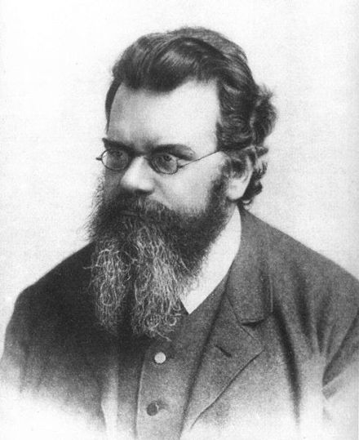
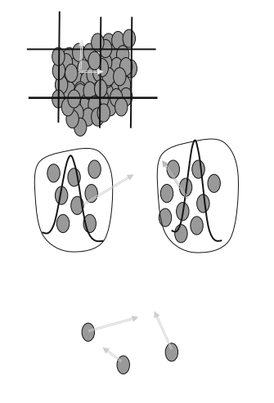
Lattice Boltzmann Method: Overview
1.Continuum
2.Discrete
Two main approaches to simulate transport equations
The numerical scheme for the Boltzmann equation ,
Quite simple, both to implement and to parallelize. (hyperbolic
equation with force free formulation)
Easy to apply.
For complex domains,
Easy to treat multi-phase and multi-component flows.
Naturally adapted to parallel processes computing. [3]
No need to solve Laplace equation at each time step as in FVM.
Macroscopic
(FVM,FEM)
Mesoscopic
(LBM)
Microscopic
(MD)
Figure02:Different scales in simulation.[2]

Slide 4
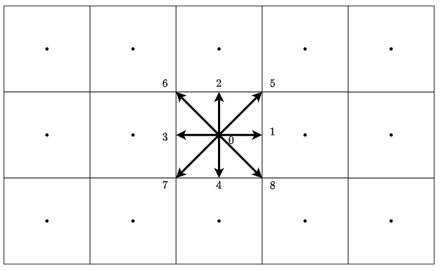
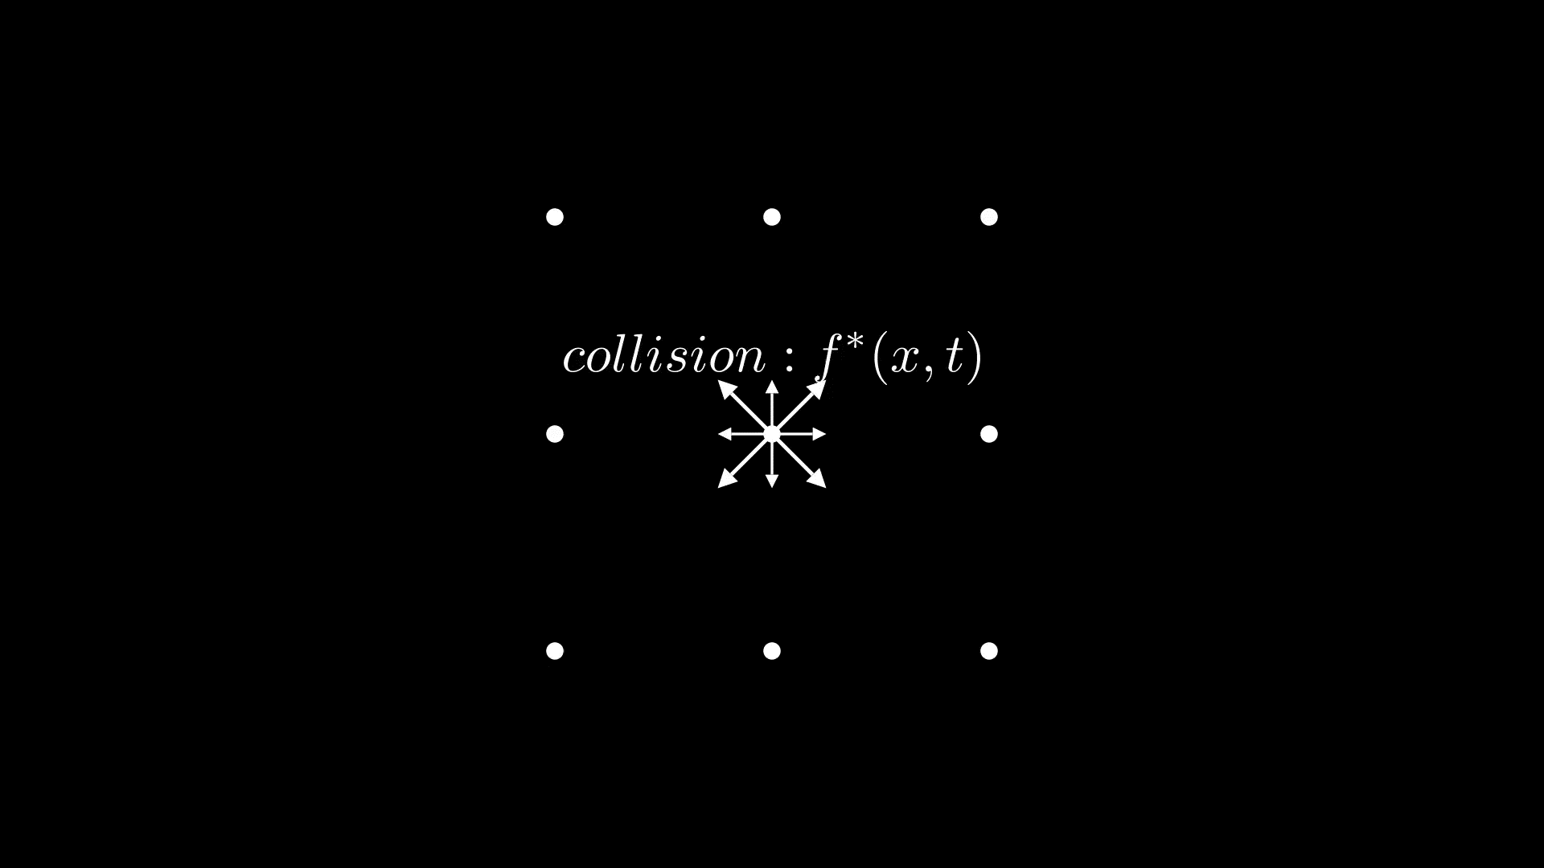
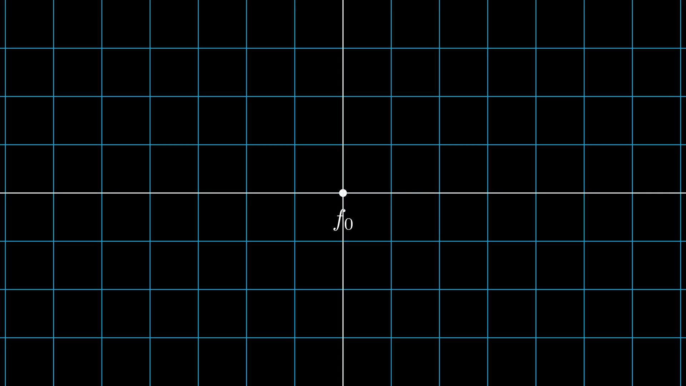


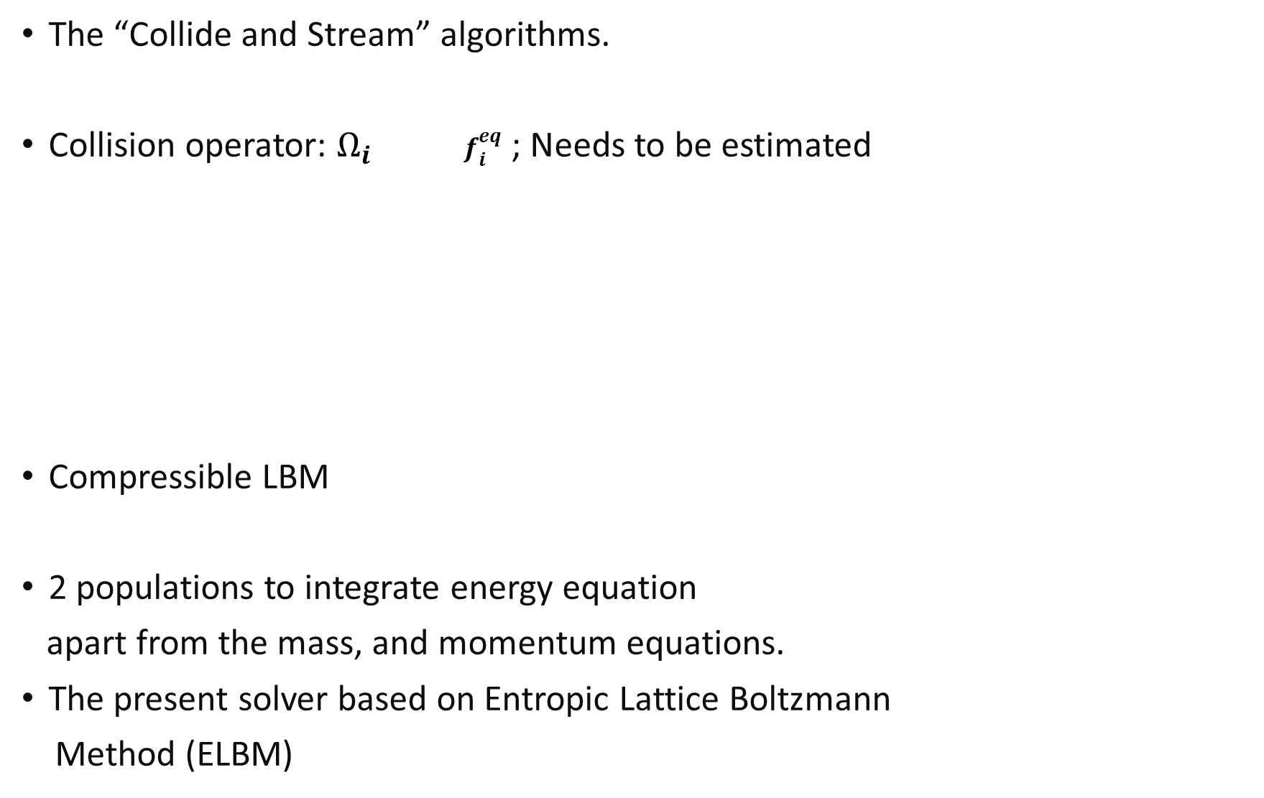
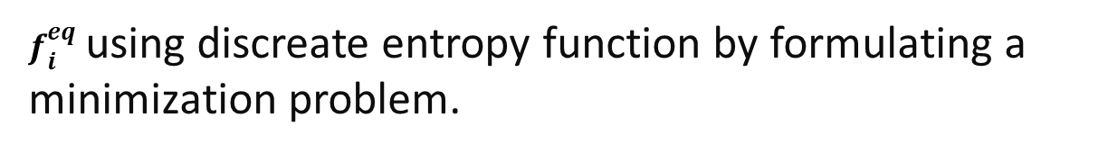
The “Collide and Stream” algorithms.
Collision operator: $Ω_{i}$ $f_{i}^{eq}$ ; Needs to be estimated
Compressible LBM
2 populations to integrate energy equation
apart from the mass, and momentum equations.
The present solver based on Entropic Lattice Boltzmann
Method (ELBM)
$$f_{i}^{∗}(x,t)=f_{i}\left(x,t\right)+ Ω_{i}(x,t)$$
$$f_{i}\left(x+c_{i}∆t, t+∆t\right)=f_{i}^{∗}(x,t)$$
Figure 03:Lattice with D2Q9 stencil
Beauty, yet a weakness, of the LBM lies in its explicitness and uniform grid.
Widely used for simulating incompressible fluid flows
Figure 04: Collide and Stream
$f_{i}^{eq}$ using discreate entropy function by formulating a
minimization problem.
Figure 05: f and g populations in a lattice node

Slide 5
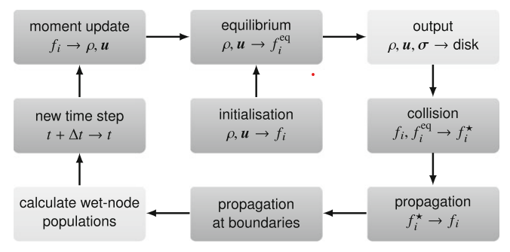
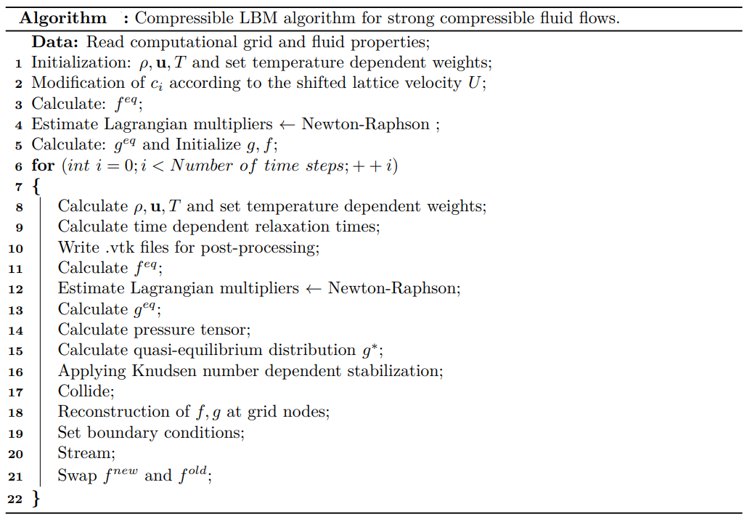
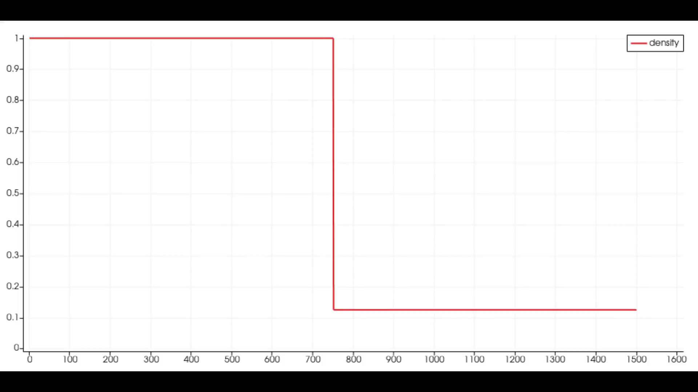
CLBM: Algorithm
Figure 06: Standard LBM algorithm.[3]
Figure 07: CLBM algorithm
Solver is based on C++ and OpenMP.
Build using CMake.
Input parameter file defines the simulation properties.
For initial benchmarking and profiling, a 2D shock tube simulation is considered.
Figure 08: Results for density variation of air inside a 2D shock tube using CLBM solver
git@gitlab.cs.fau.de:yh54ojyn/mucosim.git

Slide 6
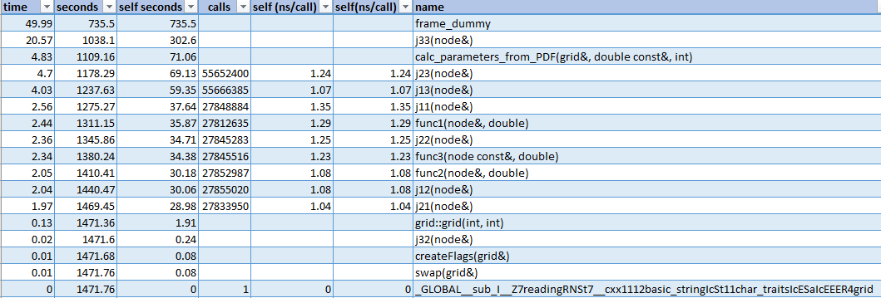
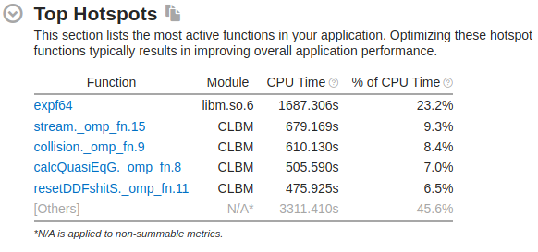
CLBM runtime profile
CPU name: Intel Xeon Platinum 8360Y CPU @ 2.40GHz
CPU type : Intel Icelake SP processor
Number of lattice nodes: 2000 x 2000= 4000000 Lattice nodes.
Compiler: g++
Compiler Directives: -O3 –pg –march=native –mavx –ftree-vectorize
A runtime profile in “Fritz”.
Initially use gprof for the profiling.
Vtune is preferred; much more insights.
Required modules:
gsl (GNU scientific library)
Cmake
vtune
Figure09: gprof hotspot results.
Figure10: Vtune hotspot results.

Slide 7
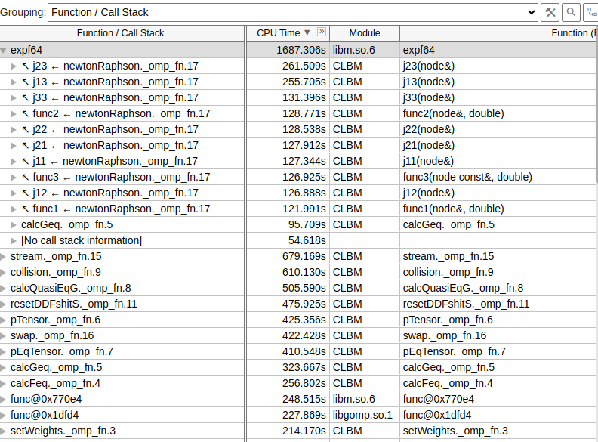
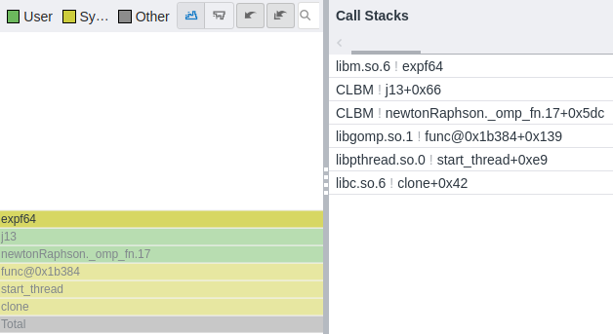
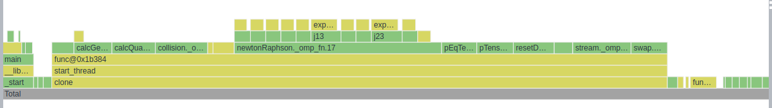
CLBM runtime profile
High OpenMP overhead is observed for small data set.
The newtonRaphson function is the most critical one in CLBM function.
On top of that the calculation of exponential function using math.h library is critical.
Figure10: Vtune hotspot results.
Figure09: Vtune hotspot flame graph.

Slide 8
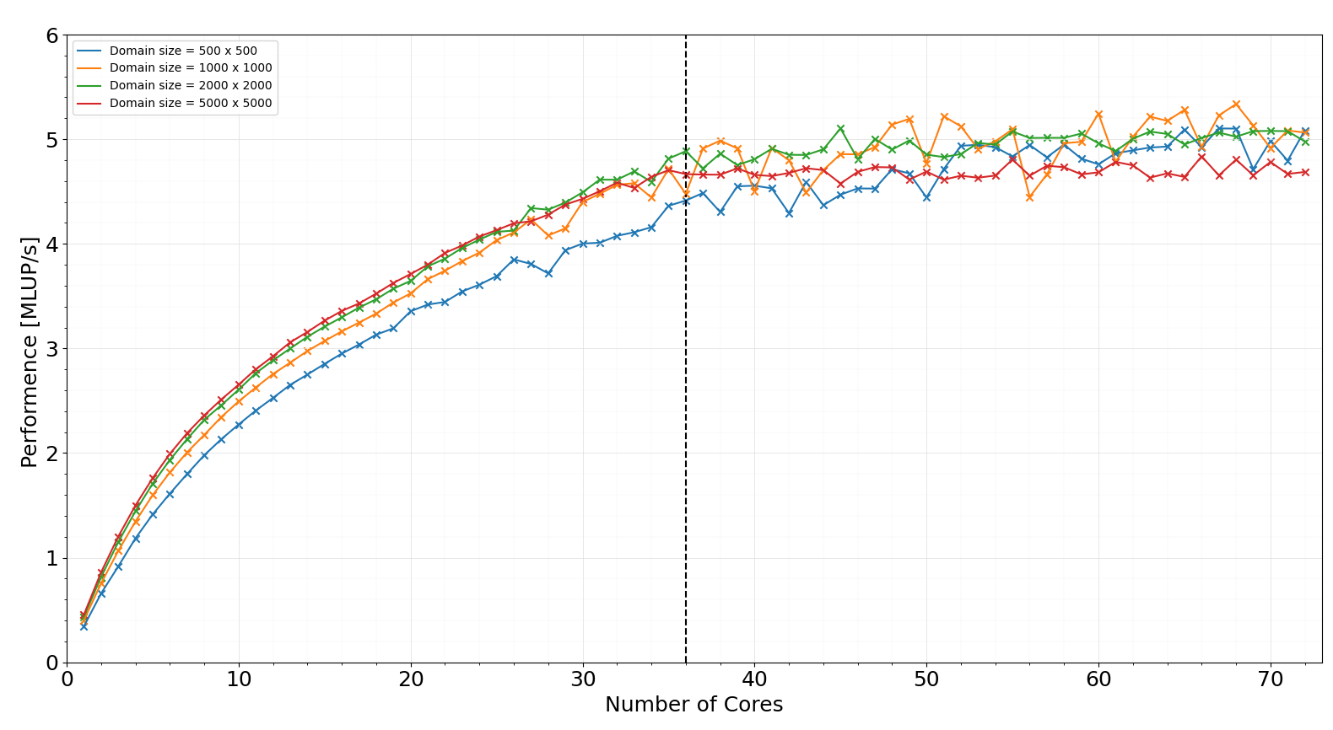
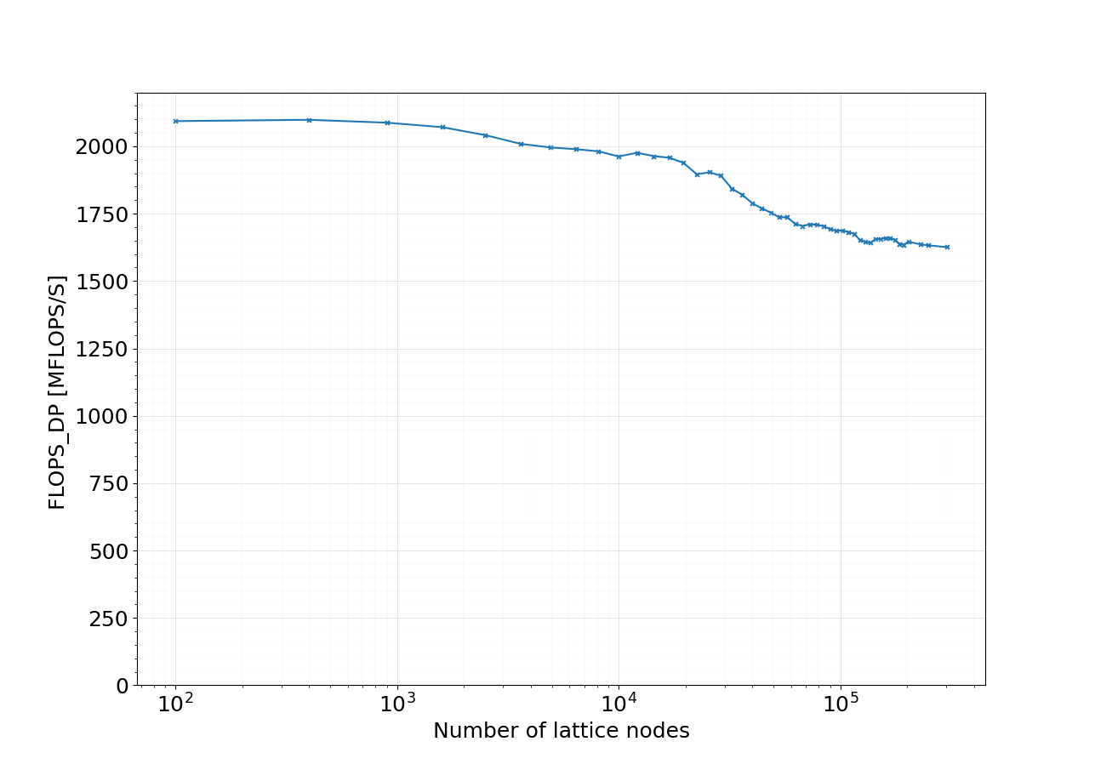
Strong scaling
CPU name: Intel Xeon Platinum 8360Y CPU @ 2.40GHz
CPU type : Intel Icelake SP processor
Compiler: g++
Compiler Directives: -O3 –march=native –mavx –ftree-vectorize
S0
S1
500 x 500 domain size does not have performance saturation.
According to single core performance it fits to L3 cache.
Figure10: Performance saturation in one node.
2000 x 2000 elements seems to be good starting point for measurements.
Figure 11: single core performance for fixed 2.4GHz.

Slide 9
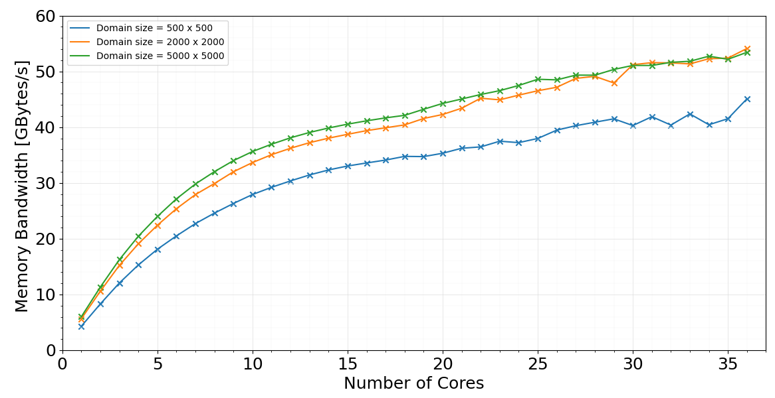
Memory bandwidth
CPU name: Intel Xeon Platinum 8360Y CPU @ 2.40GHz
CPU type : Intel Icelake SP processor
Compiler: g++
Compiler Directives: -O3 –march=native –mavx –ftree-vectorize
Total memory bandwidth has a saturating trend in 1st NUMA domain.
Generally, LBM solvers are known to be memory bound.[3]
Figure12: Memory bandwidth saturation in first socket.

Slide 10
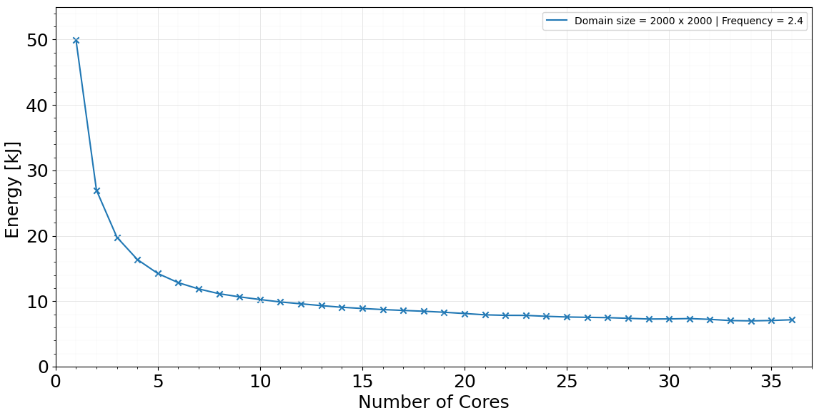
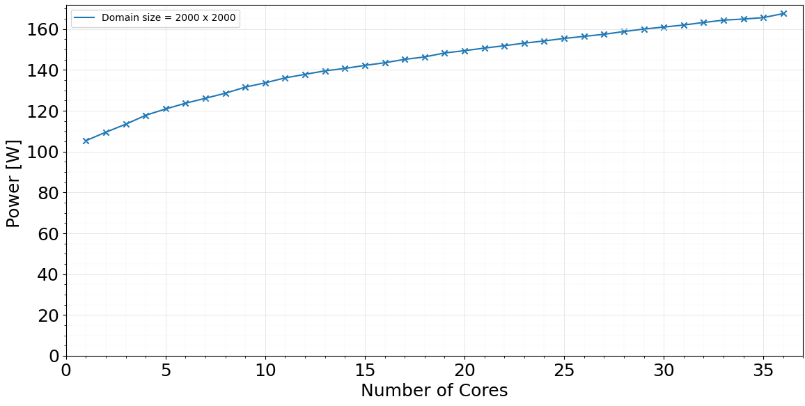
Energy and power
CPU name: Intel Xeon Platinum 8360Y CPU @ 2.40GHz
CPU type : Intel Icelake SP processor
Compiler: g++
Compiler Directives: -O3 –march=native –mavx –ftree-vectorize
Figure13: Energy variation in first socket.
Total energy decreases with increasing core count.
Power increase with increasing core count.
Figure14: Power variation in first socket.

Slide 11
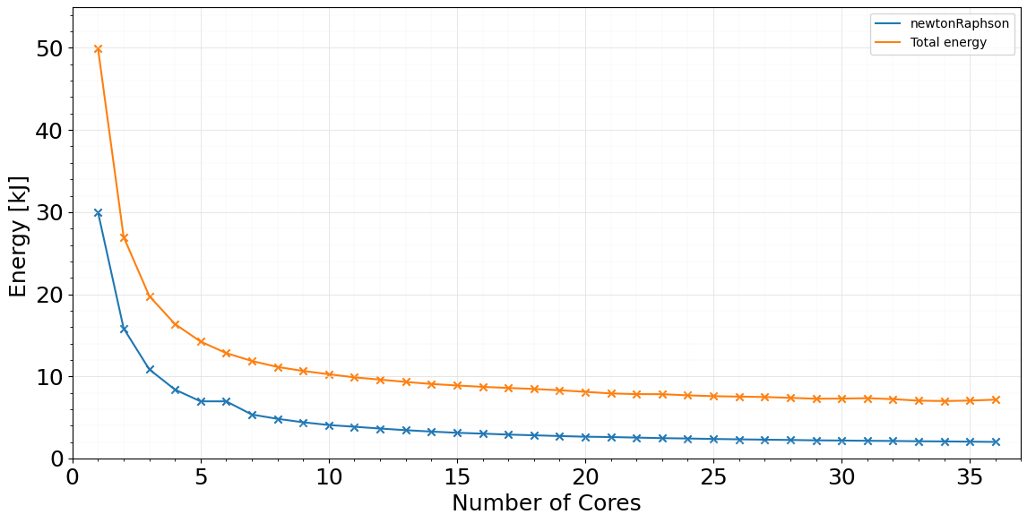
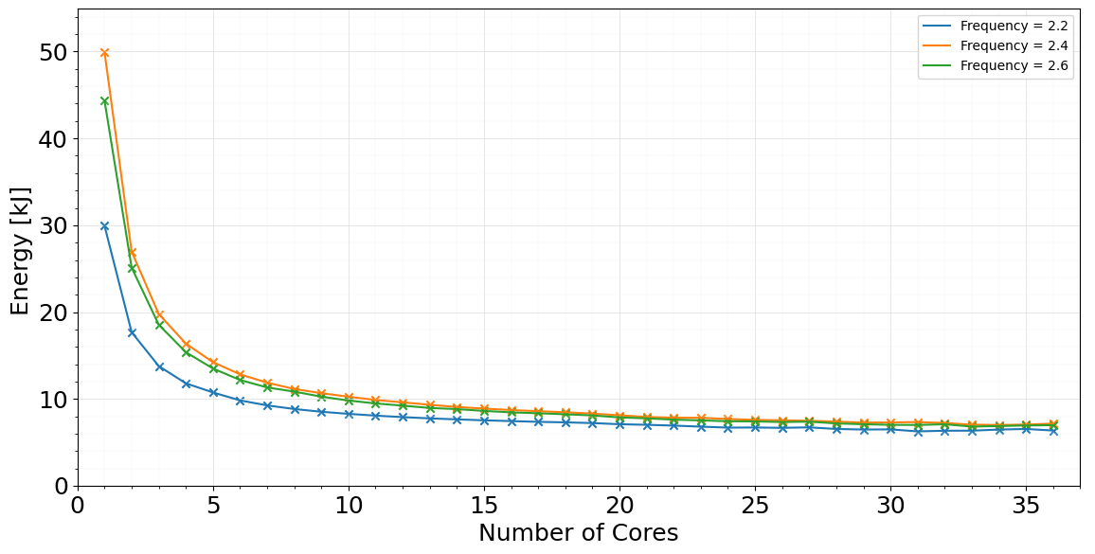
More on energy
Even with the increasing frequencies total energy curves tend to meet at 36 core count.
newtonRaphson function also has the same trend as the total energy.
Figure15: Total energy for 2.4 GHz vs energy taken for the newtonRaphson function.
Figure16: Total energy variation for different frequencies for domain size of 2000 x 2000

Slide 12
Remarks and TODOs
High OpenMP overhead can be observed according to the profiling results.
Newton Raphson function is the most critical function in CLBM solver.
According to the physics number of newton Raphson iteration not unique in each domain sizes.
Solver is memory bound.
Need to focus on parallelization.
Experiments with OpenMP scheduling
Barrier effect.
Investigation of memory bandwidth in entire node.
Investigation of the effect of different compilers.
Benchmarking of 3D application.
Investigation of optimal energy point for the present implementation.

Slide 13
Reference
The Landscape of Parallel Computing Research A View from Berkeley, 2006 Electrical Engineering and Computer Sciences, University of California at Berkeley, Electrical Engineering and Computer Sciences, University of California at Berkeley,
A. A. Mohamad. Lattice Boltzmann Method Fundamentals and Engineering Applications with Computer Codes. Springer, 2019
Timm Krüger, Halim Kusumaatmaja, Alexandr Kuzmin, Orest Shardt, Goncalo Silva, and Erlend Magnus Viggen. The Lattice Boltzmann Method. Springer International Publishing, 2017.

