Slide 1

COMPRESSIBLE LATTICE BOLTZMANN SOLVER CPU BENCHMARK
MuCoSim WS 2023/24
PHASE: 2
Sudesh Rathnayake
Advisor: Dane Lacey
Notes:
application is in LBM in the context of compressible supersonic flows
developed my be
all the benchmark analysis are considering

Slide 2
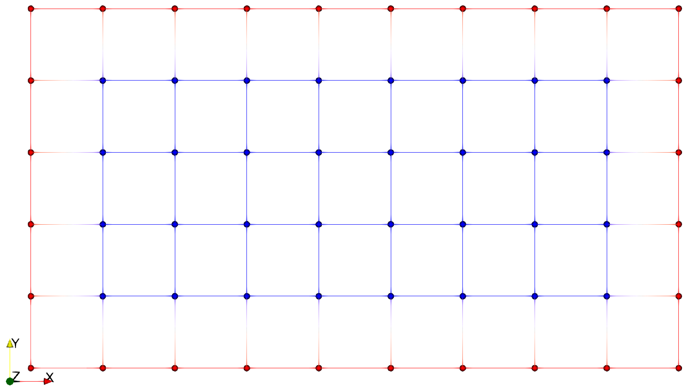
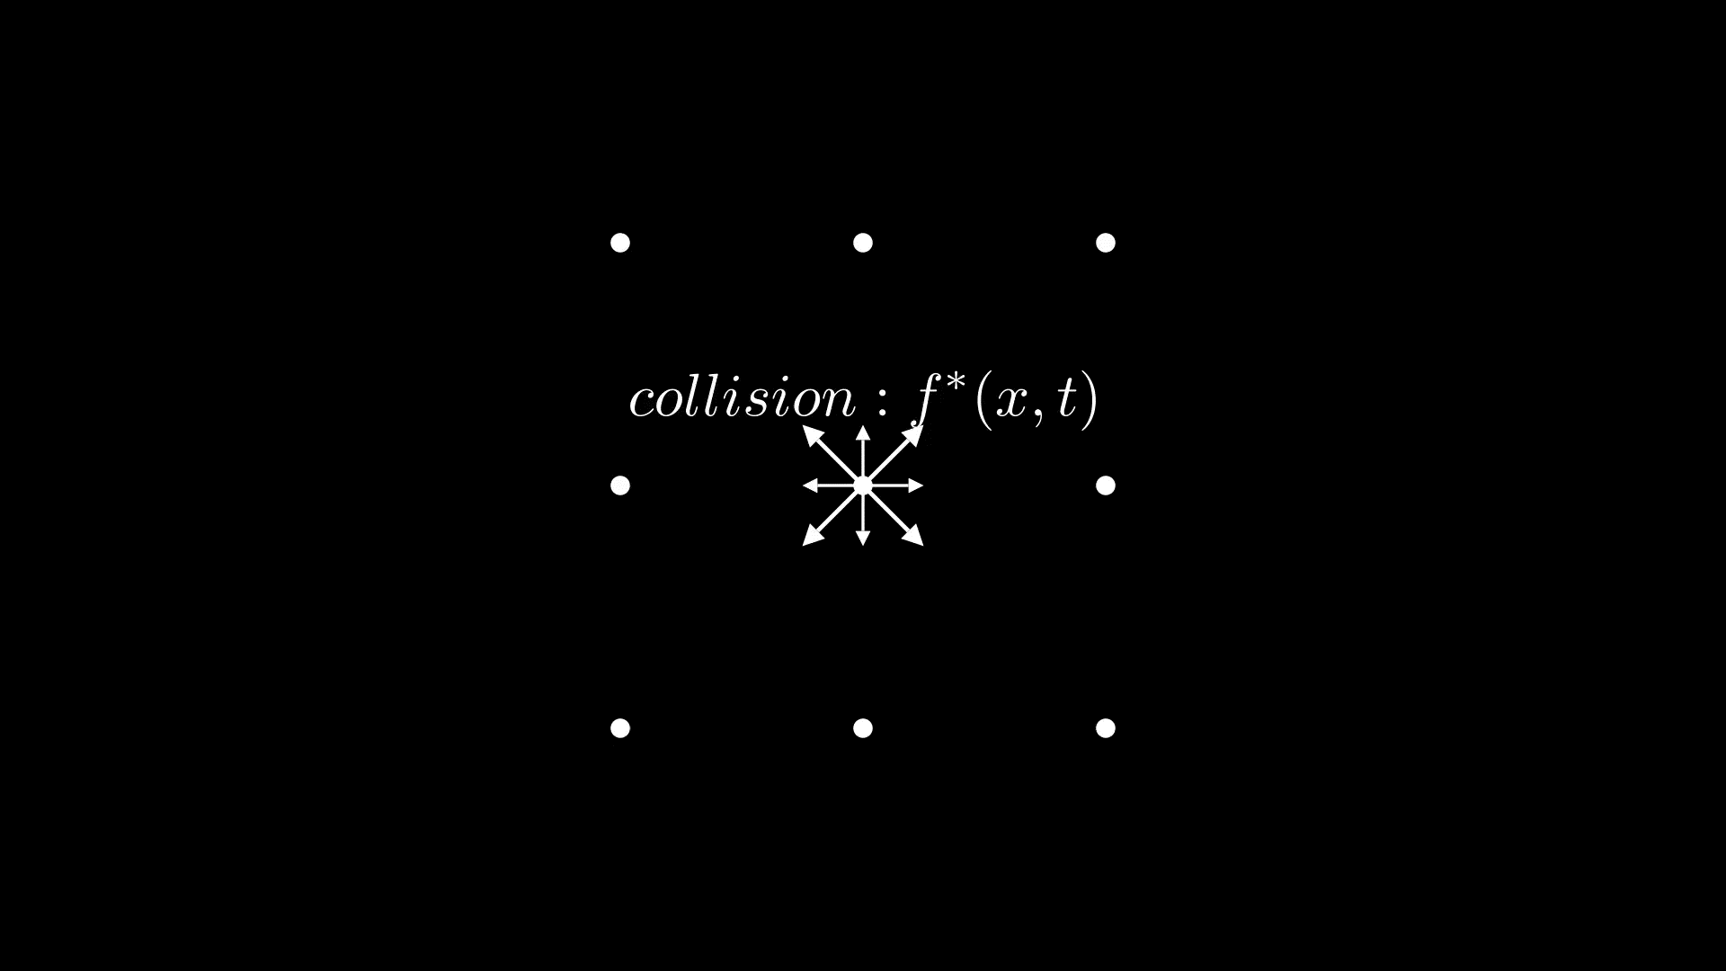
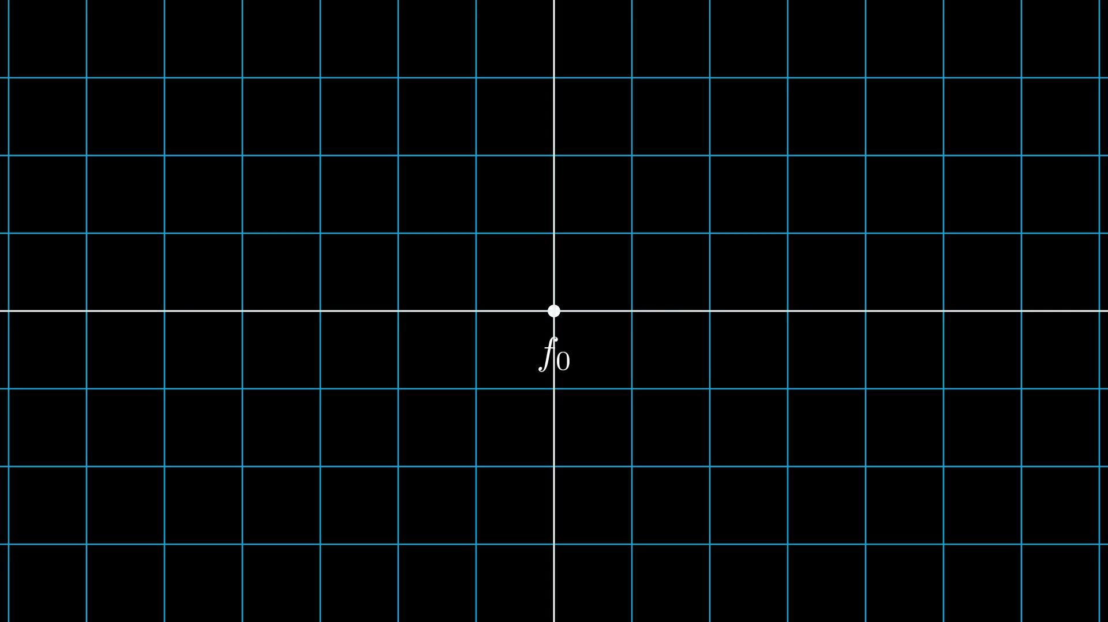


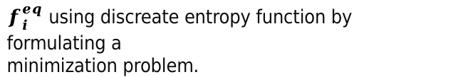
Introduction: Summary
Lattice Boltzmann Method(LBM) commonly adopt a structured grid in practice.
Naturally adapted to parallel processes computing. [3].
The “Collide and Stream” algorithms.
Compressible LBM
2 pdfs’ to integrate energy equation apart from the mass, and momentum equations.
The present solver based on Entropic Lattice Boltzmann Method (ELBM)
“Represented by a regular grid; points on grid are conceptually updated together. It has high spatial locality”’[1]
Figure 1: Exemplary structured grid
$$f_{i}^{∗}(x,t)=f_{i}\left(x,t\right)+ Ω_{i}(x,t)$$
$$f_{i}\left(x+c_{i}∆t, t+∆t\right)=f_{i}^{∗}(x,t)$$
$f_{i}^{eq}$ using discreate entropy function by formulating a
minimization problem.
Figure 02: Collide and Stream
Figure 03: f and g populations in a lattice node
git@gitlab.cs.fau.de:yh54ojyn/mucosim.git
Notes:
summarize the outcomes from phase 1
LBM >>> commonly utilized structured grid>>high spatial locality as mentioned in seven warf doc
fdr popoluer among hpc community due to the parallalizbility
2 main working horses
but here 2 pdf instead 1 and use minimization techniques to find some pdfs

Slide 3
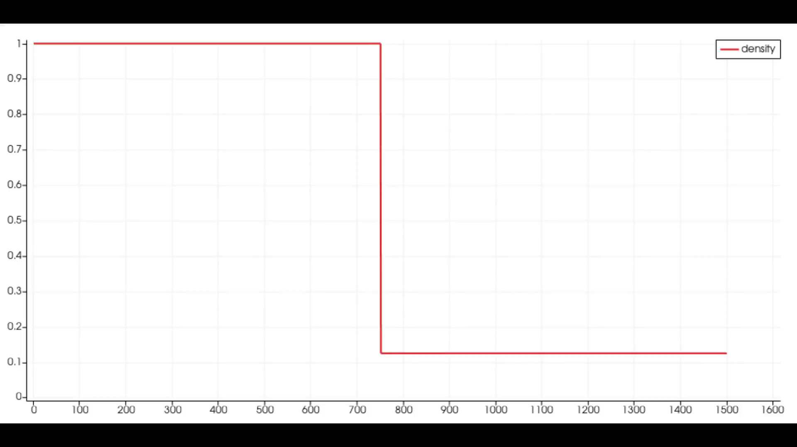
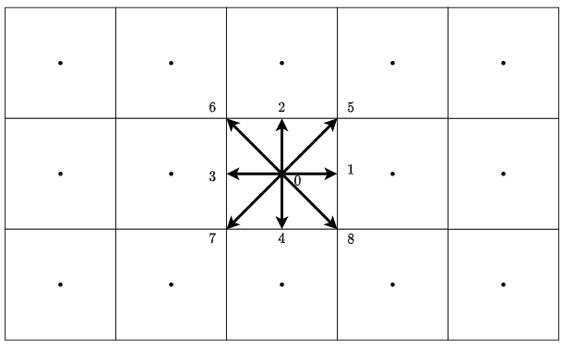
Test system & CLBM solver
Algorithm
Solver is based on C++ with OpenMP and build using Cmake 3.23.1.
Input parameter file defines the simulation properties.
For benchmarking, a 2D shock tube simulation is considered.
Stencil configuration : D2Q9 (D2Q9 X 2 in one LB node);
Domain size : 3000 x 3000 lattice nodes
Figure 05: Results for density variation of air inside a 2D shock tube using CLBM solver
Test system
Name | Fritz
Processor | Intel Xeon Platinum 8360Y
Micro architecture | Icelake
Frequency [GHz] | 2.4
Cores | 72
Sockets | 2 (No SMT)
NUMA domains | 4
Main memory [GB] | 256
Thermal design power [W] | 250
Tools
LIKWID version : 5.3.0
LIKWID flags : likwid-perfctr -g MEM/ENERGY/MEM_DP
: likwid-topology
Figure 04:Lattice with D2Q9 stencil
Compiler
GNU g++
compiler flags : -O3 –march=native –mavx –ftree-vectorize
Notes:
developed by using c++ and openmp build using cmake
here, a 2d shock tube simulation is simulate and all the parameters can be fed using seperate input file
I use likwid >> relevent parametes >> initially mem and energy but then mem_dp give all in one go

Slide 4
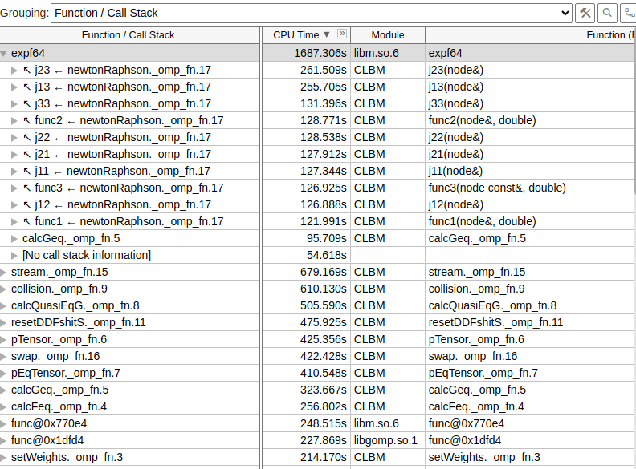
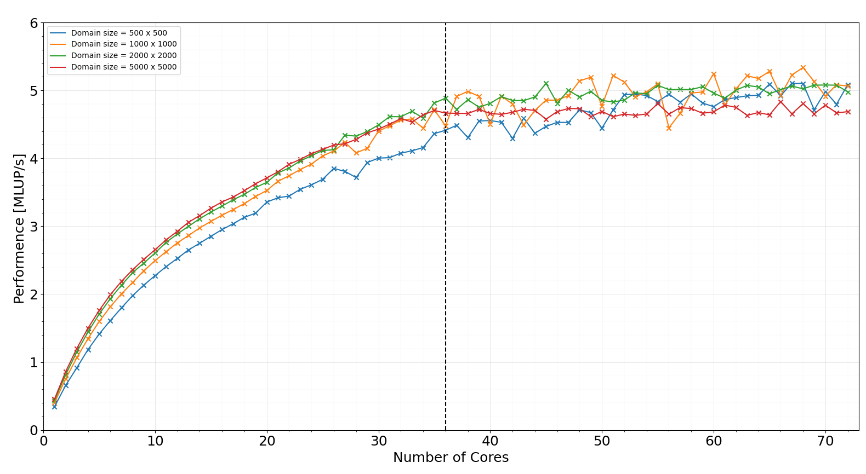
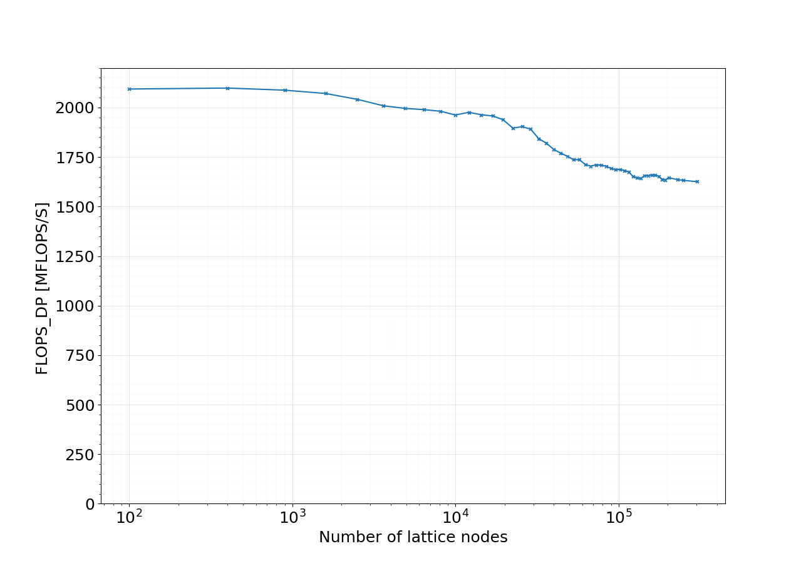
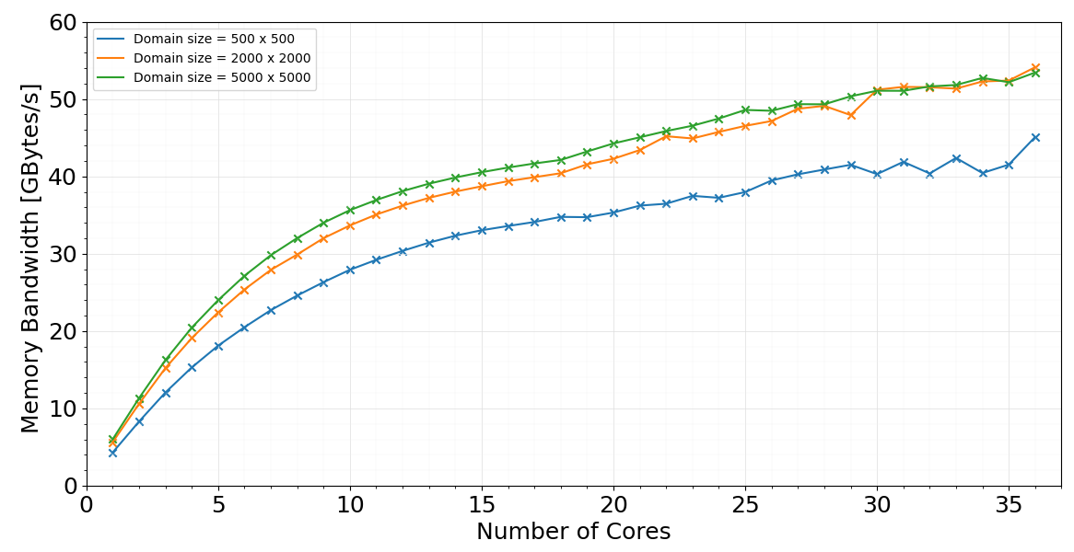
Issues: Phase01
According to single core performance, domain size of 500x500 fits to L3 cache.
Bad scaling behaviour after the second socket.
Total memory bandwidth and performance has a saturating trend in 1st NUMA domain.
expf4; calculation of exponential function using math.h library is critical inside the newtonRaphson kernel.
S0
S1
Figure 6: Vtune hotspot results..
BAD IMPLEMENTATION?
NEED CODE OPTIMIZATIONS?
OpenMP scheduling?
Figure 6: Performance saturation in one node. (phase:01)
Figure 7: single core performance for fixed 2.4GHz.
Figure 8: Memory bandwidth saturation in one node. (phase:01)
Notes:
At phase we obtained bad scaling behaviour
However, we got some insights of the solver throgh strong scaling and profiling results.
the top hotspot was the exp function call which is in c++ math library
so we needed some code optimizations.

Slide 5
Issues: Phase01
According to the initial profiling results; investigated possible issues in newtonRaphson kernel.
Repeated calls for expf4 unnecessarily.
Since it’s the hotpost, investigated the possible code optimizations.
Therefore, modified the newtonRapson subroutines.
Further, experimented OpenMP scheduling chunk size.
High OpenMP overhead for small domain sizes.
Tried performance vs chunk size investigations
Use the static sheduling.
Found out that peformance is better in default settings compared to settings with chunk size.
Ready for phase to tests.
Notes:
in newtonRraphson need to calculate jacobian each time
fdr needs to calculate resiuls an functions approximation each time.
foun that when approximatinf pdfs it has same pattern
put all in to one place and there we call it once
chriti suggested that may be theres a serial part in the code >> went throught the implelemntaton an parrallize which I didnt paralllize it earlier
did some experiments with scheduling but foun out that the defaults openmp static sheduling works well rathet than usng a chunk size

Slide 6
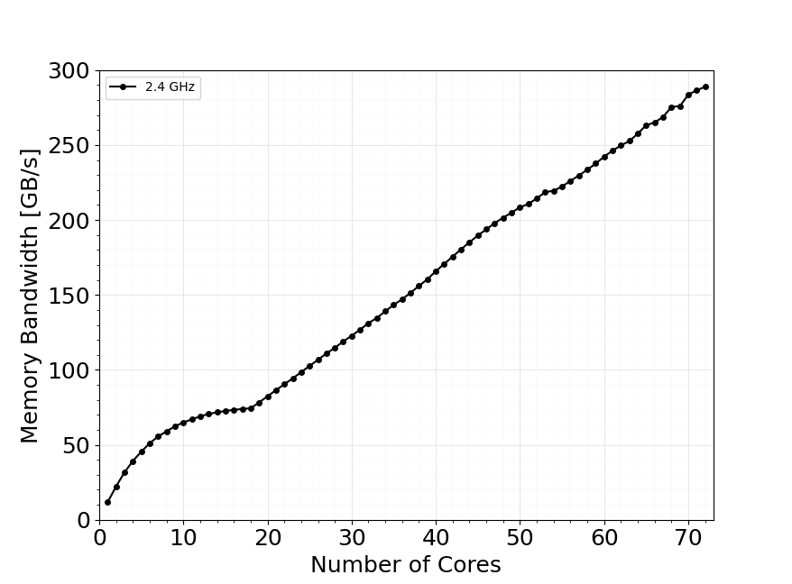
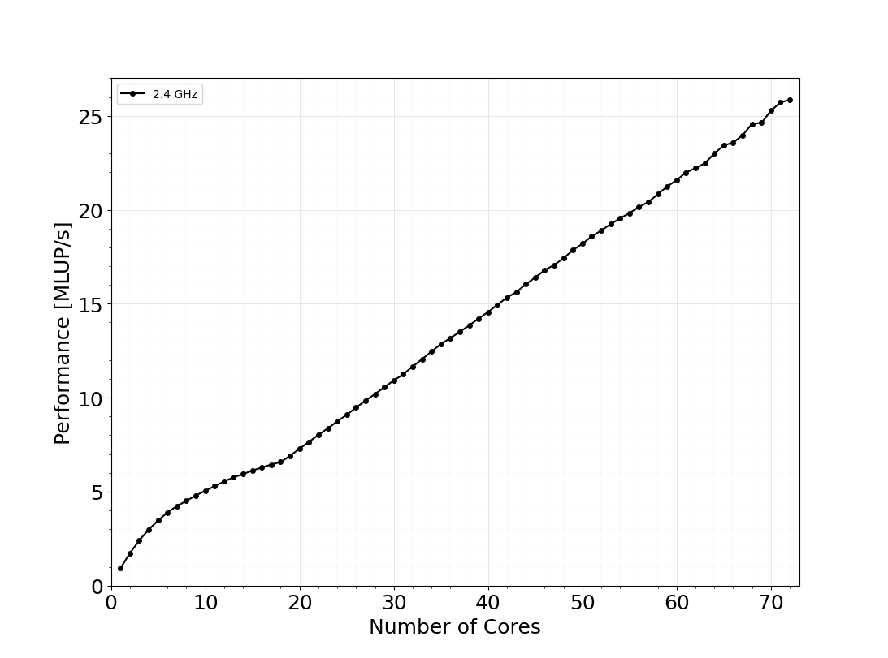
Strong scaling.
Better strong scaling results compared to phase 01
Performance saturation in 1st NUMA domain.
Maximum performance of ~26 MLUP/S with using full node.
Figure 9: Performance measurements in one node at 2.4 GHz
Memory Bandwidth also saturates in 1st NUMA domain. (74.5 GB/s).
Single core performance is ~3x compared to phase 01.
Figure 10: Memory bandwidth measurements in one node at 2.4 GHz
Notes:
As you may no normally we use Lattice updates per second
numa domain saturation
approximatly 26 MLUPs
memory banwith also saturate at 1 numa and its about 75
compared to phase 1 the single core performance tribaled compared to phase 1

Slide 7
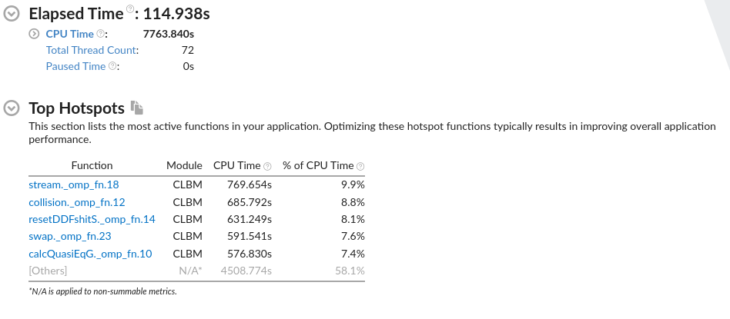
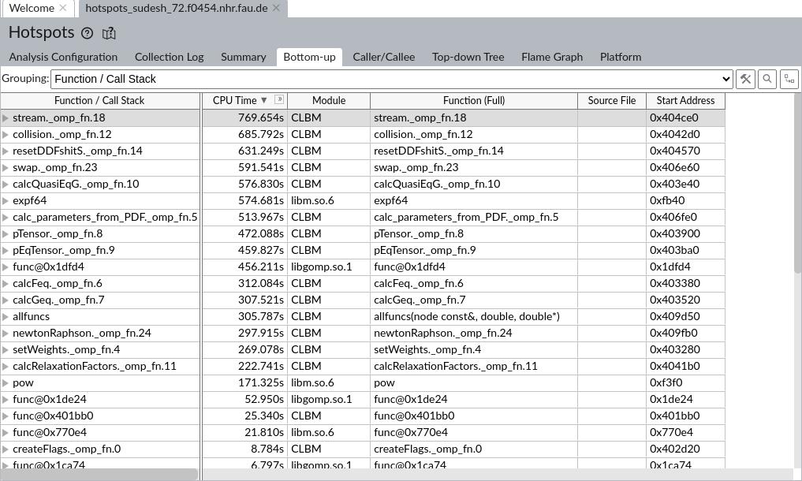
Profiling
Focused kernels considering energy measurements
Stream
Collision
calcQuasiEqG
newtonRaphson
Figure 11: Vtune Hotspot results.
Now the stream and collision kernels plays a critical role as in standard LBM schemes.
According to literature, there was a strong focus for the root finding scheme considering compressible LBM performance [4].
Figure 12: Vtune call stack
Notes:
now we see the the collide and stream toped accoring to profiling an both contribute around 9 percent
choose newtonraph >> beacause in literature related to compressible LBM the more concern is on root finding scheme in temrs of performance of the algorithm
figure 12 the rest of the function call stack
I focused mainly collision streaming and nr

Slide 8
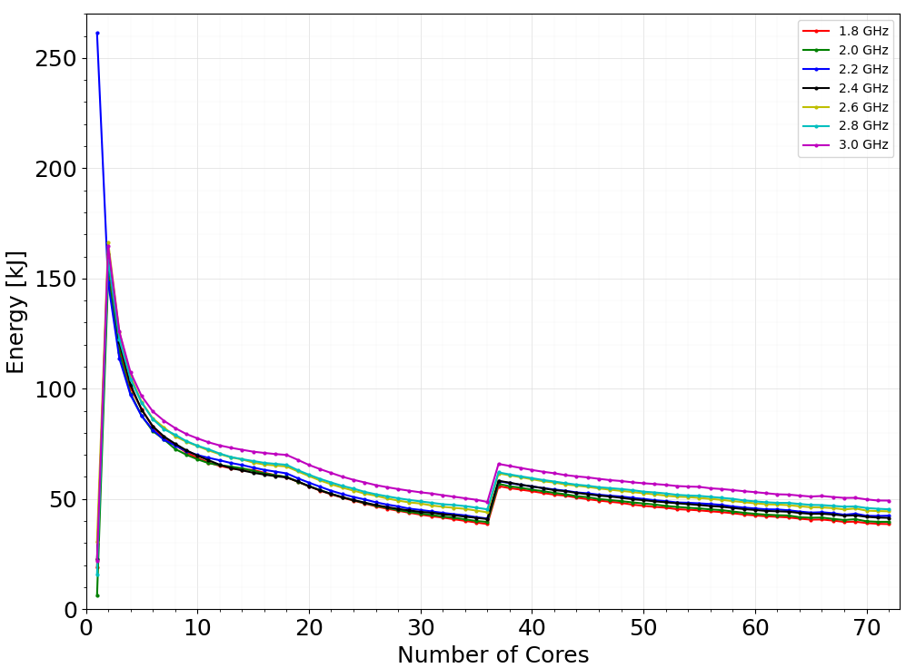
Energy and power measurements; main
An unusual behaviour can be observed at single core power measurement.
This behaviour persists for several data samples
However, for 2.2 GHz, the intended energy measurements can be obtained.
The energy values have a saturating optimum point at 1st NUMA domain before it reaches a second optimum point at 1st socket.
Sudden energy jump when moving to second socket before decrease in a quite linear fashion in second socket.
The frequencies (GHz) 1.8, 2.0, 2.2 and 2.4 shows the lowest CPU energy measurements in first socket.
Figure 13: Energy measurements in one node
Notes:
Interms of energy measuremnts unexpecte ata point in single core measurements
coul not avoid it eventhough did some measurent three times but 2.2 there was no issue
numa domain saturation
suden energy jump at the secon secket
1.8 2,2,2,2,4 show some low energy results
in 1st numa doamin it 2.4 an socekt , noed level its 1.8

Slide 9
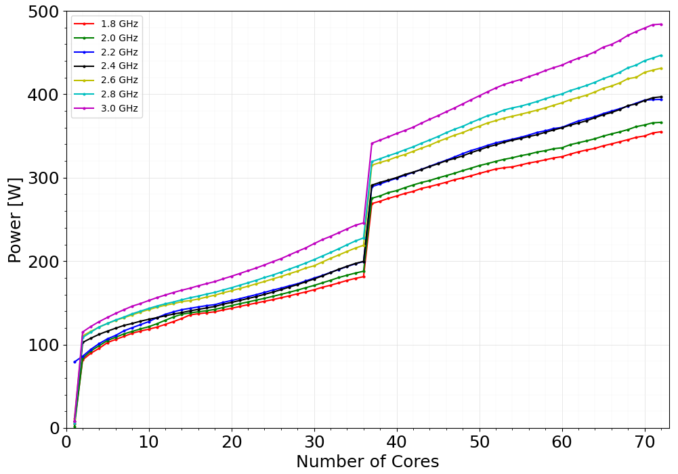
Energy and power measurements; main
An unusual behaviour also can be observed at first core power measurment.
LIKWID-POWERMETER also produced the same results.
Sudden power jump when moving to second socket.
Figure 14: Power measurements in one node
Notes:
the power mesurements also has that unexpected point
i tried to use likwid power meter and it also prouce the same outcome
also the power jum can also seen as before

Slide 10
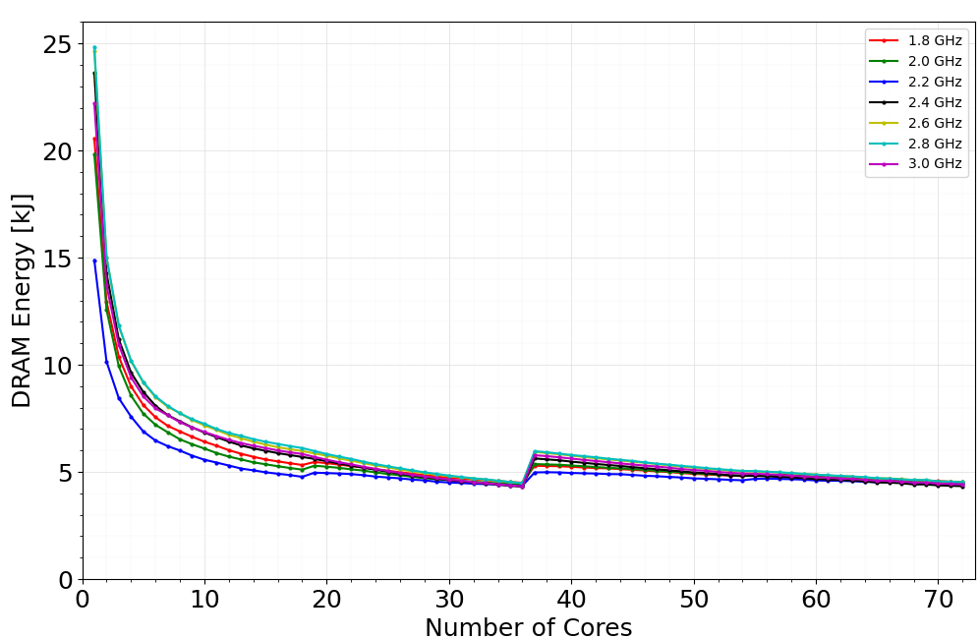
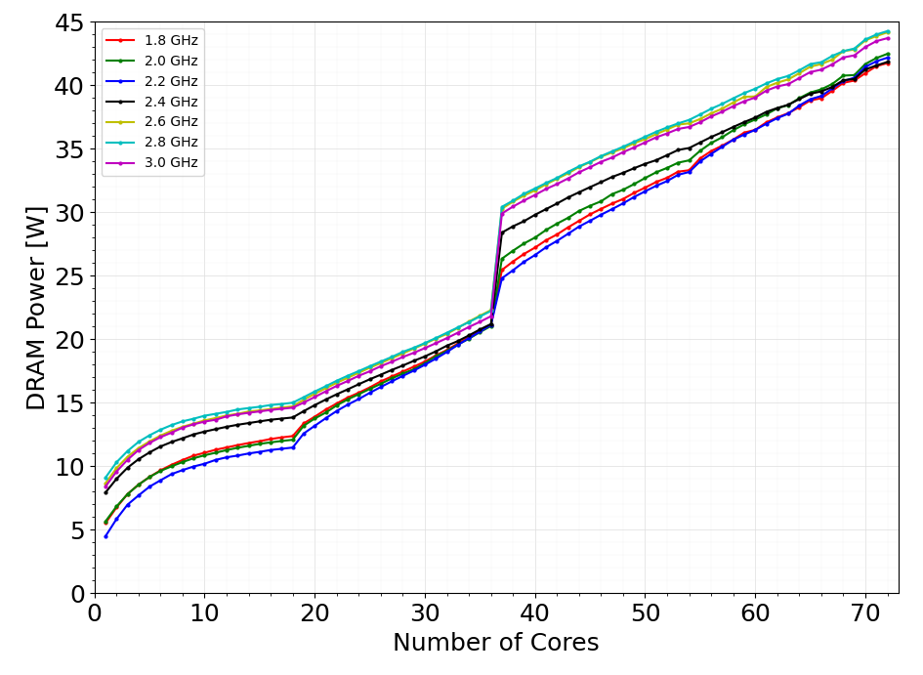
DRAM;Energy and power measurements; main
DRAM energy measurements do not show an unexpected behaviour at single core measurements all the time.
2.2 GHz seems to be the lowest energy curve for a wider domain.
The DRAM energy contribution to the total energy is in the range of 5%-11%.
Figure 15: DRAM Energy measurements in one node
First NUMA domain there is a saturating trend considering DRAM power.
Figure 16: DRAM Power measurements in one node
Notes:
cannot see the unusual measurement in dram energy an power plots
2.2 shows the lowset for wider omain
energy contribution is 5-11 percent
dram power sho some saturating trent at 1st numa domain

Slide 11
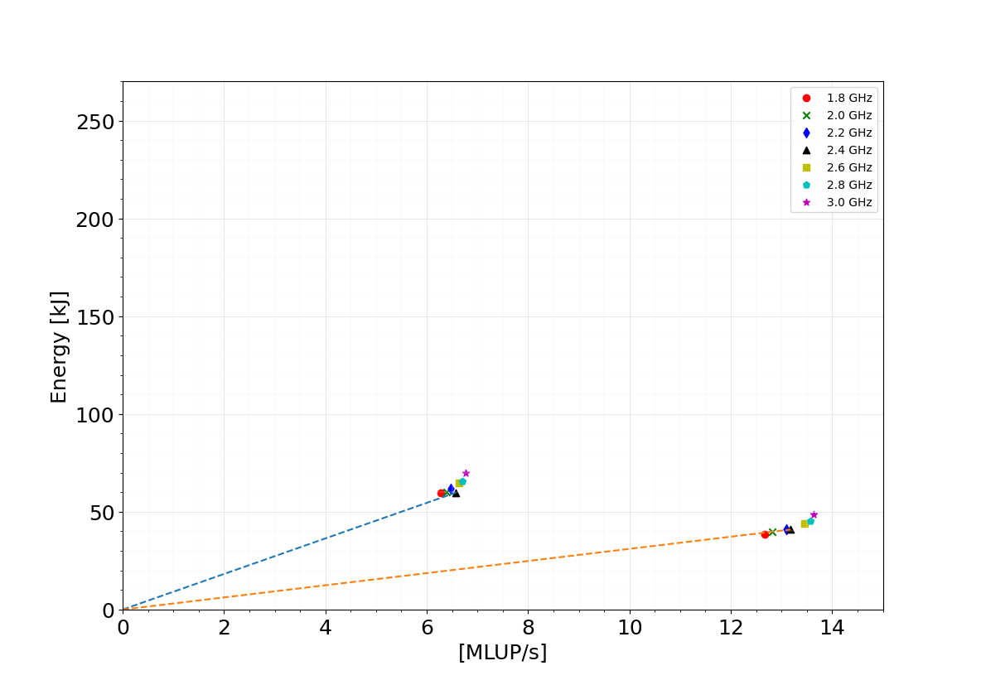
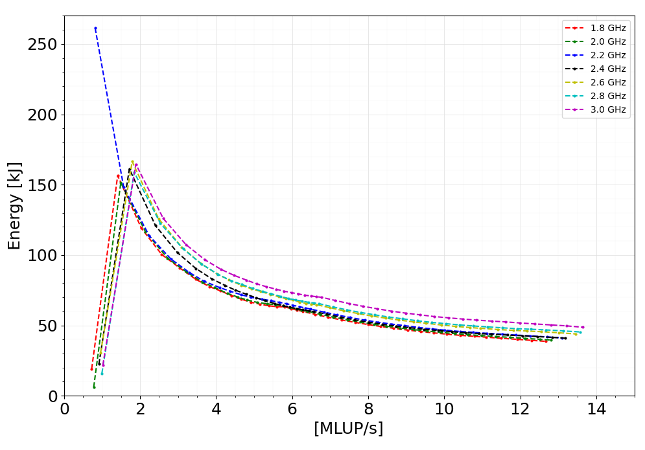
Energy Delay Product (EDP)
Z-plot considers dissipated energy versus any suitable performance metric for a given program.
EDP is the gradient of a line passing through in z-plot.
First socket measurements are taken for the Z-plot.
9.09 kJs/MLUP
3.10 kJs/MLUP
Figure 17: EDP related to 18 and 36 cores at 2.4 GHz
This verifies the earlier point relating energy with first four frequencies.
Figure 18: Z-plot considering one socket.
Notes:
In literatue z plot is used to stdy some enerrgy efficiency of a scalabel programm
here I use the first socket and constructe the zplot for studied frequencies
higher the frequenci can obtain low edp
if we construct the edp for 1 st numa and socket can see that the 4 frequencie of 1.8 2.4 have some what similar edp

Slide 12
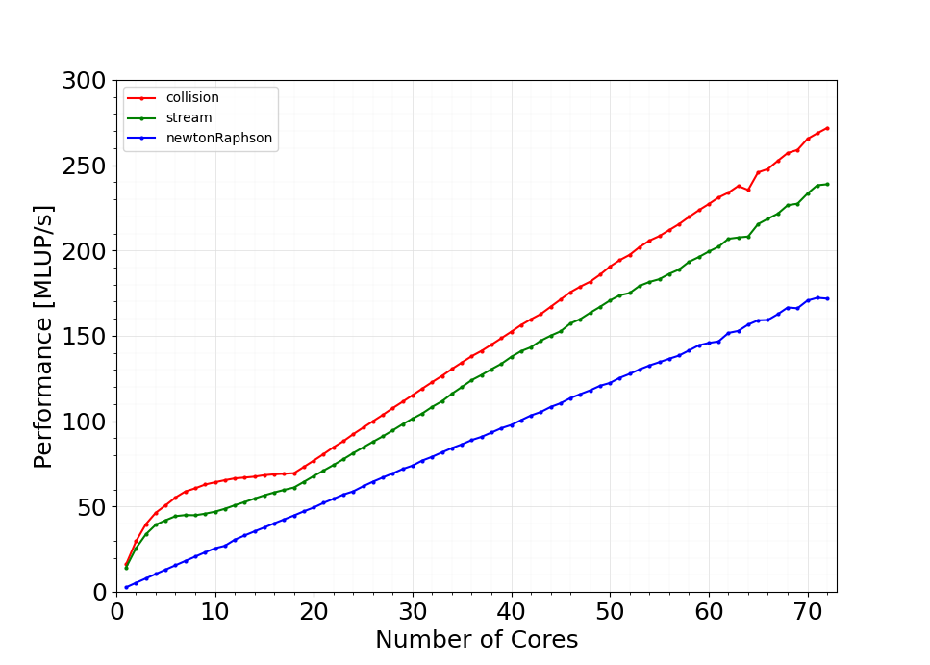
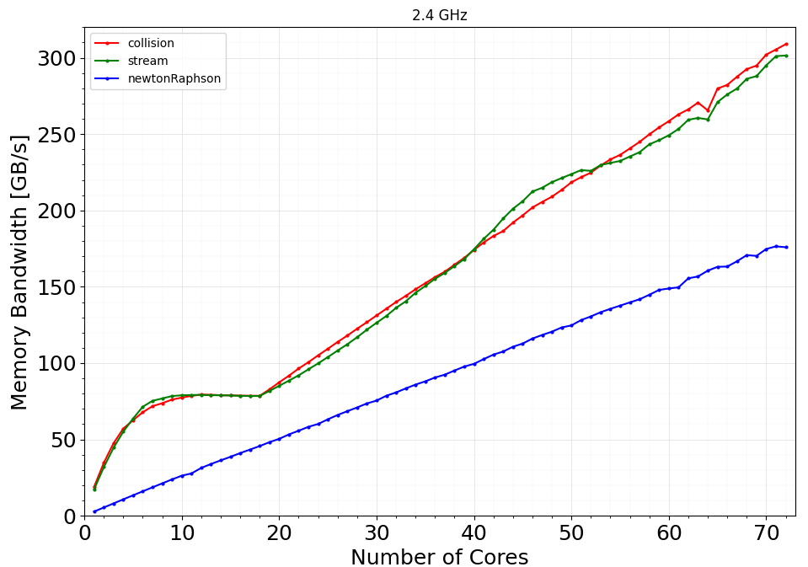
Hotspots measurements
Considered the stream, collision, calcQuasiEqG and newtonRaphson kernels.
Observed the performance, memory bandwidth saturations and energy contributions.
Figure 19: Performance vs. core count
Figure 20: Memory bandwidth vs. core count
newtonRaphson kernel does not show any saturation in full node.
collision and streaming shows the saturating trend inside the first NUMA doamin.
Note that here, MLUP/s have high values. Because we calcultate the same metric with respect to the hotspot runtime. (total runtime >> hotspot runtime; for 2.7 Billion lattice updates)
Cannot use Flop/s for the representation. Because stream does not have floating point operations.
Notes:
Then the previous investigataaion also continued to the hotspots
but theres no perf or mem saturation in newton while stream n collide has perf an meme saturation at first numa

Slide 13
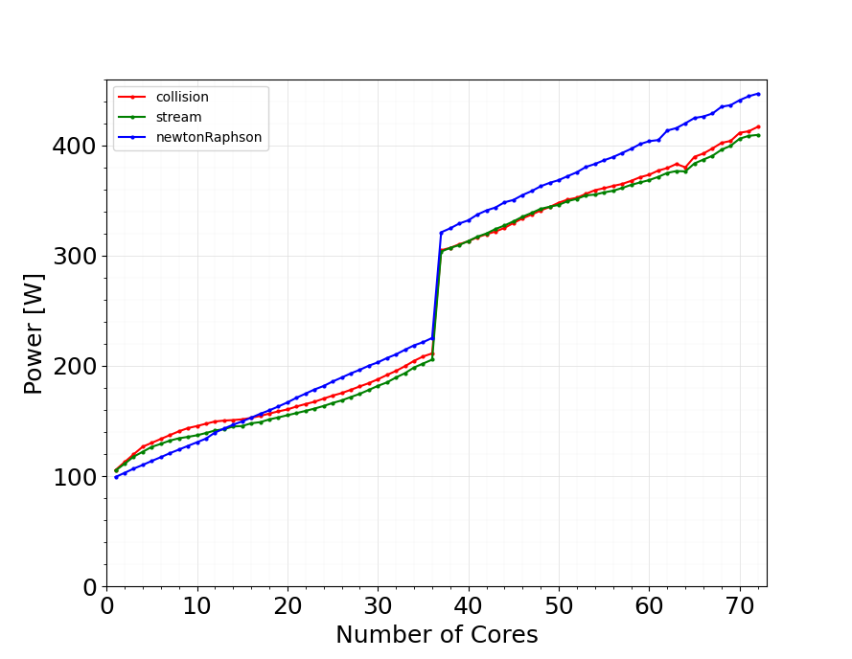
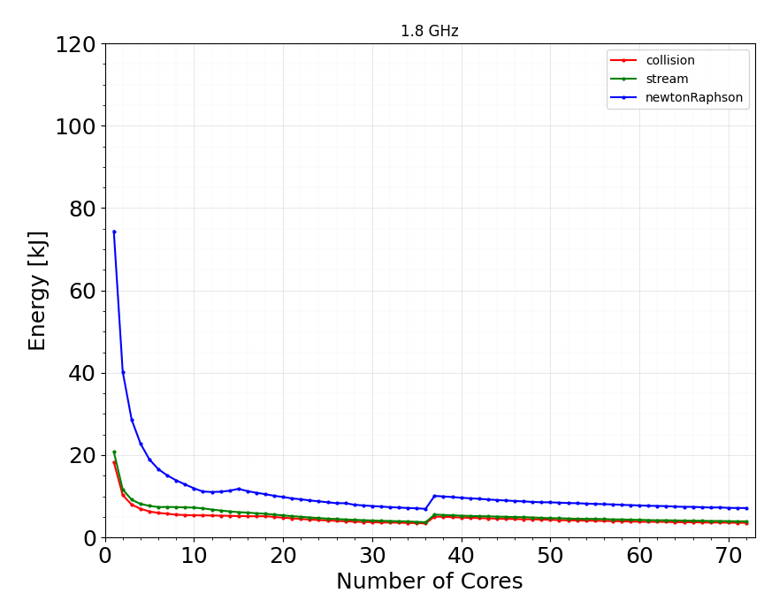
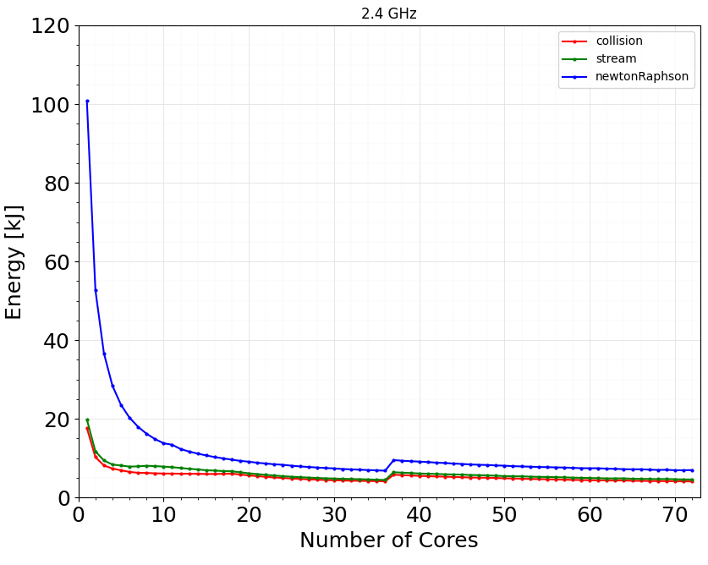
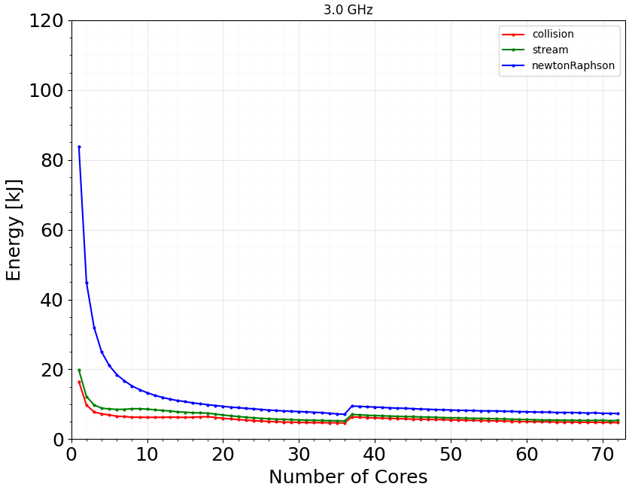
Hotspots measurements...
The previously observed, unexpected measurement point at single cores does not appear in energy plots.
Figure 21: Energy vs. core count
Figure 22: Power vs. core count
All three kernels contributes 9% - 16% to the main energy measurements.
newtonRaphson has the highest contribution while showing a scalable performance within the node.
Both the highest hotspot ranks seems to be having similar variation in terms of power and energy.
Notes:
Alao for hotspot the unexpected point at single core cannot observed
so in energy measurements it can seee that the nr has the highets contribbution
collision an stream shows the simila contrbutions to the total energy
how everer the investigated hotspots have 16 % contrubition to the total energy

Slide 14
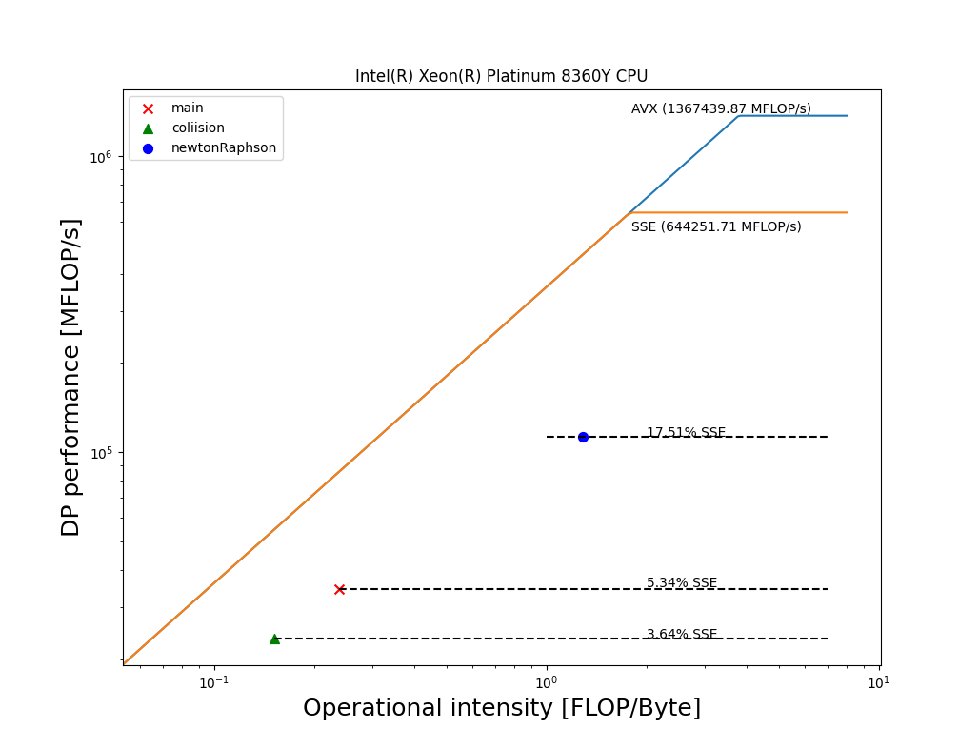
Roofline modelling
LIKWID-bench tool is utilized to construct the empherical roofline diagram [7].
Maximum performance is related to the AVX FLOPS.
Maximum data throughput is related to the likwid-bench load_avx
Here the performance metric is double precision performance.
Stream kernal does not have any flops.
CLBM application is close to memory bound.
Figure 22: Roofline diagram.
Notes:
empherical rooh line model
note that the here the performance metric is dp flops
so we cant include stream kernal here
closely mempry bound

Slide 15
Remarks.
This is the first kind of benchmarking effort considering LBM in compressible supersonic flow
CLBM 2D test application shows scalable performance.
Solver is close to memory bound. According to the roofline analysis, the application has arbitrary horizontal roofs.
May be more opportunity to increase bandwidth utilization, for example by using SIMD instructions in the newtonRaphson routine.
Optimal energy can be observed at the first socket in fritz node considering 1.8 GHz, 2.0 GHz, 2.2 GHz and 2.4 GHz
EDP results verified the point above.
DRAM energy contribution to the total energy is 5%-11%.
Root finding scheme has less significance in terms of performance, even though root finding algorithm was the highlight in previous literature regarding, this LBM regime.

Slide 16
Reference
The Landscape of Parallel Computing Research A View from Berkeley, 2006 Electrical Engineering and Computer Sciences, University of California at Berkeley, Electrical Engineering and Computer Sciences, University of California at Berkeley,
A. A. Mohamad. Lattice Boltzmann Method Fundamentals and Engineering Applications with Computer Codes. Springer, 2019
Timm Krüger, Halim Kusumaatmaja, Alexandr Kuzmin, Orest Shardt, Goncalo Silva, and Erlend Magnus Viggen. The Lattice Boltzmann Method. Springer International Publishing, 2017.
Jonas Latt, Christophe Coreixas, Joël Beny, and Andrea Parmigiani. Efficient supersonic flow simulations using lattice boltzmann methods based on numerical equilibria. Philosoph ical Transactions of the Royal Society A:Mathematical, Physical and Engineering Sciences,378(2175):20190559, jun 2020. 5.
https://blogs.fau.de/hager/archives/tag/energy
Ayesha Afzal,Georg Hager,Gerhard Wellein,SPEChpc 2021 Benchmarks on Ice Lake and Sapphire Rapids Infiniband Clusters: A Performance and Energy Case Study, SC-W '23: Proceedings of the SC '23 Workshops of The International Conference on High Performance Computing, Network, Storage, and Analysis,November 2023, Pages 245–1254,https://doi.org/10.1145/3624062.3624197
https://github.com/RRZE-HPC/likwid/wiki/Tutorial:-Empirical-Roofline-Model

Slide 17
Thank you!

Slide 18
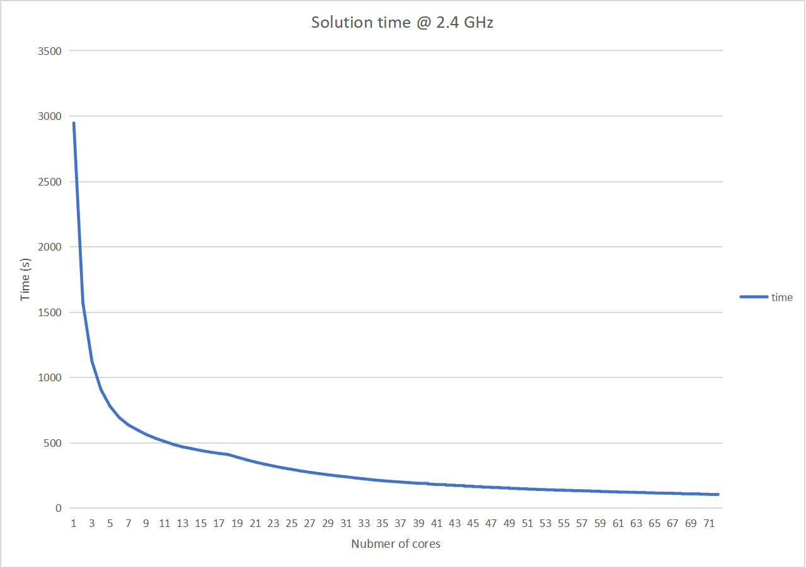
Appendix

Slide 19
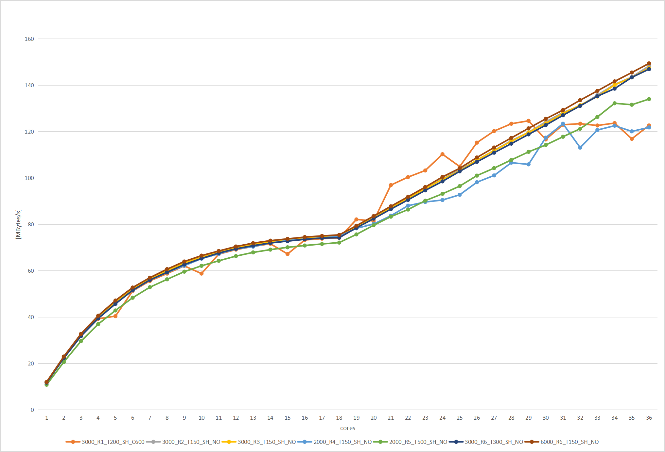
OpenMP_chunk_size

