Slide 1
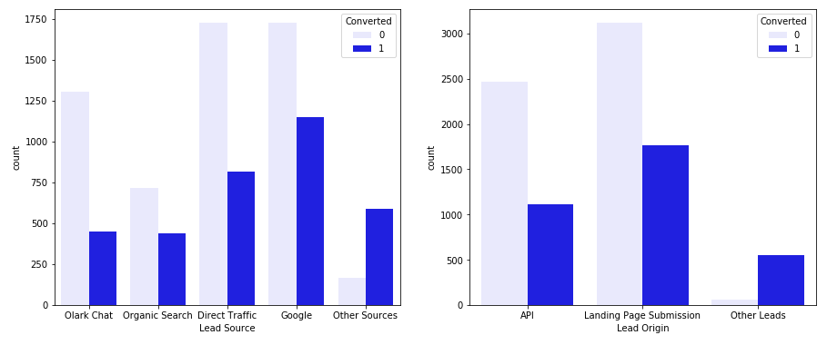
HOT LEADS
Lead Source from Google has comparatively more conversion than rest

Slide 2
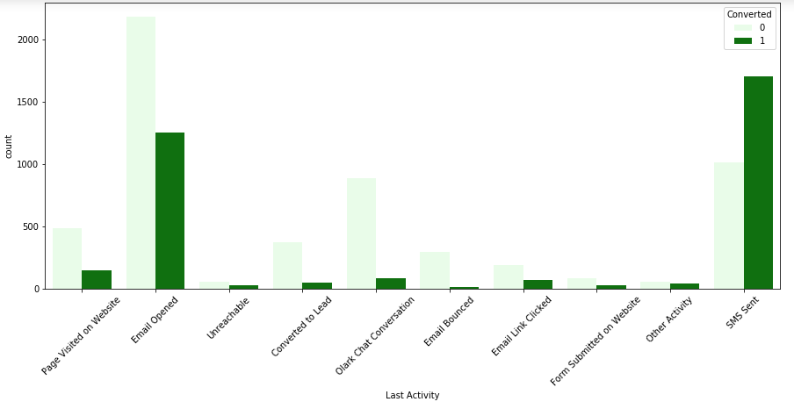
People with Last Activity as SMS Sent have higher conversion

Slide 3
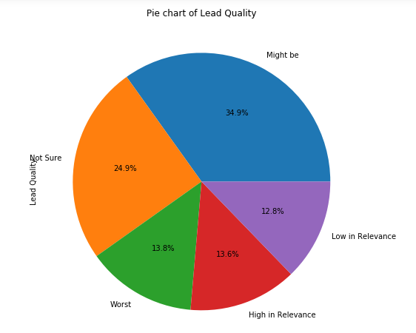
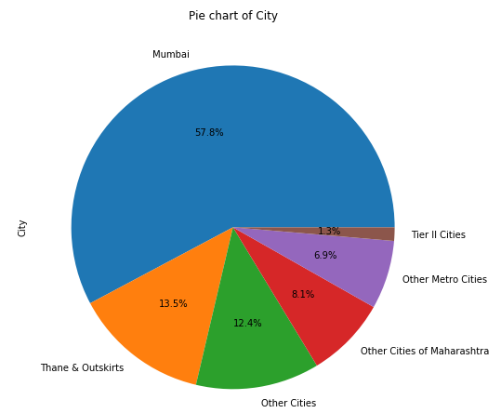
Pie Chart Showing Segments of Data

Slide 4
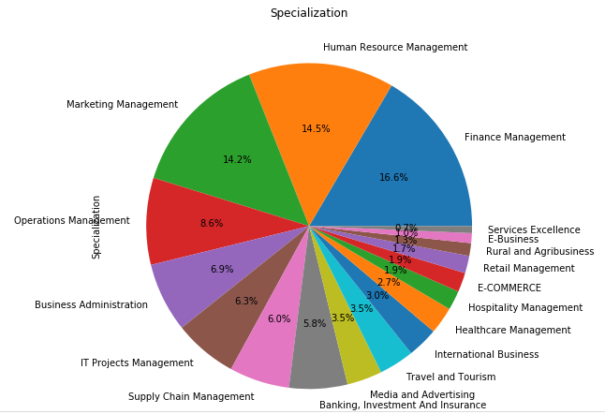
Pie Chart Showing Segments of Specialization

Slide 5
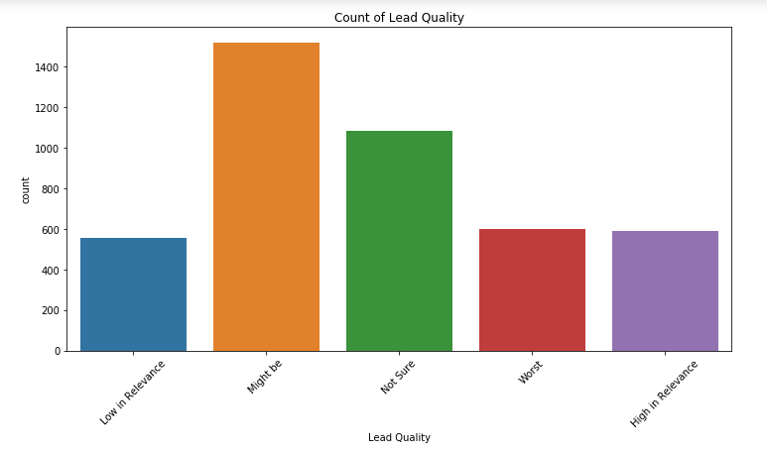
There are more people who are uncertain

Slide 6
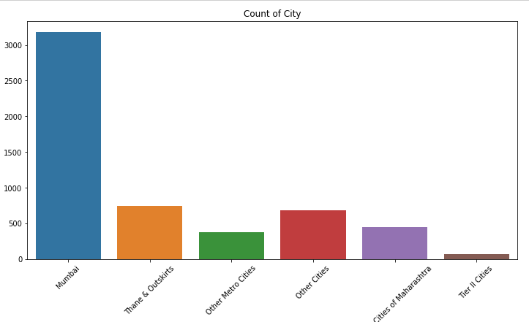
Maximum queries are from Mumbai

Slide 7
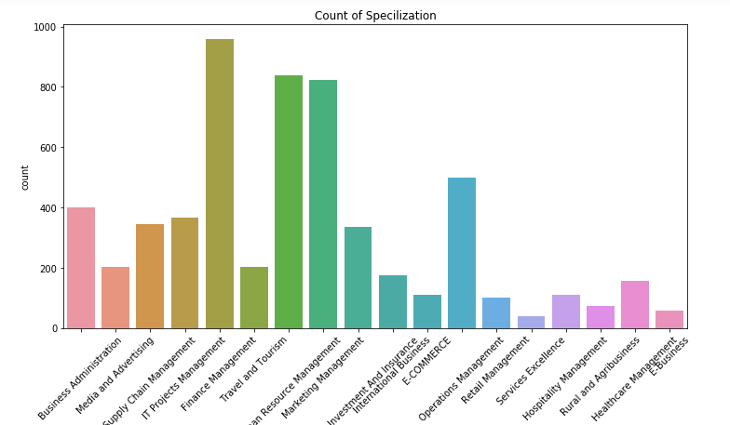
IT Project Mgmt., Travel and Tourism and HR Mgmt. enquire most

Slide 8
The top 5 variables are:
- Lead Quality High in Relevance
- Lead Quality Low in Relevance
- Lead Quality Might be
- Last Activity SMS Sent
- Website Time

Slide 9
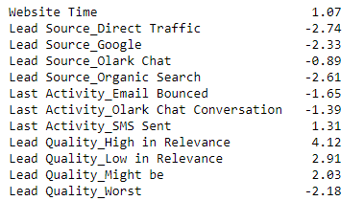
Model Coefficients

Slide 10
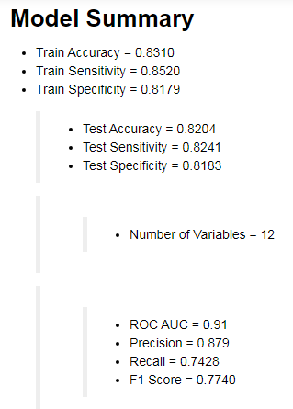

Slide 11
Business Recommendations
Leads classified as converted should be called first.
Lead score generated takes into considerations the following factors.
- Lead Quality High in Relevance
- Lead Quality Low in Relevance
Lead Quality Might be
Intuition of Lead Team is very important High, Low and Might be are strong predictors of Hot Leads
Last Activity SMS Sent- People actively participating in campaign via SMS are Hot Leads
Website Time – People who spend more time on website are more likely to become Hot Leads.
- Lead Score above 34 are Hot Leads

Slide 12
Thank you

