Slide 1
Yet another Hadoop
By: Sudharshan T R
PES1UG19CS534

Slide 2
Introduction
This project is a simulation of a Distributed File System (DFS) where the user can:
store and retrieve his/her files/directories
without realizing the fact that any given file is broken into chunks and stored
across a cluster of commodity hardware
This project also provides a framework using which MapReduce jobs can be executed

Slide 3
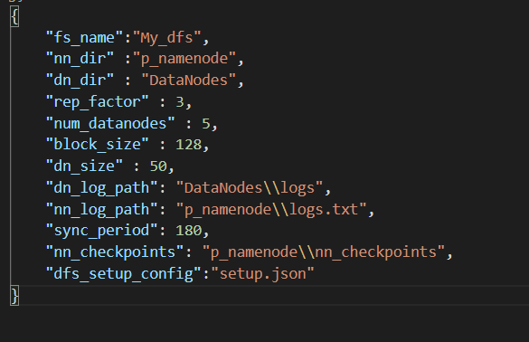
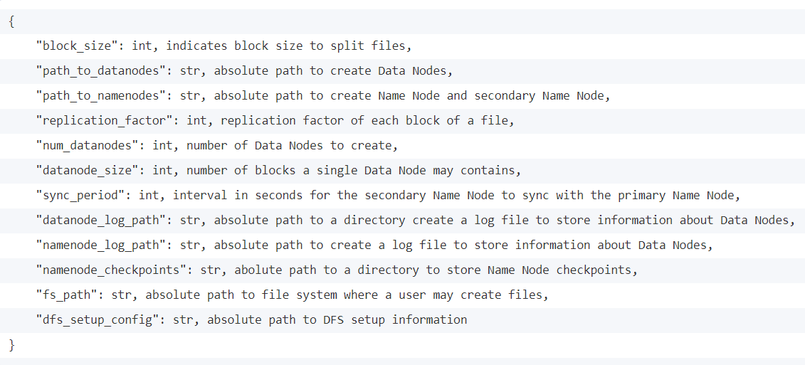
Config format

Slide 4
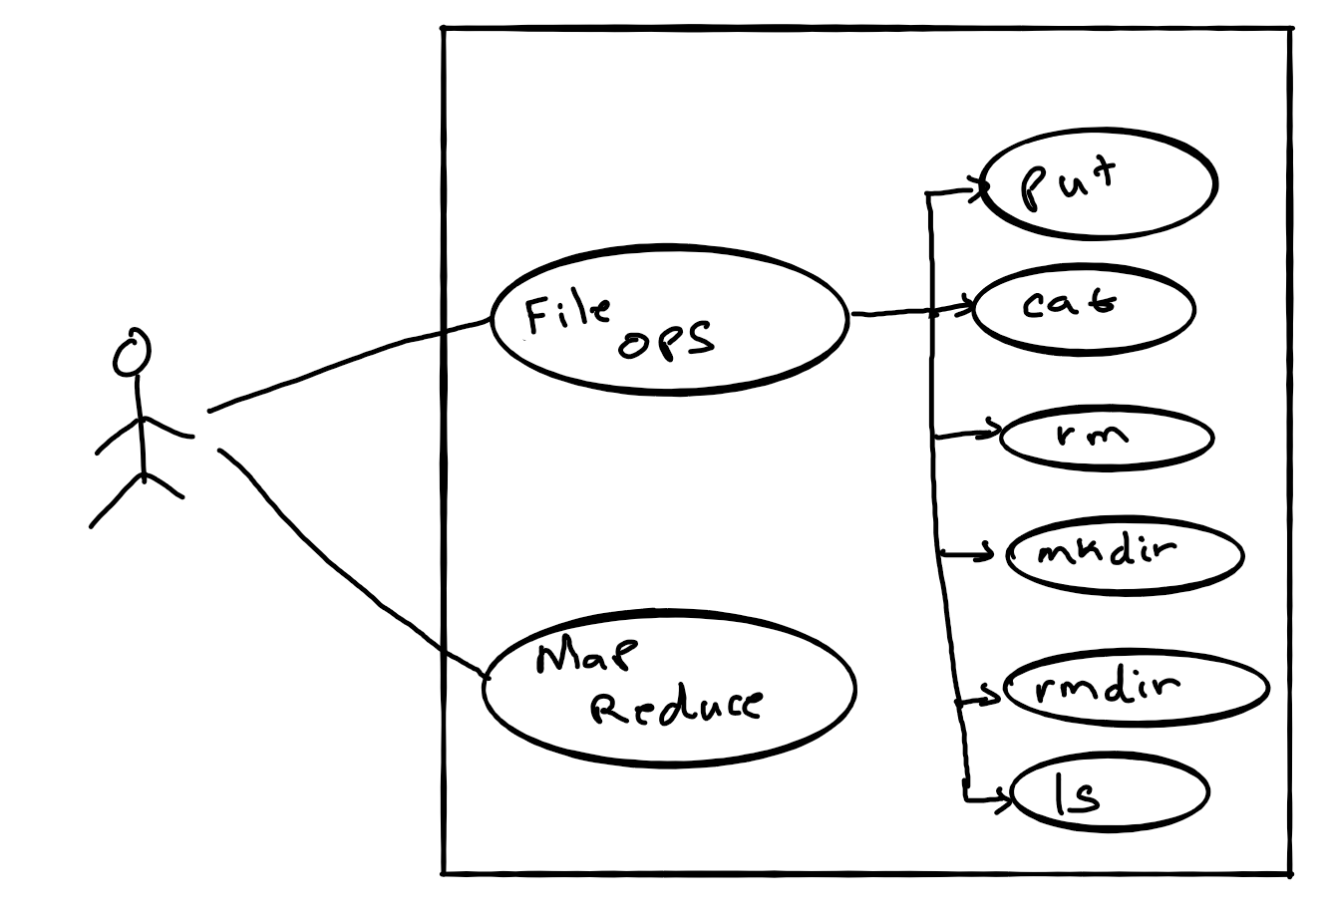
Use cases

Slide 5
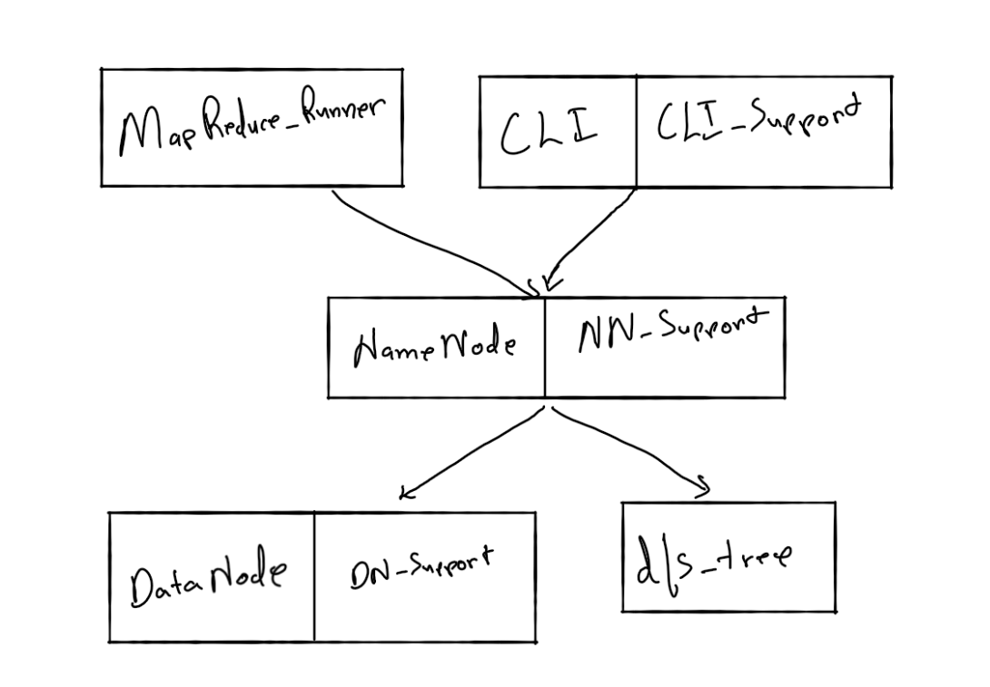
Class/module

Slide 6
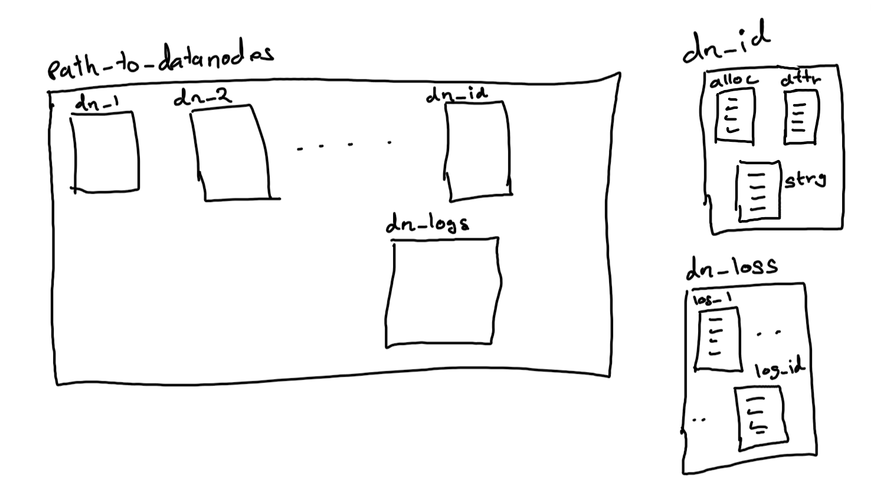
Internal workings: datanode

Slide 7
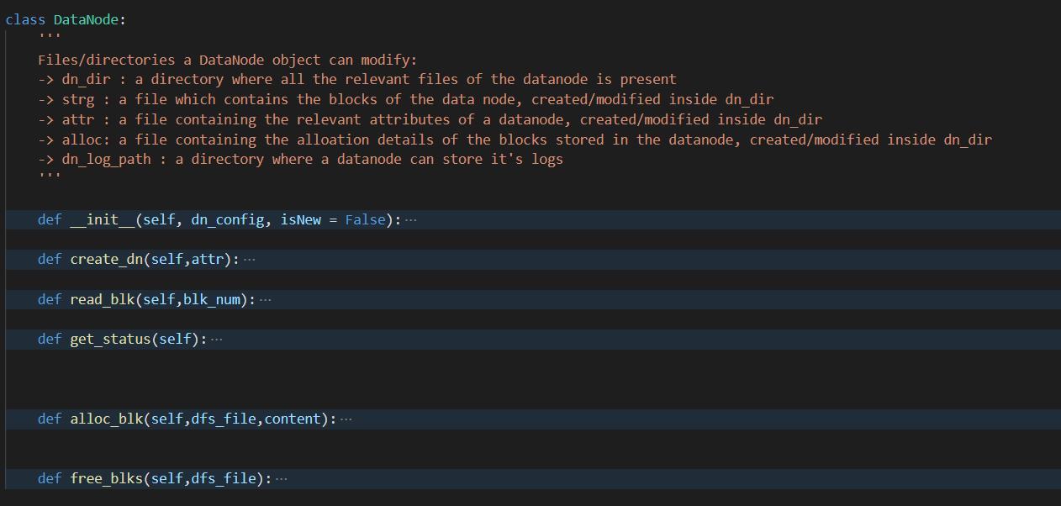
Internal workings: datanode - 2
Functionalities offered by datanode class:

Slide 8
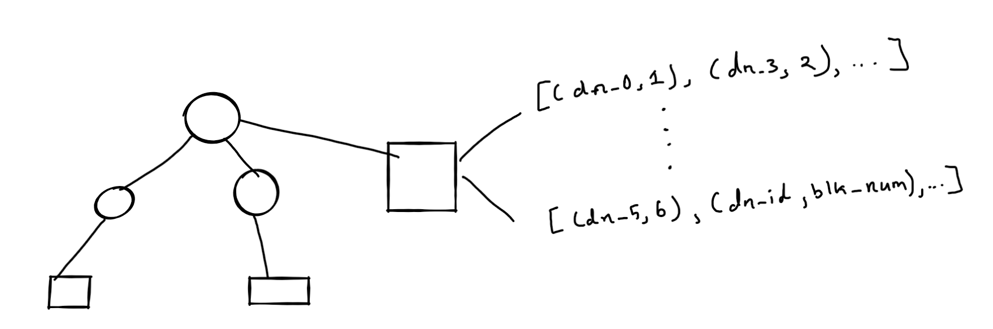
Internal workings: dfs_tree

Slide 9
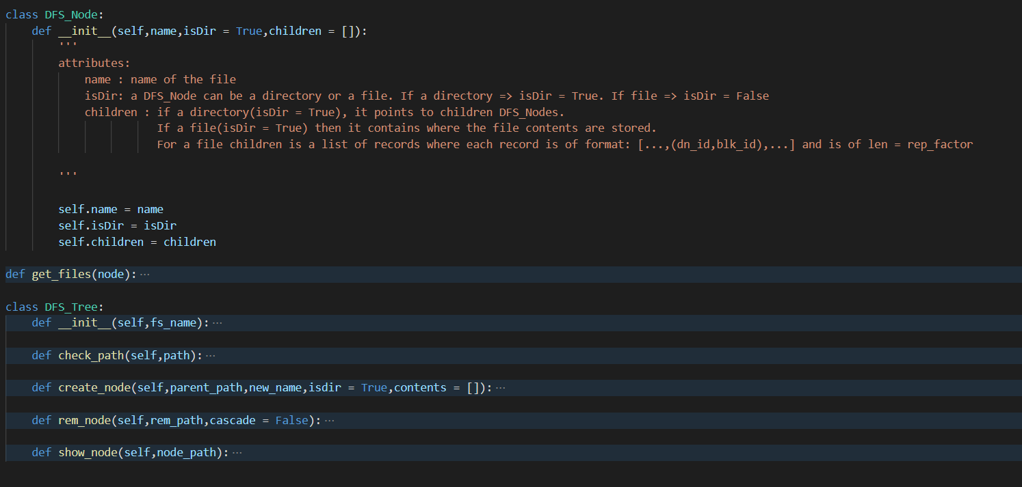
Internal workings: dfs_tree - 2

Slide 10
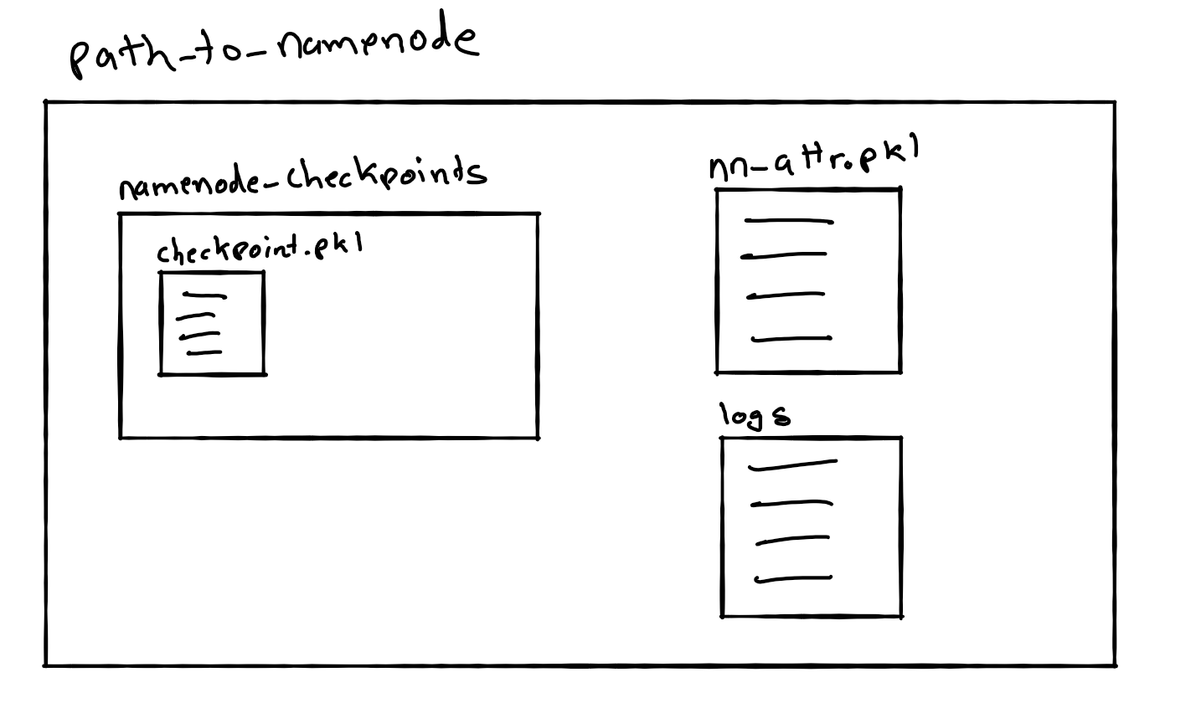
Internal workings: Name node

Slide 11
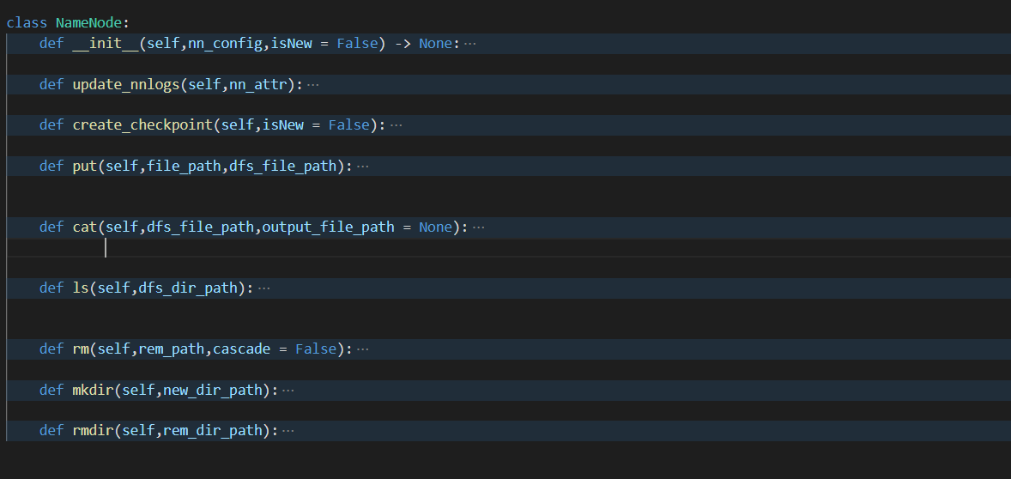
Internal workings: Name node - 2

Slide 12
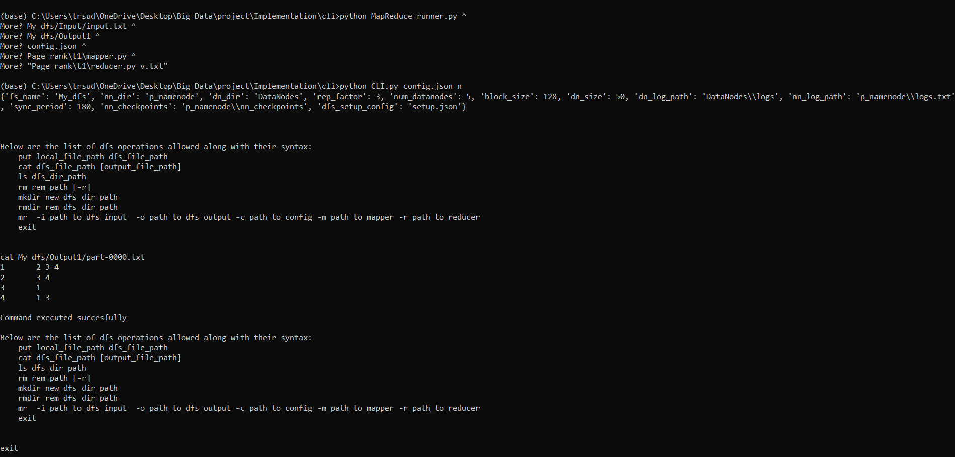
Running A2T1 on YAH and MR framework

Slide 13
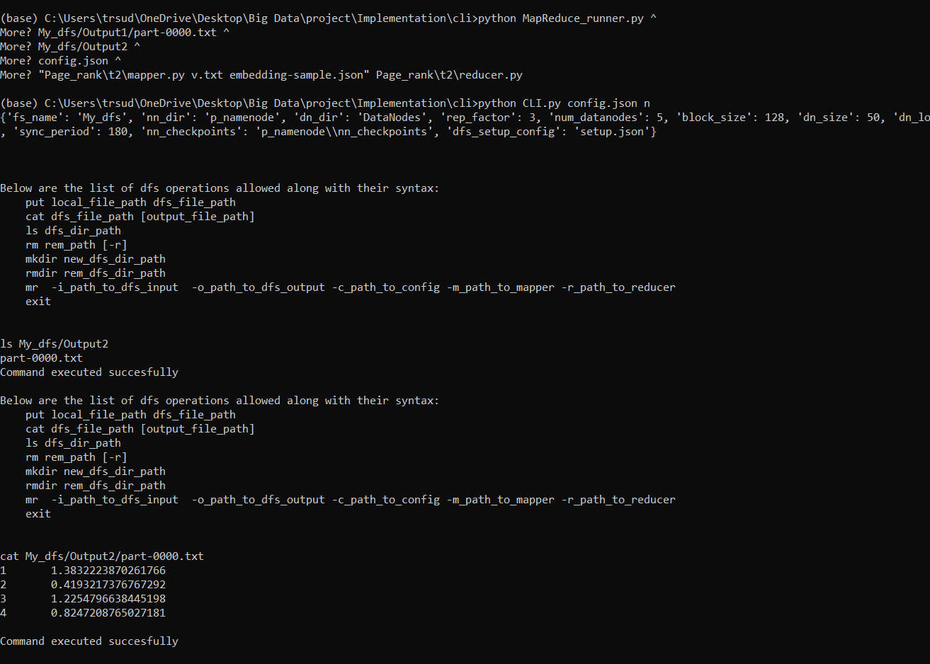
Running a2t2 on yah and mr framework

Slide 14
Thankyou

