Slide 1
Retail Sales Analysis
Data Storytelling & Statistical Validation
Prepared By: Sudarshini Sri V
Data Analytics Internship
ApexPlanet Software Pvt. Ltd.

Slide 2
Project Overview
Content
Retail Sales Analysis is an Excel-based data analytics project designed to evaluate
sales performance using key business metrics and interactive visualizations. The
project analyzes sales trends, top-performing products, and regional sales
performance to generate actionable business insights and support data-driven decision-
making.
Objectives
Analyze retail sales performance.
Track monthly sales trends.
Identify top-performing products and locations.

Slide 3
Business Objectives
Objective of the Project
This project aims to analyze retail sales data to understand sales performance,
identify business trends, and support better decision-making through data
visualization.
Key Objectives
Compare montly sales trends (September vs. October).
Evaluate sales performance across different locations.
Calculate key performance indicators (KPIs).
Provide business insights and recommendations for improving sales.

Slide 4
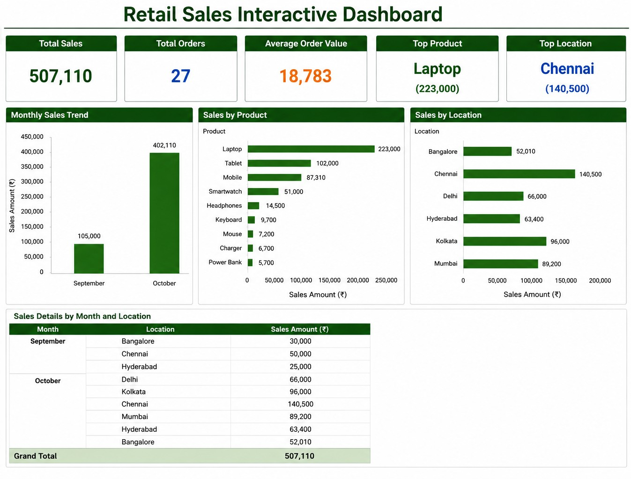
Retail Sales Dashboard

Slide 5
Key Insights
Total sales generated during the analysis period were 507,110 from 27 orders.
October recorded the highest sales (402,110), contributing significantly more than September (105,500).
Laptop was the top-performing product, generating 223,000 in sales.
Chennai was the highest-performing location with 140,500 in total sales.
The Average Order Value (AOV) was 18,783 indicating high-value retail transactions.

Slide 6
Recommendations
Increase inventory for Laptops to meet customer demand.
Strengthen marketing efforts in Bangalore and Hyderabad to improve sales.
Continue successful sales strategies that contributed to October’s higher sales.
Monitor monthly sales trends regularly to improve inventory planning and business decisions.

Slide 7
Statistical Validation
Hypothesis Testing
Null Hypothesis: There is no significant difference between September and October sales.
Alternative Hypothesis:
There is a significant difference between September and October sales.
Observation:
October sales (402,110) were much higher than September sales (105,000).
Conclusion:
Based on the sales analysis, October performed better than September, indicating improved sales performed during the analysis period.

Slide 8
Conclusion
Successfully analyzed retail sales data using WPS Excel.
Built an interactive dashboard to bisualize key business metrics and sales trends.
Identified top-performing products, locations, and monthly sales performance.
Generated actionable insights and recommendations to support data-driven decision-making.
Thank You!
Any Questions?

