Slide 1
ELECTRONICS PROJECT
TOPIC: RECTIFIER
GROUP MEMBERS:
SAMEEKSHA SRIVASTAVA
SRISTI AGRAWAL
SUDHA CHAUDHRY
SECTION: A5 ,A6

Slide 2
What is Rectifier?
A rectifier is an electrical device that converts alternating current (AC), which periodically reverses direction, to direct current (DC), which flows in only one direction.

Slide 3
TYPES OF RECTIFIERS
Rectifier
Half-wave Rectifier
Full-wave Rectifier
Centre-tape
full-wave rec.
Full-wave
Bridge rec.

Slide 4
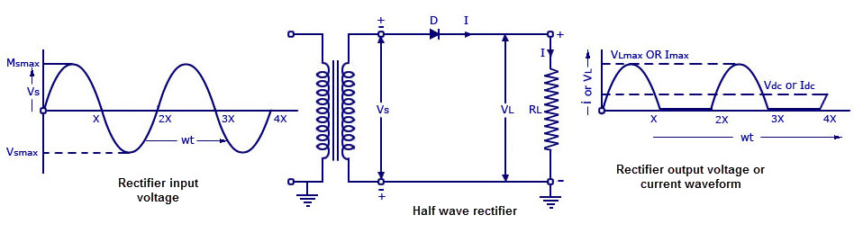
HALF WAVE RECTIFIER
Circuit Diagram with waveforms:

Slide 5
Working of Half Wave Rectifier
During the positive half cycle the diode is under forward bias condition and it conducts current to RL (Load resistance). A voltage is developed across the load, which is same as the input AC signal of the positive half cycle.
Alternatively, during the negative half cycle the diode is under reverse bias condition and there is no current flow through the diode. Only the AC input voltage appears across the load and it is the net result which is possible during the positive half cycle. The output voltage pulsates the DC voltage.

Slide 6
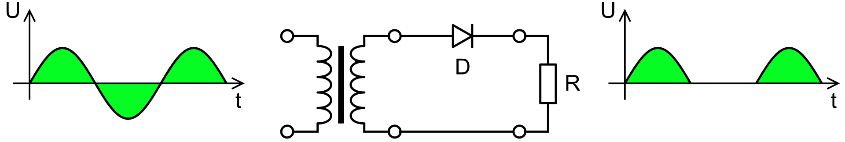
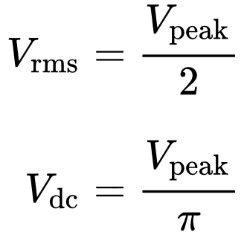
The no-load output DC voltage of an ideal half-wave rectifier for a sinusoidal input voltage is:
where:
V_{dc}, V_{av} – the DC or average output voltage,
V_{peak}, the peak value of the phase input voltages,
V_{rms}, the root mean square (RMS) value of output voltage.

Slide 7
APPLICATIONS
Some of the applications are:
Appliances
Used with transformers
Soldering
AM radio
Pulse generated circuits
Signal demodulation
Voltage Multiplier
Because of the low cost compared to the center tapped, rectifier are majorly used in power supply circuits.

Slide 8
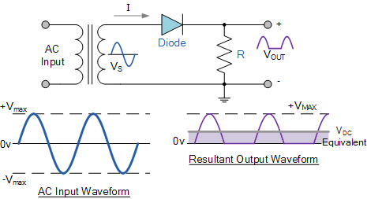
Numerical
V_{DC} and the current I_{DC}, flowing through a 100Ω resistor connected to a 240 Vrms single phase half-wave rectifier as shown above. Also calculate the DC power consumed by the load.

Slide 9

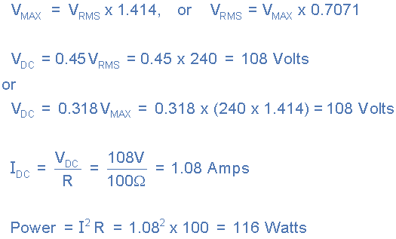

Slide 10
CONCLUSION
Thus, we can understand the importance, necessity & use of
Half Wave Rectifiers.
THANK YOU.

