Slide 1
Predicting Crop Yield
Using Machine Learning
A Data-Driven Approach
Lakshmi Sudha Pandiri
University of Hertfordshire | MSc Data Science
github.com/lakshmi-sudha-pandiri

Slide 2
Introduction & Motivation
Research Context
Research Question
Agriculture accounts for a significant share of GDP in developing nations, yet crop yield remains highly unpredictable due to variable rainfall, temperature, soil conditions, and farming practices.
Machine learning offers a data-driven alternative to traditional agronomic models by learning complex, non-linear relationships between environmental factors and yield outcomes.
Can machine learning models accurately predict crop yield (tons/hectare) using environmental and agricultural features such as rainfall, temperature, soil type, and farming inputs?
Objectives:
• Compare regression models (Linear, Decision Tree, Random Forest, Ridge)
• Evaluate using R², RMSE, MAE
• Identify key yield drivers via SHAP
• Provide actionable agricultural insights

Slide 3
Previous Work
Literature Review
Pedregosa et al. (2011) established scikit-learn as the standard ML toolkit for regression and classification tasks, providing robust implementations of Linear Regression, Decision Trees, and Random Forests used extensively in agricultural prediction studies.
Lundberg and Lee (2017) introduced SHAP (SHapley Additive exPlanations) for model interpretability, enabling transparent explanation of how individual features influence predictions — critical for agricultural decision-making.
McKinney (2010) developed pandas for structured data manipulation, while Harris et al. (2020) contributed NumPy for efficient numerical computing — both foundational for preprocessing large agricultural datasets.
Waskom (2021) and Hunter (2007) provided seaborn and matplotlib respectively, enabling comprehensive exploratory data analysis and visual communication of agricultural trends and model results.

Slide 4
Methodology / Approach Comparison
Linear Regression
Decision Tree
Baseline parametric model assuming linear relationship between features and yield. Simple, interpretable, fast training.
Non-parametric model that partitions feature space recursively. Captures non-linear patterns. max_depth=10 to prevent overfitting.
Random Forest
Ridge Regression
Ensemble of 50 decision trees with bootstrap aggregation. Reduces variance, improves generalization. max_depth=10.
Regularized linear regression with L2 penalty. Controls multicollinearity and prevents coefficient inflation. Alpha tuned via GridSearchCV.

Slide 5
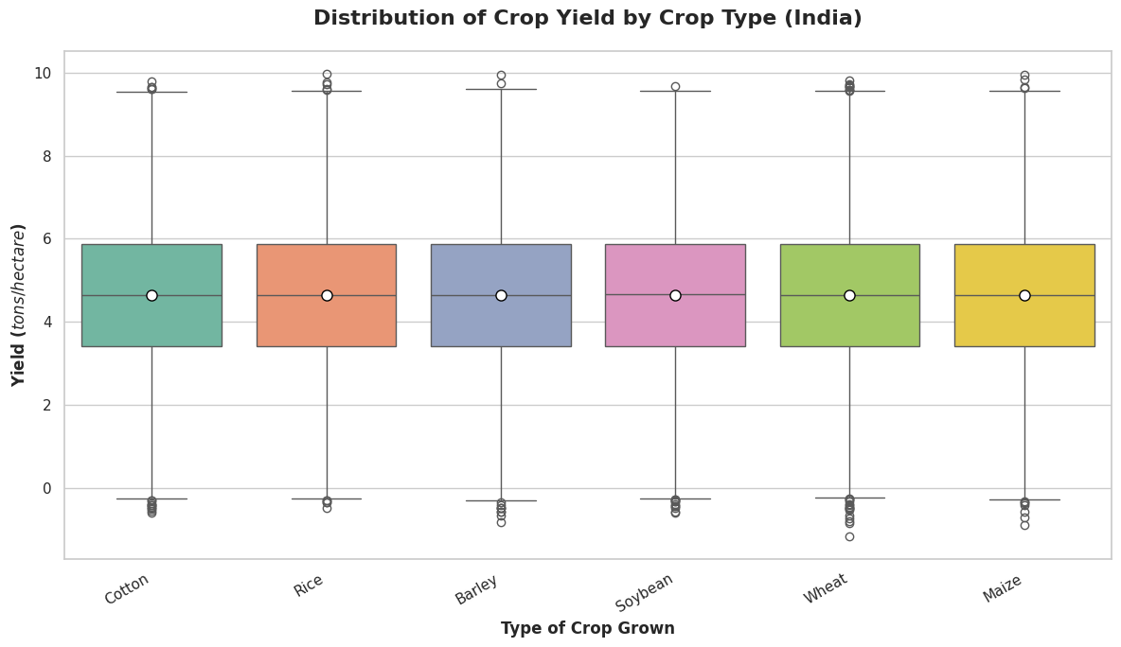
Dataset
Dataset Overview
Crop Yield by Type
Source: Kaggle — Agriculture Crop Yield
(samuelotiattakorah/agriculture-crop-yield)
Type: Tabular regression dataset
Total Samples: 1,000,000 rows
After Cleaning: 999,769 rows
Columns: 11 features
Target: Yield_tons_per_hectare
Key Features:
• Rainfall_mm, Temperature_Celsius
• Soil_Type, Crop, Region
• Fertilizer_Used, Irrigation_Used
• Days_to_Harvest, Weather_Condition

Slide 6
Ethical Implications
Data Privacy & Bias
Fairness & Accessibility
Environmental Impact
The dataset is synthetic/aggregated from Kaggle with no personal farmer data, minimizing privacy risks. However, regional bias (India only) limits global applicability. Label encoding of categorical features may introduce ordinal assumptions.
Predictions should not disadvantage smallholder farmers. Model outputs must be interpreted alongside local agricultural knowledge. Open-source tools (scikit-learn, SHAP) ensure reproducibility and equitable access.
Responsible use of ML-driven yield predictions can optimize fertilizer and water usage, reducing environmental footprint. However, over-reliance on predictions without ground truth validation could lead to harmful farming decisions.

Slide 7
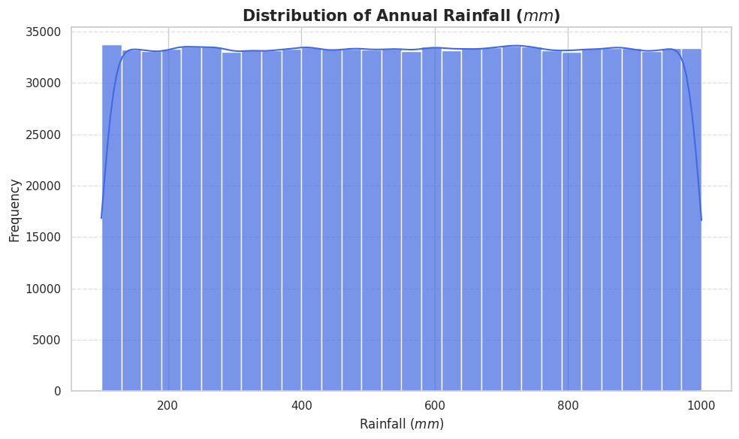
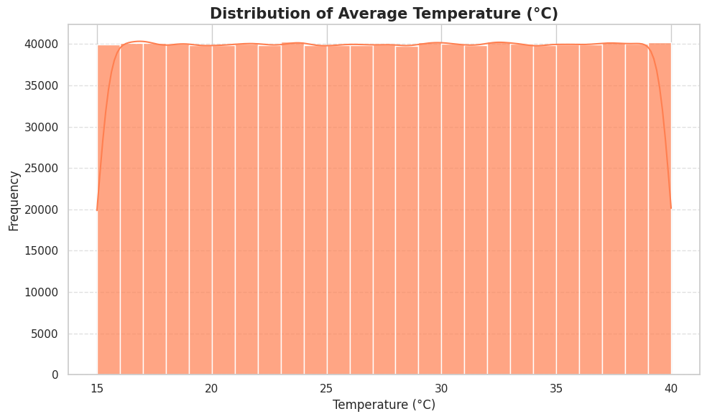
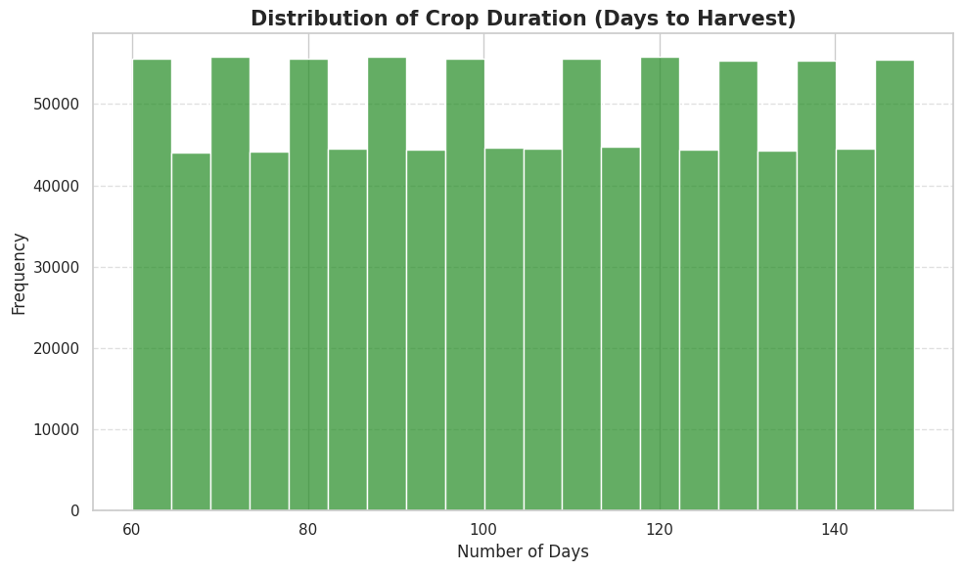
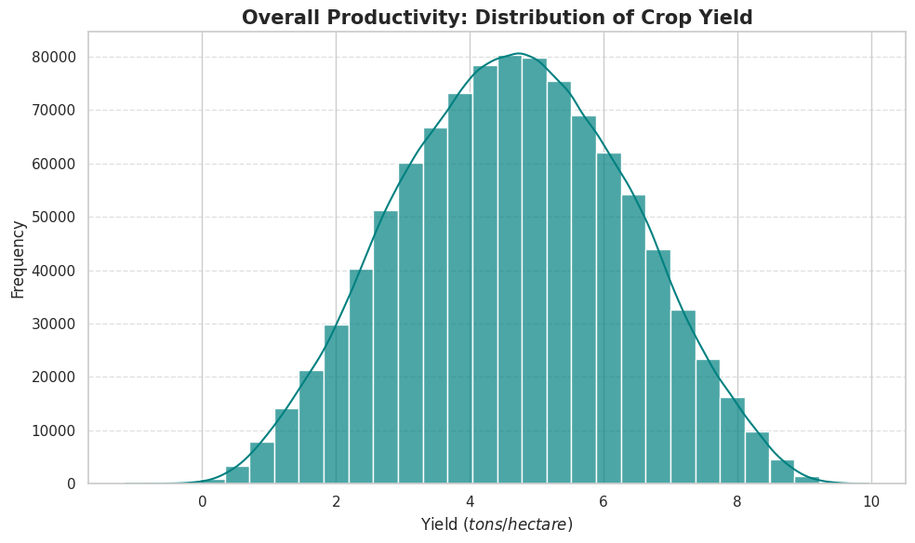
Exploratory Data Analysis
Rainfall Distribution
Temperature Distribution
Harvest Duration
Crop Yield Distribution

Slide 8
Data Pre-processing
Processing Pipeline
Dataset Statistics
1. Data Cleaning
• Removed 231 rows with negative yield values
• No missing values or duplicates found
2. Feature Encoding
• Boolean columns → integer (0/1)
• Categorical → Label Encoding
• Dropped 'Country' (constant value)
3. Feature Scaling
• StandardScaler (zero mean, unit variance)
• Applied to all features except target
4. Train-Test Split
• 80/20 split (random_state=42)
• Train: 799,815 | Test: 199,954
Feature | Mean | Std | Range
Rainfall (mm) | 549.98 | 259.85 | 100-1000
Temp (°C) | 27.50 | 7.22 | 15-40
Harvest Days | 104.50 | 25.95 | 60-149
Yield (t/ha) | 4.65 | 1.70 | -1.15 to 9.96
Encoding Summary
• Region: 3 categories → 0,1,2
• Soil_Type: 4 categories → 0,1,2,3
• Crop: 5 categories → 0,1,2,3,4
• Weather: 3 categories → 0,1,2
• Boolean features: True/False → 1/0

Slide 9
Models Used
Regression Model Pipeline
Linear Regression
Decision Tree (depth=10)
y = β₀ + β₁x₁ + ... + βₙxₙ
Baseline model with closed-form OLS solution. Assumes linearity between features and yield.
Recursive binary splitting on feature thresholds. min_samples_leaf=10 for regularization. Captures non-linear patterns.
Random Forest (n=50)
Ridge Regression
Ensemble of 50 trees with bagging. max_depth=10, min_samples_split=5. Reduces variance via averaging.
Linear model + L2 penalty (α). Minimizes: ||y - Xβ||² + α||β||². Controls overfitting when features are correlated.

Slide 10
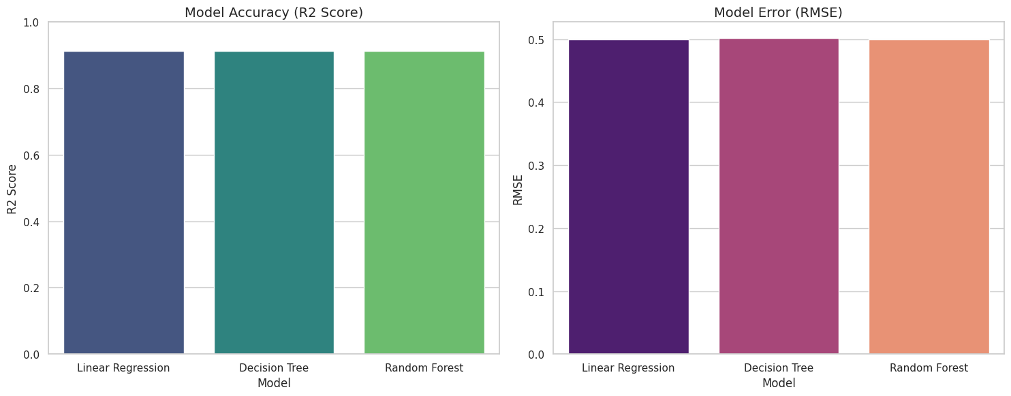
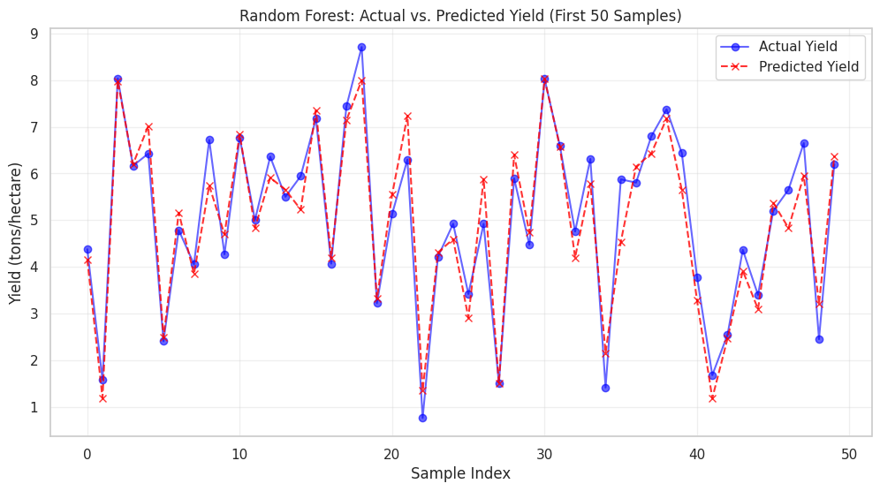
Model Results
Performance Comparison
Model Accuracy (R² Score)
Model | R² | RMSE | MAE
Linear Reg. | 0.9132 | 0.4993 | 0.3983
Decision Tree | 0.9122 | 0.5022 | 0.4008
Random Forest | 0.9129 | 0.5002 | 0.3991
Ridge | 0.9132 | 0.4993 | -
Random Forest: Actual vs Predicted (50 Samples)

Slide 11
Hyperparameter Tuning
Tuning Strategy
5-Fold Cross-Validation
GridSearchCV (Ridge & Decision Tree)
• Sample: 100,000 rows (10% of data)
• CV Folds: 3
Ridge Parameters:
• alpha: [0.1, 1.0, 10.0]
• Best: R² = 0.9132, RMSE = 0.4993
Decision Tree Parameters:
• max_depth: [10, 20]
• min_samples_leaf: [5, 10]
• Best: depth=10, leaf=10
• R² = 0.9122, RMSE = 0.5022
RandomizedSearchCV (Random Forest)
• n_estimators: [50]
• max_depth: [10, 20]
• min_samples_split: [5]
• Best: n=50, depth=10, split=5
• R² = 0.9129, RMSE = 0.5002
Model | Avg R² | Avg RMSE
Linear Reg. | 0.9130 | 0.5001
Decision Tree | 0.9119 | 0.5032
Random Forest | 0.9126 | 0.5011
Key Findings
• All models achieve ~91.3% variance explained
• Very stable across all 5 folds
• Ridge and Linear Regression perform nearly identically (both R² = 0.913)
• Minimal overfitting observed — train/test gap is negligible
• Hyperparameter tuning provided marginal improvement

Slide 12
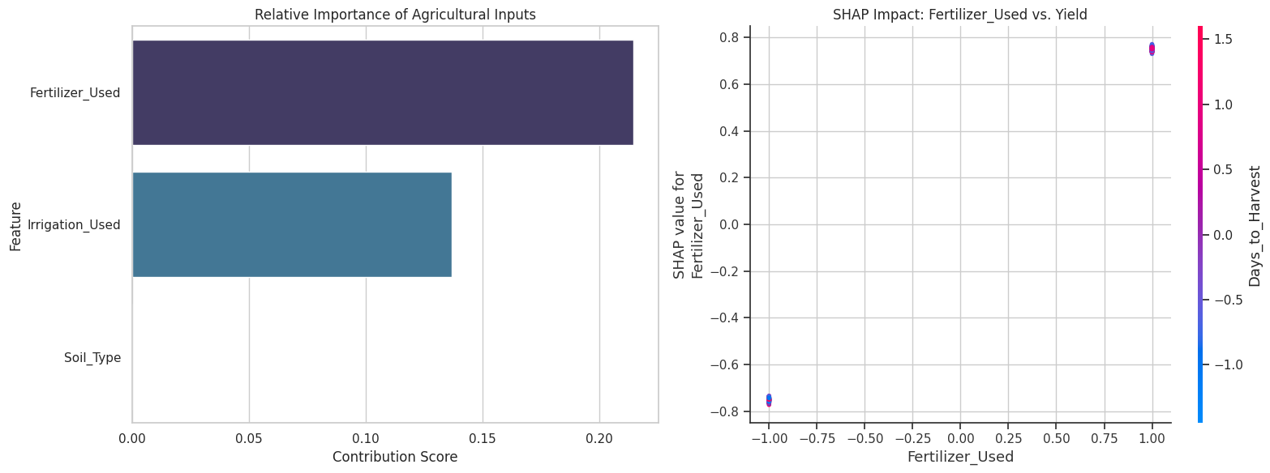
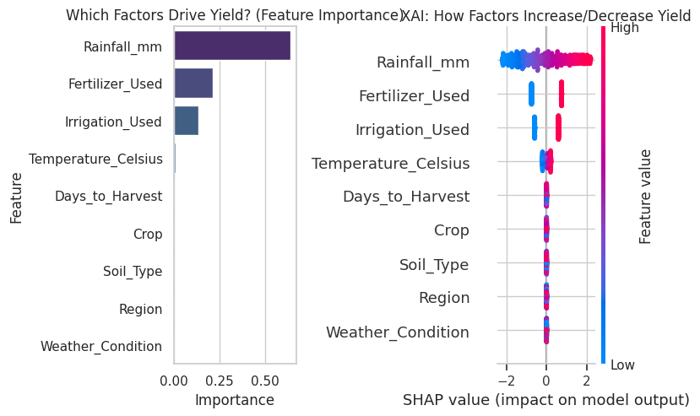
Analysis & Feature Importance
Feature Importance (RF)
Agricultural Inputs Impact
Result Satisfaction
All models achieve R² > 0.91, explaining over 91% of yield variance. Days_to_Harvest, Rainfall, and Temperature are the top 3 predictors.
Improvements planned:
• Larger hyperparameter search space
• Gradient Boosting (XGBoost, LightGBM)
• Deep learning for non-linear interactions
• Real-world multi-country datasets

Slide 13
Summary & Conclusions
Key Findings
Next Steps
• All 4 models achieved R² > 0.91 on 999,769 agricultural samples
• Ridge Regression achieved the best R² = 0.9132 with RMSE = 0.4993
• Days_to_Harvest is the single most important predictor of crop yield
• Rainfall and Temperature are the next most significant environmental factors
• SHAP analysis revealed directional feature impacts for transparent decision-making
• 5-fold cross-validation confirmed stable generalization across all models
• Expand to multi-country datasets for broader applicability
• Integrate temporal features (seasonal trends, climate change patterns)
• Test ensemble methods: XGBoost, LightGBM, Stacking
• Explore deep learning architectures for complex non-linear relationships
• Develop a user-friendly web application for real-time yield prediction
• Collaborate with agricultural domain experts for feature engineering

Slide 14
References
Takorah, S.O. (2024) 'Agriculture Crop Yield', Available at: https://www.kaggle.com/datasets/samuelotiattakorah/agriculture-crop-yield (Accessed: 26 January 2026). Pedregosa, F., Varoquaux, G., Gramfort, A., Michel, V., Thirion, B., Grisel, O., Blondel, M., Prettenhofer, P., Weiss, R., Dubourg, V. and Vanderplas, J. (2011) 'Scikit-learn: Machine Learning in Python', Journal of Machine Learning Research, 12, pp. 2825-2830. Lundberg, S.M. and Lee, S.I. (2017) 'A Unified Approach to Interpreting Model Predictions', in Advances in Neural Information Processing Systems, pp. 4765-4774. McKinney, W. (2010) 'Data Structures for Statistical Computing in Python', in Proceedings of the 9th Python in Science Conference, pp. 56-61. Harris, C.R., Millman, K.J., van der Walt, S.J. et al. (2020) 'Array programming with NumPy', Nature, 585(7825), pp. 357-362. Waskom, M.L. (2021) 'seaborn: statistical data visualization', Journal of Open Source Software, 6(60), p. 3021. Hunter, J.D. (2007) 'Matplotlib: A 2D graphics environment', Computing in Science & Engineering, 9(3), pp. 90-95.

