Slide 1
Set up of chrome to project

Slide 2
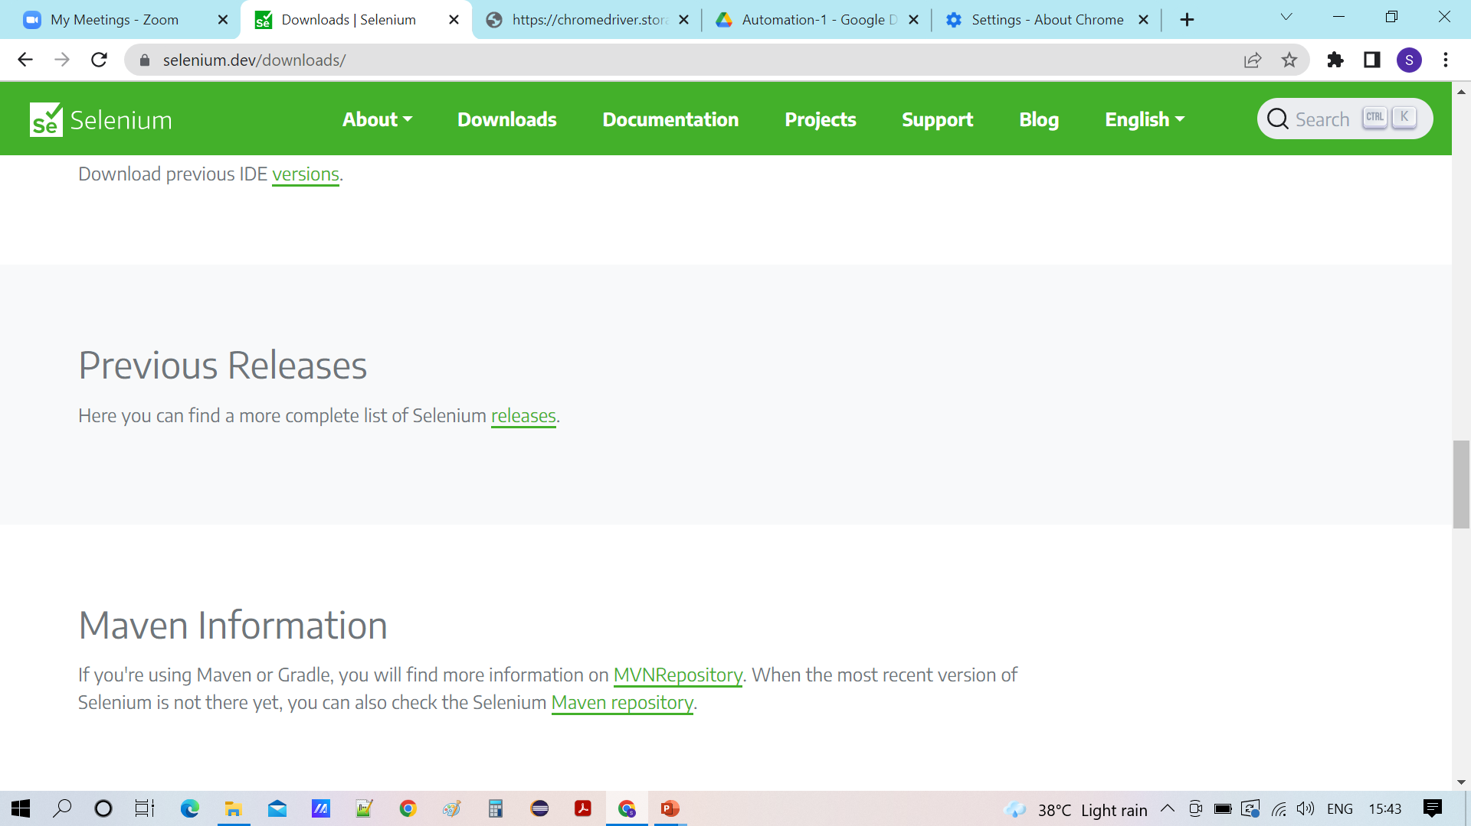




Slide 3
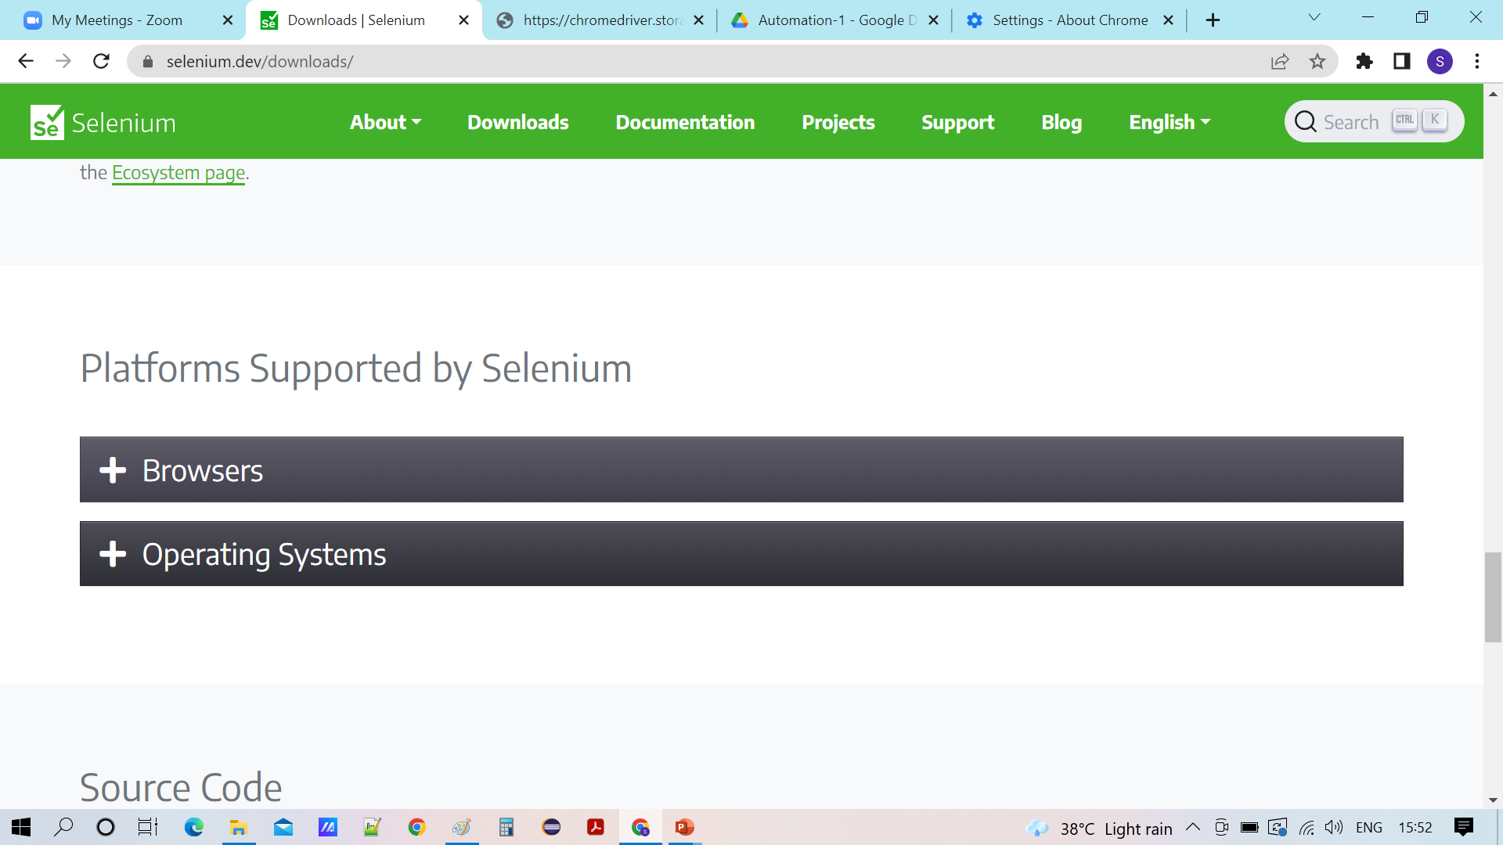

Slide 4
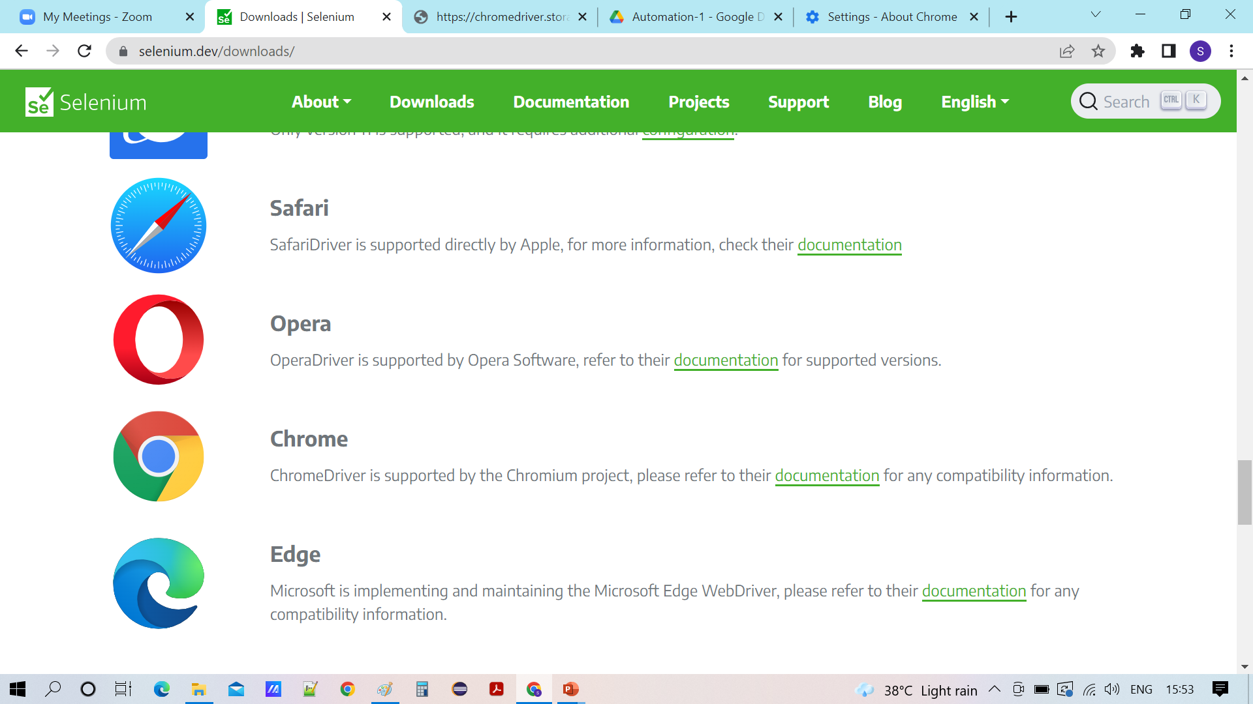

Slide 5
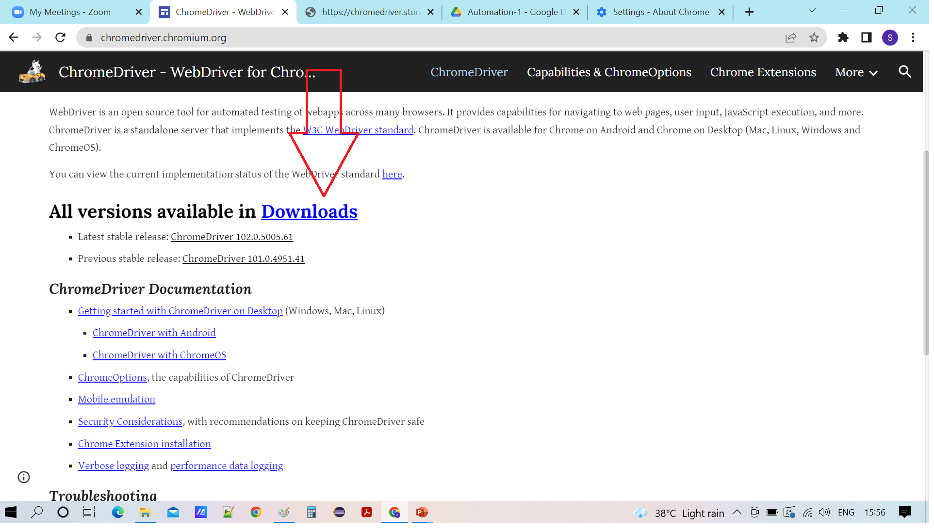

Slide 6
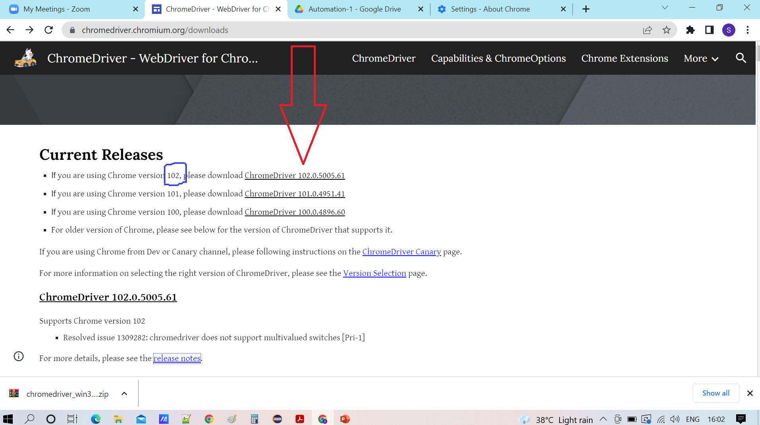

Slide 7
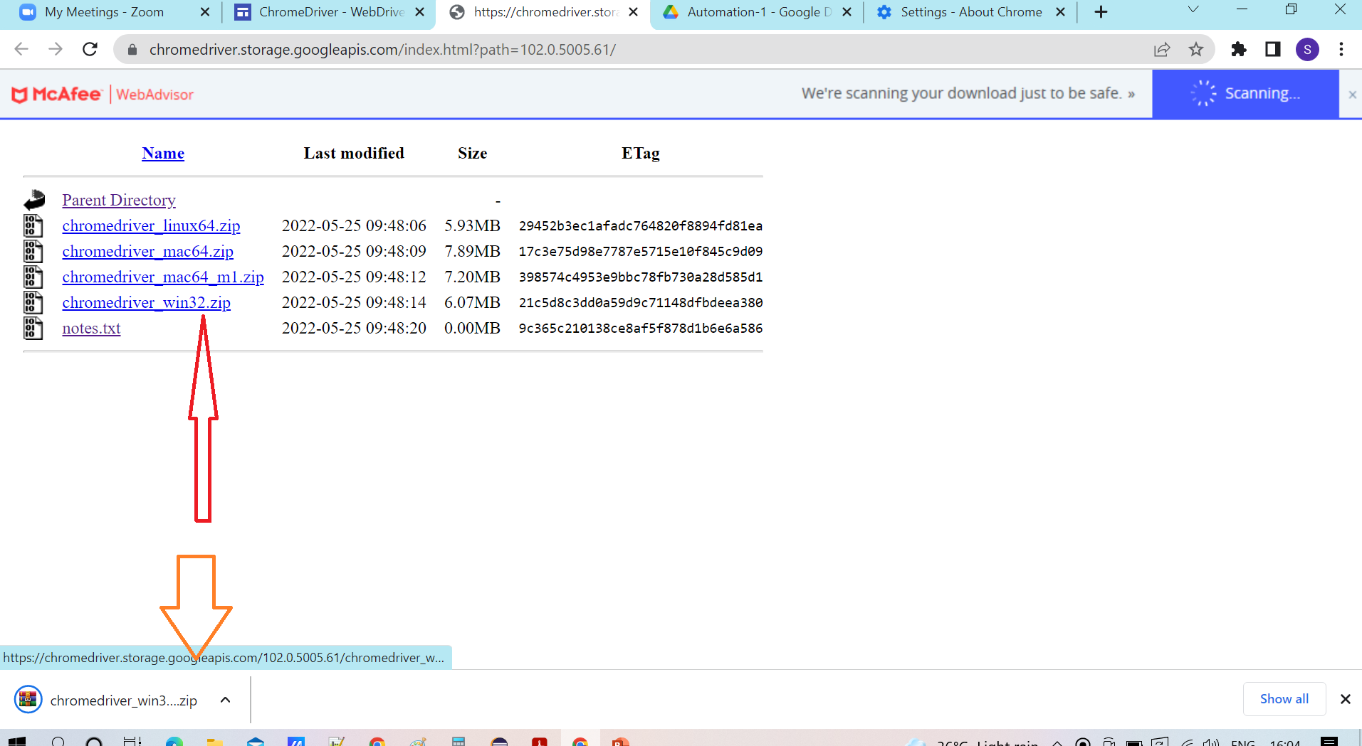

Slide 8
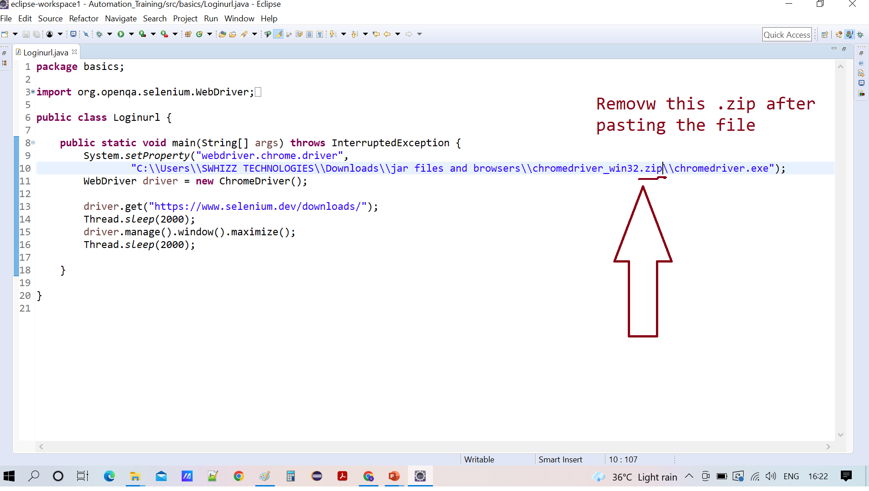

Slide 9
Or else update the chrome browser and use the .exe file which I have provided

Slide 10
Why Swhizz?
Follow the project-oriented training By working on user stories
Real time people will deliver the classes
Hands on experience.
One to One monitoring
Expertise in resume preparation
Mock interviews
Job assistance
Associated with 50+ Clients
900+ students got placed

Slide 11
Any Queries?

Slide 12
Thank You
Mr.SubbaRao (Relationship Manager)
Contact:9059002244

