Slide 1
Online Library Management System
Group Members :
Ayush Kumar Mishra AP22110010202
Darbha Sudha Vaishnavi AP22110010201
Aparajita Kundu AP22110010247

Slide 2

Overview
This presentation offers a detailed insight into our sophisticated Library Management System (LMS), meticulously crafted to enhance the management of books, borrowers, and library branches. At its core lies a robust database schema, represented through an Entity-Relationship Diagram (ERD), which serves as the backbone of the system (References: tbl_publisher, tbl_book, tbl_library_branch, tbl_borrower, tbl_book_loans, tbl_book_copies). By leveraging this system, librarians gain efficient tools to oversee various aspects of library operations, including cataloging books, managing borrower records, and monitoring book loans across multiple branches.

Slide 3

Table and Structures from DBMS Perspective
The comprehensive database schema of our LMS encompasses essential tables and structures crucial for efficient data management. Entities such as publishers, books, library branches, borrowers, book loans, and book copies are meticulously defined and interconnected, providing a structured framework for organizing library-related data (References: tbl_publisher, tbl_book, tbl_library_branch, tbl_borrower, tbl_book_loans, tbl_book_copies). This relational model ensures seamless data retrieval and manipulation, facilitating smooth functioning of the library system.

Slide 4
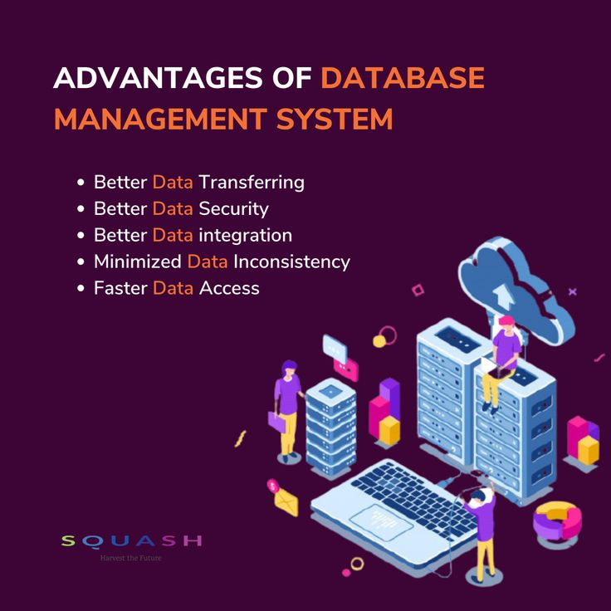
Advantages :
Our LMS offers numerous advantages, including streamlined library operations, enhanced data organization, and improved accessibility for librarians and patrons alike. By centralizing information about publishers, books, borrowers, and library branches, the system simplifies tasks such as cataloging, managing borrower accounts, and tracking book loans (References: tbl_publisher, tbl_book, tbl_library_branch, tbl_borrower, tbl_book_loans, tbl_book_copies). Additionally, the implementation of stored procedures enhances data querying and analysis capabilities, empowering librarians to make informed decisions for resource allocation and service optimization.

Slide 5
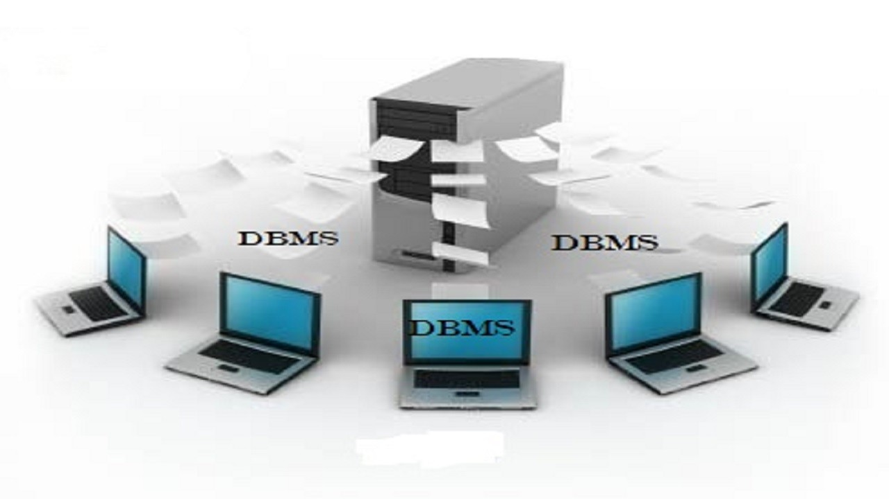
Usage:
The usage of our LMS spans various functionalities essential for efficient library management. Librarians can utilize the system to catalog new books, update existing records, manage borrower accounts, and track the circulation of books across different branches (References: tbl_publisher, tbl_book, tbl_library_branch, tbl_borrower, tbl_book_loans, tbl_book_copies). Moreover, patrons benefit from the system by accessing a well-organized catalog, checking book availability, and borrowing materials seamlessly.

Slide 6
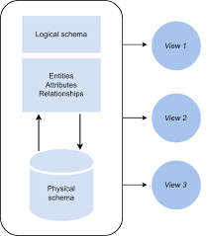
Database Schema :
The database schema of our LMS is meticulously designed to capture and organize pertinent information related to library operations. Entities such as publishers, books, borrowers, and book loans are interconnected through defined relationships, facilitating efficient data management (References: tbl_publisher, tbl_book, tbl_library_branch, tbl_borrower, tbl_book_loans, tbl_book_copies). This structured approach ensures optimal organization and accessibility of library resources for both librarians and patrons.

Slide 7
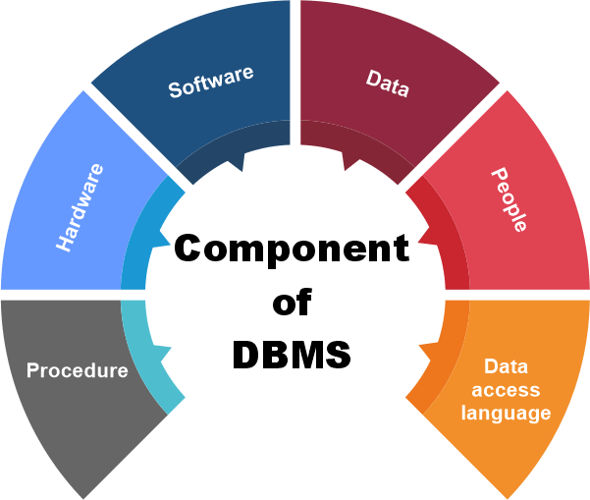
Procedure Overview:
Custom procedures play a vital role in enhancing the functionality of our LMS by enabling advanced data querying and analysis. These stored procedures, such as bookCopiesAtAllBranches and TotalLoansPerBranch, provide librarians with powerful tools to generate insightful reports and gain valuable insights into library operations (References: Stored procedures: bookCopiesAtAllSharpstown, bookCopiesAtAllBranches, NoLoans, LoanersInfo, TotalLoansPerBranch, BooksLoanedOut). By leveraging these procedures, librarians can make informed decisions for collection development and resource allocation.

Slide 8
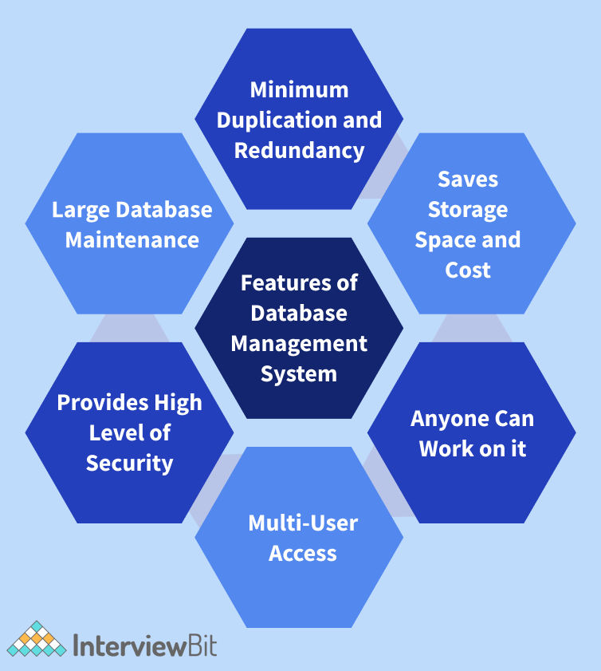
Feature: Book Availability
One notable feature of our LMS is its ability to track the availability of books across various library branches in real-time. By maintaining detailed records of book copies and their respective locations (References: tbl_book_copies, tbl_library_branch), the system enables librarians to quickly determine the availability of specific titles and efficiently fulfill patron requests. This feature enhances patron satisfaction and improves the overall user experience of the library system.

Slide 9
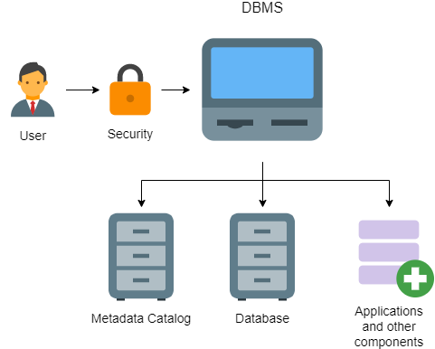
Feature: Fine Management
Our LMS includes robust functionality for managing fines associated with overdue book returns. Through the tracking of book loan records (References: tbl_book_loans), the system automatically calculates fines based on predefined rules and enforces timely returns. Librarians can efficiently monitor overdue loans, assess fines, and manage payment transactions, ensuring compliance with library policies and promoting responsible borrowing behavior.

Slide 10

Feature: Reporting and Analytics
Another key feature of our LMS is its comprehensive reporting and analytics capabilities, facilitated by custom procedures and structured data models. Librarians can generate detailed reports on various aspects of library operations, including book circulation statistics, borrower demographics, and collection usage patterns (References: Stored procedures: bookCopiesAtAllSharpstown, bookCopiesAtAllBranches, NoLoans, LoanersInfo, TotalLoansPerBranch, BooksLoanedOut). These insights empower librarians to make data-driven decisions for optimizing library services, improving resource allocation, and enhancing overall efficiency.

