Slide 1
BANK ACCOUNT MANAGEMENT SYSTEM
Project Mentor Presented By
S.ATHILAKSHMI SOWNDARIYA. R(920415205037)
AP/IT SUDHAKAR. P(920414205039)
AARTHY.N(920415205001)
KOUSALYA.S(920414205016)

Slide 2
Outline
Objective
Abstract
Problem Statement
System Requirements
Table Design
UML Diagram
List Of Modules
System Testing
Conclusion
References

Slide 3
Objective
The main objective of this project is to develop bank management system to manage account details.
Users have to visit bank to deposit or withdrawal amount. In present bank system it is also difficult to find account information of account holder.
In our bank account management system user can check his/her balance and he/she can also transfer money to other account. In this software you can keep record for daily bank transactions.
The main purpose of developing bank management system is to design an application, which could store bank data and provide an interface for retrieving customer related details with 100% accuracy.

Slide 4
Abstract
The main aim of this project is to develop software for Bank Account Management System.
This project has been developed to carry out the processes easily and quickly.
This project is developed using Python, MYSQL and Oracle use for database connection.
Using this system, user can check his account details.
This system is also help bank user to create new account easily.

Slide 5
PROBLEM STATEMENT
The main purpose of this bank management system is to provide a secure system.
Our system is password protected and it only allows authorized user to access various function available in the system.
Through this bank management system user can manage all bank account activity like deposit money, withdraw money, transfer money from one account to another account.
The Administrator can check bank account with a login can work out with account holders.

Slide 6
System Requirements
HARDWARE REQUIREMENTS
PROCESSOR: Intel
RAM: 4GB
SYSTEM TYPE: 64 bit operating system.
SOFTWARE REQUIRMENTS
FRONT END: Python 2.7
BACK END: Oracle11g , Cx_Oracle , ArgoUML

Slide 7
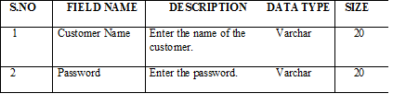
TABLE DESIGN
LOGIN TABLE

Slide 8
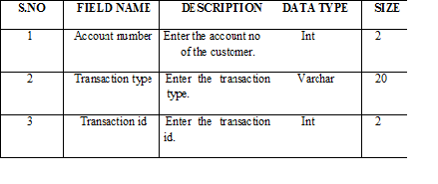
TRANSACTION TABLE

Slide 9
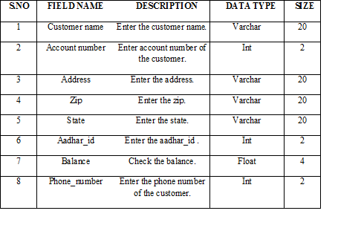
CUSTOMER TABLE

Slide 10

LOAN TABLE

Slide 11
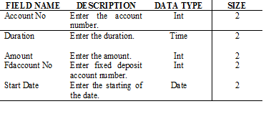
FIXED DEPOSIT TABLE

Slide 12
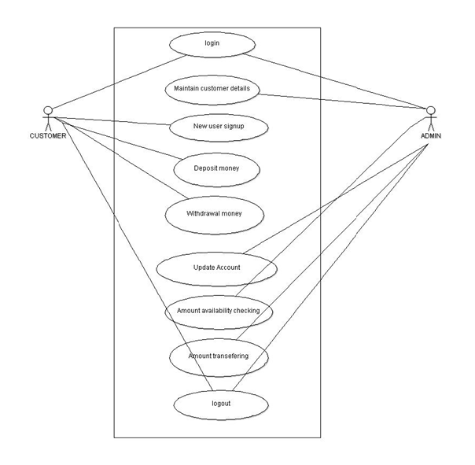
UML DIAGRAM ((USE CASE DIAGRAM))

Slide 13
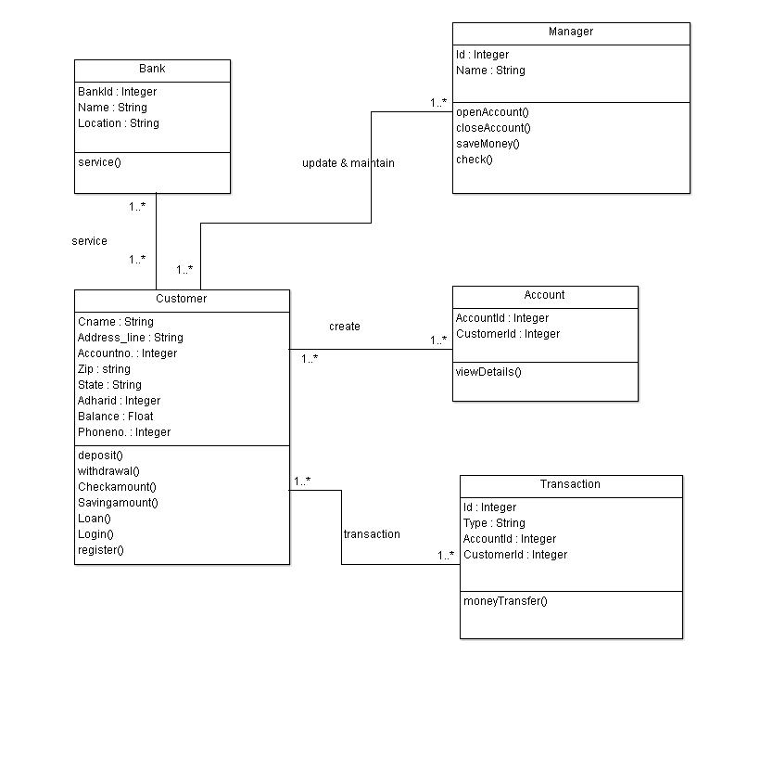
CLASS DIAGRAM

Slide 14
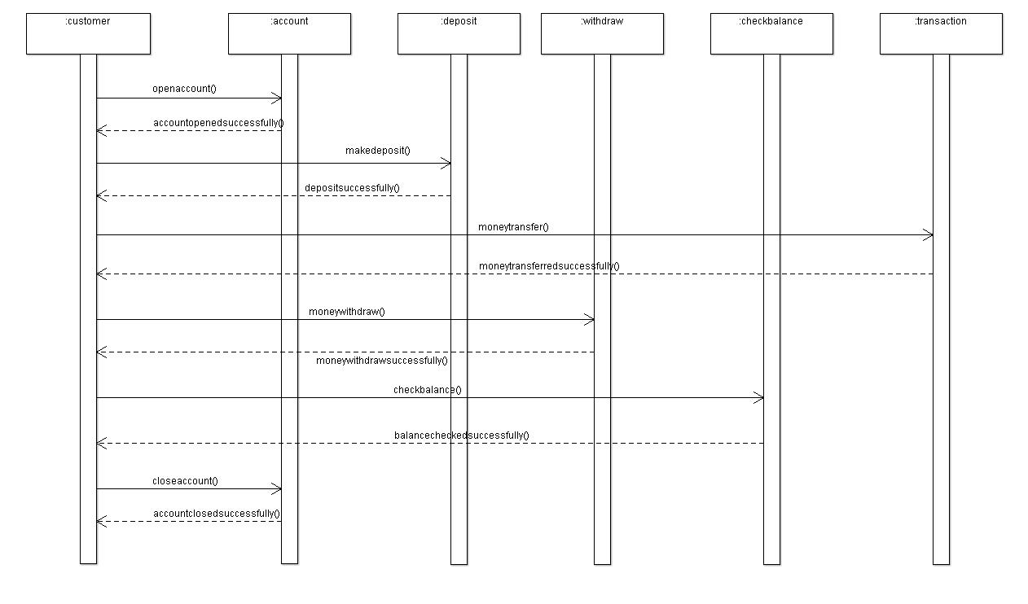
SEQUENCE DIAGRAM

Slide 15
LIST OF MODULES
Create new account
Deposit
Withdraw
Check status
Close account
Exit

Slide 16
ADMIN ROLE
Create new account
Deposit
Withdraw
Check status
Close account
Exit

Slide 17
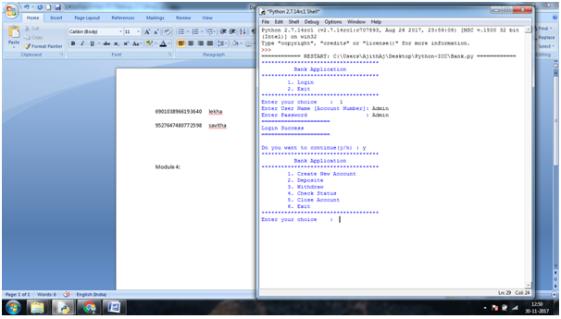
SCREEN SHOTS

Slide 18
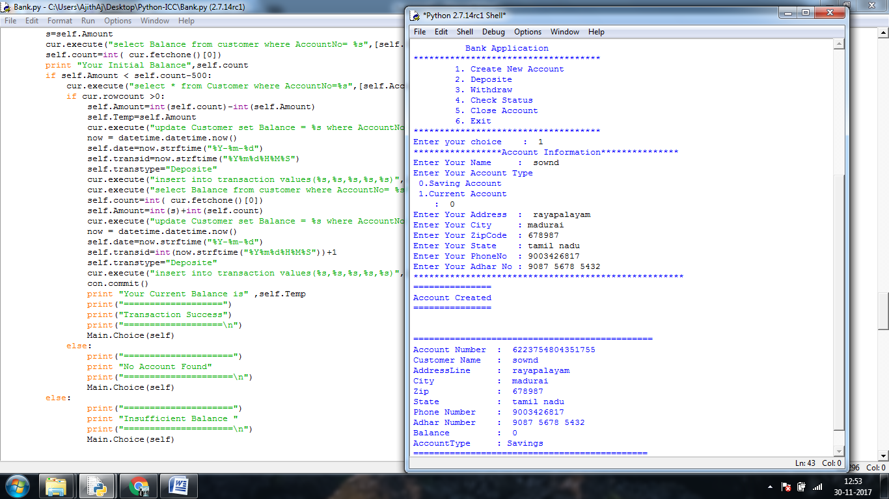

Slide 19
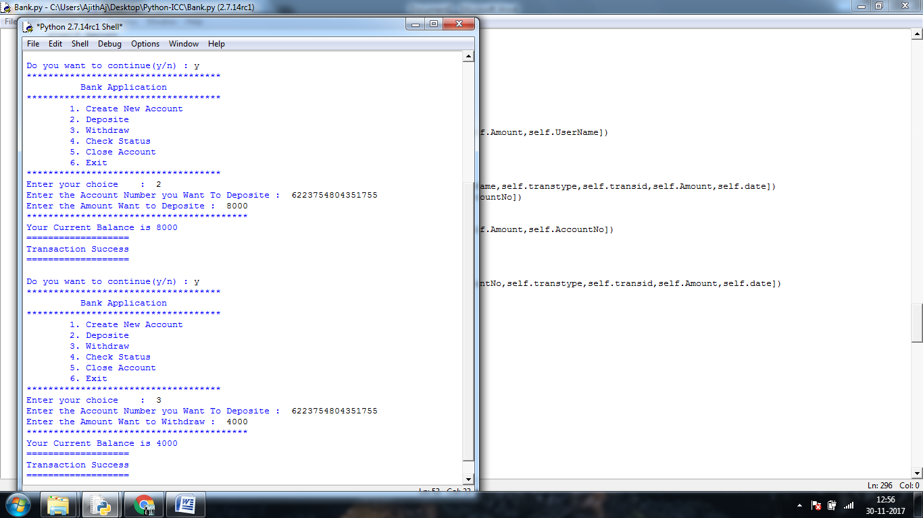

Slide 21
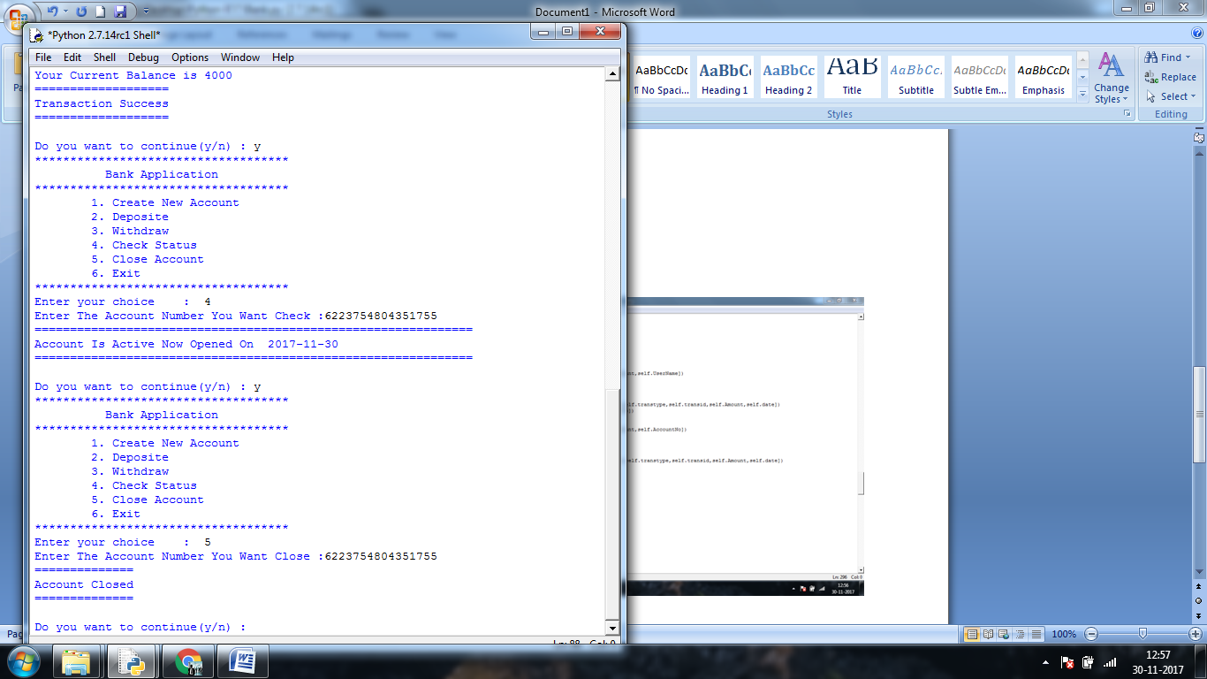

Slide 23
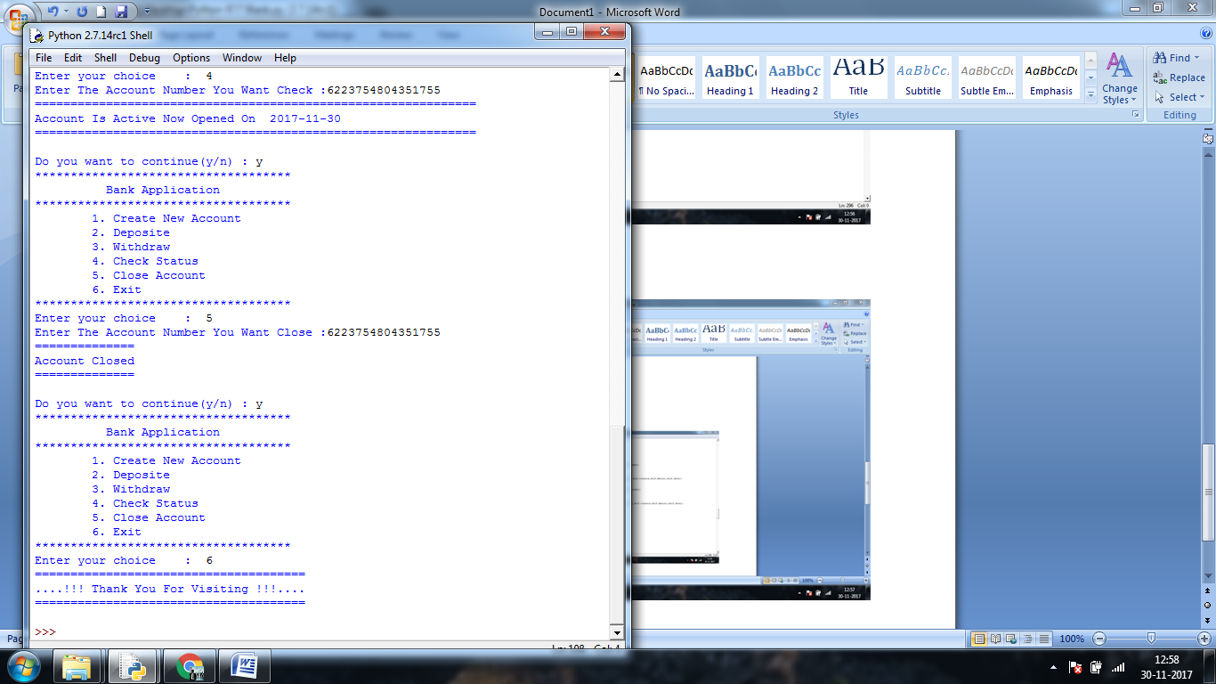

Slide 24
USER ROLE
Apply Loan
Fixed Deposit
Check Balance
Mini state
View account details
Exit

Slide 25
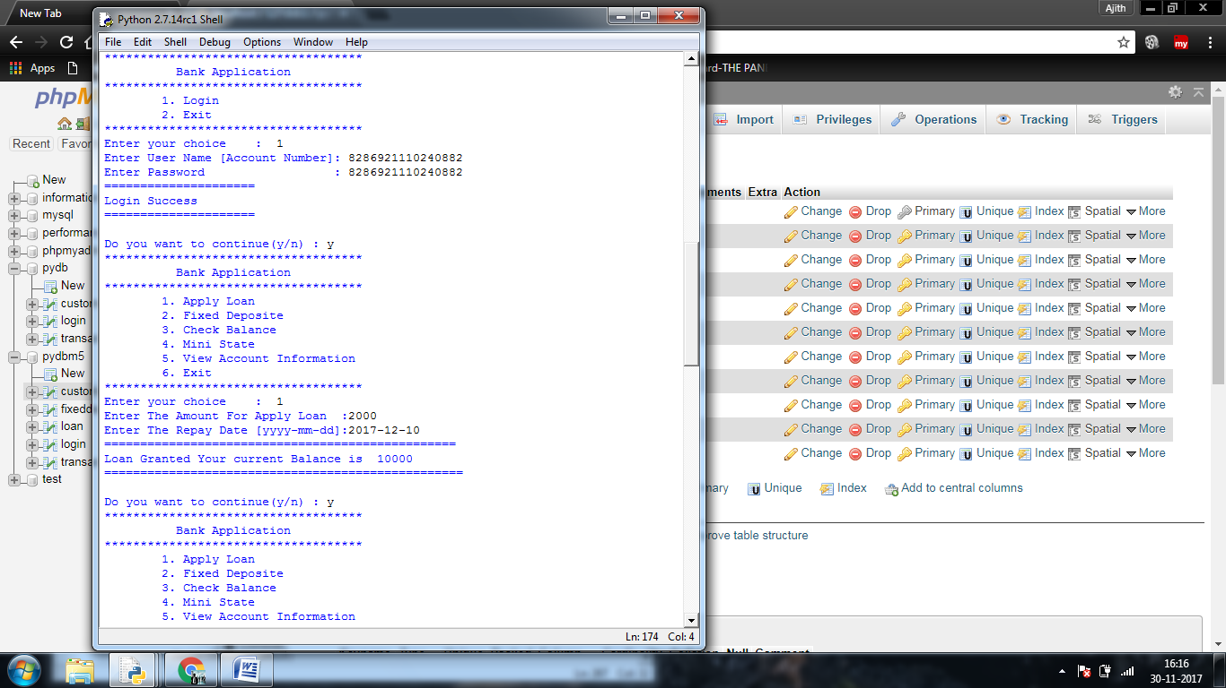
SCREEN SHOTS

Slide 27
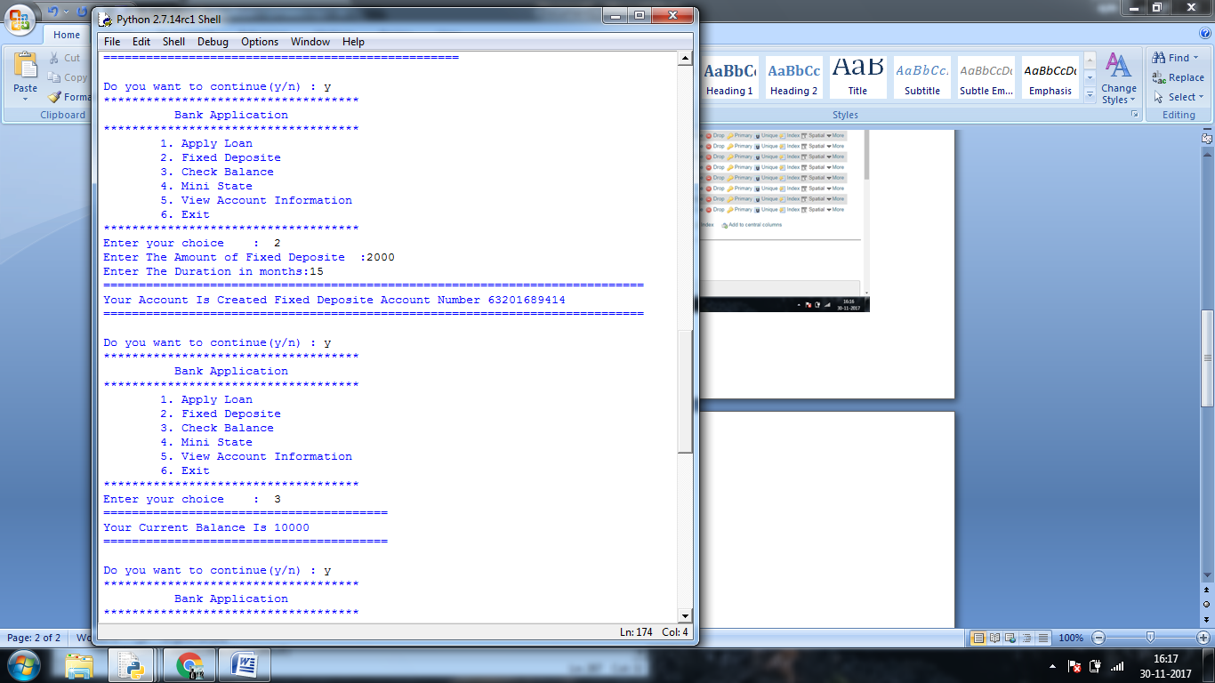

Slide 29
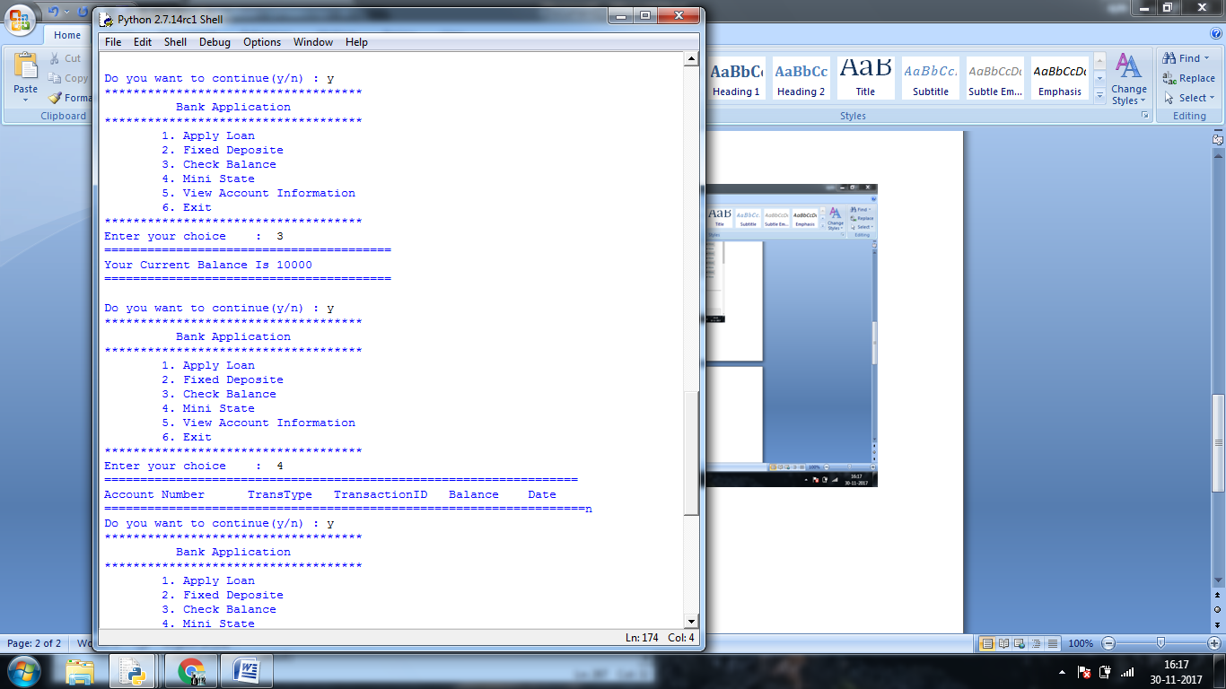

Slide 30
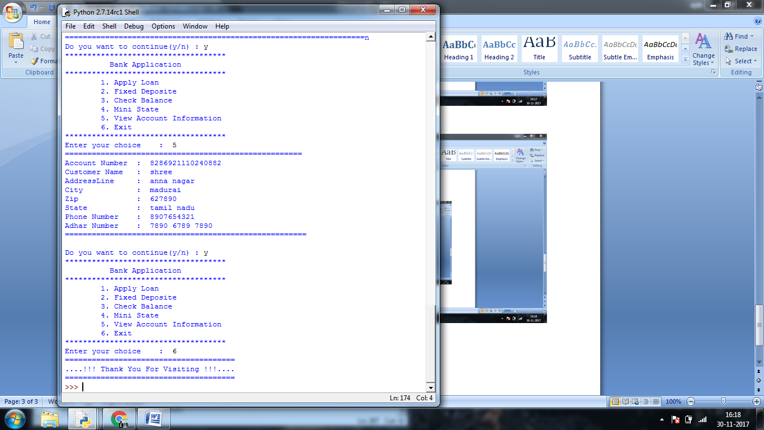

Slide 32
SYSTEM TETING
WHITE BOX TESTING
BLACK BOX TESTING
VALIDATION TESTING
ACCEPTANCE TESTING
UNIT TESTING
OUTPUT TESTING
TEST CASES

Slide 33
BLACK BOX TESTING
Black box testing is done to find incorrect or missing function.
Interface error
Performance errors
Initialization and termination errors
Errors in the external access

Slide 34
WHITE BOX TESTING
White Box testing is a test case design method that uses the control structure of the procedural design to drive cases.
Using the white box testing methods, we derived test cases that guarantee that all independent paths within a module have been exercised at least once.

Slide 35
VALIDATION TESTING
After the culmination of black box testing, software is completed assembly as a package, interfacing errors have been uncovered and corrected and final series of software validation tests begin.
validation testing can be defined as many, but a single definition is that validation succeeds when the software functions in a manner that can be reasonably expected by the customer.

Slide 36
ACCEPTANCE TESTING
User acceptance of the system is the key factor for the success of the system.
The system under consideration is tested for user acceptance by constantly keeping in touch with prospective system at the time of developing changes whenever required.

Slide 37
UNIT TESTING
Unit testing is the testing of each module and the integration of the overall system is done.
Unit testing becomes verification efforts on the smallest unit of software design in the Module. This is known as ‘module testing’.
This testing is carried out during the programming itself.
In this testing steps, each model found to be working satisfactorily as regard to be expected output from the module.

Slide 38
OUTPUT TESTING
After performing the validation testing, the next step is output asking the user about the format required testing of the proposed system.
Since no system could be useful if it does not produce the required output in the specific format.
The output displayed or generated by the system under consideration.
Here the output format is considered in two ways.
One is screen and the other is printed format.

Slide 39
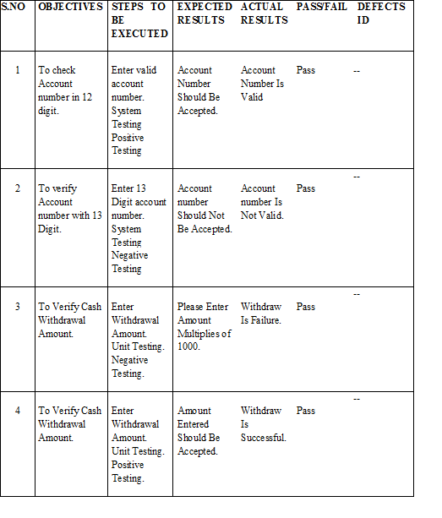
TEST CASES

Slide 40
Conclusion
This project is developed to nurture the needs of a user in a banking sector by embedding all the tasks of transaction taking place in a bank.
It also minimise the work and time. Future version of this software will still be much enhanced than the current version.
Thus the banking system is developed and executed successfully.
The proposed system has many added advantage that it is cost effective process which consumes less processing power.
It is an automated process.
Our system is password protected and it only allows authorized user to access various function available in the system.

Slide 41
Reference
John V Guttag, ―Introduction to Computation and Programming Using Python’’, Revised Edition 2013
Robert Sedgewick, Kevin Wayne, Robert Dondero, ―Introduction to Programming in Python.
Timothy A. Budd, ―Exploring Python‖, Mc-Graw Hill Education (India) Private Ltd.,, 2015.

