Slide 1
User Models:
Speller with word-completion/prediction
Sudhakaran Jain, Arnout Van Heereveld, Rohit Mandyam

Slide 2
What it does
3 word suggestions based on a letters chosen by traditional speller or previous words chosen by user (using 5-grams).
User can select the intended word using eye blinks. Spaces are added after the word is appended.
If a word is chosen or completed, suggestions for the next word will be shown
If the intended word was not present in the suggestions, the user can move on to type the next letter and so on..

Slide 3
How it works
List of frequently used words arranged in priority.
Parse through the list to find appropriate suggestions for the letter.
Respective priority value is increased if a suggested word is chosen.
For previous words in sentence, 5-gram list is parsed to suggest next intended word.
New/unknown words typed are added to word list to improve suggestions in future.

Slide 4
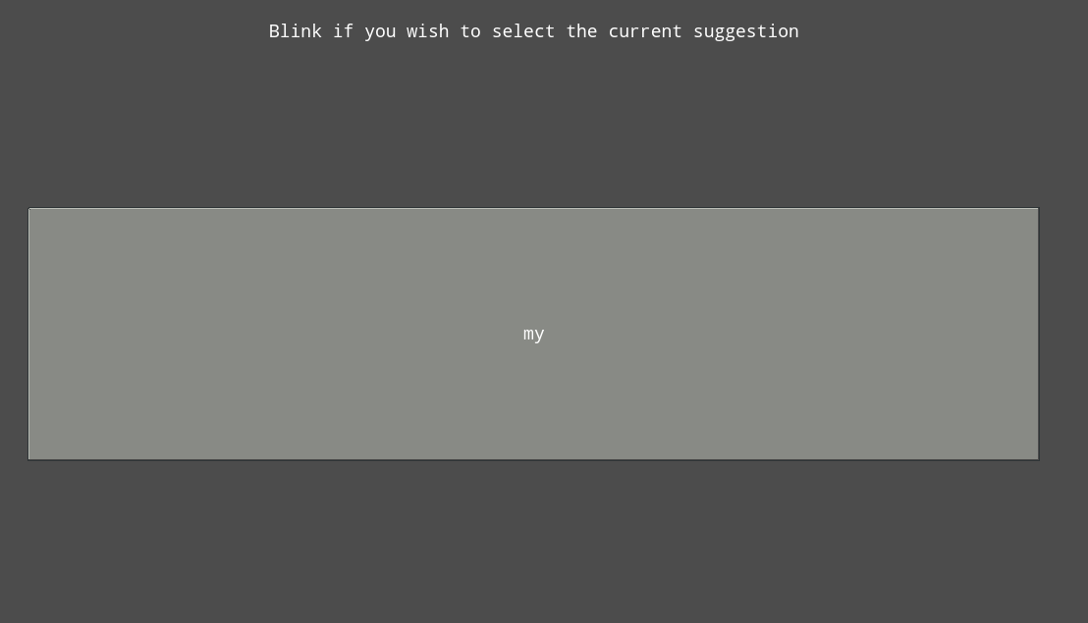
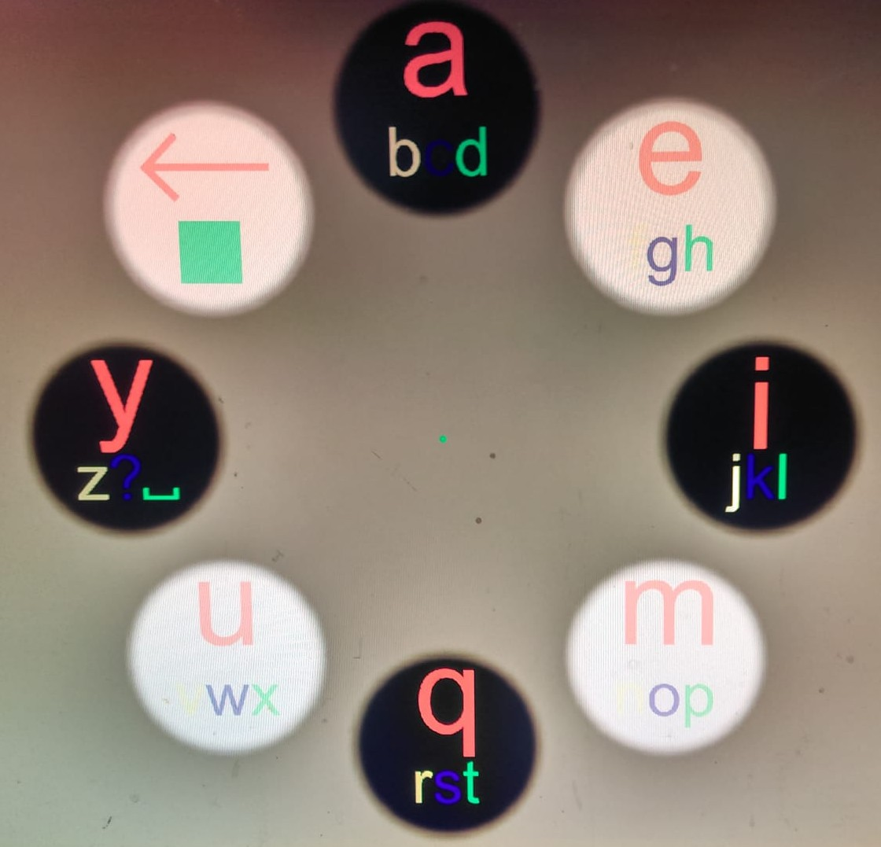
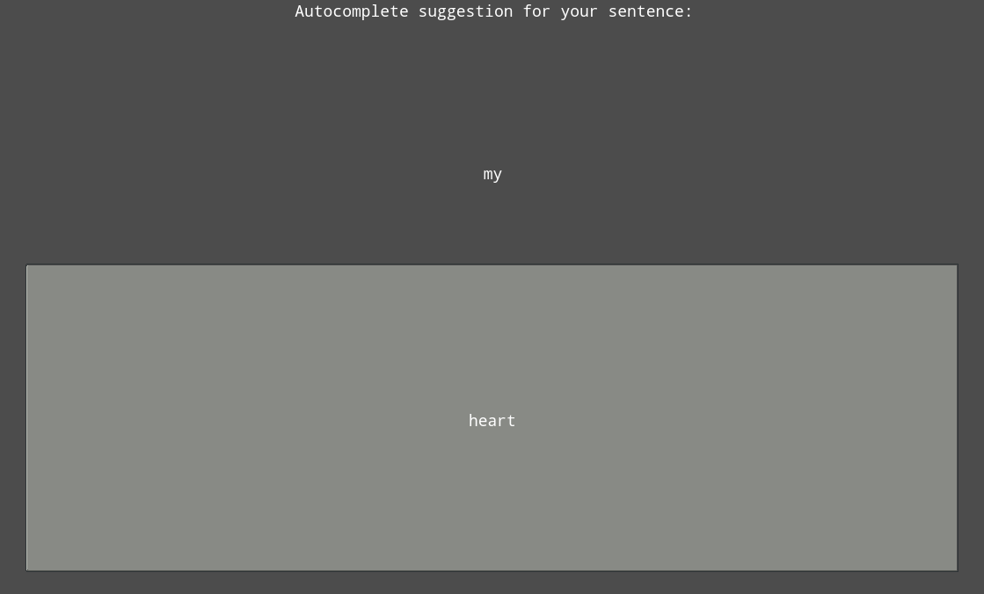
How it looks
Word suggested for letter ‘m’
Traditional Speller
Word predictions using 5-grams

Slide 5
Aim of proposed system
Faster sentence completion
Improved personal user experience
Lesser typo errors

Slide 6
Hypothesis:
Largest timesave believed to be because of keeping speller to the minimum
Expected amount of steps in traditional speller: 17
Expected amount after upgrade: 8 (+ selection menus)
Expected improvement: ~50%

Slide 7
Experiment:
Write the sentence “my name is lisa”
Traditional Speller
Our upgraded System
Compare the time it takes to complete this sentence

Slide 8
Participants:
7 Subjects
Students from RuG
Data from 3 subjects was discarded
Participants were unable to complete the task
Participants became frustrated

Slide 9
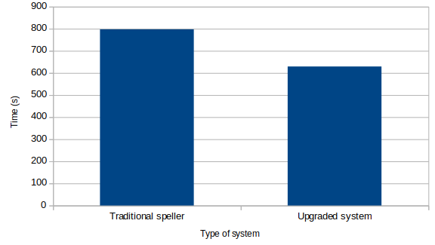
Results
Avg time taken by traditional speller: 797.4 seconds
Avg time taken by our
system: 629.2 seconds
Overall improvement:
Around 21%

Slide 10
Conclusion
Overall, our system led to faster task completion
We were able to reliably distinguish between normal and intentional blinks
However; Looking away also classified as an intentional blink
Blink detection proves to be a fast method for word selection
Improvements were there, but not as high as expected

Slide 11
Discussion
Fetching suggestions took more time than expected
Participants had trouble using the traditional speller
Check for fixation was dropped
Average error rate of 10%
Some participants became frustrated because of the impact of errors
Error handling needs to be improved
Erroneous blinks especially are detrimental
Verification could also be considered as a fail-safe
Only 5-grams used in the final version
The system cannot be easily used by anyone
Large individual differences in performance

Slide 12
Future work
Other ngrams to be incorporated
Find optimal parameters for updating repositories according to use
Optimizing the amount of time suggestions are shown
Prevent wrongful blink classifications when user is looking away
Improve the delete function

Slide 13
Thank You!

