Slide 1
RSVP Meetup

Slide 2
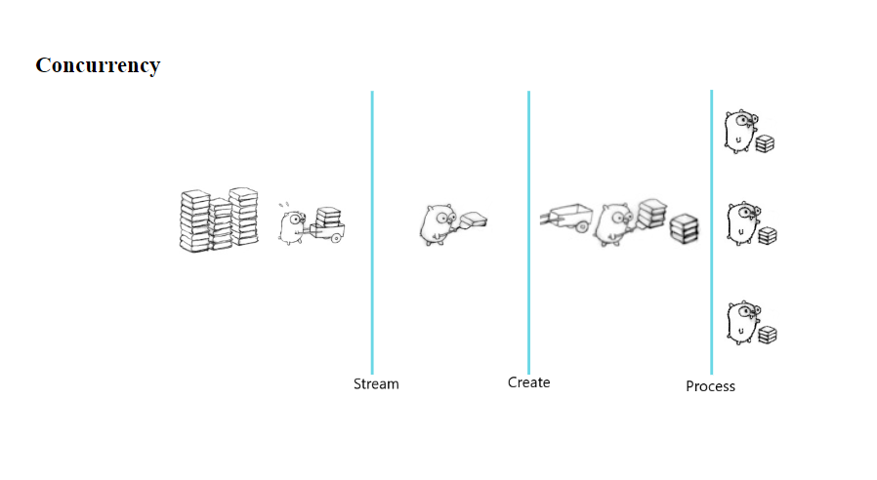

Slide 3
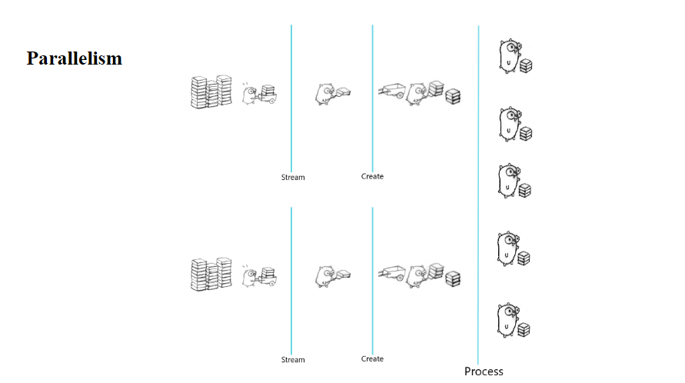

Slide 4
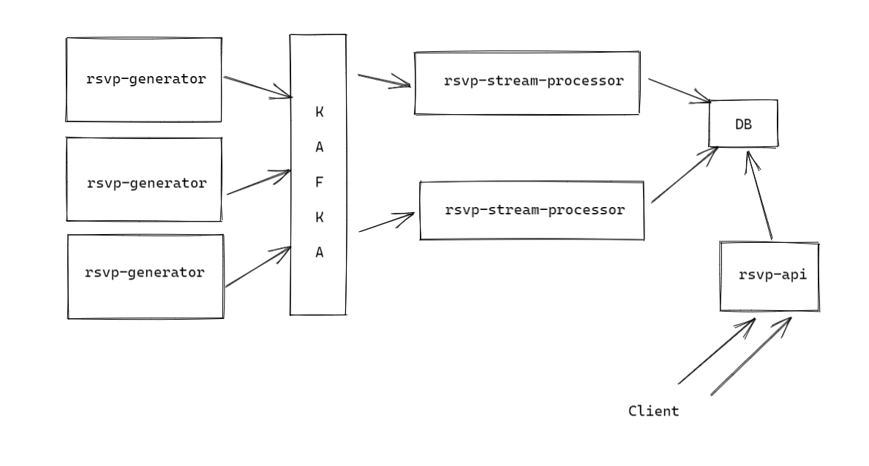
High level design

Slide 5
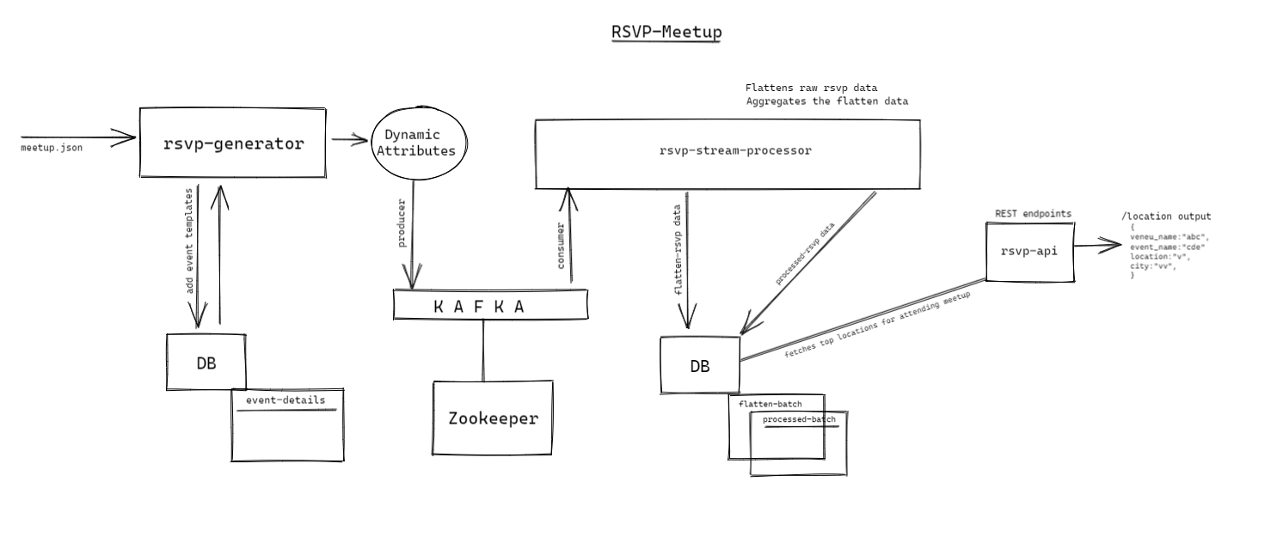
Detailed flow

Slide 6
Thank You

