Slide 1
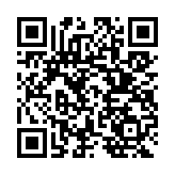
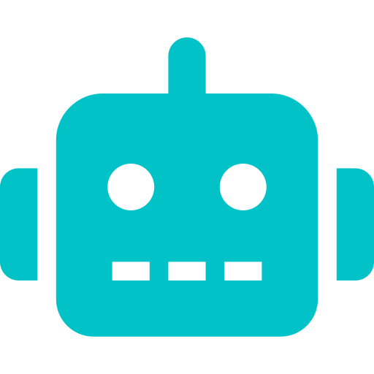
B2B Conversational Sales Agent
Autonomous Multi-Agent Orchestration for Telecom B2B Sales
Sudhaman Chandrasekaran · Raja · Arun Mohan · Aubin
Drexel University · CS Senior Design · Spring 2026
Google ADK
Gemini Flash
FastAPI
React 19
Multi-Agent

Slide 2
What We'll Cover Today
01
04
The Problem
Research Foundation & Dev Process
Why B2B Telco sales is broken
ADK, academic grounding, AI-assisted coding
02
05
The Solution & Architecture
Comcast Relevance
SuperAgent + 10 sub-agents
SMB segment, Comcast Business opportunities
03
06
Tech Stack & Implementation
Q&A
Stack, demo, and key decisions
2

Slide 3


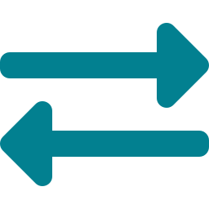
The Problem
A sales rep walks into a call with a mid-market prospect.
The prospect asks: "Can you connect our 8 locations in the Southeast with guaranteed SLAs?"
The rep opens 4 internal tools, 2 spreadsheets, and shoots a Slack to the solutions engineer.
The prospect emails a competitor while waiting.
RFP Hell
Product Complexity
Broken Handoffs
Avg B2B Telco RFP: 3–6 weeks. Reps manually stitch product specs, pricing, and eligibility — across siloed tools.
Hundreds of SKUs, bandwidth tiers, contract bundles. Reps can't hold it all. Customers wait. Deals slip.
Discovery → Quoting → Order → Fulfillment — each step a different team, different system. Nothing talks to anything.
3

Slide 4
The Solution
One conversation. End-to-end. No human switching tools.
SuperAgent Orchestrator
A hierarchical multi-agent system where a central SuperAgent routes every user message to the right specialist sub-agent — instantly, with full session context preserved. No human handoffs. No tool switching. One conversation thread drives the entire sales lifecycle.
1
2
3
4
5
6
Prospect
Discovery
›
Address
Serviceability
›
Product
Recommendation
›
Quote &
Pricing
›
Order &
Contract
›
Fulfillment
& Activation
Powered by Google ADK · Gemini Flash · FastAPI · React 19
4

Slide 5

Architecture: SuperAgent + 10 Specialist Agents
SuperAgent
Orchestrator
Greeting
Discovery
Serviceability
Product
Offer Mgmt
Order
Payment
Fulfillment
Comms
FAQ
Key Design Principles: Zero hallucination on critical data · Temperature-stratified agents (0.0 for deterministic, 0.7 for conversational) · Router-only SuperAgent (never generates user-facing text)
5

Slide 6
Tech Stack
Orchestration
Native sub-agent delegation, no custom A2A protocol
The Core Design Bet
Google ADK
✦
LLM decides, tools execute
LLM
Fast, cost-efficient; per-agent temperature config
The LLM classifies intent and routes. Addresses, prices, order IDs always come from deterministic tool calls — never hallucinated.
Gemini 3.0 Flash
Backend
Token streaming to React frontend; single Cloud Run container
✦
ADK-native delegation
FastAPI + SSE
No custom inter-agent protocol. ADK's transfer_to_agent() is the entire handoff mechanism. Simple by design.
Frontend
Real-time streaming chat UI
✦
Importlib isolation
React 19
Sub-agents loaded without triggering __init__.py — prevents ADK parent-binding conflicts in a monorepo.
Data
Lightweight, portable; synced to GCS for durability
SQLite + GCS sync
✦
Structured tool contracts
Tools return JSON, never prose. Prevents LLM from rephrasing critical values like prices or order IDs.
Deploy
Containerized monorepo; single startup script
GCP Cloud Run
6

Slide 7
Conversation Demo
Scenario: prospect inquires about connectivity
User: I need internet for my ice-cream shop Mango Mango . I am at 123 Main Street Philadelphia PA 19103
Agent → DiscoveryAgent: We're more than happy to have you as a customer! I've successfully registered Mango Mango at 123 Main Street in Philadelphia in our system.
To help me find the best internet options for your ice cream shop, could you tell me a bit more about what you're looking for?
User: Brand new location and new internet asap . I am Mr Mumbo Jumbo and i am the manager. My email id - User@gmail.com and Phone number is 434-444-4564. My budget is $400 per month
Agent → ServiceabilityAgent + ProductAgent: ✓ Address serviceable — Fiber available.
User: Show me all available products - internet (fiber and non fiber) and other products at this location
Agent → OfferManagementAgent: Based on the serviceability check for your location at 123 Main Street, Philadelphia, here are the available products across our categories..
7
→ Super Agent and Sub agent routes each turn automatically — user sees one seamless conversation

Slide 8
Key Technical Decisions
ADK transfer_to_agent()
JSON-only tool contracts
Zero-boilerplate agent handoff — no message queues, no custom protocol. ADK handles routing state.
Tools return structured JSON, never prose — eliminates LLM rephrasing risk on prices, order IDs, addresses.
SSE (Server-Sent Events)
SQLite + GCS sync pattern
One-directional token stream from FastAPI to React — simpler than WebSockets for LLM output.
Local-first for dev speed; GCS sync for Cloud Run statelessness without a full managed DB overhead.
Temperature stratification
Single Cloud Run container
0.0 for Order/Payment/Fulfillment agents (deterministic accuracy); 0.7 for Greeting/FAQ (natural conversation).
Backend (FastAPI) + frontend (served static) in one container — simplifies deployment, reduces cold-start complexity.
Importlib isolation
Per-agent system prompts
Prevents ADK parent-agent re-binding when loading sub-agents in a shared monorepo package structure.
Each agent has narrowly scoped instructions — prevents context bleed and keeps reasoning focused per domain.
8

Slide 9
How the Code Was Written
01
04
Architecture & Design First
GitHub for Coordination
Started with AGENTS.md, CLAUDE.md, and a full C4-style architecture brief. System prompt design was the first artifact — not code.
Feature branches per agent. PR-based code review across 4 team members. CLAUDE.md served as the AI context file for Claude Code in the repo.
02
05
AI-Assisted Development
Iterative Agent Testing
Claude Code used for scaffolding agents, FastAPI routes, and React components. ~70% of boilerplate generated; 100% human-reviewed for ADK correctness.
ADK dev server + per-agent log files in SuperAgent/logs/agents/. Each agent validated independently before integration into SuperAgent.
03
06
Human Judgment on Critical Paths
Spec-Driven Development
Agent routing logic, temperature config, tool contract schemas, and importlib isolation — all human-authored. AI doesn't know our ADK constraints.
AGENTS.md and Openspec files defined tool contracts before implementation. Prevented agent drift — each agent knew exactly what to own and what not to touch.
10

Slide 10
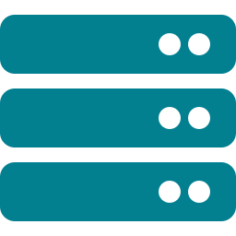


Research Foundation & Grounding
Google ADK
Cable/MSO Domain
Academic Grounding
Gemini API / ADK Shell
· Native hierarchical agent orchestration
· Real Comcast B2B product taxonomy mapped to agents
· Multi-agent LLM orchestration literature
· Gemini Flash for cost/speed tradeoff in production-grade use
· transfer_to_agent() as the primary delegation primitive
· Serviceability check mirrors actual BSS/OSS pre-sales flow
· Hierarchical decomposition patterns for domain-specific agents
· ADK shell provides CLI + dev server for rapid agent iteration
· Session state shared across all agents without custom sync
· Pricing/discount logic mirrors real enterprise telco quoting
· Tool-augmented LLM reasoning
· Google AI Studio for prompt engineering and evals
9

Slide 11

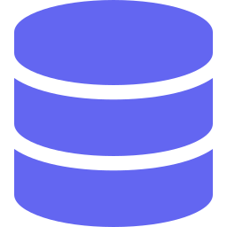


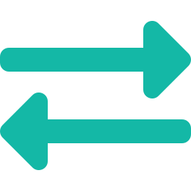

What This Means for Comcast
Immediate Fit: Comcast Business SMB segment — the exact profile this agent is designed for. Sub-100 employee businesses with multi-location needs, high churn from slow quoting cycles.
Churn Prediction Agent
CRM Integration Layer
Upsell Intelligence – using Sub Agents
Sub-agent that flags at-risk accounts mid-conversation and proactively generates retention offers
Connect to Dynamicsvia MCP — auto-log every conversation turn as a CRM activity, zero rep effort
Cross-agent signal: if Fulfillment sees 80% bandwidth utilization, trigger OfferMgmt for proactive upgrade quote
RFP Response Generator
Multi-tenant Architecture
SRE / NOC Agent Variant
Customer uploads an RFP PDF; agent generates a structured response using live product catalog + current pricing
Namespace agents per market segment (SMB vs Enterprise vs Wholesale) — same orchestration pattern, different policy layers
Reuse SuperAgent pattern for internal ops: customer reports outage → DiscoveryAgent → ServiceFulfillment → ticket auto-generated
11

Slide 12
What We Built
✓ A production-grade multi-agent system — not a demo chatbot
✓ Hierarchical orchestration: 1 SuperAgent routing 10 specialists, with zero custom protocol
✓ Zero hallucination on critical data — prices, orders, addresses always from deterministic tools
✓ Full B2B sales lifecycle: Discovery → Quote → Order → Fulfillment in one conversation thread
✓ A pattern directly transferable to Comcast Business SMB sales automation
Q & A
github.com/sudhamanc/ConversationalSalesAgent

