Slide 1


B2B Conversational Sales Agent
Autonomous Multi-Agent Orchestration for Telecom B2B Sales
Sudhaman Chandrasekaran · Raja Barathan · Arun Mohan · Aubin Clever
Drexel University · CS Senior Design · Spring 2026
Google ADK
Gemini Flash
FastAPI
React 19
Multi-Agent
github.com/sudhamanc/ConversationalSalesAgent

Slide 2
What We'll Cover Today
01
04
The Problem
Research Foundation & Dev Process
Why B2B Telco sales is broken
ADK, academic grounding, AI-assisted coding
02
05
The Solution & Architecture
Comcast Relevance
SuperAgent + 10 sub-agents
SMB segment, Comcast Business opportunities
03
06
Tech Stack & Implementation
Work Done
Stack, demo, and key decisions
The team
2

Slide 3


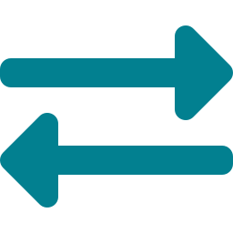
The Problem
A sales rep walks into a call with a mid-market prospect.
The prospect asks: "Can you connect our 8 locations in the Southeast with guaranteed SLAs?"
The rep opens 4 internal tools, 2 spreadsheets, and shoots a Slack to the solutions engineer.
The prospect emails a competitor while waiting.
RFP Hell
Product Complexity
Broken Handoffs
Avg B2B Telco RFP: 3–6 weeks. Reps manually stitch product specs, pricing, and eligibility — across siloed tools.
Hundreds of SKUs, bandwidth tiers, contract bundles. Reps can't hold it all. Customers wait. Deals slip.
Discovery → Quoting → Order → Fulfillment — each step a different team, different system. Nothing talks to anything.
3

Slide 4
The Solution
One conversation. End-to-end. No human switching tools.
SuperAgent Orchestrator
A hierarchical multi-agent system where a central SuperAgent routes every user message to the right specialist sub-agent — instantly, with full session context preserved. No human handoffs. No tool switching. One conversation thread drives the entire sales lifecycle.
1
2
3
4
5
6
Prospect
Discovery
›
Address
Serviceability
›
Product
Recommendation
›
Quote &
Pricing
›
Order &
Contract
›
Fulfillment
& Activation
Powered by Google ADK · Gemini Flash · FastAPI · React 19
4

Slide 5

Architecture: SuperAgent + 10 Specialist Agents
SuperAgent
Orchestrator
Greeting
Discovery
Serviceability
Product
Offer Mgmt
Order
Payment
Fulfillment
Comms
FAQ
Key Design Principles: Zero hallucination on critical data · Temperature-stratified agents (0.0 for deterministic, 0.7 for conversational) · Router-only SuperAgent (never generates user-facing text)
5

Slide 6





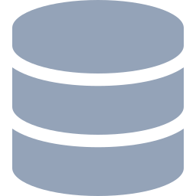

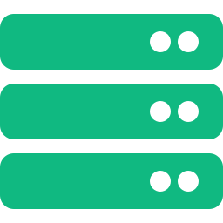



Agent –Workflows - Architecture Diagram
Discovery
Serviceability
Product
Offer Mgmt
Order
React + FastAPI
SuperAgent
SQLite DB
GIS API
Chroma RAG
Orchestrator
Payment
Fulfillment
Comms
Greeting
FAQ
8 / 21

Slide 7
Conversation Demo
Scenario: prospect inquires about connectivity
User: I need internet for my ice-cream shop Mango Mango . I am at 123 Main Street Philadelphia PA 19103
Agent → DiscoveryAgent: We're more than happy to have you as a customer! I've successfully registered Mango Mango at 123 Main Street in Philadelphia in our system.
To help me find the best internet options for your ice cream shop, could you tell me a bit more about what you're looking for?
User: Brand new location and new internet asap . I am Mr Mumbo Jumbo and i am the manager. My email id - User@gmail.com and Phone number is 434-444-4564. My budget is $400 per month
Agent → ServiceabilityAgent + ProductAgent: ✓ Address serviceable — Fiber available.
User: Show me all available products - internet (fiber and non fiber) and other products at this location
Agent → OfferManagementAgent: Based on the serviceability check for your location at 123 Main Street, Philadelphia, here are the available products across our categories..
7
→ Super Agent and Sub agent routes each turn automatically — user sees one seamless conversation

Slide 8
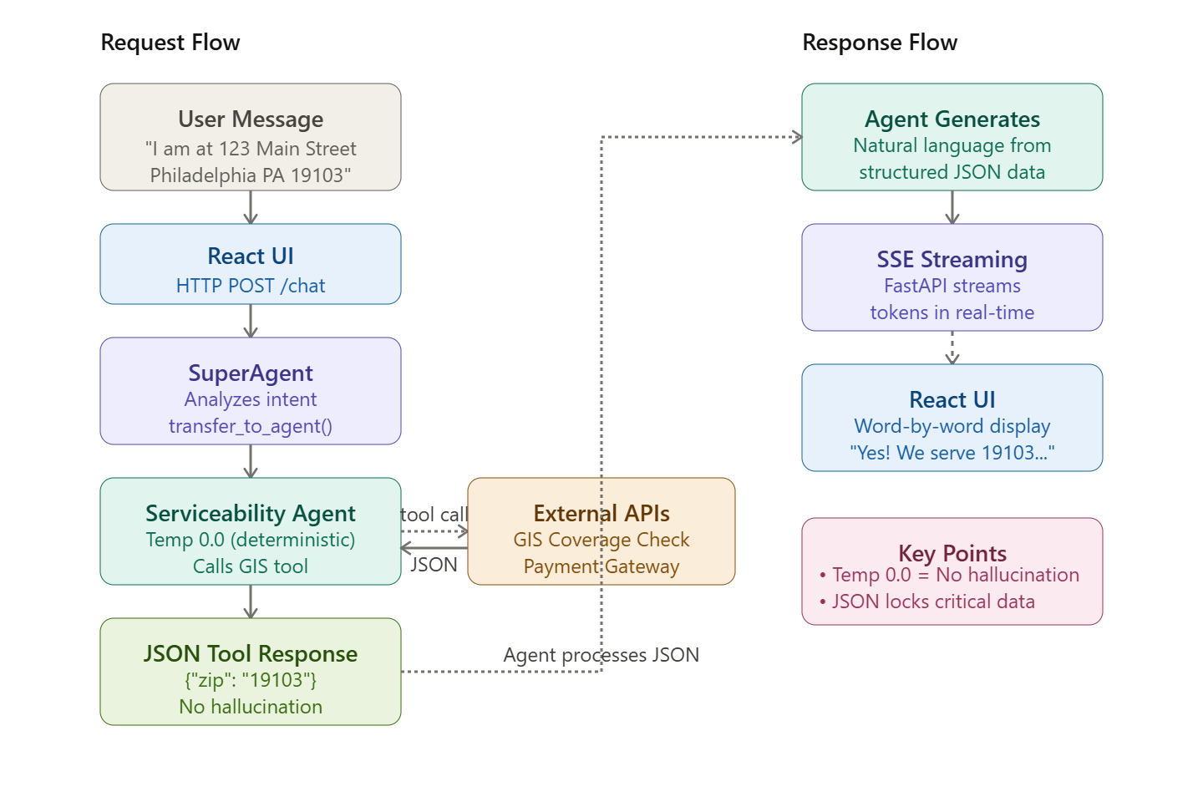
Conversation Demo Request
7

Slide 9
Tech Stack
Orchestration
Native sub-agent delegation, no custom A2A protocol
The Core Design Bet
Google ADK
✦
LLM decides, tools execute
LLM
Fast, cost-efficient; per-agent temperature config
The LLM classifies intent and routes. Addresses, prices, order IDs always come from deterministic tool calls — never hallucinated.
Gemini 3.0 Flash
Backend
Token streaming to React frontend; single Cloud Run container
✦
ADK-native delegation
FastAPI + SSE
No custom inter-agent protocol. ADK's transfer_to_agent() is the entire handoff mechanism. Simple by design.
Frontend
Real-time streaming chat UI
✦
Importlib isolation
React 19
Sub-agents loaded without triggering __init__.py — prevents ADK parent-binding conflicts in a monorepo.
Data
Lightweight, portable; synced to GCS for durability
SQLite + GCS sync
✦
Structured tool contracts
Tools return JSON, never prose. Prevents LLM from rephrasing critical values like prices or order IDs.
Deploy
Containerized monorepo; single startup script
GCP Cloud Run
6

Slide 10
Key Technical Decisions
ADK transfer_to_agent()
Temperature stratification
Native multi-agent delegation method in Google ADK. Enables seamless handoff between agents without custom message queues or orchestration protocols. ADK manages routing state internally.
Without this we would need to manually build:
Custom protocols to track which agent is active
State management to remember conversation context
Routing logic to decide which agent handles what
Message queues to pass data between
Critical data agents (Order, Payment, Fulfillment) use temperature 0.0 for deterministic, accurate responses on prices and order IDs. Conversational agents (Greeting, FAQ, SuperAgent) use 0.7 for natural language generation. This prevents hallucinations on financial data while maintaining natural conversation.
SSE (Server-Sent Events)
Importlib isolation
SSE (Server-Sent Events) is the technology that enables real-time streaming of the AI agent responses from our backend to the user's browser.
As Gemini generates tokens, SSE streams them to the frontend immediately. Simpler than WebSockets since communication is unidirectional (server-to-client only).
Is a Python technique that loads modules in separate namespaces to prevent them from sharing state or interfering with each other.
This allow us, when loading our ten sub-agents (Discovery, Serviceability, Product, Offer, Order, Payment, Fulfillment, Comms, Greeting, FAQ) in the shared monorepo, importlib to avoid namespace collisions. Without this, the ADK would re-bind parent-agent references causing cross-agent contamination during dynamic imports.
9

Slide 11
Key Technical Decisions
JSON-only tool contracts
Single Cloud Run container
All agent tools return structured JSON schemas instead of natural language. This eliminates LLM rephrasing risks on critical data like prices, order IDs, and addresses, ensuring data integrity.
This means when the Serviceability Agent gets a zip code "19103" from the GIS API, it stays exactly "19103" in the JSON response, and the LLM cannot rephrase it to "19106" or any other value when presenting it to the customer.
Unified deployment model where FastAPI backend and React frontend (served as static files) run in a single Cloud Run container. Simplifies deployment configuration and reduces cold-start complexity.
This makes the entire system easier to version, roll back, and monitor since there's only one deployment artifact to track instead of coordinating versions across separate frontend and backend services.
SQLite + GCS sync pattern
Per-agent system prompts
Each sub-agent receives domain-specific system prompts tailored to its function. By giving each agent domain-specific instructions that explicitly define what it should and shouldn't do, we keep each agent's reasoning focused, prevent cross-contamination of responsibilities, and ensure that only agents with the right tools and temperature settings handle the questions they're designed for.
Hybrid storage approach. SQLite provides fast local-first development with file-based persistence. Google Cloud Storage sync pattern handles Cloud Run statelessness without the overhead of a full managed database.
This gives us the development speed of a local file and the production reliability of cloud-backed persistence without the operational burden of managing a traditional database server.
10

Slide 12
How the Code Was Written
01
04
Architecture & Design First
GitHub for Coordination
Started with AGENTS.md, CLAUDE.md, and a full C4-style architecture brief. System prompt design was the first artifact — not code.
Feature branches per agent. PR-based code review across 4 team members. CLAUDE.md served as the AI context file for Claude Code in the repo.
02
05
AI-Assisted Development
Iterative Agent Testing
Claude Code used for scaffolding agents, FastAPI routes, and React components. ~70% of boilerplate generated; 100% human-reviewed for ADK correctness.
ADK dev server + per-agent log files in SuperAgent/logs/agents/. Each agent validated independently before integration into SuperAgent.
03
06
Human Judgment on Critical Paths
Spec-Driven Development
Agent routing logic, temperature config, tool contract schemas, and importlib isolation — all human-authored. AI doesn't know our ADK constraints.
AGENTS.md and Openspec files defined tool contracts before implementation. Prevented agent drift — each agent knew exactly what to own and what not to touch.
10

Slide 13
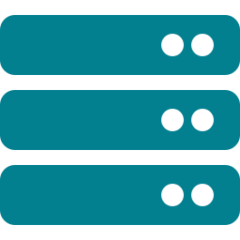


Research Foundation & Grounding
Google ADK
Cable/MSO Domain
Academic Grounding
Gemini API / ADK Shell
· Native hierarchical agent orchestration
· Real Comcast B2B product taxonomy mapped to agents
· Multi-agent LLM orchestration literature
· Gemini Flash for cost/speed tradeoff in production-grade use
· transfer_to_agent() as the primary delegation primitive
· Serviceability check mirrors actual BSS/OSS pre-sales flow
· Hierarchical decomposition patterns for domain-specific agents
· ADK shell provides CLI + dev server for rapid agent iteration
· Session state shared across all agents without custom sync
· Pricing/discount logic mirrors real enterprise telco quoting
· Tool-augmented LLM reasoning
· Google AI Studio for prompt engineering and evals
9

Slide 14

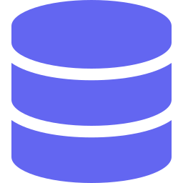


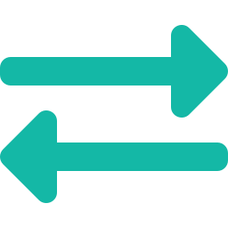

What This Means for Comcast
Immediate Fit: Comcast Business SMB segment — the exact profile this agent is designed for. Sub-100 employee businesses with multi-location needs, high churn from slow quoting cycles.
Churn Prediction Agent
CRM Integration Layer
Upsell Intelligence – using Sub Agents
Sub-agent that flags at-risk accounts mid-conversation and proactively generates retention offers
Connect to Dynamicsvia MCP — auto-log every conversation turn as a CRM activity, zero rep effort
Cross-agent signal: if Fulfillment sees 80% bandwidth utilization, trigger OfferMgmt for proactive upgrade quote
RFP Response Generator
Multi-tenant Architecture
SRE / NOC Agent Variant
Customer uploads an RFP PDF; agent generates a structured response using live product catalog + current pricing
Namespace agents per market segment (SMB vs Enterprise vs Wholesale) — same orchestration pattern, different policy layers
Reuse SuperAgent pattern for internal ops: customer reports outage → DiscoveryAgent → ServiceFulfillment → ticket auto-generated
11

Slide 15

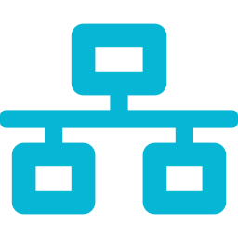


What This Means for Telecom +
Massive Market Opportunity
Sales Cycle: Weeks to Minutes
Global telecom market is ~$1.7 trillion. Every major provider employs thousands of inside sales reps doing similar workflows.
The full sales cycle — from prospect to signed, paid order — completes in a single conversation. No human rep picks up the phone.
Scales Without Headcount
Architecture Is Generalizable
System handles 10,000 concurrent B2B prospect conversations with no additional headcount. Smaller ISPs gain capability that only large enterprises could previously afford.
SuperAgent / Sub-Agent hierarchical orchestration applies to any multi-step workflow: insurance quoting, healthcare enrollment, commercial real estate leasing, banking loan origination.
Eliminates Human Error
All critical values (addresses, zip codes, prices, order IDs) come from deterministic Python tools. LLM reasoning never generates facts. No place for data entry error.
5 / 21

Slide 16
Work Completed
Winter
Spring
10 agents built and integrated
ChromaDB / RAG for product Q&A
Observability dashboard
Full end-to-end sales flow working
Persistent quote/order databases
Multi-turn coordination pattern
Deploy to Vertex/GCP
React UI with SSE streaming — real-time agent responses
Full integration testing across all sales scenarios
Structured JSON tool outputs — solved cross-agent hallucination
Customer Comms Agent
ServiceFulfillmentAgent — Equipment shipment, provisioning & Activation
153 Commits by the team over a period of 4 months
15 / 17

Slide 17
Who Did What
Sudhaman Chandrasekaran
Lead Dev
Raja Barathan
Prod / Comms
→ SuperAgent orchestrator + routing logic
→ ProductAgent with catalog data
→ OfferManagementAgent pricing engine
→ ServiceabilityAgent + GIS tools
→ FastAPI server + SSE streaming
→ OrderAgent cart management
→ Integration of all 10 sub-agents
→ CustomerCommsAgent notifications
→ Multi-turn coordination strategy
→ Documentation (AGENTS.md, CLAUDE.md)
Arun Mohan
Payment
Aubin
Data Guy
→ PaymentAgent — credit checks & authorization
→ DiscoveryAgent — prospect database (SQLite)
→ ServiceFulfillmentAgent — scheduling
→ Lead Generation Agent — BANT qualification
→ Payment gateway integration
→ Database schema & migration scripts
→ Persistent Quote/Order Database
→ Company data seeding
→ Rag Chroma / DB
→ End to End Testing
16 / 21

