Slide 1


B2B Conversational
Sales Agent
Winter Quarter Progress Report
March 4, 2026
github.com/sudhamanc/ConversationalSalesAgent

Slide 2


Team
Member | Role | Key Contributions
Sudhaman Chandrasekaran | Agent Developer | SuperAgent orchestrator, OfferManagement, system integration, ADK architecture, Agent(s) Integration
Raja Barathan | Agent Developer | ProductAgent, ServiceabilityAgent, OrderAgent, Customer Comms Agent, Integration
Arun Mohan | Agent Developer | PaymentAgent, Service Fulfillment Agent, Integration
Aubin | Agent Developer | DiscoveryAgent (Prospect DB), Lead Generation Agent, Integration
github.com/sudhamanc/ConversationalSalesAgent
2 / 17

Slide 3




Project Overview
A multi-agent B2B system that automates the sales cycle for an MSO/telco — from prospect discovery through order fulfillment — using conversational AI.
Problem
Solution
B2B telecom sales involves multiple handoff steps, each requiring domain expertise
10 specialized AI agents orchestrated by a SuperAgent using Google ADK
Stack
Pattern
Google Gemini LLM · Google ADK · FastAPI · React 19 · SQLite
Super Agent / Sub-Agent hierarchical delegation
3 / 17

Slide 4
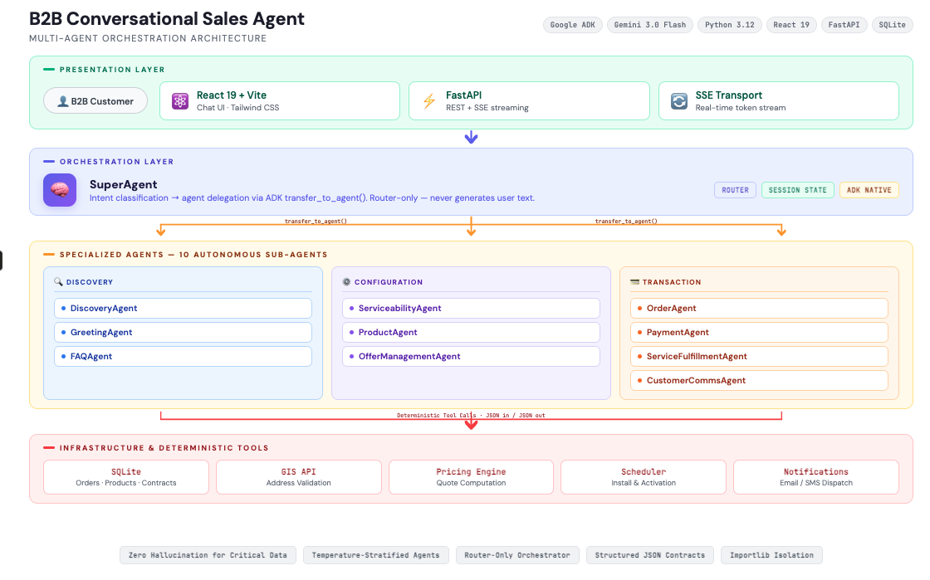
Architecture
16 / 17

Slide 5






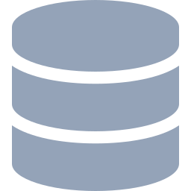

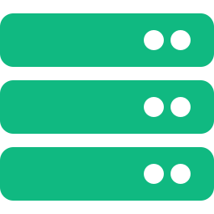



Agent –Workflows - Architecture Diagram
Discovery
Serviceability
Product
Offer Mgmt
Order
React + FastAPI
SuperAgent
SQLite DB
GIS API
Catalog
Pricing
Orchestrator
Payment
Fulfillment
Comms
Greeting
FAQ
Pay Gateway
Scheduler
4 / 17

Slide 6
Tech Stack Summary
Layer | Technology | Purpose
LLM | Google Gemini 3 Flash Preview | Autonomous reasoning, intent analysis
Agent Framework | Google ADK 1.20+ | Multi-agent orchestration, tool integration
Backend | Python 3.12 + FastAPI | Agent logic, REST + SSE streaming
Frontend | React 19 + Vite + Tailwind | Chat UI with real-time message display
Database | SQLite | Prospect data, order storage
Agent Comms | ADK Sub-Agent Delegation | Native inter-agent routing (no custom protocol)
AI Assistants | GitHub Copilot, Claude | Development acceleration
16 / 17

Slide 7




Example : Conversation Flow
Actor
Message
Response / Routing
1
Customer
"I need internet for my office"
SuperAgent → Discovery
2
Discovery
"Company name and address?"
Customer
3
Customer
"Crane.io, 123 Main St, Phila PA"
Discovery → Registered!
4
SuperAgent
Route → Serviceability
"Fiber 1G/5G/10G available"
5
Customer
"Fiber 5G pricing?"
Offer Mgmt → $299/mo (36-mo)
6
Customer
"I'll take it"
Order → Confirmed! Install Feb 28
5 / 17

Slide 8
Code: SuperAgent — The Root Orchestrator
The SuperAgent is the central brain. It routes every user message to the correct sub-agent.
from google.adk.agents import Agent
from google.genai import types
# All 10 sub-agents imported
from .sub_agents.discovery import discovery_agent
# ... (serviceability, product, offer, order, payment, fulfillment, comms, greeting, faq)
root_agent = Agent(
name="super_sales_agent",
model="gemini-2.0-flash", # Google Gemini LLM
instruction=ORCHESTRATOR_INSTRUCTION, # Routing rules
description="B2B Sales Orchestrator",
sub_agents=[ # ADK handles delegation natively
discovery_agent, serviceability_agent, product_agent,
offer_management_agent, payment_agent, order_agent,
service_fulfillment_agent, customer_communication_agent,
greeting_agent, faq_agent,
],
generate_content_config=types.GenerateContentConfig(
temperature=0.7, # Creative for conversation
top_p=0.9, # Nucleus sampling
top_k=40, # Token selection breadth
max_output_tokens=2048,
),
)
6 / 17

Slide 9
Code: Orchestrator Prompt (Routing Rules)
The SuperAgent's prompt defines priority-ordered routing rules — it acts purely as a router.
ORCHESTRATOR_INSTRUCTION = """
You are the central orchestrator for a
B2B sales system. Your ONLY job is to
route each request to the correct
specialist sub-agent.
ROUTING RULES (priority order):
1. Company identification → discovery_agent
2. Address / coverage → serviceability_agent
3. Product specs → product_agent
4. Pricing / quotes → offer_management_agent
5. Cart / orders → order_agent
6. Payment → payment_agent
7. Installation → service_fulfillment_agent
8. Notifications → customer_communication_agent
9. Greetings → greeting_agent
10. FAQ → faq_agent
You MUST ALWAYS call transfer_to_agent.
You MUST NOT generate any text response.
"""
Key Design Decisions
Router-only pattern
SuperAgent never talks to the user directly
Priority ordering
discovery before product, product before pricing
Automatic chaining
after discovery → auto-route to serviceability
ADK delegation
transfer_to_agent is an ADK-native function
7 / 17

Slide 10
Code: Sub-Agent — Deterministic Agent Pattern
Sub-agents like ServiceabilityAgent use temperature 0.0 for deterministic, tool-based responses.
from google.adk.agents import Agent
from google.genai import types
from .tools.gis_tools import check_service_availability
# Hardcoded name — never read from .env to avoid conflicts
GEMINI_MODEL = os.getenv("GEMINI_MODEL")
serviceability_agent = Agent(
name="serviceability_agent", # Hardcoded, not from env var
model=GEMINI_MODEL,
instruction=SERVICEABILITY_INSTRUCTION, # Domain-specific prompt
description="PRE-SALE address validation & coverage check",
tools=[
validate_and_parse_address, # Address parsing
check_service_availability, # GIS / coverage lookup
get_infrastructure_by_technology, # Tech-specific details
],
generate_content_config=types.GenerateContentConfig(
temperature=0.0, # Deterministic — no hallucination
top_p=0.1, # Very focused sampling
top_k=10, # Minimal token variation
max_output_tokens=2048,
),
)
8 / 17

Slide 11
Code: Tool Pattern (FunctionTool)
Tools are deterministic functions — no LLM calls inside. They return structured JSON to prevent hallucination.
# Tools return JSON, not prose text
# This prevents the LLM from rephrasing
# or hallucinating critical data
def search_companies(
company_name: str = None,
) -> str:
"""Search the prospecting database."""
results = db.search_companies(company_name)
return json.dumps({
"found": len(results),
"companies": [{
"company_name": c['Company Name'],
"address": {
"street": c['Street'],
"city": c['City'],
"state": c['State'],
"zip_code": c['zip_code']
}
} for c in results]
})
Why JSON Tool Outputs?
→ Problem: LLMs rephrase text, changing digits
→ Tool returns "19103" → LLM says "19106"
→ Solution: Structured JSON with explicit fields
→ Result: Zero hallucination on addresses, prices
Temperature Guide
Agent | Temp | Why
SuperAgent | 0.7 | Conversational
Greeting/FAQ | 0.7 | Natural language
Serviceability | 0.0 | Deterministic
Product | 0.0 | Catalog-exact
Payment | 0.0 | Financial accuracy
9 / 17

Slide 12
Code: Importlib Isolation for Sub-Agents
Problem: ADK enforces one parent per agent. Importing normally triggers __init__.py, binding to the wrong parent.
# SuperAgent/super_agent/sub_agents/discovery/agent.py
# Loads DiscoveryAgent WITHOUT triggering its __init__.py
import importlib.util
import sys
import types as pytypes
# Stub parent packages to prevent __init__.py execution
for pkg_name in ["bootstrap_agent", "bootstrap_agent.sub_agents",
"bootstrap_agent.sub_agents.discovery"]:
if pkg_name not in sys.modules:
stub = pytypes.ModuleType(pkg_name)
stub.__path__ = [os.path.join(DISCOVERY_BASE, *pkg_name.split("."))]
sys.modules[pkg_name] = stub
# Load the agent module in isolation — fresh, unbound instance
agent_spec = importlib.util.spec_from_file_location(
"bootstrap_agent.sub_agents.discovery.discovery_agent",
os.path.join(DISCOVERY_PKG, "discovery_agent.py"),
)
agent_mod = importlib.util.module_from_spec(agent_spec)
agent_spec.loader.exec_module(agent_mod)
discovery_agent = agent_mod.discovery_agent # Fresh instance for SuperAgent
10 / 17

Slide 13

Progress Made — Winter Quarter
Completed (Weeks 1–9)
Key Milestones
React 19 + Vite Chat UI
Feb 2
Repo created, README, architecture docs
FastAPI + SSE Backend
Feb 7
BootStrapAgent template, MilestonePlan
SuperAgent Orchestrator
Feb 10
SuperAgent + FastAPI + SSE + React UI
DiscoveryAgent + SQLite DB
ServiceabilityAgent + GIS
Feb 11
DiscoveryAgent with SQLite prospect DB
ProductAgent + Catalog
Feb 13
Serviceability + Product integrated
OfferManagement + Pricing
Feb 15
Multi-turn coordination + JSON integrity
OrderAgent + Cart/Contracts
Feb 17
Payment + Installation
PaymentAgent + Credit Check
Service Fulfillment Agent (scheduling)
Feb 21
Offer Mgmt, Order agents
GreetingAgent + FAQAgent
Feb 26
10-agent orchestration working
40+ commits across the team
11 / 17

Slide 14
Progress vs. Initial Goals — Honest Accounting
On Schedule ✅
Remaining / Deferred to Spring ⬜
10 agents built and integrated (Initial goal was 6–7 by end of Winter)
ChromaDB / RAG for product Q&A (replaced by in-repo catalog)
Agent-to-Agent (A2A) protocol — using ADK native delegation
Full end-to-end sales flow working (was a Spring goal)
Observability dashboard — logging infra in place but no UI
Multi-turn coordination pattern developed and tested
Persistent quote/order databases — currently in-memory
Edge case handling & comprehensive error recovery
React UI with SSE streaming — real-time agent responses
Deploy to Vertex/GCP
Structured JSON tool outputs — solved cross-agent hallucination
Full integration testing across all sales scenarios
Customer Comms Agent
ServiceFulfillmentAgent — Equipment shipment, provisioning & Activation
Overall: We are tracking to our milestone plan for Winter Quarter. All core agents are functional. Spring Quarter shifts to hardening, persistence, observability, and the final demo.
12 / 17

Slide 15




Research & Background
What the work is based on
Google ADK
Google Gemini API
Agent Development Kit — ADK's native multi-agent delegation was the key architectural choice
First-class integration with ADK; gemini-3-flash-preview
chosen for speed/cost balance
Cable/MSO Domain
Academic Research
Team works at Comcast — direct familiarity with B2B sales, serviceability, fulfillment and order flows for SMB products.
Reviewed LLM multi-agent patterns (ReAct, CoT) — chose hierarchical orchestration
ADK Shell
Agent Development Frameworks
Working on an internal initiative that allowed us to reuse an ADK shell agent
Reviewed LangGraph/LangChain, ADK and Strands before choosing Google ADK
13 / 17

Slide 16




How the Code Was Written
Human + AI Collaboration
Architecture & Design
Made by the team, based on ADK docs and telecom domain expertise
AI-Assisted Coding
GitHub Copilot & Claude used for boilerplate, debugging, prompt writing, DB schemas
Human-Written Core Logic
Routing rules, tool implementations, agent coordination, integration testing
Code Review
All code reviewed by team members before merging
We believe in transparent attribution. AI tools accelerated development but every design decision and integration was human-driven.
14 / 17

Slide 17
Who Did What
Sudhaman Chandrasekaran
38 commits
Raja (rgbarathan752)
20 commits
→ SuperAgent orchestrator + routing logic
→ ProductAgent with catalog data
→ OfferManagementAgent pricing engine
→ ServiceabilityAgent + GIS tools
→ FastAPI server + SSE streaming
→ OrderAgent cart management
→ Integration of all 10 sub-agents
→ CustomerCommsAgent notifications
→ Multi-turn coordination strategy
→ Documentation (AGENTS.md, CLAUDE.md)
Arun Mohan
4 commits
Aubin
10 commits
→ PaymentAgent — credit checks & authorization
→ DiscoveryAgent — prospect database (SQLite)
→ ServiceFulfillmentAgent — scheduling
→ Lead Generation Agent — BANT qualification
→ Payment gateway integration
→ Database schema & migration scripts
→ Company data seeding
15 / 17

Slide 18

Questions?
github.com/sudhamanc/ConversationalSalesAgent
Winter Quarter 2026

