Slide 1
Why Prompt Engineering Matters
Notes:
“We’ve spent 20 years writing code… Now we are writing prompts. But the mindset hasn't changed
Why I am saying mindset has not changed? because

Slide 2
LLMs are:
Not deterministic programs
Not databases
Not rule engines
They are:
Probability-based text generators conditioned on context

Slide 3
“Prompt Engineering: The New Programming Language for AI”
“Your AI Is Only as Smart as Your Prompt”
“Prompt = Program: Engineering Control over LLMs”
“You Don’t Control the Model — You Control the Prompt”

Slide 4
This is your control layer
This is a probabilistic engine
This is not truth.
Prompt
LLM
Output
The clearer the prompt, the better the result.”
it predicts the next best token base on your prompt
It is the best guess base on your prompt.

Slide 5
Prompt:
Context + Instructions+ query
LLM:
Pattern Prediction Engine
Output:
Generated Response
Notes:
Pattern means nearest match

Slide 6
Simple Principle
You must define inputs clearly
Define processing expectations
Define output format strictly

Slide 7
3 Core Parts of Every High-Quality Prompt
You mentioned:
✅ Context ✅ Instruction ✅ Query

Slide 8
What MUST be included in Context(1/2)
Role (Who the model is)
Why:
Sets expertise level
Controls tone + depth
Example:
You are a senior Java architect specializing in distributed systems.
System / Business Context
Without this: Model gives generic answer.
Example:
We are building a high-traffic e-commerce platform handling 50k TPS.
Constraints
Example:
- Must support horizontal scaling
- Latency < 100ms
- Cloud-native (Kubernetes)

Slide 9
What MUST be included in Context(2/2)
Audience
Why:
Depth
Terminology
Examples
Example:
The explanation is for senior engineers..
Data
Here is the existing code:
<code snippet>

Slide 10
Decompose Task (CRITICAL for complex tasks)
Example:
Step 1: Identify requirements
Step 2: Propose architecture
Step 3: Evaluate trade-offs
Step 4: Recommend solution

Slide 11
Add Thinking Constraints
Example:
Think step-by-step before answering.
Notes:
Or Explain reasoning clearly before final answer.

Slide 12
Control Scope
Example:
Focus only on backend architecture.
Notes:
Or Explain reasoning clearly before final answer.

Slide 13
OUTPUT FORMAT
Example:
Option 2: JSON (Best for engineers)
{
"architecture": "",
"components": [],
"tradeoffs": []
}
Option 1: Structured bullets
Output:
- Architecture
- Components
- Trade-offs
Option 3: Tables
Provide comparison in table format:
Approach | Pros | Cons
Notes:
Or Explain reasoning clearly before final answer.

Slide 14
Template and Example Prompt

Slide 15
Choose Right Model
General-Purpose LLMs
GPT (OpenAI)
Claude (Anthropic)
Gemini (Google)
Code-Specialized Models
Github copilot
Code Llama
DeepSeek Coder
Embedding Models
Convert text → vectors
Fine-tuned Models
Trained for specific domain (finance, legal, medical)
Notes:
Characteristics:
Strong reasoning
Good coding ability
Multi-domain knowledge
Use cases:
Code generation
System design
Documentation
Chatbots

Slide 16
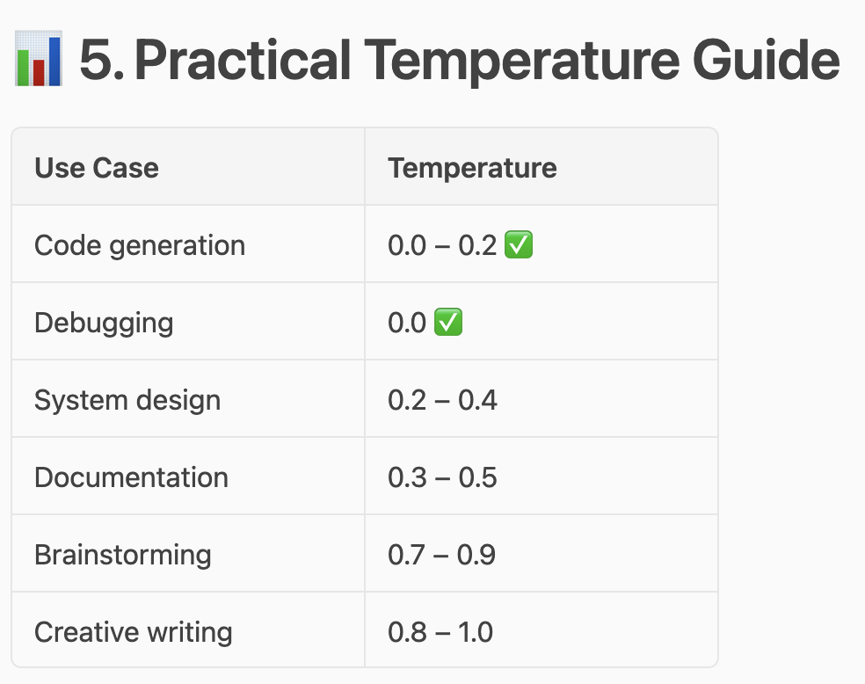
Temperature
0.0 → deterministic
1.0 → very creative/random

Slide 17
Demo (1/3)
1. Design a food delivery application
2. Design a food delivery application for users to order food online and get it delivered.
3. We are building a food delivery application like Uber Eats.
Requirements:
- Millions of users
- Real-time order tracking
- Multiple restaurants
- Payment integration
Design the system.

Slide 18
You are a senior system architect.
Context:
We are building a food delivery application like Uber Eats:
- Millions of users
- Real-time tracking
- Payment integration
- High availability
Design the system.
You are a senior system architect.
Context:
Food delivery system:
- Millions of users
- Real-time tracking
- Payment integration
- High availability
Instruction:
1. Identify functional requirements
2. Identify non-functional requirements
3. Design system architecture
4. Explain key components
5. Discuss trade-offs
Design the system.

Slide 19
Demo (3/3)
You are a senior system architect.
Context:
Food delivery system:
- Millions of users
- Real-time tracking
- Payment integration
- High availability
Instruction:
1. Identify functional requirements
2. Identify non-functional requirements
3. Design system architecture
4. Explain key components
5. Discuss trade-offs
Design the system.
Output Format:
{
"functional_requirements": [],
"non_functional_requirements": [],
"architecture": "",
"components": [],
"tradeoffs": []
}
onstraints:
- Be specific to large-scale systems
- Avoid generic explanations
- Include real technologies where relevant
- If unsure, say "I don’t know"
Focus:
Backend distributed system only (ignore UI and mobile apps)

Slide 20
How to evaluate a Prompt

