Slide 1
End-to-end testing for web app using Playwright
By: Sudha mohan Panda
Date: 22/Jan/2026

Slide 2
What you can expect in this presentation
What is Playwright
Why Playwright
Setup environment
Demo: My first automation
Demo: Automate using codegen
Demo: Using agents automate entire webapp
Notes:
Welcome! In this session, I’ll demonstrate end‑to‑end testing with Playwright , how Agent Mode accelerates test creation inside VS Code. We’ll generate tests with natural language, run them across browsers, and explore rich debugging tools.

Slide 3
What is Playright
is an open-source framework for reliable end-to-end testing for modern web apps. released in 2020
Playwright is a robust testing and automation framework developed by Microsoft
Quickly gained popularity among testers due to its powerful features, ease of use
Playwright operates by leveraging the underlying browser protocols directly, Unlike traditional WebDriver-based tools like Selenium. Due to which it is faster and more reliable.
Features like automatic waiting, full test isolation, and robust handling of complex web elements like iframes and Shadow DOM.

Slide 4
Prerequisites
node
npm
VS code (optional)

Slide 5
Demo: First automation using commandline
npm init playwright@latest
npx playwright test
npx playwright show-report
npx playwright test --project chromium
report
npx playwright test --reporter=line/list/dot/html
trace
npx playwright test --trace on

Slide 6
Congratulations! You successfully installed Playwright and ran the example test

Slide 7
Why Playwright
Any browser • Any platform • One API
headless or headed.
Cross-language TypeScript, JavaScript, Python, .NET, Java
Test Mobile Web
Auto-wait.
Tracing. Configure test retry strategy, capture execution trace, videos, screenshots to eliminate flakes.
Codegen. Generate tests by recording your actions. Save them into any language.
Playwright inspector. Inspect page, generate selectors, step through the test execution, see click points, explore execution logs.
Trace Viewer. Capture all the information to investigate the test failure. Playwright trace contains test execution screencast, live DOM snapshots, action explorer, test source, and many more.

Slide 8
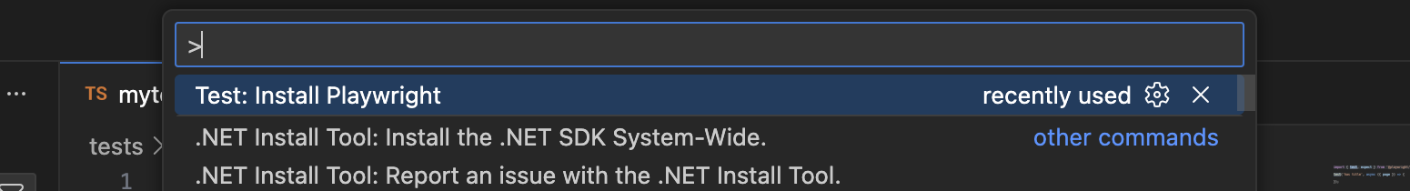
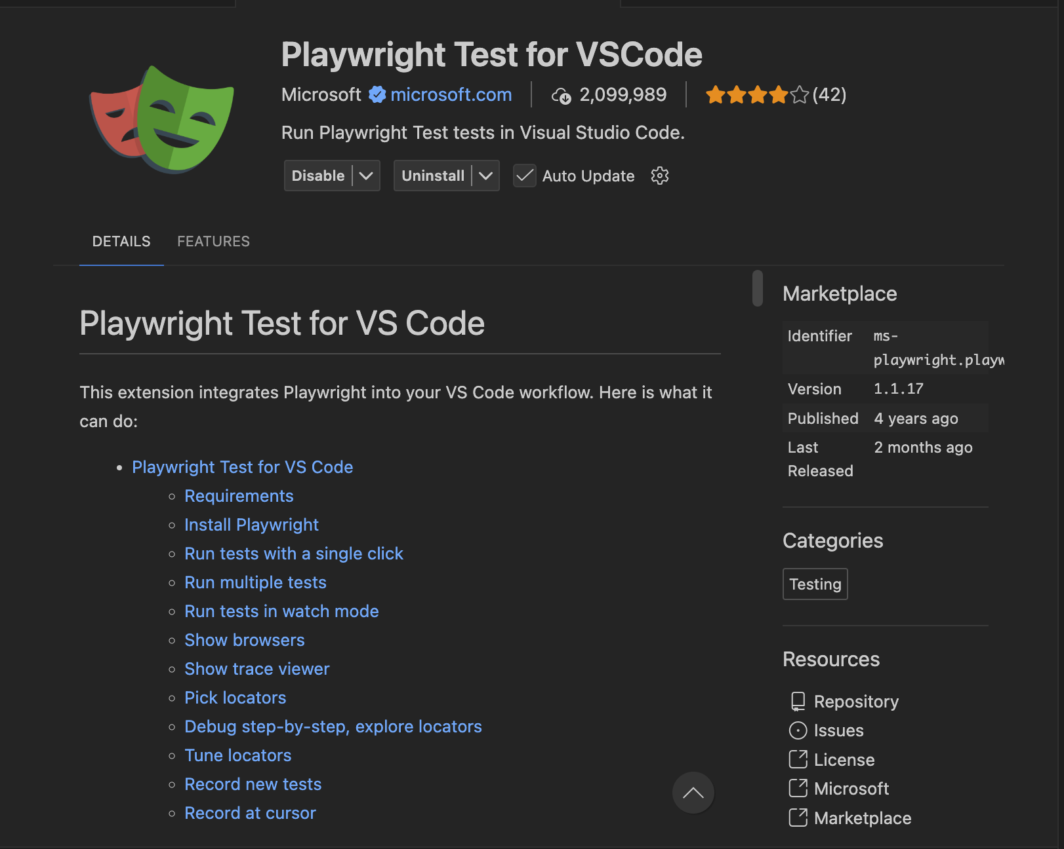
Demo:using VS Code
Install extension “Playwright test for vscode” from microsoft
Install playwright

Slide 9
Demo:using VS Code
Using “record new”

Slide 10
Arrange Act Assert
1.Arrange
2.Act
3.Assert

Slide 11
Demo on codegen
playwright codegen <base-url>

Slide 12
Demo: Automate using github copilot and agents
Prerequisites
VS Code
Why not Intellij IDE
Agent generat the code base on vs code
Github copilot
Why not Rabo Github copilot
MCP not enable

Slide 13
Demo: Automate using github copilot and agents
Three Agents
Planner
Generator
Healer

Slide 14
Example Prompt for Agents

Slide 15
Intigrate with pipeline

Slide 16
Comparison with Selenium, Cypress

Slide 17
Commands
npx playwright test
  Runs the end-to-end tests.
npx playwright test --ui
  Starts the interactive UI mode.
npx playwright test --project=chromium
  Runs the tests only on Desktop Chrome.
npx playwright test example
  Runs the tests in a specific file.
npx playwright test --debug
  Runs the tests in debug mode.
npx playwright codegen
  Auto generate tests with Codegen.
npx playwright show-report
  To open last HTML report run

Slide 18
Reference Material
https://playwright.dev/python/
https://playwright.dev/python/community/learn-videos
https://playwright.dev/python/community/mcp-videos

