Slide 1


SKILLSYNC AI
An Intelligent Data Engineering Platform for
Real-Time Job Market & Emerging Skill Intelligence
FUNDAMENTALS OF DATA ENGINEERING FOR AI
Team Members: 2420030753 - Sudhamsha A 2420090087 - V Akshaya 2420030619 - Tanishka
Guide: Dr.N.Shirisha Associate Professor
REVIEW 1 & 2

Slide 2

ABSTRACT
From fragmented job data to AI-powered skill intelligence
SkillSync AI is an intelligent data engineering platform designed to transform continuously evolving job-market data into actionable skill intelligence. The platform integrates heterogeneous job data from multiple sources using batch and real-time streaming ingestion, followed by automated data-quality validation, deduplication, standardization, and scalable processing using PySpark. Natural Language Processing (NLP) techniques are applied to unstructured job descriptions to extract, normalize, and categorize relevant skills. The processed data enables job-market analytics, emerging-skill detection, role-based skill-gap analysis, and machine-learning-based demand forecasting. By combining Data Engineering, NLP, Machine Learning, and analytics, SkillSync AI provides a scalable end-to-end solution for converting raw job-market data into reliable insights and decision-ready intelligence.

Slide 3


INTRODUCTION
The need for intelligent job-market data engineering
CURRENT CHALLENGE
Job-market data is continuously generated across multiple sources.
Data exists in different formats and schemas.
Important skill information is hidden unstructured job descriptions.
Traditional analysis struggles to track rapidly emerging skills and changing demand.
SKILLSYNC AI
SkillSync AI unifies the complete workflow:
Multi-source data
↓
Data Engineering Pipeline
↓
AI-Based Skill Extraction
↓
Trend Analysis & Forecasting
↓
Decision-Ready Insights
It combines Data Engineering, NLP, Machine Learning, and analytics in one scalable platform.
inside

Slide 4

OBJECTIVES
Four focused objectives
01 INTELLIGENT DATA INTEGRATION
02 AI-POWERED SKILL INTELLIGENCE
Design a scalable pipeline that integrates heterogeneous job-market data from multiple sources into reliable, analytics-ready information.
Automatically extract, normalize, and categorize skills from unstructured job descriptions using NLP-based techniques.
03 EMERGING SKILL DETECTION & FORECASTING
04 SKILL-GAP & DECISION INTELLIGENCE
Analyze changing skill trends, identify emerging skills, and forecast future skill demand using machine learning.
Provide job-market insights and role-based skill-gap analysis through an interactive decision-support platform.

Slide 5










LITERATURE SURVEY
Skill extraction and large-scale job-market analysis
PAPER | TYPE / LINK | CORE CONTRIBUTION | DRAWBACK | FUTURE WORK
Deep Learning-based Computational Job Market Analysis: A Survey on Skill Extraction and Classification from Job Postings | Survey ACL Anthology 2024 Survey Paper Open Paper ↗ | Reviews deep-learning methods, datasets, and terminology for extracting and classifying skills from job postings. | Reviews existing methods rather than building a complete end-to-end platform. | Integrate skill extraction with ingestion, scalable processing, storage, and analytics.
Rethinking Skill Extraction in the Job Market Domain using Large Language Models | Conference NLP4HR 2024 Conference Paper Open Paper ↗ | Explores few-shot and in-context LLM approaches for extracting complex and | Performance depends on the model and prompting strategy. | Evaluate practical NLP/LLM extraction within a scalable data pipeline.
 |  | ambiguous skill mentions.
Skill Requirements in Job Advertisements: A Comparison of Skill-Categorization Methods Based on Wage Regressions | Research Article IPM 2023 Research Article Open Paper ↗ | Compares dictionary and topic-modeling m e t h o d s u s i n g l a r g e - s c a l e j o b advertisements. | Some topic-model outputs are difficult to interpret. | Combine scalable extraction with normalization and interpretable skill intelligence. ↗ Click “Open Paper” to access source

Slide 6
LITERATURE SURVEY
Labour-market intelligence and advanced skill extraction
PAPER | TYPE / LINK | CORE CONTRIBUTION | DRAWBACK | FUTURE WORK
From Data to Insight: Transforming Online Job Postings into Labor-Market Intelligence | Research Article Information 2024 Research Article Open Paper ↗ | Transforms online job postings into labour-market intelligence using NLP-based skill extraction. | Focuses more on analysis methodology than a complete automated real-time platform. | Extend with automated ingestion, scalable processing, and forecasting.
SKORE: Skill-Oriented Extraction Engine from Job Advertisements Using Large Language Models | Methods Research 2026 Methods Paper Open Paper ↗ | Extracts, normalizes, and categorizes skills from online job advertisements using LLM-oriented methods. | Primarily focuses on skill extraction rather than the full data-engineering lifecycle. | Connect extraction with a data lake/ warehouse, trend detection, and demand forecasting.
In-demand Skills: A Shield Against Automation—Evidence from Online Job Vacancies | Research Article JLMR 2026 Research Article Open Paper ↗ | Uses online vacancy data and extracted skills to analyze in-demand skill patterns. | Focuses on a specific labour-market study rather than a reusable intelligence platform. | Develop continuous monitoring and predictive skill intelligence.
RESEARCH GAP → Existing studies focus on extraction or analysis individually; SkillSync AI unifies ingestion, data quality, scalable processing, AI extraction, forecasting, and decision intelligence.

Slide 7
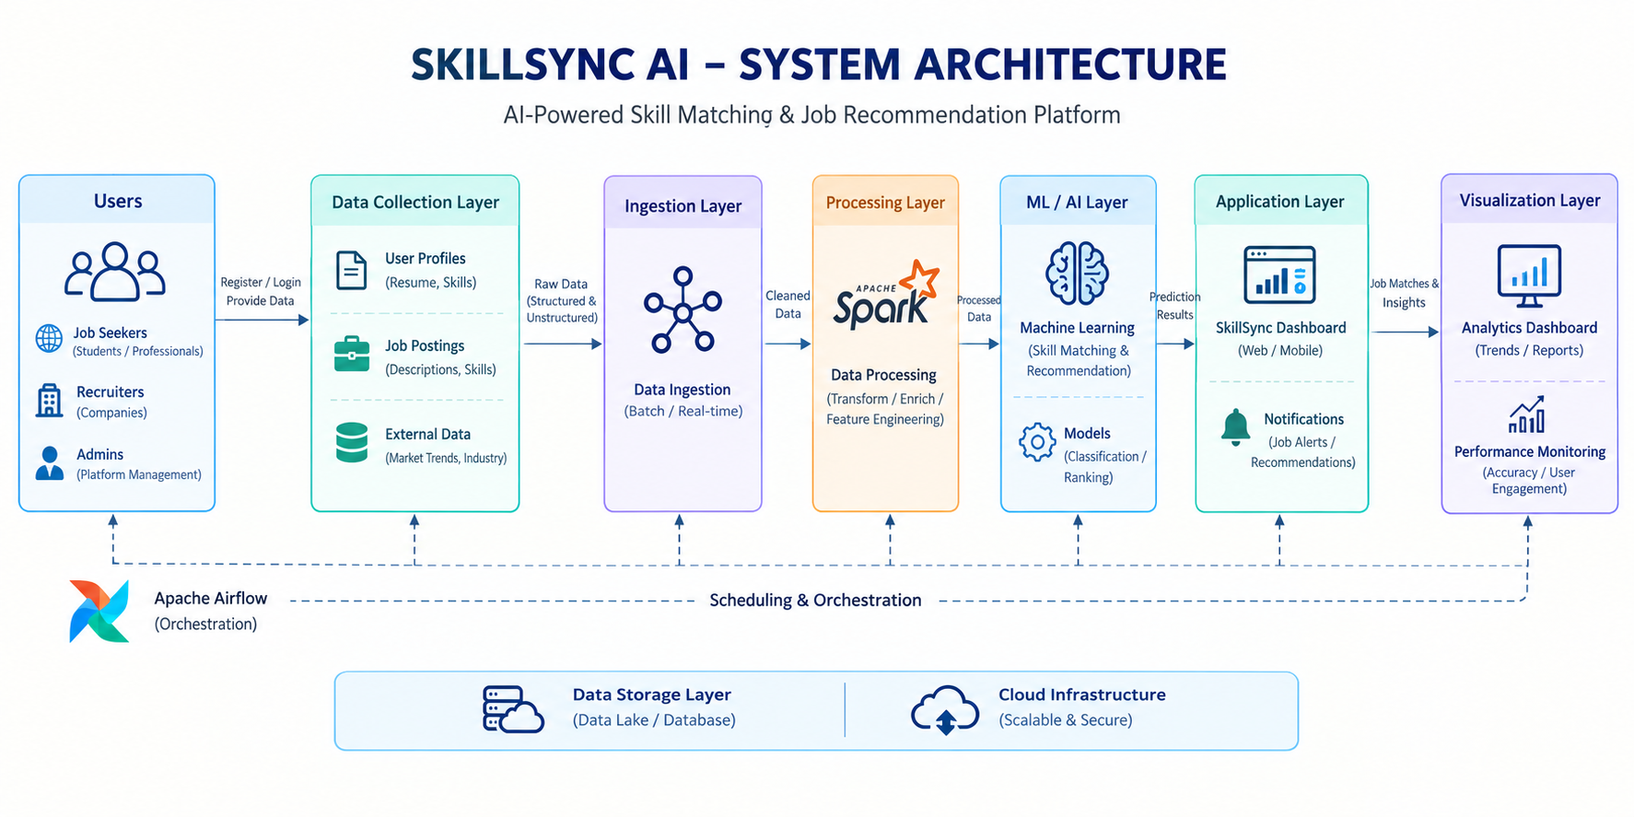

Slide 8

PROPOSED SOLUTION
End-to-end architecture connecting Data Engineering with AI
01 MULTI-SOURCE JOB DATA
02 DATA INGESTION
CSV • JSON • APIs • Historical + streaming events
Batch ingestion + real-time event streaming
03 DATA LAKE
04 QUALITY + PYSPARK PROCESSING
Raw and processed datasets stored efficiently
Validate • clean • transform • integrate
05 ANALYTICS STORAGE
06 AI SKILL INTELLIGENCE
Structured warehouse for analytical queries
Extract • normalize • categorize skills from descriptions
07 INTELLIGENCE ENGINE
08 DECISION LAYER
Emerging skills • skill gaps • demand forecasting
Interactive dashboard • trends • predictions • insights

Slide 9

TECHNOLOGY STACK
Scalable, AI-ready, and reproducible
Programming
Ingestion & Streaming
Python
CSV • JSON • APIs • Apache Kafka
Data Lake
Processing
MinIO • Apache Parquet
Apache Spark • PySpark
Data Quality
Great Expectations
Warehouse
PostgreSQL • SQL • Star Schema
NLP / AI
Machine Learning
spaCy • Transformer / LLM-based extraction
Scikit-learn • Forecasting models
Orchestration
Visualization
Apache Airflow
Streamlit / Power BI
Deployment
Docker

Slide 10
THANK YOU
SkillSync AI • Fundamentals of Data Engineering for AI

