Slide 1

Chapter 27
WWW and HTTP
27.<number>
Copyright © The McGraw-Hill Companies, Inc. Permission required for reproduction or display.

Slide 2
27-1 ARCHITECTURE
The WWW today is a distributed client/server service, in which a client using a browser can access a service using a server. However, the service provided is distributed over many locations called sites.
Topics discussed in this section:
Client (Browser)
Server
Uniform Resource Locator
Cookies
27.<number>

Slide 3

Figure 27.1 Architecture of WWW
27.<number>

Slide 4
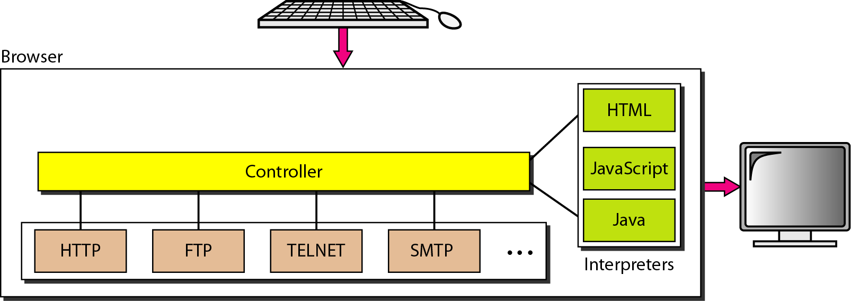
Figure 27.2 Browser
27.<number>

Slide 5
The controller receives input from
the keyboard or the mouse and uses the client programs to access the document. After
the document has been accessed, the controller uses one of the interpreters to display the
document on the screen. The client protocol can be one of the protocols described previously
such as FTP or HTTP . The interpreter can be HTML,
Java, or JavaScript, depending on the type of document.
27.<number>

Slide 6
Figure 27.3 URL
27.<number>

Slide 7
Uniform Resource Locator
A client that wants to access a Web page needs the address. To facilitate the access of documents
distributed throughout the world, HTTP uses locators. The uniform resource
locator (URL) is a standard for specifying any kind of information on the Internet. The
URL defines four things: protocol, host computer, port, and path
27.<number>

Slide 8
The protocol is the client/server program used to retrieve the document. Many
different protocols can retrieve a document; among them are FTP or HTTP. The most
common today is HTTP.
27.<number>

Slide 9
Web pages are usually stored in computers, and computers
are given alias names that usually begin with the characters "www". This is not mandatory,
however, as the host can be any name given to the computer that hosts the Web page.
27.<number>

Slide 10
The URL can optionally contain the port number of the server. If the port is
included, it is inserted between the host and the path, and it is separated from the host
by a colon.
Path is the pathname of the file where the information is located. Note that the path
can itself contain slashes that, in the UNIX operating system, separate the directories
from the subdirectories and files.
27.<number>

Slide 11
Cookies
The World Wide Web was originally designed as a stateless entity. A client sends a
request; a server responds. Their relationship is over. The original design of WWW,
retrieving publicly available documents, exactly fits this purpose. Today the Web has
other functions; some are listed here.
27.<number>

Slide 12
I. Some websites need to allow access to registered clients only.
2. Websites are being used as electronic stores that allow users to browse through the
store, select wanted items, put them in an electronic cart, and pay at the end with a
credit card.
3. Some websites are used as portals: the user selects the Web pages he wants to see.
4. Some websites are just advertising.
27.<number>

Slide 13
27-2 WEB DOCUMENTS
The documents in the WWW can be grouped into three broad categories: static, dynamic, and active. The category is based on the time at which the contents of the document are determined.
Topics discussed in this section:
Static Documents
Dynamic Documents
Active Documents
27.<number>

Slide 14
WEB DOCUMENTS
The documents in the WWWcan be grouped into three broad categories: static, dynamic,
and active. The category is based on the time at which the contents of the document are
determined.
27.<number>

Slide 15
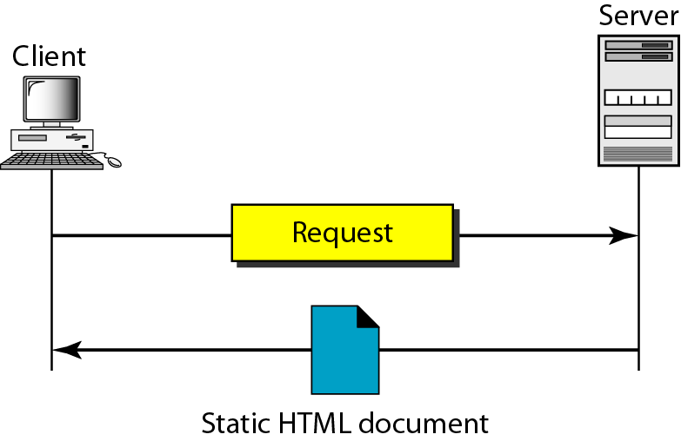
Figure 27.4 Static document
27.<number>

Slide 16
Static Documents
Static documents are fixed-content documents that are created and stored in a server.
The client can get only a copy of the document. In other words, the contents of the file
are determined when the file is created, not when it is used. Of course, the contents in
the server can be changed, but the user cannot change them.
27.<number>

Slide 17
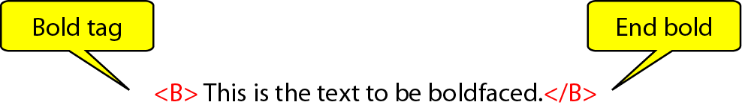
Figure 27.5 Boldface tags
27.<number>

Slide 18
Dynamic Documents
A dynamic document is created by a Web server whenever a browser requests the document.
When a request arrives, the Web server runs an application program or a script
that creates the dynamic document. The server returns the output of the program or
script as a response to the browser that requested the document. Because a fresh document
is created for each request, the contents of a dynamic document can vary from
one request to another.
27.<number>

Slide 19
Common Gateway Interface (CGI)
The Common Gateway Interface (CGI) is a technology that creates and handles
dynamic documents. CGI is a set of standards that defines how a dynamic document is
written, how data are input to the program, and how the output result is used.
27.<number>

Slide 20
Active Documents
For many applications, we need a program or a script to be run at the client site. These
are called active documents. For example, suppose we want to run a program that
creates animated graphics on the screen or a program that interacts with the user. The
program definitely needs to be run at the client site where the animation or interaction
takes place. When a browser requests an active document, the server sends a copy of the
document or a script. The document is then run at the client (browser) site.
27.<number>

Slide 21
Java Applets
One way to create an active document is to use Java applets. Java is a combination of a
high-level programming language, a run-time environment, and a class library that
allows a programmer to write an active document (an applet) and a browser to run it. It
can also be a stand-alone program that doesn't use a browser.
An applet is a program written in Java on the server.
27.<number>

Slide 22
JavaScript
The idea of scripts in dynamic documents can also be used for active documents. If the
active part of the document is small, it can be written in a scripting language; then it can
be interpreted and run by the client at the same time. The script is in source code (text)
and not in binary form. The scripting technology used in this case is usually JavaScript.
JavaScript, which bears a small resemblance to Java,
27.<number>

Slide 23
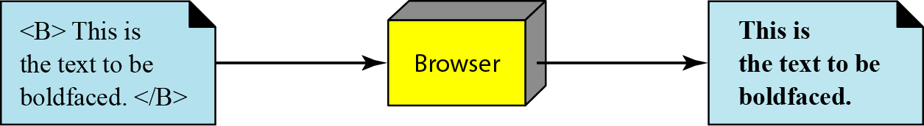
Figure 27.6 Effect of boldface tags
27.<number>

Slide 24
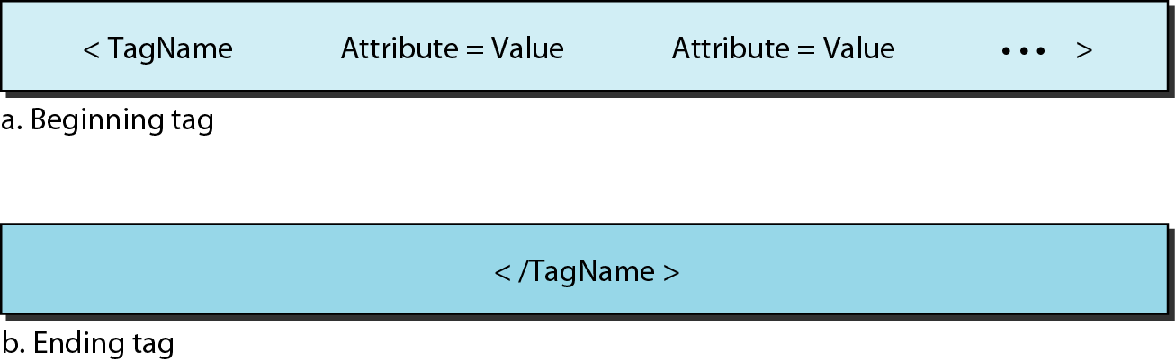
Figure 27.7 Beginning and ending tags
27.<number>

Slide 25
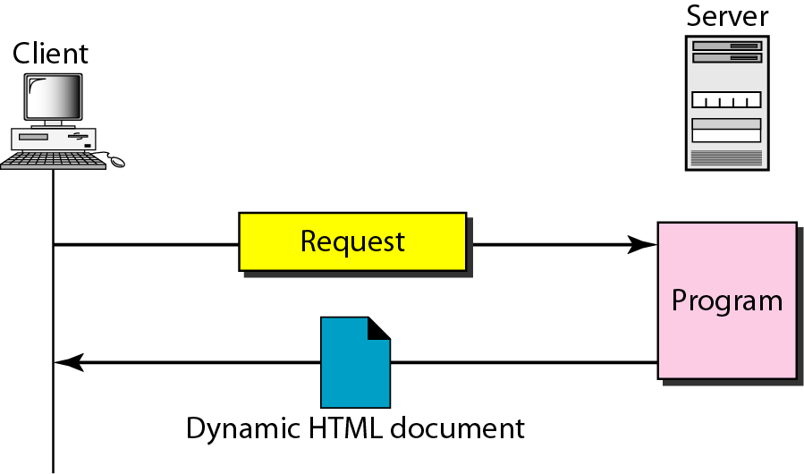
Figure 27.8 Dynamic document using CGI
27.<number>

Slide 26
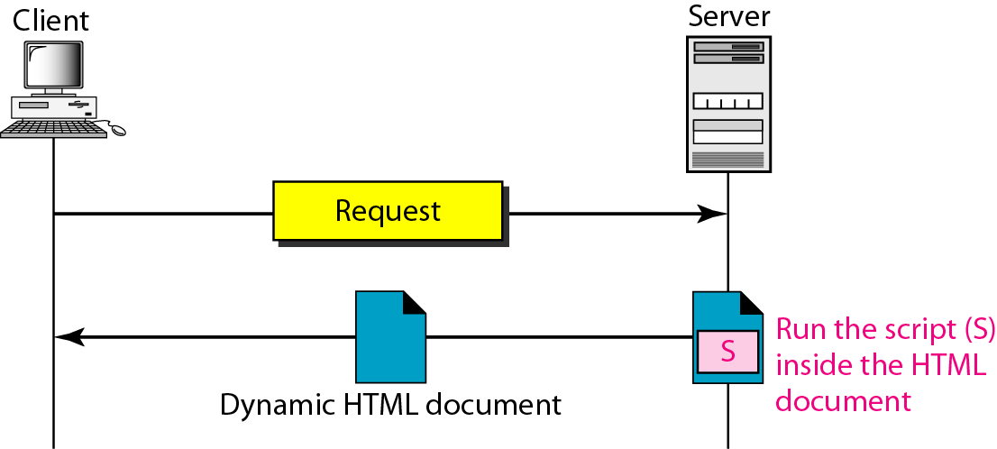
Figure 27.9 Dynamic document using server-site script
27.<number>

Slide 27

Note
Dynamic documents are sometimes referred to as server-site dynamic documents.
27.<number>

Slide 28
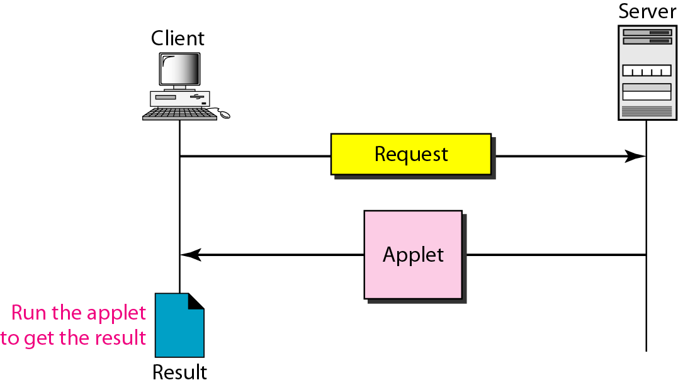
Figure 27.10 Active document using Java applet
27.<number>

Slide 29
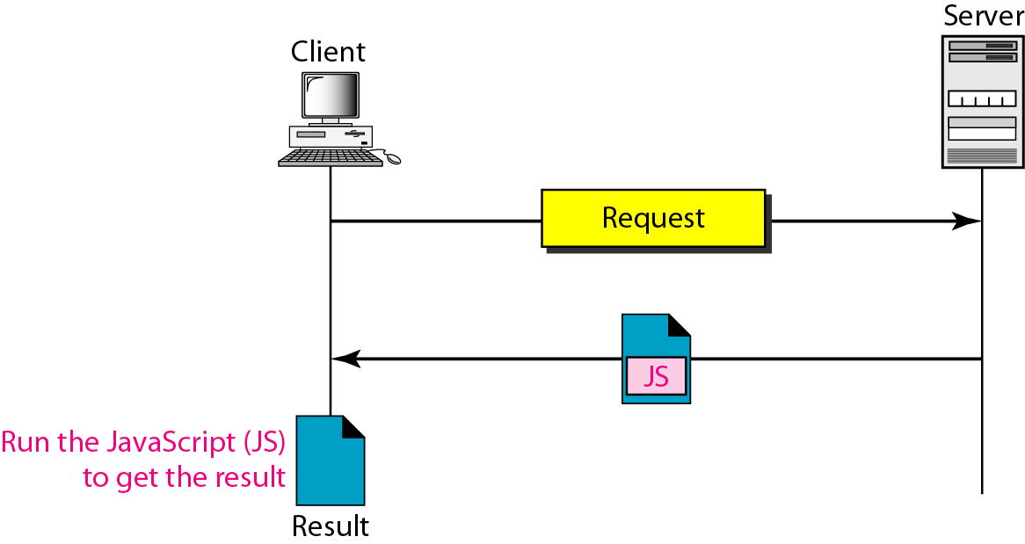
Figure 27.11 Active document using client-site script
27.<number>

Slide 30
Note
Active documents are sometimes referred to as client-site dynamic documents.
27.<number>

Slide 31
27-3 HTTP
The Hypertext Transfer Protocol (HTTP) is a protocol used mainly to access data on the World Wide Web. HTTP functions as a combination of FTP and SMTP.
Topics discussed in this section:
HTTP Transaction
Persistent Versus Nonpersistent Connection
27.<number>

Slide 32
Note
HTTP uses the services of TCP on well-known port 80.
27.<number>

Slide 33
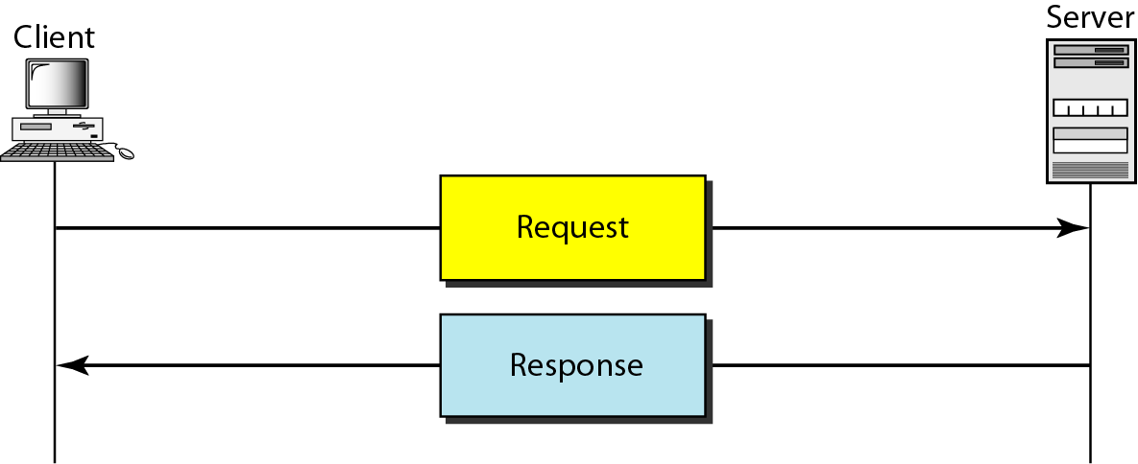
Figure 27.12 HTTP transaction
27.<number>

Slide 34
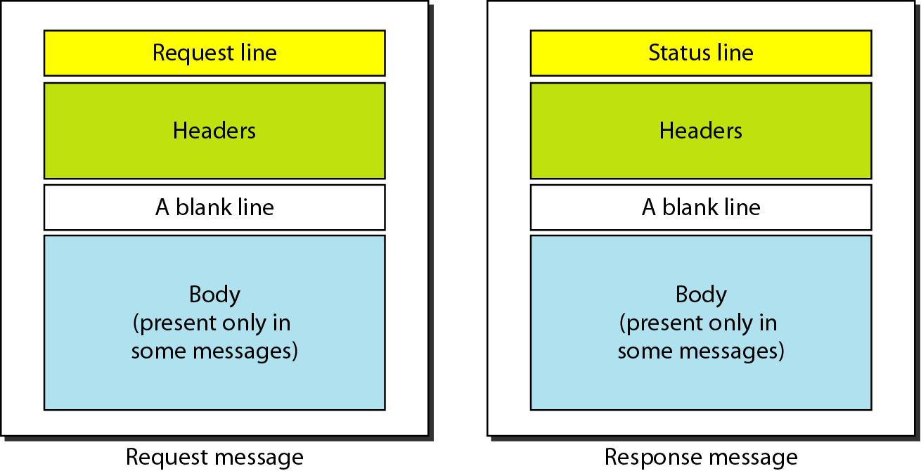
Figure 27.13 Request and response messages
27.<number>

Slide 35
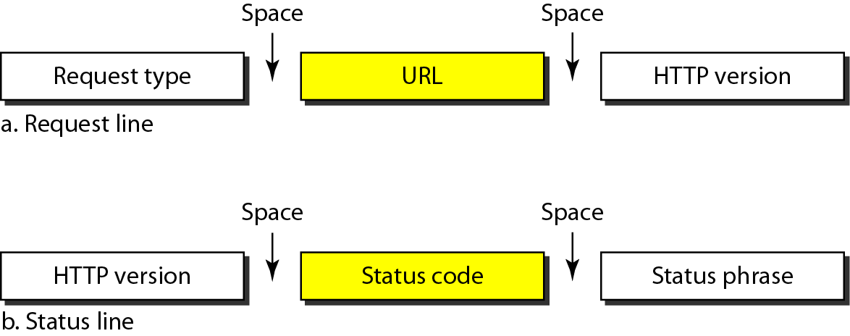
Figure 27.14 Request and status lines
27.<number>

Slide 36
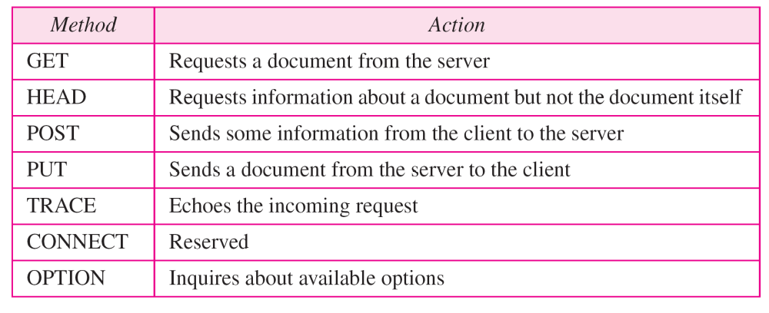
Table 27.1 Methods
27.<number>

Slide 37
Table 27.2 Status codes
27.<number>

Slide 38
Table 27.2 Status codes (continued)
27.<number>

Slide 39
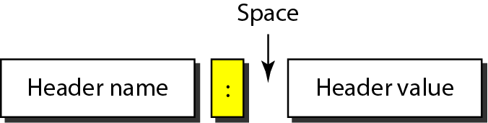
Figure 27.15 Header format
27.<number>

Slide 40
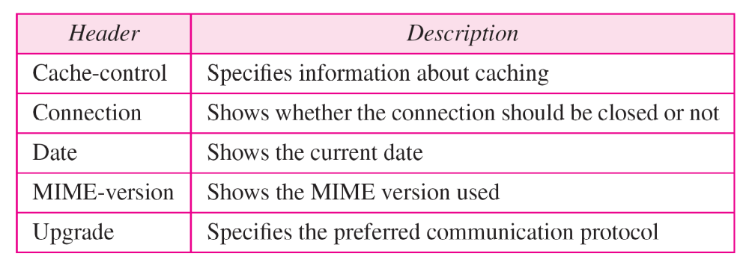
Table 27.3 General headers
27.<number>

Slide 41
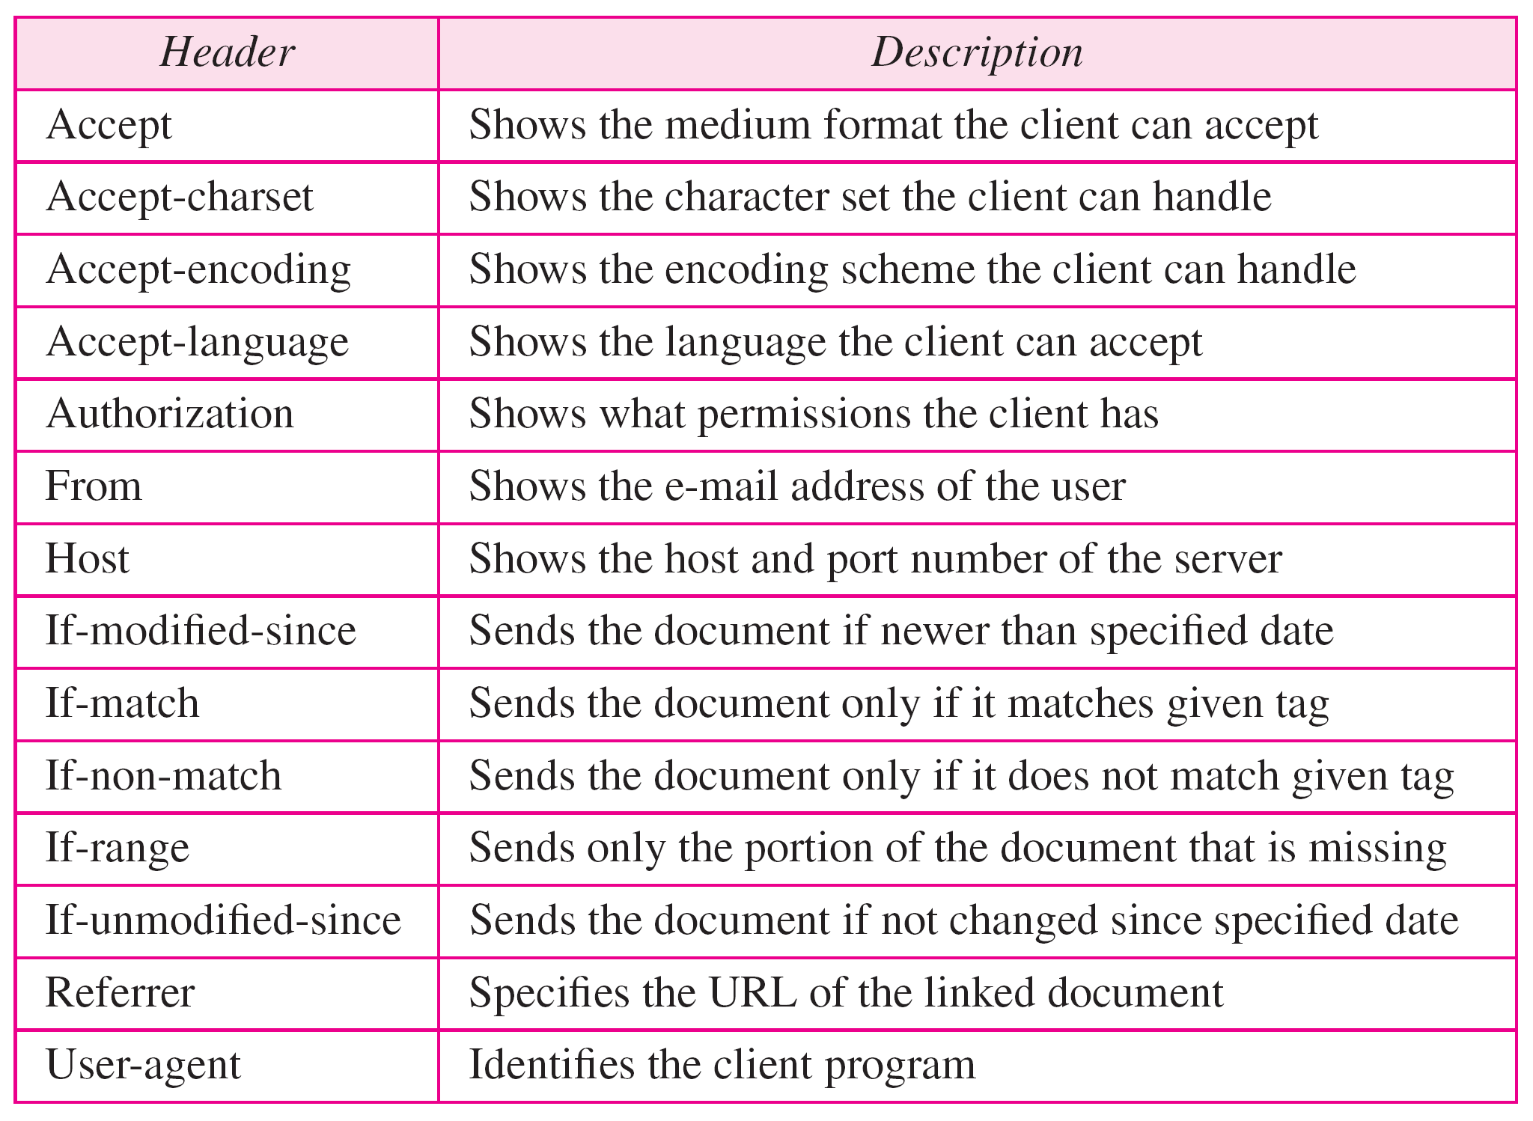
Table 27.4 Request headers
27.<number>

Slide 42
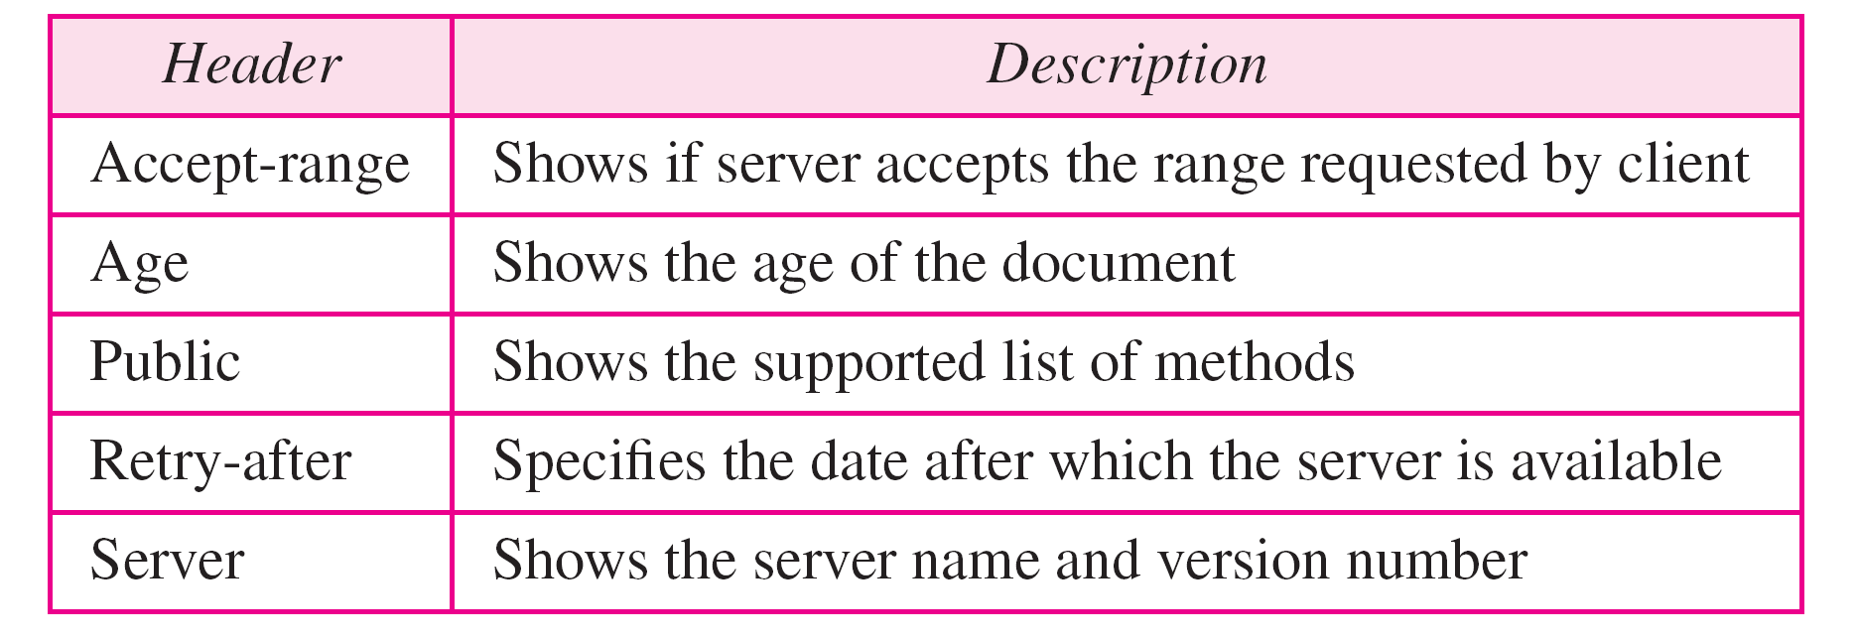
Table 27.5 Response headers
27.<number>

Slide 43
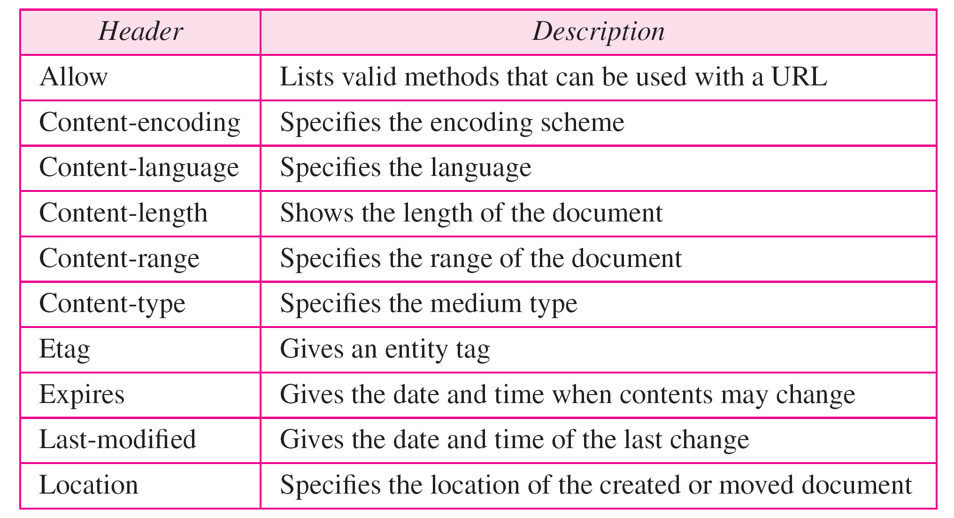
Table 27.6 Entity headers
27.<number>

Slide 44
Example 27.1
This example retrieves a document. We use the GET method to retrieve an image with the path /usr/bin/image1. The request line shows the method (GET), the URL, and the HTTP version (1.1). The header has two lines that show that the client can accept images in the GIF or JPEG format. The request does not have a body. The response message contains the status line and four lines of header. The header lines define the date, server, MIME version, and length of the document. The body of the document follows the header (see Figure 27.16).
27.<number>

Slide 45
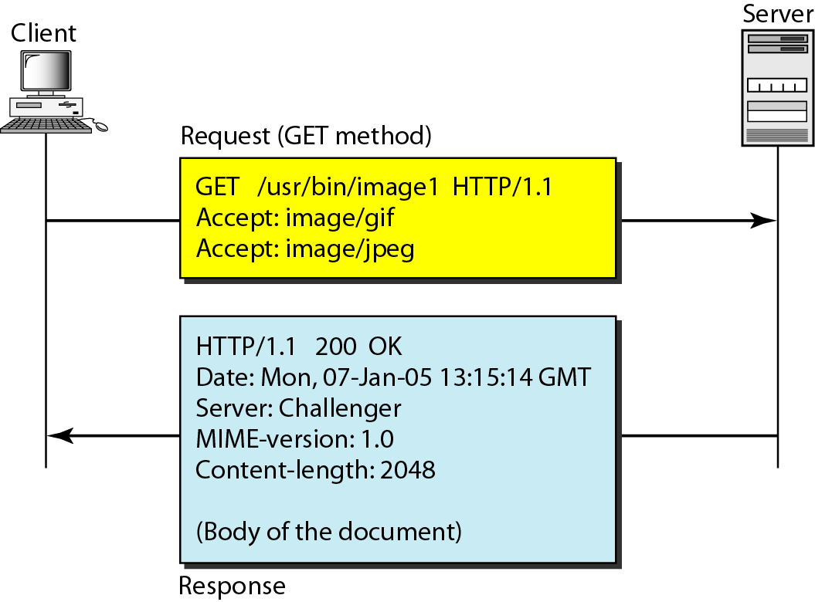
Figure 27.16 Example 27.1
27.<number>

Slide 46
Example 27.2
In this example, the client wants to send data to the server. We use the POST method. The request line shows the method (POST), URL, and HTTP version (1.1). There are four lines of headers. The request body contains the input information. The response message contains the status line and four lines of headers. The created document, which is a CGI document, is included as the body (see Figure 27.17).
27.<number>

Slide 47
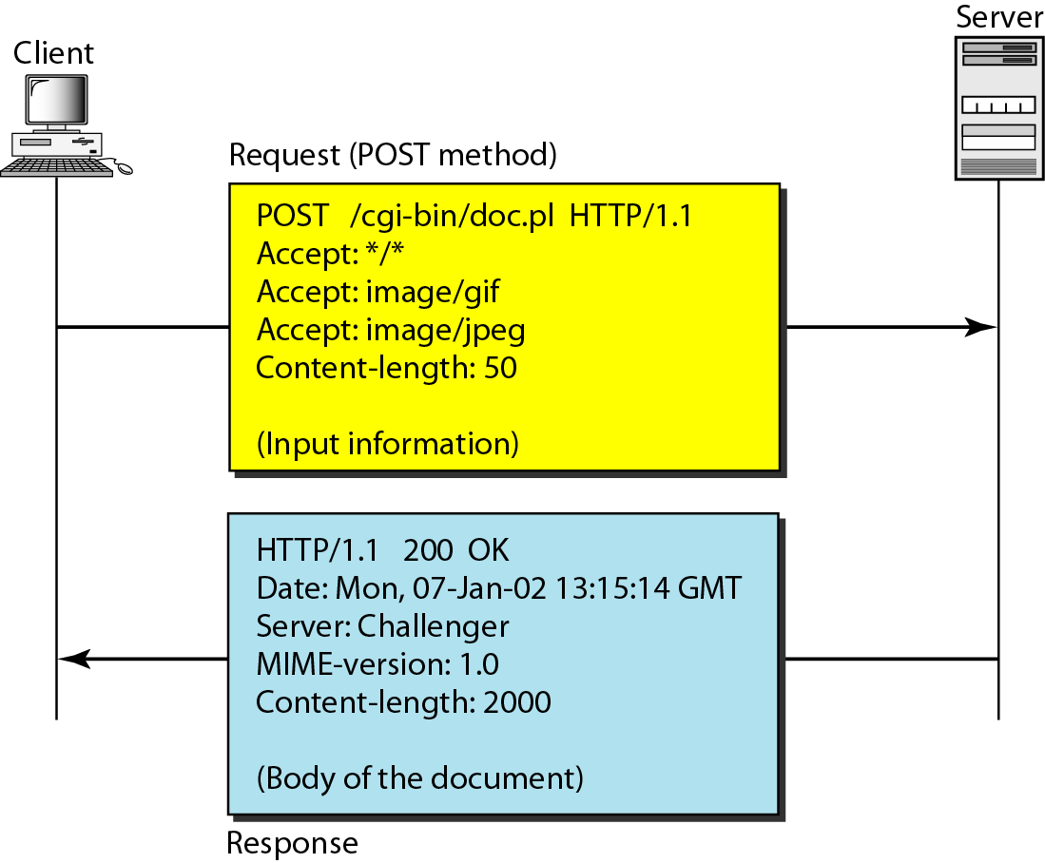
Figure 27.17 Example 27.2
27.<number>

Slide 48
Example 27.3
HTTP uses ASCII characters. A client can directly connect to a server using TELNET, which logs into port 80 (see next slide). The next three lines show that the connection is successful. We then type three lines. The first shows the request line (GET method), the second is the header (defining the host), the third is a blank, terminating the request. The server response is seven lines starting with the status line. The blank line at the end terminates the server response. The file of 14,230 lines is received after the blank line (not shown here). The last line is the output by the client.
27.<number>

Slide 49
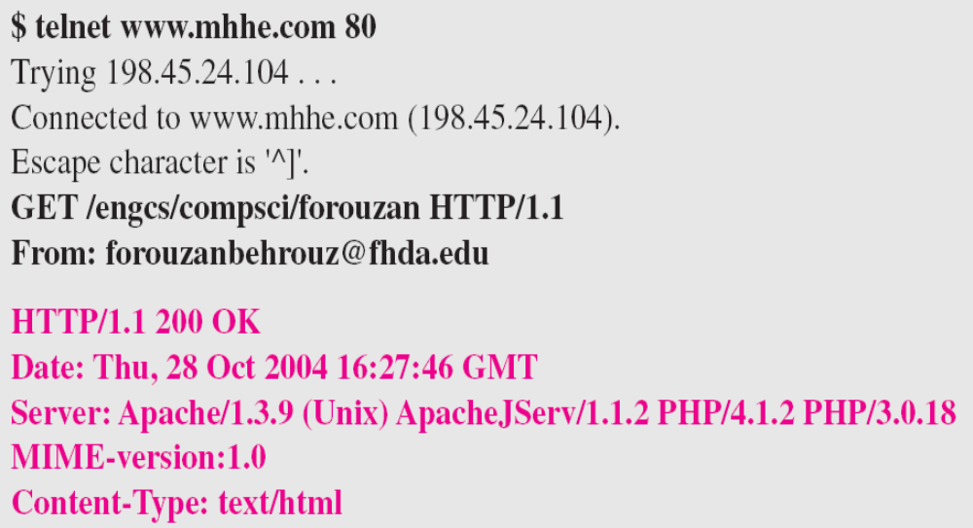
Example 27.3 (continued)
27.<number>

Slide 50
Note
HTTP version 1.1 specifies a persistent connection by default.
27.<number>

