Slide 1
Chapter 1: Introduction

Slide 2
Outline
Embedded systems overview
  What are they?
Design challenge – optimizing design metrics
Technologies
  Processor technologies
  IC technologies
  Design technologies

Slide 3


Embedded systems overview
Computing systems are everywhere
Most of us think of “desktop” computers
  PC’s
  Laptops
  Mainframes
  Servers
But there’s another type of computing system
  Far more common...

Slide 4



Embedded systems overview
Embedded computing systems
  Computing systems embedded within electronic devices
  Hard to define. Nearly any computing system other than a desktop computer
  Billions of units produced yearly, versus millions of desktop units
  Perhaps 50 per household and per automobile
Computers are in here...
and here...
and even here...
Lots more of these, though they cost a lot less each.

Slide 5




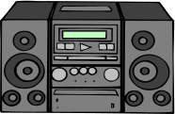

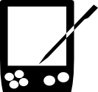


A “short list” of embedded systems
Anti-lock brakes
Auto-focus cameras
Automatic teller machines
Automatic toll systems
Automatic transmission
Avionic systems
Battery chargers
Camcorders
Cell phones
Cell-phone base stations
Cordless phones
Cruise control
Curbside check-in systems
Digital cameras
Disk drives
Electronic card readers
Electronic instruments
Electronic toys/games
Factory control
Fax machines
Fingerprint identifiers
Home security systems
Life-support systems
Medical testing systems
Modems
MPEG decoders
Network cards
Network switches/routers
On-board navigation
Pagers
Photocopiers
Point-of-sale systems
Portable video games
Printers
Satellite phones
Scanners
Smart ovens/dishwashers
Speech recognizers
Stereo systems
Teleconferencing systems
Televisions
Temperature controllers
Theft tracking systems
TV set-top boxes
VCR’s, DVD players
Video game consoles
Video phones
Washers and dryers
And the list goes on and on

Slide 6
Some common characteristics of embedded systems
Single-functioned
  Executes a single program, repeatedly
Tightly-constrained
  Low cost, low power, small, fast, etc.
Reactive and real-time
  Continually reacts to changes in the system’s environment
  Must compute certain results in real-time without delay

Slide 7
An embedded system example -- a digital camera
Digital camera chip
CCD
A2D
CCD preprocessor
Pixel coprocessor
D2A
lens
JPEG codec
Microcontroller
Multiplier/Accum
DMA controller
Display ctrl
Memory controller
ISA bus interface
UART
LCD ctrl
Single-functioned -- always a digital camera
Tightly-constrained -- Low cost, low power, small, fast
Reactive and real-time -- only to a small extent

Slide 8
Design challenge – optimizing design metrics
Obvious design goal:
  Construct an implementation with desired functionality
Key design challenge:
  Simultaneously optimize numerous design metrics
Design metric
  A measurable feature of a system’s implementation
  Optimizing design metrics is a key challenge

Slide 9
Design challenge – optimizing design metrics
Common metrics
  Unit cost: the monetary cost of manufacturing each copy of the system, excluding NRE cost
  NRE cost (Non-Recurring Engineering cost): The one-time monetary cost of designing the system
  Size: the physical space required by the system
  Performance: the execution time or throughput of the system
  Power: the amount of power consumed by the system
  Flexibility: the ability to change the functionality of the system without incurring heavy NRE cost

Slide 10
Design challenge – optimizing design metrics
Common metrics (continued)
  Time-to-prototype: the time needed to build a working version of the system
  Time-to-market: the time required to develop a system to the point that it can be released and sold to customers
  Maintainability: the ability to modify the system after its initial release
  Correctness, safety, many more

Slide 11
Design metric competition -- improving one may worsen others
Expertise with both software and hardware is needed to optimize design metrics
  Not just a hardware or software expert, as is common
  A designer must be comfortable with various technologies in order to choose the best for a given application and constraints
Power
Performance
Size
NRE cost
CCD
Digital camera chip
A2D
CCD preprocessor
Pixel coprocessor
D2A
lens
JPEG codec
Microcontroller
Multiplier/Accum
DMA controller
Display ctrl
Hardware
Software
Memory controller
ISA bus interface
UART
LCD ctrl

Slide 12
Time-to-market: a demanding design metric
Time required to develop a product to the point it can be sold to customers
Market window
  Period during which the product would have highest sales
Average time-to-market constraint is about 8 months
Delays can be costly
Revenues ($)
Time (months)

Slide 13
Losses due to delayed market entry
Simplified revenue model
  Product life = 2W, peak at W
  Time of market entry defines a triangle, representing market penetration
  Triangle area equals revenue
Loss
  The difference between the on-time and delayed triangle areas
Peak revenue
Peak revenue from delayed entry
Revenues ($)
On-time
Market rise
Market fall
Delayed
D
W
2W
On-time Delayed
entry entry
Time

Slide 14
Losses due to delayed market entry (cont.)
Area = 1/2 * base * height
  On-time = 1/2 * 2W * W
  Delayed = 1/2 * (W-D+W)*(W-D)
Percentage revenue loss = (D(3W-D)/2W²)*100%
Try some examples
Peak revenue
Peak revenue from delayed entry
Revenues ($)
On-time
Market rise
Market fall
Delayed
  Lifetime 2W=52 wks, delay D=4 wks
  (4*(3*26 –4)/2*26^2) = 22%
  Lifetime 2W=52 wks, delay D=10 wks
  (10*(3*26 –10)/2*26^2) = 50%
  Delays are costly!
D
W
2W
On-time Delayed
entry entry
Time

Slide 15
D(3W-D)/2W^2 * 100%
W=52/2=26 WEEKS
D=10 WEEKS
10(3*26 -10)/ 2*26^2
50.29%
D=5 & W=10
$25 MILLION

Slide 16
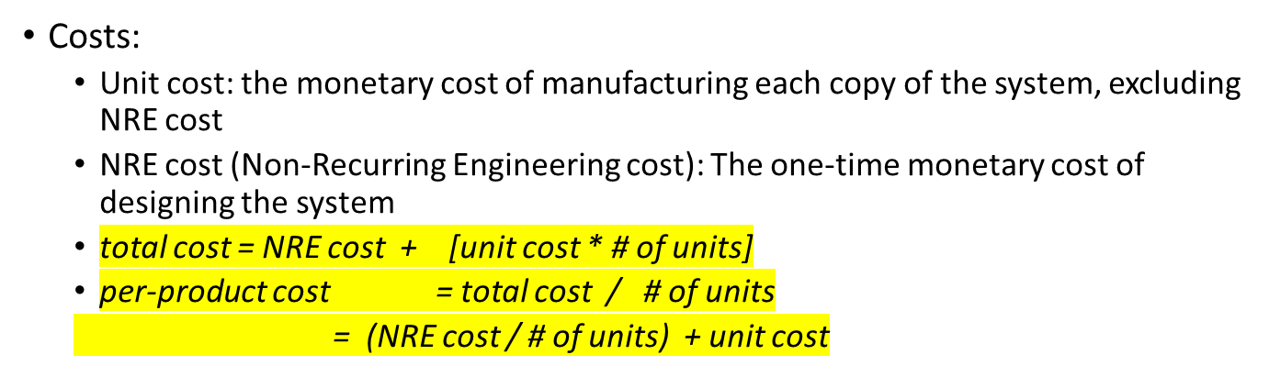
NRE and unit cost metrics
Example
  NRE=$2000, unit=$100
  For 10 units
    total cost = $2000 + 10*$100 = $3000
    per-product cost = $2000/10 + $100 = $300
Amortizing NRE cost over the units results in an additional $200 per unit

Slide 17
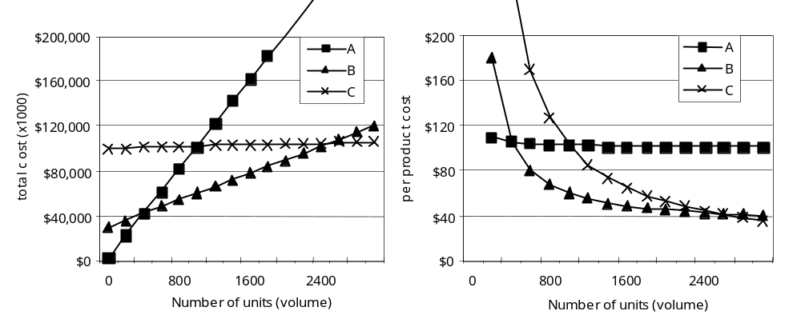
NRE and unit cost metrics
Compare technologies by costs -- best depends on quantity
  Technology A: NRE=$2,000, unit=$100
  Technology B: NRE=$30,000, unit=$30
  Technology C: NRE=$100,000, unit=$2
But, must also consider time-to-market

Slide 18
The performance design metric
Widely-used measure of system, widely-abused
  Clock frequency, instructions per second – not good measures
  Digital camera example – a user cares about how fast it processes images, not clock speed or instructions per second
Latency (response time)
  Time between task start and end
  e.g., Camera’s A and B process images in 0.25 seconds
Throughput
  Tasks per second, e.g. Camera A processes 4 images per second
  Throughput can be more than latency seems to imply due to concurrency, e.g. Camera B may process 8 images per second (by capturing a new image while previous image is being stored).
Speedup of B over S = B’s performance / A’s performance
  Throughput speedup = 8/4 = 2

Slide 19
Speed up of A over B=performance of A/Performance of B

Slide 20
Three key embedded system technologies
Technology
  A manner of accomplishing a task, especially using technical processes, methods, or knowledge
Three key technologies for embedded systems
  Processor technology
  IC technology
  Design technology

Slide 21
Processor technology
The architecture of the computation engine used to implement a system’s desired functionality
Processor does not have to be programmable
  “Processor” not equal to general-purpose processor
Controller
Datapath
Controller
Datapath
Controller
Datapath
Control
logic and State register
Register
file
Control logic and State register
Registers
Control
logic
index
total
Custom
ALU
State register
+
General
ALU
IR
PC
IR
PC
Data
memory
Data
memory
Program memory
Data
memory
Program memory
Assembly code for:
total = 0
for i =1 to …
Assembly code for:
total = 0
for i =1 to …
General-purpose (“software”)
Application-specific
Single-purpose (“hardware”)

Slide 22
Processor technology
Processors vary in their customization for the problem at hand
total = 0
for i = 1 to N loop
total += M[i]
end loop
Desired functionality
General-purpose processor
Application-specific processor
Single-purpose processor

Slide 23
General-purpose processors
Programmable device used in a variety of applications
  Also known as “microprocessor”
Features
  Program memory
  General datapath with large register file and general ALU
User benefits
  Low time-to-market and NRE costs
  High flexibility
“Pentium” the most well-known, but there are hundreds of others
Controller
Datapath
Control
logic and State register
Register
file
General
ALU
IR
PC
Program memory
Data
memory
Assembly code for:
total = 0
for i =1 to …

Slide 24
Single-purpose processors
Digital circuit designed to execute exactly one program
  a.k.a. coprocessor, accelerator or peripheral
Features
  Contains only the components needed to execute a single program
  No program memory
Benefits
  Fast
  Low power
  Small size
Controller
Datapath
Control logic
index
total
State register
+
Data
memory

Slide 25
Application-specific processors
Programmable processor optimized for a particular class of applications having common characteristics
  Compromise between general-purpose and single-purpose processors
Features
  Program memory
  Optimized datapath
  Special functional units
Benefits
  Some flexibility, good performance, size and power
Controller
Datapath
Control
logic and State register
Registers
Custom
ALU
IR
PC
Data
memory
Program memory
Assembly code for:
total = 0
for i =1 to …

Slide 26
Microcontroller
Dsp

