Slide 1
Module5
Randomization
Text book: Chris Spear

Slide 2
Randomization Overview
Why Randomize?
As designs grow it becomes more difficult to test their features through directed test cases
Directed test cases checks specific features of a design and can only detect anticipated bugs
Directed test case approach is a time consuming exercise
Directed tests detect only anticipated bugs in the design
Solution is Constrained Random Testcases (CRT) which randomize the input stimulus
Random testing detects the bugs you did not expect in your design

Slide 3
Randomization
Randomization is the process of making something random.
SystemVerilog randomization is the process of generating random values to a variable.
Verilog has a $random method for generating the random integer values-this is good for randomizing the variables alone, but it is hard to use in case of class object randomization.
For easy randomization of class properties, SystemVerilog provides rand keyword and randomize() method.

Slide 4
What to Randomize?
Device configurations
Try different device configurations
For instance for a switch verification try different configurations of input and output ports
Environment configurations
Randomize the entire environment that the device operates in
The number of objects
Object configurations
For instance randomize the number of PCI busses connected to a particular device

Slide 5
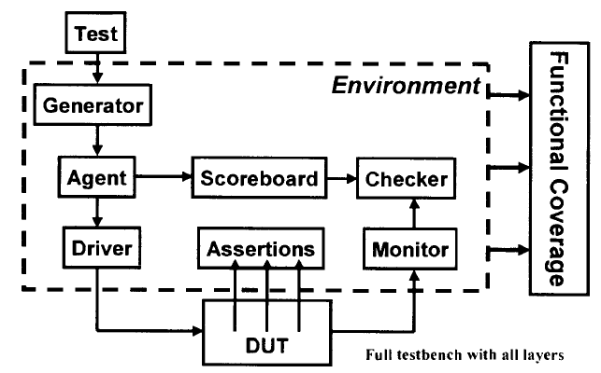
Test Bench

Slide 6
What to Randomize?
Primary Input Data
Randomize input data
Constrain the inputs to be within valid limits
Encapsulated input data
If the data is encapsulated, the different layers of encapsulation should be randomized and the device should be tested with different input configurations
The encapsulated data should also be randomized

Slide 7
What to Randomize?
Protocol exceptions, errors and violations
Verify how system handles errors
Anticipate error cases and inject into the system to ensure that the design gracefully handles them
Inject errors randomly
Delays
Use random legal delays specified by the protocols
Check for clock jitter sensitivity
Do not try to violate set up and hold requirements

Slide 8
random variables: The class variables which get random values on randomization are called random variables.
In order to make variables as random variables, Class variables need to be declared using the rand and randc type-modifier keywords.
Following types can be declared as rand and randc,
--singular variables of any integral type
--arrays
--arrays size
--object handle’s

Slide 9
Ex: rand bit [3:0] addr;
addr is a 4-bit unsigned integer with a range of 0 to 15. on randomization this variable shall be assigned any value in the range 0 to 15 with equal probability
randc keyword
randc is random-cyclic. For the variables declared with the randc keyword, on randomization variable values don’t repeat a random value until every possible value has been assigned.

Slide 10
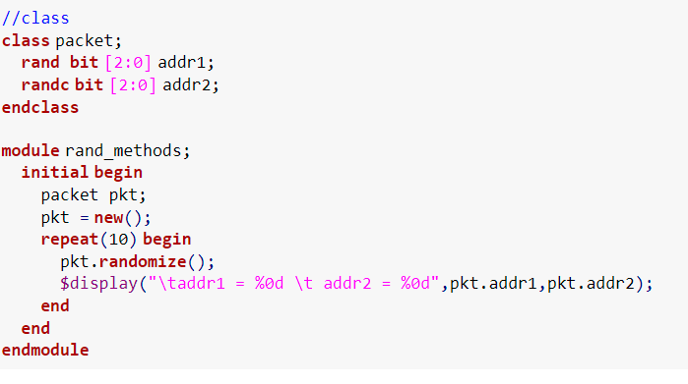
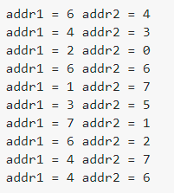

Slide 11
randomization example
In the previous example, Two variables addr1 and addr2 of same bit type are declared as rand and randc respectively, observe the randomized values of addr1 and addr2.
addr1 – takes the random value on every randomization addr2 – takes the random value on every randomization, but takes random value until every possible value has been assigned

Slide 12
In order to randomize the object variables, the user needs to call randomize() method.
example: object.randomize()

Slide 13
Randomization in SystemVerilog
Overview
Randomization enables users to automatically generate random input stimulus for functional verification
SystemVerilog enables user to specify random constrained (legal) values
Random constraints should be specified using OOP

Slide 14
Randomization in SystemVerilog
rand keyword
Random variables are declared with the rand keyword
Their values are uniformly distributed over the specified range
If unconstrained the variable shall assign any value in the specified range with equal probability
rand bit [7:0] y;
8-bit unsigned integer with the range 0 to 255
The probability of the same value repeating on successive calls to randomize is 1/256
If unconstrained y is assigned any value in the range 0 to 255 with equal probability
The probability of a value occurring on simultaneous calls to randomize is 1/256

Slide 15
Randomization in SystemVerilog
randc keyword
Random cyclic variables are declared with the randc keyword
They cycle through all the values in a random permutation of their declared range
Can only be of the type bit or enum
randc randomly iterates over all the values in the range and no value is repeated within an iteration
When the iteration finishes, a new iteration automatically starts
randc bit [1:0] y;
2-bit unsigned integer with the range 0 to 3
y can take values 0,1,2,3
initial permutation 0 -> 3 -> 2 -> 1
next permutation 2 -> 1 -> 3 -> 0
next permutation 2 -> 0 -> 1 -> 3

Slide 16
Randomization in SystemVerilog
Simple class with random variables
The Bus class models a simplified bus with two random variables: addr and data
The range1 constraint specifies the limits for the values of addr
Ensure non conflicting and legal constraints
class Bus
rand bit[15:0] addr;
randc bit[31:0] data;
constraint range1 {addr>1024; addr<16384;}
endclass
random variable
random cyclic: the random solver
will not repeat a permutation of values
Example: Simple class with random variables
constraining the random variables to values between 1024 and 16384

Slide 17
Randomization in SystemVerilog
randomize()function
Calling randomize() causes new values to be selected for all of the random variables in an object
The random values obey the constraints
randomize function returns a 1 on success and 0 on failure
Unconstrained variables are assigned any values in their declared range
a bus object is created and
randomized 50 times
result of each randomization
is checked
Bus bus=new;
repeat (50) begin
if(bus.randomize()==1)
$display(bus.addr, bus.data);
else
$display (“Randomization failed”);
end
Example: randomize() function example

Slide 18
Randomization in SystemVerilog
The constraint solver
Solves constraint expressions
The same seed results in the same random values
Use a different seed to generate different set of random values
The solver is specific to the simulation vendor

Slide 19
Constraint Details
Constraint Blocks
Values of random variables are determined using constraint expressions that are declared using constraint blocks
Smart stimulus tests relationships between variables
They are class members like tasks, functions and variables
Constraint declaration
Constraint identifier: is the name of the constraint block.
Constraint block: is a list of expression statements that restrict the range of variable or define relations between variables
In the example below randomize() fails sometimes and succeeds sometimes, why?
constraint_identifier
constraint_block
Error!!!
rand bit[15:0] addr;
class Bus
bit[15:0] addr;
randc bit[31:0] data;
constraint range1 {addr>1024; addr<16384;}
endclass
Example: Simple constraint example

Slide 20
Constraint Details
Simple expressions
Constraint variables have to be in a fixed order
There can be only one relational operator (<, <=, ==, >= or >)
For multiple variables use multiple expressions
Declare a constraint to solve: 0 < a < b < c
Error!!! wrong way
right way
class Bus
rand bit[15:0] a,b,c;
constraint c1 { 0 < a < b < c; }
endclass
class Bus
rand bit[15:0] a,b,c;
constraint c1 { 0 < a;
a < b;
b < c;}
endclass

Slide 21
Constraint Details: Example
Set membership Operator: inside
If other constraints are absent, all values have an equal probability of being chosen by the inside operator
The negated (!) form of inside operator denotes that expression lies outside the set
addr is between 0 to 100
or between 1024 to 16384
multiple mutually exclusive
constraints can be defined
within one constraint
class Bus
rand bit[15:0] addr;
randc bit[31:0] data;
constraint range1
{
addr inside {[0:100],[1024:16384]};
data > 1000;
data < 10000;
}
endclass
Example: Constraint example with inside operator

Slide 22
Constraint Details: Quiz
Declare constraint blocks c1,c2,c3 and c4 so that variable x, a and v get the values shown:
x takes any values described in the constraint_block :
x is: 3,5,9,10,11,12,13,14,15,24,25,26,27,28,29,30,31,32
x is: 3,5,9,10,11,12,13,14,15,24,25,26,27,28,29,30,31,32, between y and 2y, z
rand integer x,y,z;
constraint c1 {x inside {3,5,[9:15],[24:32];}
constraint c1 {x inside {3,5,[9:15],[24:32],[y:2*y],z};}
b<=a and a<=c or b<=a<=c
rand integer a,b,c;
constraint c2 {a inside {b,c};}
c3: v is either 5,10,15,20
c4: v is never 5,10,15,20
integer fives[0:3] = {5,10,15,20};
rand integer v;
constraint c3 {v inside fives;}
constraint c4 !{v inside fives;}

Slide 23
Weighted Distribution
In constraint blocks, we can control the occurrence or repetition of the same value on randomization using dist operator.
Some values can be allocated more often to a random variable. This is called as weighted distribution. Weights will be specified to the values inside the constraint block.
Dist operator takes a list of values and weights, separated by := or :/

Slide 24
Weighted Distribution
Distributions: dist operator
Used to weigh some values more than the others
Property 1: They are a relational test for set membership
Property 2: They specify a statistical distribution function for the result
Can use := or :/ operator
:= specifies that the weight has to be the same for every specified value in the range
:/ operator specifies that the weight is to be equally divided between all values. If there are n values in a range the weight is range_weight/n
Values can be a single value or range such as [lo:hi]
The weights are not percentage and do not have to add up to a 100
Cannot be used with a randc
c1 should be 0 once and 1 five times
Error!!! wrong way
right way
rand integer a;
constraint c1 {a inside {0,1,1,1,1,1});
rand integer a;
constraint c1 {a dist {0:=1, 1:=5}};

Slide 25
Weighted Distribution
Another example
rand int src, dst;
costraint c1 {
src dist {0:=40, [1:3]:=60};
dst dist {0:=40, [1:3]:/60};
}
Example: Weighted random distribution with dist
src | weight
0 | 40/220
1 | 60/220
2 | 60/220
3 | 60/220
dst | weight
0 | 40/100
1 | 20/100
2 | 20/100
3 | 20/100

Slide 26
Weighted Distribution: Quiz
Distributions: dist operator := and :/
x is 100, 200 and 300 with a weight of 1,2 and 5 respectively
x dist {100:=1, 200:=2, 300:=5}
x is 100 and 300 with a weight of 1 and 5 respectively
x is never 200
x!=200;
x dist {100:=1, 300:=5}
x is 100, 101 , 102 with a weight of 1 each
x is 200 and 300 with a weight of 2 and 5 respectively
x dist {[100:102]:=1, 200:=2, 300:=5}
x is 100, 101 , 102 with a weight of 1/3 each
x is 200 and 300 with a weight of 2 and 5 respectively
x dist {[100:102]:/1, 200:=2, 300:=5}

Slide 27
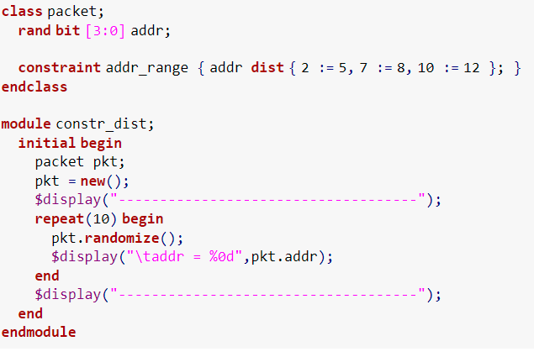
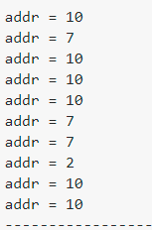

Slide 28
Bidirectional Constraints
Bidirectional Constraints
Constraint blocks are not procedural but declarative
All active at one time
Solve the constraint
30>d>b==c>=25
Solution
A
B
C
D
E
F
b | c | d
26 | 26 | 27
26 | 26 | 28
26 | 26 | 29
27 | 27 | 28
27 | 27 | 29
28 | 28 | 29
rand logic [15:0] b,c,d;
costraint c1 {
b<d;
c==b;
d<30;
c>=25;
}
Example: Bidirectional constraints
Solutions for Bidirectional Constraints

Slide 29
Conditional Constraints
Conditional constraint operators
Constraint provide two constructs for declaring conditional relations
Implication operator ->
if…else
if(mode==small)
len<10;
else if (mode==large)
len>100;
mode == small -> len<10;
mode == large -> len>100
Example: if…else example
Example: Equivalent implication example
bit [3:0] a,b;
if(a==0)
b==1;
bit [3:0] a,b;
constraint c {(a==0)->(b==1);}
Example: if…else example
Example: Equivalent implication example

Slide 30
Solution Probabilities
Unconstrained
Probability of distribution
Solution | x | y | Probability
A | 0 | 0 | 1/8
B | 0 | 1 | 1/8
C | 0 | 2 | 1/8
D | 0 | 3 | 1/8
E | 1 | 0 | 1/8
F | 1 | 1 | 1/8
G | 1 | 2 | 1/8
H | 1 | 3 | 1/8
class Unconstrained;
rand bit x;
rand bit [1:0] y;
endclass
Example: Class with unconstrained random variables
There are 8 possible solutions and because there are no constraints each has the same probability
Solutions for Unconstrained class

Slide 31
Solution Probabilities
Implication
Probability of distribution changes due to the implication operator
Implication is bidirectional
class Imp1;
rand bit x;
rand bit [1:0] y;
constraint c_xy {
(x==0)->y==0;
}
endclass
Solution | x | y | Probability
A | 0 | 0 | 1/2
B | 0 | 1 | 0
C | 0 | 2 | 0
D | 0 | 3 | 0
E | 1 | 0 | 1/8
F | 1 | 1 | 1/8
G | 1 | 2 | 1/8
H | 1 | 3 | 1/8
Example: Class with implication
Value of y depends on x. When x is 0, y is 0. Hence for x=0, y cannot have any other value and hence the probability of x=0 and y!=0 is 0
Solutions for Imp1 class

Slide 32
Solution Probabilities
Implication and bidirectional constraints
Probability of distribution changes due to an addition constraint
class Imp_Bid;
rand bit x;
rand bit [1:0] y;
constraint c_xy {
y>0;
(x==0)->y==0;
}
endclass
Solution | x | y | Probability
A | 0 | 0 | 0
B | 0 | 1 | 0
C | 0 | 2 | 0
D | 0 | 3 | 0
E | 1 | 0 | 0
F | 1 | 1 | 1/3
G | 1 | 2 | 1/3
H | 1 | 3 | 1/3
Example: Class with implication and constraint
When x is 0, y is 0 but when y is 0 there is no constraint on x. Since implication is bidirectional, if y was forced to a non zero value, x would have to be 1. Hence x can never be 0.
Solutions for Imp_Bid class

Slide 33
Solution Probabilities
Solve…before
Solve…before does not change the solution space but changes the probability of the results
class SolveBefore;
rand bit x;
rand bit [1:0] y;
constraint c_xy {
(x==0)->y==0;
solve y before x;
}
endclass
Example: Class with implication and solve…before

Slide 34
Solution Probabilities
class SolveBefore;
rand bit x;
rand bit [1:0] y;
constraint c_xy {
(x==0)->y==0;
solve y before x;
}
endclass
Example: Class with implication and solve…before
Solution | y | x | Unconstrained Probability | Solution Possibility | Probability
A | 0 | 0 | 1/8 |  | 1/8
B | 0 | 1 | 1/8 |  | 1/8
C | 1 | 0 | 1/8 |  | 0
D | 1 | 1 | 1/8 |  | 1/4
E | 2 | 0 | 1/8 |  | 0
F | 2 | 1 | 1/8 |  | 1/4
G | 3 | 0 | 1/8 |  | 0
H | 3 | 1 | 1/8 |  | 1/4
Solutions for solve y before x constraint

Slide 35
Solution Probabilities
Solve…before
Solve…before does not change the solution space but changes the probability of the results
Solution | y | x | Probability
A | 0 | 0 | 1/8
B | 0 | 1 | 1/8
C | 1 | 0 | 0
D | 1 | 1 | 1/4
E | 2 | 0 | 0
F | 2 | 1 | 1/4
G | 3 | 0 | 0
H | 3 | 1 | 1/4
class SolveBefore;
rand bit x;
rand bit [1:0] y;
constraint c_xy {
(x==0)->y==0;
solve y before x;
}
endclass
Example: Class with implication and solve…before
Solutions for solve y before x constraint

Slide 36
Solution Probabilities
Solve…before
Solution | x | y | Probability
A | 0 | 0 | 1/2
B | 0 | 1 | 0
C | 0 | 2 | 0
D | 0 | 3 | 0
E | 1 | 0 | 1/8
F | 1 | 1 | 1/8
G | 1 | 2 | 1/8
H | 1 | 3 | 1/8
class Imp4;
rand bit x;
rand bit [1:0] y;
constraint c_xy {
(x==0)->y==0;
solve x before y;
}
endclass
Example: Class with implication and solve…before
Solutions for solve x before y constraint

Slide 37
Constraints
Iterative constraints
Allows arrayed variables to be constrained in a parameterized manner using loop variables
C1 constraints each element of an array to be in the set [2,4,8,16]
C2 constraints each element of an array to be greater than twice its index
class C;
rand byte A[4];
constraint C1{ foreach (A[i]) A[i]inside {2,4,8,16};}
constraint C2{ foreach (A[j]) A[j]> 2*j;}
endclass

Slide 38
Constraints
Iterative constraints
bit [3:0][2:1] B [5:1][4]
int A [2][3][4];
2
1
3
3
2
1
0
2
4
5:1
foreach (A[i,j,k])…
4
i iterates from 0 to 1
j iterates from 0 to 2
k iterates from 0 to 3
foreach (B[q,r,,s])…
q iterates from 5 to 1
r iterates from 0 to 3
s iterates from 2 to 1

Slide 39
Constraints
Functions in constraints
Some properties are unwieldy or impossible to express in a single expression
For instance computing the sum of one’s in a packed array uses a loop
Without the loop the loop will have to be unrolled
SystemVerilog allows constraint expressions to include function calls
Functions cannot contain output or ref arguments
Functions should be automatic
Functions that appear in constraints cannot modify the constraints
Functions shall be called before constraints are solved, and their return values shall be treated as state variables
Random variables used as function arguments shall establish an implicit variable ordering or priority
class B;
rand int x,y;
constraint C{x<=F(y);}
constraint D{ y inside {2,4,8};}
endclass
Forces y to be solved before x

Slide 40
Constraints
Constraint guards
Constraint guards are predicate expressions that function as guards against creation of constraints
They are not logical relations that have to be satisfied by the constraint solver
Prevents the solver from generating evaluation errors
Constraint guards are solved before the constraints and involve
Constants
State variables
Object handle comparisons
The constraint will fail on the last element due to a non existent handle in the linked list
class SList;
rand int n;
constraint sort{n<next.n;}
endclass
if statement acts as a constraint guard
class SList;
rand int n;
constraint sort{if(next!=null)n<next.n;}
endclass

Slide 41
Constraints
Constraint guards
Guard expressions can themselves include sub-expressions that result in evaluation errors
A 4-state representation is used where
0 : false -> Subexpression evaluates to FALSE
1 : true -> subexpression evaluates to TRUE
E: Error -> Subexpression causes an evaluation error
R: Random -> Expression includes random variables and cannot be evaluated
class D
int x;
endclass
class C;
rand int x,y;
D a,b;
constraint C1{(x<y || a.x > b.x || a.x==5) -> x+y==10;}
endclass
Case | a | b | a.x | b.x | Constraint
1 | !0 | 0 | 5 | error | x+y=10
2 | 0 | - | error | - | always error
3 | !0 | !0 | 10 | 20 | ( x<y) -> (x+y==10)

Slide 42
Constraints
Constraint guards
class D
int x;
endclass
class C;
rand int x,y;
D a,b;
constraint C1{(x<y && a.x > b.x && a.x==5) -> x+y==10;}
endclass
Case | a | b | a.x | b.x | Constraint
1 | !0 | 0 | 5 | error | error
2 | 0 | - | error | - | always error
3 | !0 | !0 | 5 | 2 | ( x<y) -> (x+y==10)

Slide 43
Disabling Random Variables
Disabling random variables with rand_mode()
Can be used to control whether a random variable is active or inactive
When a random variable is inactive it implies that the variable was never declared rand or randc
rand_mode() method is inbuilt and cannot be overridden
Value | Meaning | Description
0 | OFF | Sets the specified variable to inactive so that they are not randomized on subsequent calls to randomize() method
1 | ON | Sets the specified variable to active so that they are randomized on subsequent calls to randomize() method
class Packet;
rand integer src, dst;
endclass
int r;
Packet packet_a=new;
packet_a.rand_mode(0);
packet_a.src.rand_mode(1);
r=packet_a.dst.rand_mode();

Slide 44
Controlling Constraints
Controlling constraints with constraint_mode()
Can be used to control whether a constraint is active or inactive
When a constraint is inactive is not considered by randomize()
All constraints are initially active
constraint_mode method is built it and cannot be overridden
Value | Meaning | Description
0 | OFF | Sets the specified constraint block to inactive so that it is not enforced by subsequent calls to randomize() method
1 | ON | Sets the specified constraint block to active so that it is considered by subsequent calls to randomize() method
class Packet;
rand integer src, dst;
constraint filter{src>2*dst;}
endclass
function integer toggle_rand (Packet p);
if (p.filter.constraint_mode()==1)
p.filter.constraint_mode(0);
else
p.filter.constraint_mode(1);
toggle_rand=p.randomize();
endfunction

Slide 45
rand_mode method
The rand_mode() method is used to disable the randomization of a variable declared with the rand/randc keyword.
rand_mode(1) means randomization enabled
rand_mode(0) means randomization disabled
The default value of rand_mode is 1, i.e enabled
Once the randomization is disabled, it is required to make rand_mode(1) enable back the randomization
rand_mode can be called as SystemVerilog method, the randomization enables/disable .
Status of a variable can be obtained by calling vairble.rand_mode().

