Slide 1
Module3
Ch:3 Procedural Statements and Routines
Ch4: Connecting test bench and DUT

Slide 2
System Verilog Procedural Statements
New Operators
Increment and decrement operator
Used the same way as C
Post-increment/decrement and pre-increment/decrement
May cause a race condition since ++ and -- operators behave as blocking assignments
for (i=0; i<=31; i++)
begin
…
end
j=i++
j=++i
j=i--;
j=-i;
j is assigned value of i and then i is incremented by 1
i is incremented by 1 and j is assigned value of i
j is assigned value of i and then I is decremented by 1
i is decremented by 1 and then j is assigned value of i

Slide 3
System Verilog Procedural Statements
Enhanced for loops
for loop variables are declared outside the loop in Verilog
Concurrent loops interfere with each other
SystemVerilog allows the for loop variables to be declared inside the loop
Each variable is local and unique to the loop, hence same name usage does not cause any interference
Local loop variables are automatic
The variables do not exist outside the loops

Slide 4
always @(posedge clock) begin
for(int i=1; i<=1024; i=i+1)
…
end
endmodule

Slide 5
System Verilog Procedural Statements
do…while loop
A while loop in Verilog might not execute at all
If the test of control values is false the first time the loop is encountered in the execution flow
SystemVerilog adds a do..while loop (similar to C)
A do while loop executes atleast once
Control of the loop is tested at the end of each pass of the loop
All logic for setting the outputs of the loop can be placed inside the loop
Makes code more concise and intuitive
do <statement or statement block>
while (<condition>);

Slide 6
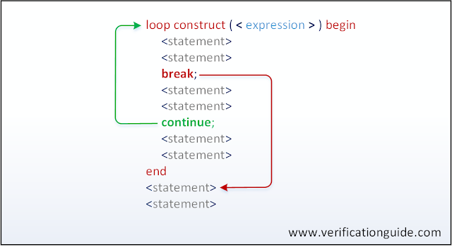
break and continue statements

Slide 7
System Verilog Procedural Statements
break and continue:
The execution of a break statement leads to the end of the loop.
break shall be used in all the loop constructs (while, do-while, foreach, for, repeat and forever).
Execution of continue statement leads to skip the execution of statements followed by continue and jump to next loop or iteration value

Slide 8
Example for break statement
module break_in_loop;
initial begin
$display("-----------------------------------------------------------------");
for(int i=0;i<8;i++) begin
$display("\tValue of i=%0d",i);
if(i == 4) begin
$display("\tCalling break,");
break;
end
end
$display("-----------------------------------------------------------------");
end
endmodule
when the loop value equals 4, the break is called this leads to the end of the loop.

Slide 9
Example for continue statement
module continue_in_loop;
initial begin
$display("-----------------------------------------------------------------");
for(int i=0;i<8;i++) begin
if((i > 2) && (i < 7))begin
$display("\t\tCalling continue,");
continue;
end
$display("\t\tAfter Continue\t:: Value of i=%0d",i);
end
$display("-----------------------------------------------------------------");
end
Endmodule
when ever the loop value is with in 3 to 6, continue statement will be executed, this leads to skip the execution of display statement after the continue.

Slide 10
Tasks and functions
Tasks and Functions provide a means of splitting code into small parts.
A Task can contain a declaration of parameters, input arguments, output arguments, in-out arguments, registers, events, and zero or more behavioral statements.
Static tasks
Static tasks share the same storage space for all task calls.
Automatic tasks
Automatic tasks allocate unique, stacked storage for each task call.

Slide 11
Task declration can be as in verilog 1995/2001 or can be declared as in C or C++. In SystemVerilog following rules hold good for any Task declaration
Default Port Direction : Any port is seen as input, unless declared as other types. Following are port types
input : copy value in at beginning
output : copy value out at end
inout : copy in at beginning and out at end
ref : pass reference

Slide 12
Default Data TYpe : Unless declared, data types of ports are of logic type.
begin..end : There is no need to have begin, end, when more then one statement is used.
return : A task can be terminated before endtask, by usage of return statement.
Variables : Systemverilog allows to have local static, or local dynamic variables.
life time : SystemVerilog allows a task to static or automatic.
wire : Wire data type can not be used in port list;

Slide 13
task arguments in parentheses
module sv_task;
int x;
//task to add two integer numbers.
task sum(input int a,b,output int c);
c = a+b;
endtask
initial begin
sum(10,5,x);
$display("\tValue of x = %0d",x);
end
endmodule

Slide 14
task arguments in declarations and mentioning directions
module sv_task;
int x;
//task to add two integer numbers.
task sum;
input int a,b;
output int c;
c = a+b;
endtask
initial begin
sum(10,5,x);
$display("\tValue of x = %0d",x);
end
endmodule

Slide 15
Functions
A Function can contain declarations of range, returned type, parameters, input arguments, registers, and events.
A function without a range or return type declaration returns a one-bit value
Any expression can be used as a function call argument
Functions cannot contain any time-controlled statements, and they cannot enable tasks
Functions can return only one value

Slide 16
Function declration can be as in verilog 1995/2001 or can be declared as in C or C++. In SystemVerilog following rules hold good for any Function declaration
Default Port Direction : Any port is seen as input, unless declared as other types. Following are port types
input : copy value in at beginning
output : copy value out at end
inout : copy in at beginning and out at end
ref : pass reference

Slide 17
Default Data TYpe : Unless declared, data types of ports are of logic type.
begin..end : There is no need to have begin, end, when more then one statement is used.
return : A function can be terminated before endfunction, by usage of return statement.
Variables : Systemverilog allows to have local static, or local dynamic variables.
life time : SystemVerilog allows a function to static or automatic.
Wire : Wire data type can not be used in port list;
void : SystemVerilog allows functions to be declared as type void

Slide 18
function arguments in parentheses
module sv_function;
int x;
//function to add two integer numbers.
function int sum(input int a,b);
sum = a+b;
endfunction
initial begin
x=sum(10,5);
$display("\tValue of x = %0d",x);
end
endmodule

Slide 19
function arguments in declarations and mentioning directions
module sv_function;
int x;
//function to add two integer numbers.
function int sum;
input int a,b;
sum = a+b;
endfunction
initial begin
x=sum(10,5);
$display("\tValue of x = %0d",x);
end
endmodule

Slide 20
function with return value with the return keyword
module sv_function;
int x;
//function to add two integer numbers.
function int sum;
input int a,b;
return a+b;
endfunction
initial begin
x=sum(10,5);
$display("\tValue of x = %0d",x);
end
endmodule

Slide 21
Void function
module sv_function;
int x;
//void function to display current simulation time
function void current_time;
$display("\tCurrent simulation time is %0d",$time);
endfunction
initial begin
#10;
current_time();
#20;
current_time();
end

Slide 22
discarding function return value
The function return value must be assigned to a variable or used in an expression.
Calling a function without return value assigned to a variable can result in a warning message. SystemVerilog void data type is used to discard a function’s return value without any warning message.

Slide 23
module sv_function;
int x;
//function to add two integer numbers.
function int sum;
input int a,b;
return a+b;
endfunction
initial begin
$display("Calling function with void");
void'(sum(10,5));
end
endmodule

Slide 24
function call as an expression
module sv_function;
int x;
//function to add two integer numbers.
function int sum;
input int a,b;
return a+b;
endfunction
initial begin
x = 10 + sum(10,5);
$display("\tValue of x = %0d",x);
end
endmodule

Slide 25
SystemVerilog Tasks and Functions
Tasks and Functions
SystemVerilog functions and tasks do not require begin and end statements
SystemVerilog adds a return statement
Void functions do not return a value
Functions can have output and inout as formal arguments
task reset();
reset_l = 1’b0;
#100
reset_l = 1’b1;
endtask
function int add2(int n);
return n + 2;
endfunction

Slide 26
SystemVerilog Tasks and Functions
Return Statement
SystemVerilog adds a return statement
If a return statement is executed that value is returned else the last value assigned to the function name is the return value
A return statement can be used to exit a task or a function
function int add_and_inc (input [31:0] a,b);
add_and_inc=a+b+1;
endfunction
Return has priority over returning the value in the name of the function
function int add_and_inc (input [31:0] a,b);
add_and_inc=a+b;
return ++add_and_inc;
endfunction

Slide 27
SystemVerilog Tasks and Functions
Void functions
Void functions do not return a value
Output and inout formal arguments allow a void function to propagate changes to the scope
A void function can be called like a task but must adhere to the restriction of function contents

Slide 28
typedef struct{
logic valid;
logic [7:0] check;
logic [63:0] data;
} packet_t;
function void fill_packet (
input logic[63:0] data_in, output packet_t data_out);
data_out.data=data_in;
endfunction

Slide 29
SystemVerilog Tasks and Functions
Passing task/function arguments by name
SystemVerilog can pass argument values to tasks or functions using the names of formal arguments
Reduces errors
The arguments can be passed in any order
Syntax for named argument passing is the same as Verilog’s syntax for named port connections

Slide 30
function int divide (input int numerator, denominator);
if(denominator==0)
begin
return 0;
end
else
return numerator/denominator;
endfunction
always @(posedge clock)
result<=divide(b,a)
always @(posedge clock)
result<=divide(.deominator(b),.numerator(a))

Slide 31
Connecting the Testbench and the Design
How do I connect my design to the testbench?
Testbench
Driver
Design Under Test
?
.*Port, .Name,
Interfaces

Slide 32
Connecting the Testbench and the Design
One way to connect the testbench and the design is to use the conventional verilog module ports convention
Verilog Connection Review
Module A
A_out_signal1
B_in_signal1
Module B
A_out_signal2
B_in_signal2
A_in_signal1
B_out_signal1
A_in_signal2
B_out_signal2
module A (
input A_in_signal1,
input A_in_signal2
output A_out_signal1,
output A_out_signal2,
);
…
endmodule
module B (
input B_in_signal1,
input B_in_signal2
output B_out_signal1,
output B_out_signal2,
);
…
endmodule

Slide 33
Connecting the Testbench and the Design
Verilog connection review
Verilog language connects modules together through module ports
Module A
A_out_signal1
conn1
B_in_signal1
Module B
A_out_signal2
conn2
B_in_signal2
A_in_signal1
conn3
B_out_signal1
A_in_signal2
conn4
B_out_signal2
module top (
wire conn1,
wire conn2
wire conn3,
wire conn4,
);
A A_instance1(.A_out_signal1(conn1),
.A_out_signal2(conn2),
.A_in_signal1(conn3),
.A_in_signal2(conn4));
B B_instance1(.B_in_signal1(conn1),
.B_in_signal2(conn2),
.B_out_signal1(conn3),
.B_out_signal2(conn4));
endmodule

Slide 34
Connecting the Testbench and the Design
Lets do another example:
Testbench
request [1:0]
Arbiter
grant [1:0]
reset
clk
module arb_port (
output logic [1:0] grant,
input logic [1:0] request,
input logic reset,
input logic clk
);
…
endmodule
module test (
input logic [1:0] grant,
output logic [1:0] request,
output logic reset,
input logic clk
);
…
endmodule

Slide 35
SystemVerilog: .*Port Connections
Implicit .* port connections
.* infers connections of all nets and ports of the same name
For a connection to be inferred the name and the vector sizes should be the same
Types connected together should be compatible
module top
logic [1:0] grant,request;
logic clk, reset;
arb_port a1(.grant(grant), .request(request), .reset(reset), .clk(clk));
test t1(.grant(grant), .request(request), .reset(reset), .clk(clk));
…
endmodule
module top
logic [1:0] grant,request;
logic clk, reset;
arb_port a1(.*);
test t1(.*);
…
endmodule
.*Port Connections

Slide 36
SystemVerilog: .Name Connections
Implicit .name connections
.name is an abbreviation of named port connections
.name infers a connection of a net and port of the same name and same vector sizes
.name simplifies connections to module instances
.name can be combined with named port connections
module top
logic [1:0] grant,request;
logic clk, reset;
arb_port a1(.grant, .request, .reset, .clk);
test t1(.grant, .request, .reset, .clk);
…
endmodule

Slide 37
Downside of Verilog Connection Conventions
Verilog module port conventions are cumbersome
Why?
Lets change the name of a port request to request 1
module arb_port (
output logic [1:0] grant,
input logic [1:0] request1,
input logic reset,
input logic clk
);
…
endmodule
module test (
input logic [1:0] grant,
output logic [1:0] request1,
output logic reset,
input logic clk
);
…
endmodule
Need to change the port list of each module
Need to change the port list of the connecting module
Need to change the name in the instantiation of the modules
Need to change the name everywhere in the hierarchy
What if you forget to change it in someplace?? --> Compilation error!!!!

Slide 38
Downside of Verilog Connection Conventions
Verilog connections become especially tedious and cumbersome for large designs
Internal
Memory
10
Instruction Fetch
15
Master Processor
10
10
main bus
10
10
Test Generator
Slave Processor
Number of ports

Slide 39
Disadvantages of Verilog Connection Conventions
Disadvantage of Verilog Module Connections
Declarations must be duplicated in multiple modules
Communication protocols must be duplicated in several modules
Risk of mismatched declarations
A change in design specifications can require modifications in multiple modules
Solution!!!!
SystemVerilog introduces a powerful new port type called: Interface

Slide 40
SystemVerilog Interfaces
SystemVerilog Interfaces
SystemVerilog adds a powerful new port type to Verilog, called an interface.
An interface allows a number of signals to be grouped together and represented as a single port
The declarations of the signals that make up the interface are contained in a single location.
Each module that uses these signals then has a single port of the interface type, instead of many ports with the discrete signals.
Testbench
Arbiter
Interface
All the signals that are common between the major blocks of the design are encapsulated in one location- the interface declaration

Slide 41
SystemVerilog Interfaces
Using an interface to simplify connections
Testbench
Arbiter
Interface
request [1:0]
interface arb_if (input bit clk);
logic [1:0] grant, request;
logic reset;
endinterface
grant [1:0]
reset
Interface Declaration
clk
module top;
bit clk;
always #5 clk=~clk;
arb_if arbif(clk);
arb a1(arbif);
test t1(arbif);
endmodule: top
Interface
Top module using a simple arbiter interface

Slide 42
SystemVerilog Interfaces
Using an interface to simplify connections
interface arb_if (input bit clk);
logic [1:0] grant, request;
logic reset;
endinterface
Interface Declaration
module test (arb_if arbif);
…
initial begin
@(posedge arbif.clk);
arbif.request<=2’b01;
$display (“@%0d: Drove req=01”, $time);
repeat(2) @(posedge arbif.clk);
if(arbif.grant!=2’b01)
$display (“@%0d: a1: grant !=2’b01”, $time);
$finish
end
endmodule: test
test module using a simple arbiter interface

Slide 43
SystemVerilog Interfaces
Connecting interfaces and ports
Signals in an interface are referenced using the port name
<port_name>.<internal_interface_signal_name>
interface arb_if (input bit clk);
logic [1:0] grant, request;
logic reset;
endinterface
Interface Declaration
module top;
bit clk;
always #5 clk=~clk;
arb_if arbif(clk);
arb a1(.grant(arbif.grant),
.request(arbif.request),
.reset(arbif.reset),
.clk(arbif.clk));
test t1(arbif);
endmodule: top
Connecting the arbiter module using ports to the test module using an interface

Slide 44
SystemVerilog Interfaces: modports
Interface modports
SystemVerilog interfaces provide a means to define different views of the interface signal
modport is an abbreviation for module port
An interface can have any number of modport definitions
The modport declaration only defines whether the connecting module sees a signal as an input, output or bidirectional
By specifying the port directions, modport provides access restrictions
interface arb_if (input bit clk);
logic [1:0] grant, request;
logic reset;
modport TEST(output request,reset,
input grant, clk);
modport DUT(input request,reset, clk
output grant);
endinterface
module arb (abf_if.DUT arbif);
…
endmodule
2. arbiter module with interface using modports
module test (abf_if.TEST arbif);
…
endmodule
1. Interface Declaration using modports
3. test module with interface using modports

Slide 45
SystemVerilog Interfaces
SystemVerilog interfaces overview
SystemVerilog interfaces can contain functionality
They are not just bundle of wires
Discrete signal and ports for communications can be defined in one location
Communication protocols can be defined in the interface
Protocol checking and other verification routines can be built into the interface
SystemVerilog also allows multiple views of the interface to be defined
For instance the data_bus signal can be defined to be an input, output or bidirectional port
SystemVerilog interfaces cannot contain design hierarchy
cannot contain instances of modules
SystemVerilog interfaces can be used as a module port
SystemVerilog interfaces can contain modports
modports allow modules to see interface differently

Slide 46
System verilog modports-example code
//Defining modport in interface
interface intf();
//declaring the signals
logic [3:0] a;
logic [3:0] b;
logic [6:0] c;
modport driver (output a, b, input c);
endinterface
//driving using modort
//run task
task run;
vif.driver.a = 6;
vif.driver.b = 4;
$display("Value of a = %0d, b = %0d",vif.driver.a,vif.driver.b);
#5;
$display("Sum of a and b, c = %0d",vif.driver.c);
$finish;
Endtask
Simulator output:
Value of a = 6, b = 4 Sum of a and b, c = 10

Slide 47
Example2
//Defining modport in interface with the direction input
interface intf();
//declaring the signals
logic [3:0] a;
logic [3:0] b;
logic [6:0] c;
modport driver (input a, b, c);
endinterface
//driving using modport
//run task
task run;
vif.driver.a = 6;
vif.driver.b = 4;
$display("Value of a = %0d, b = %0d",vif.driver.a,vif.driver.b);
#5;
$display("Sum of a and b, c = %0d",vif.driver.c);
$finish;
Endtask
Simulation output:
Error-[MPCBD] Modport port cannot be driven environment.sv, 18 $unit, "vif.driver.a" Port 'a' of modport 'driver' has been restricted as an input port. Input ports cannot be driven.

Slide 48
Stimulus Timing
The timing between the testbench and the design should be maintained to avoid race conditions
Tsetup
start
start
write
write
addr
42
addr
42
data
5a
data
5a
10
10
Driving the signal too late and sampling it too early causes the race condition to occur
Solution: Drive the signal Tsetup early to avoid race condition

Slide 49
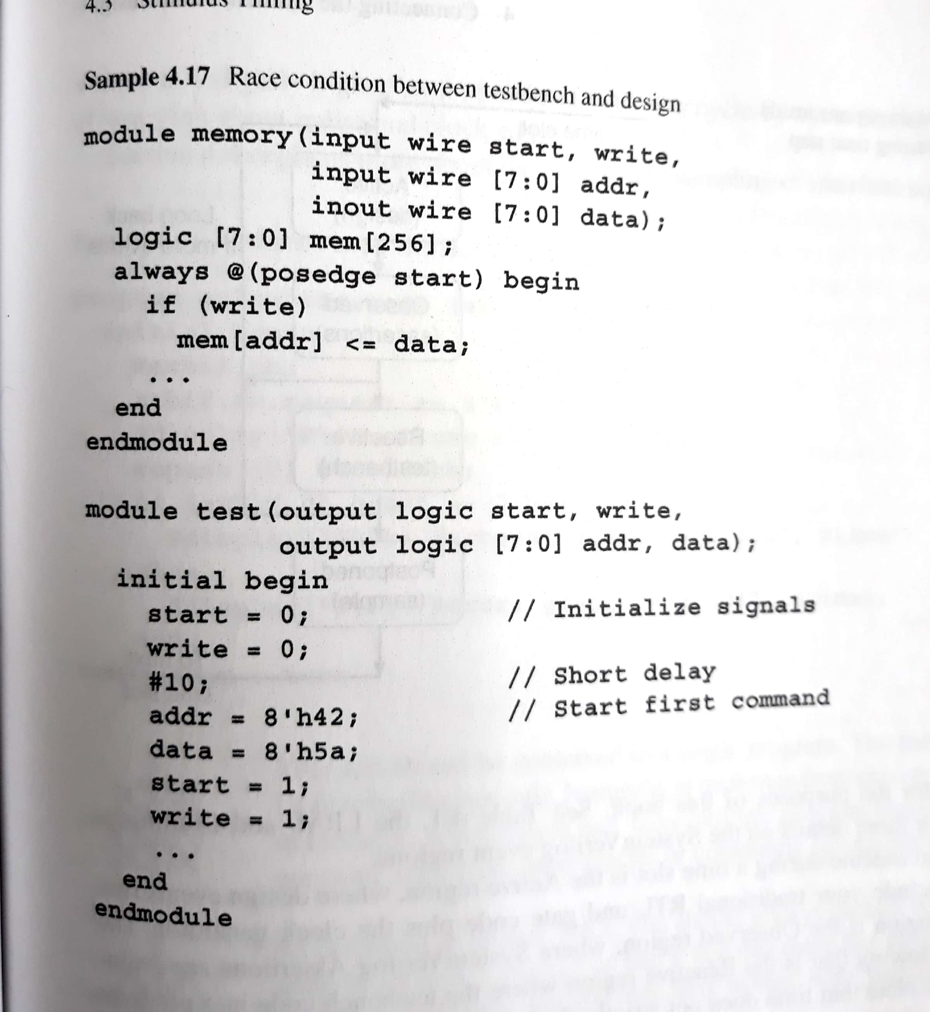
When test bench drives start signal first and then other signals, race occurs.

Slide 50
Stimulus Timing
The timing between the testbench and the design should be maintained
Ensure driving and receiving synchronous signals at the proper time in relation to the clock
Driving a signal too late or sampling it too early can cause the testbench to be off a cycle
To ensure proper sampling and signaling the testbench should be separate from the design
The inputs should be driven just before the clock edge and outputs should be sampled just after the clock edge

Slide 51
Stimulus Timing: Clocking Blocks
Controlling timing of synchronous signals by using Clocking Blocks
An interface may contain a clocking block to specify the timing of synchronous signals relative to the clock
Any signal in the clocking block is driven or sampled synchronously, ensuring that the testbench interacts with the signals at the right time
Clocking block ensures that the testbench interacts with the signals at the right time
Clocking blocks are mainly used by testbenches
An interface can contain multiple clocking blocks.
Synthesis tools do not support clocking blocks.

Slide 52
System Verilog Testbench in Simulation
When you are using interfaces with a clocking block:
There is a 1-cycle delay from DUT output to testbench input
“Virtual synchronizer” added to TB input
No delay from testbench output to DUT input
default input #1step output #0;
clock
Design
Testbench
Sample inputs
before clock
Drive outputs
at clock

Slide 53
Stimulus Timing: Clocking Blocks
Clocking Block
Can be declared as @(posedge clk)
An interface can use a clocking block to control timing
Directions are relative to program block
reset
request[1:0]
grant[1:0]
clock
arb.sv
interface arb_if (input bit clk);
logic [1:0] grant, request;
logic reset;
clocking cb @(posedge clk);
output request
input grant
endclocking
modport TEST(clocking cb,output reset);
modport DUT(input request, reset, output grant);
endinterface
Declare the clocking block and indicate that the signals will be active on positive edge of the clock
Using the clocking block, (request is output and grant is input)
Example of clocking block
Referencing signals in the Clocking Block
arb_if arbif;
arbif.cb.request<=2’b01;
if(arbif.cb.grant!=2’b01)
@arbif.cb
<my_interface.cb.signal_name>
Example of refrencing signals in the clocking block

Slide 54
Clocking Block: Signal Synchronization
Synchronize to active clock edge specified in clocking block
Synchronize to any edge of signal
Wait for N clock cycles with ##n
@arbif.cb; // continue on clock edge from arb_if
repeat (3) @arbif.cb; // Wait for 3 posedges
@arbif.cb.grant; // continue on any edge of grant
@(posedge arbif.cb.grant); // continue on posedge
@(negedge arbif.cb.grant); // continue on negedge
wait (arbif.cb.grant==1); // wait for expression
// no delay if already true
##2 arbif.cb.request <= 0; // Wait 2 cycles // then assign

Slide 55
Clocking Block: Synchronous Signal Access
Clocking Block signals are referenced by pre-pending the clocking block name to the signal:
Assignment will happen at next active clock edge
Time will NOT advance unless you use #1 or ##1
All drives must use non-blocking assignment
arbif.cb.request <= 1; // drive
value = arbif.cb.grant; // sample
interface arb_if (input bit clk);
logic grant, request, reset;
clocking cb @(posedge clk);
input grant;
output request;
endclocking
modport TB (clocking cb, output reset);
endinterface: arb_if

Slide 56
Stimulus Timing: Clocking Blocks
Clocking Blocks overview
Use in the interface, just for testbench
Benefits:
Creates explicit synchronous timing domains
Provides race-free operation if input skew > 0
Your testbench will always drive the signals at the right time!
Functionality:
An interface can contain multiple clocking blocks
There is one clock per clocking block.
Default is “default input #1step output #0;”
The 1 step delay specifies that signals be sampled in the postpone region before any design activity
Directions are with-respect-to the testbench

Slide 57
Stimulus Timing: Timing Regions
Timing Regions
Race conditions are caused by mixing design and testbench events during the same time slot
SystemVerilog introduces division of time slots
Active Region: Simulation of design code in modules
Observed Region: Assertions evaluated after design executes
Reactive Region: Execution of testbench
Postpone Region: Sampling signals after all design activity
clock
data
REGION
Active
Observed
Reactive
Postpone
ACTIVITY
design
assertions
testbench
sample
Previous
Current
Next

Slide 58
Timing Regions
Interface Synchronization
Use @ and wait signals to synchronize with the signals
Interface Sample
Sample from the postpone region
‘timescale 1ns/1ns
program test (arb_if.TEST arbif);
initial begin
$monitor(arbif.cb.grant);
#50
end
endprogram
module arb(arb_if.DUT arbif)
initial begin
arbif.grant=1;
#12 arbif.grant=2;
#18 arbif.grant=3;
end
endmodule
Input is sampled just before the clock edge
clk
DUT arb.grant
1
2
2
3
TEST arbif.cb.grant
1
2
2
3
10
20
30
40

Slide 59
Timing Regions
Interface Drive
mdule arb (arb_if.DUT arbif);
initial begin
$monitor(arbif.request);
end
endprogram
‘timescale 1ns/1ns
program test(arb_if.TEST arbif)
initial begin
arbif.cb.request<=3;
#12 arbif.cb.request<=2;
#18 arbif.cb.request<=1;
end
endmodule
Input is sampled just before the clock edge
clk
TEST arbif.cb.request
3
2
2
1
DUT arbif.request
3
2
1
10
20
30
40

Slide 60
Program Block
Program Block
In Systemverilog the test bench code is in a program block
Program block is similar to a module and can contain code and variables and be instantiated in other modules
A program cannot have hierarchy such as instances of modules or interfaces
program test (arb_if.TEST arbif);
initial begin
@arbif.cb;
repeat (3) arbif.cb;
@arbif.cb.grant;
@(posedge arbif.cb.grant);
@(negedge arbif.cb.grant);
wait (arbif.cb.grant==1);
@(posedge arbif.cb.grant or negedge arbif.reset);
end
endprogram
Continue on active clock edge
Wait for 3 active edges
Continue on any edge
Continue on positive edge
Continue on negative edge
Wait for expression to be true
Wait for several signals

Slide 61
Program Block
Create testbench program: test.sv
clk
reset
request
program test(arb_if.TB arbif);
initial begin
// Asynch drive reset
arbif.reset <= 0;
#15ns arbif.reset <= 1;
#35ns arbif.reset <= 0;
// Synch drive request
##1 arbif.cb.request <= 1;
##1 arbif.cb.request <= 0;
wait (arbif.cb.grant == 1);
end
endprogram
interface arb_if (input bit clk);
logic grant, request, reset;
clocking cb @(posedge clk);
input grant;
output request;
endclocking
modport TB (clocking cb,
output reset);
endinterface: arb_if
ns!
Wait 1 clock cycle
Common mistake: forgot “cb.” in signal reference Error: arbif.request not visible via modport

Slide 62
Program Block Overview
Benefits:
Separates the testbench from the DUT
Reduces race conditions by running in separate region
Provides an entry point for execution
Creates a scope to encapsulate program-wide data
Functionality:
Can be instantiated in any hierarchical location
Typically at the top level
Interfaces and ports can be connected in the same manner as any other module
Code goes in initial blocks & routines, no always blocks
Executes in the Reactive region
Implicit $finish when all initial blocks end in program

Slide 63
Testbench Environment – Top Block
Create top module
Implicit port connections:
The syntax .* connect ports
and signals with same names
module top;
bit clk;
arb_if arbif(.*);
test t1 (.*);
arb d1 (.*);
always #5
clk = !clk;
endmodule
interface arb_if (input bit clk);
…
endinterface: arb_if
// Synchronous TB
program test(arb_if.TB arbif);
…
endprogram
module arb(arb_if.DUT arbif,
bit clk);
// Some logic here…
endmodule
Generate clock in top module (Active region)
vs. program (Reactive) to prevent races.
Your design is tied tightly to the clock,
so they need to be in the same region.

Slide 64
Top Level Scope
SV introduces a compilation unit scope referred as $unit.
$unit contains a group of source files that are compiled together.
This scope is present outside the boundaries of any primitive, module, macro module, interface, program,package etc.

