Slide 1
Module4
Ch.4 Basic Object Oriented Programming

Slide 2
Introduction
Verilog and C both are procedural programming languages but there is a strong difference between data structures and codes that uses them
In Verilog there are no structures , only bit vectors and arrays.
If we wanted to store information about a bus transaction, we need multiple arrays: one for the address, one for the data, one for the command etc
The arrays are all static, so if our test bench only allocated 100array entries, and the current test needed 101, we would have to edit the source code to change the size and recompile
Object Oriented Programming lets us create complex data types and tie them together with the routines that work with them
We can create testbenches and system-level models at a more abstract level by calling routines to perform an action rather than toggling bits
This will make testbench more robust and easier to maintain and reuse on future projects

Slide 3
Why OOP?
Helps in creating and maintaining large testbenches:
You can create complex data types and tie them together with the routines that work with them
Increases productivity:
You can create testbenches and system-level models at a more abstract level by calling a routine to perform an action rather than toggling bits
You can work with transactions rather than signal transitions
Allows the Testbench to be reused:
OOP decouples the testbench from design details making it more robust and easier to maintain and reuse
How should the data and code be brought together
The data that flows in and out of the design is grouped together in transactions so the easiest way to organize the testbench is around the transactions and the operations that you perform

Slide 4
Maintaining a Testbench
Grouping data and code together helps us in creating and maintaining large testbenches.
The goal of a testbench is to apply stimulus to a design and then check the result to see if it is correct
The data that flows into and out of the design is grouped together into transactions.
So the easiest way to organize the test-bench is around the transactions, and the operations that we perform

Slide 5
OOP Basics: Terminology
Blueprint for a house
Class
- it is a data type( data and subroutines)
Programming element “containing” related group of features and functionality
Encapsulates functionality
Provides a template for building objects
Can be used as data structures
Object
An object is an instance of a class
Handle
Type-safe pointer to an object – can not be corrupted
Properties
Variables contained in the instance of the class
Methods
Tasks/functions (algorithms) that operate on the properties in this instance of the class
A complete house
Address of a house
Light switches
Turn on/off switches

Slide 6

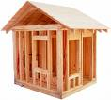


OOP Basics: Terminology
Blueprint for a house
A complete house
House Address
123 Elm Street
Class
Object
Handle
Turn on/off switches
Light switches
Methods
Properties

Slide 7
OOP Basics: Terminology
Notes:
This slide compares Verilog programming constructs with Vera and OOP.
The two are actually very similar. For example, making a copy of a “block” is called instantiation in both languages. One big difference is that Verilog modules communicate primarily using ports (data) while Vera objects communicate using task and function calls.

Slide 8
OOP Basics: Advantages
Traditional programming deals with data structures and algorithms separately
OOP organizes transactions and transactors better through encapsulation
Classes encapsulate (group) data and algorithms together logically
Objects are just an instance of a class
Classes are composed of ”members”.
Members are either properties (data/variables) or methods (functions/tasks).
OOP allows for characteristics & functionality of existing classes to be extended - inheritance
OOP enables binding of data with functions at runtime - polymorphism
Notes:
This is a discussion of the ideas behind OOP.
Traditional programming languages such as C rely heavily on global data structures which are modified by many routines. Even with the ideas of “structured programming”, these routines often have many side effects, so that calling one routine causes changes that you did not intend. The result is that the code is tightly tied to one implementation, and is hard to modify and reuse.
OOP tightly ties data structures to the routines which modify them. Encapsulating data and code together into objects makes a program easier to understand, modify, and reuse.
Once an object is defined and well debugged, its functionality can be extended by using it to build a new, more complex object by adding new data and routines, but not modifying the underlying object. Since you do not change the original object, it remains as robust as ever. The new object inherits the working code, so that you can reuse the work that has already been done.
The last concept is a way to simplify your programs by having similar routines use the same name. When you add two variables together, you always write A+B, regardless of whether A and B are integers, real numbers, or 4-state multi-bit signals. Likewise, your program should be able to say Copy(A,B) and have the program call the right routine depending on the data types of A & B.
========
OOP is an approach to programming that enables developers to group data and methods logically.
This is done through encapsulation by defining a class that is made up members. Members are either properties (variables/data) or methods.
An object is an instantiated class. Once an class is defined and well debugged, it’s functionality can be extended to
build new classes and adding more complexity or characteristics by adding new members. This
is the idea of inheritence.
Polymorphism is a bit like operator overloading. It enables classes to have the same method names. At runtime, the appropriate method
is called based on the data types.

Slide 9
Where to Define a Class
We can define a class in System Verilog in a program, module,
package, or outside of any these.
Classes can be used in programs and modules.
We can think of a program block as a module that holds our test code
The program holds a single test and contains the objects that comprise the testbench, and the initial blocks to create, initialize, and run the test
Many verification teams put either a standalone class or a group of closely related classes in a file
Bundle the group of classes with a System Verilog package
Now we can compile the package separately from the test of the system.
Unrelated classes, such as those for transactions, score-boards, or different protocols, should go into separate files.

Slide 10
OOP: Your First Class
Your first class
A class encapsulates the data together with the routines that manipulate it
A class’s data is referred to as class properties
Subroutines of a class are called methods
class BusTran;
bit [31:0] addr, crc, data[8];
function calc_crc;
crc=addr^data.xor;
endfuntion: calc_crc
function display;
$display(“BusTran: %h”, addr);
endfuntion: display
endclass: BusTran
Class properties
methods
methods
Simple BusTran Class

Slide 11
Creating New Objects
Objects (Class Instance)
An object is an instance of a class
Declare a handle that points to an object of the type BusTran. When a handle is declared it is initialized to null
BusTran b;
b= new();
Declaring and using a handle
Call the new function to construct the BusTran object. When you call new you are allocating a new block of memory to store variables for that object.
new allocates space for BusTran
Initializes the variables to their default value (0 for 2 state and x for 4-state variables)
Returns the address where the object is stored
BusTran has two 32-bit registers (addr and crc) and an array with 8, 32 bit entries.
How much space would new allocate for an object of BusTran?
= 32+32+32*8= 320 bits of storage

Slide 12
Difference between New() and New[]
New () function is called to construct a single object. It can take arguments for setting object values.
New[] is used to set the size of dynamic arrays. It builds an array with multiple elements. It takes single value for the number of elements in the array.

Slide 13
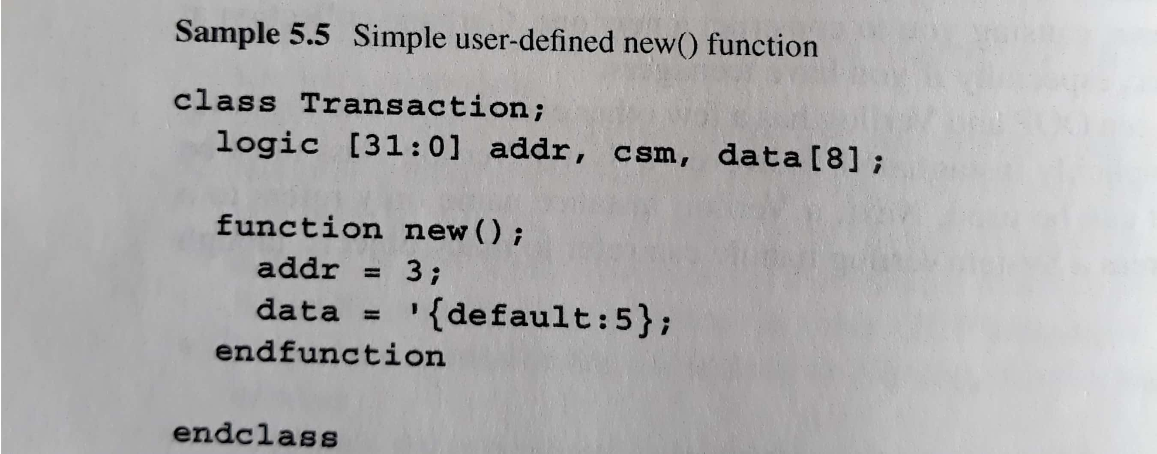
Custom Constructor
You can define your own new() function to set your own values. But you must not give a return value type, it automatically returns a handle to an object of the same type of the class.

Slide 14
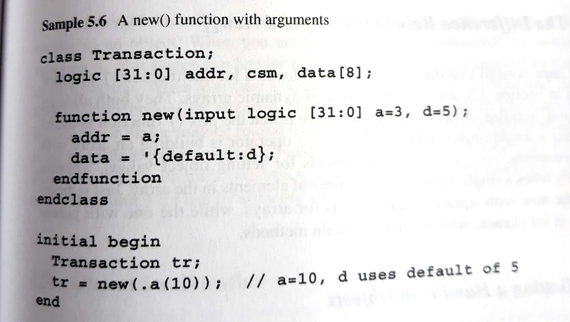

Slide 15
Handles
Getting a handle on objects
Three basic steps to using a class are
Defining class
Declaring a handle
Constructing an object
BusTran b1,b2;
b1 = new();
b2 = b1;
b1 = new();
Declare two handles
Allocate BusTran object
b1 & b2 point to it
Allocate second BusTran object
First BusTran Object
b1
b2
Second BusTran Object

Slide 16
Object Deallocation
Deallocating a handle on objects
SystemVerilog deallocates an object if there are no handles pointing to it
SystemVerilog does not deallocate an object that is being referenced by a handle
Need to manually clear all handles by setting them to null
BusTran b;
b = new();
b = new();
b = null;
Declare a handle
Allocate BusTran object
Allocate another BusTran object and free the first
Deallocate the second BusTran Object
First BusTran Object
b
Second BusTran Object

Slide 17
Using Objects
Refer to variables and routines using the . notation
class BusTran;
bit [31:0] addr, crc, data[8];
function calc_crc;
crc=addr^data;
endfuntion: calc_crc
function display;
$display(“BusTran: %h”, addr);
endfuntion: display
endclass: BusTran
BusTran b;
b= new;
b.addr=32’h42;
b.display();
Declare a handle to a BusTran
Construct a BusTran object
Set the value of a variable
Call a routine

Slide 18
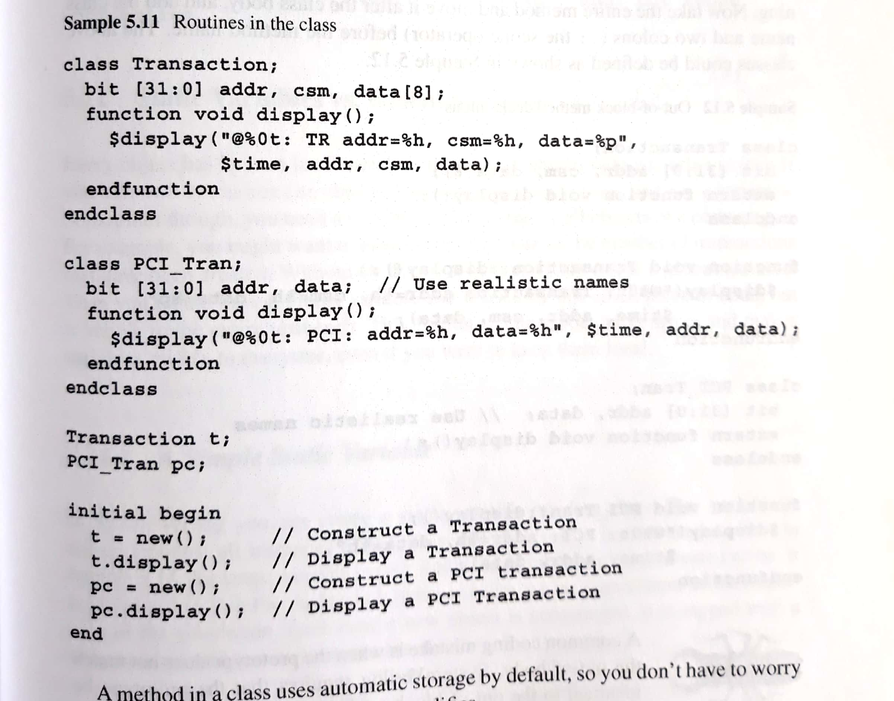
Class methods(task /function)

Slide 19
Class Routines
A routine in a class is a function or a task defined inside the scope of a class
class BusTran;
bit [31:0] addr, crc, data[8];
function void display;
$display(“BusTran”,addr,crc);
endfuntion: display
endclass: BusTran
BusTran b;
PCITran pc;
initial begin
b=new();
b.display();
pc=new();
pc.display();
end
class PCITran;
bit [31:0] addr, data[8];
function void display;
$display(“PCITran: %h”, addr, data);
endfuntion: display
endclass: PCITran

Slide 20
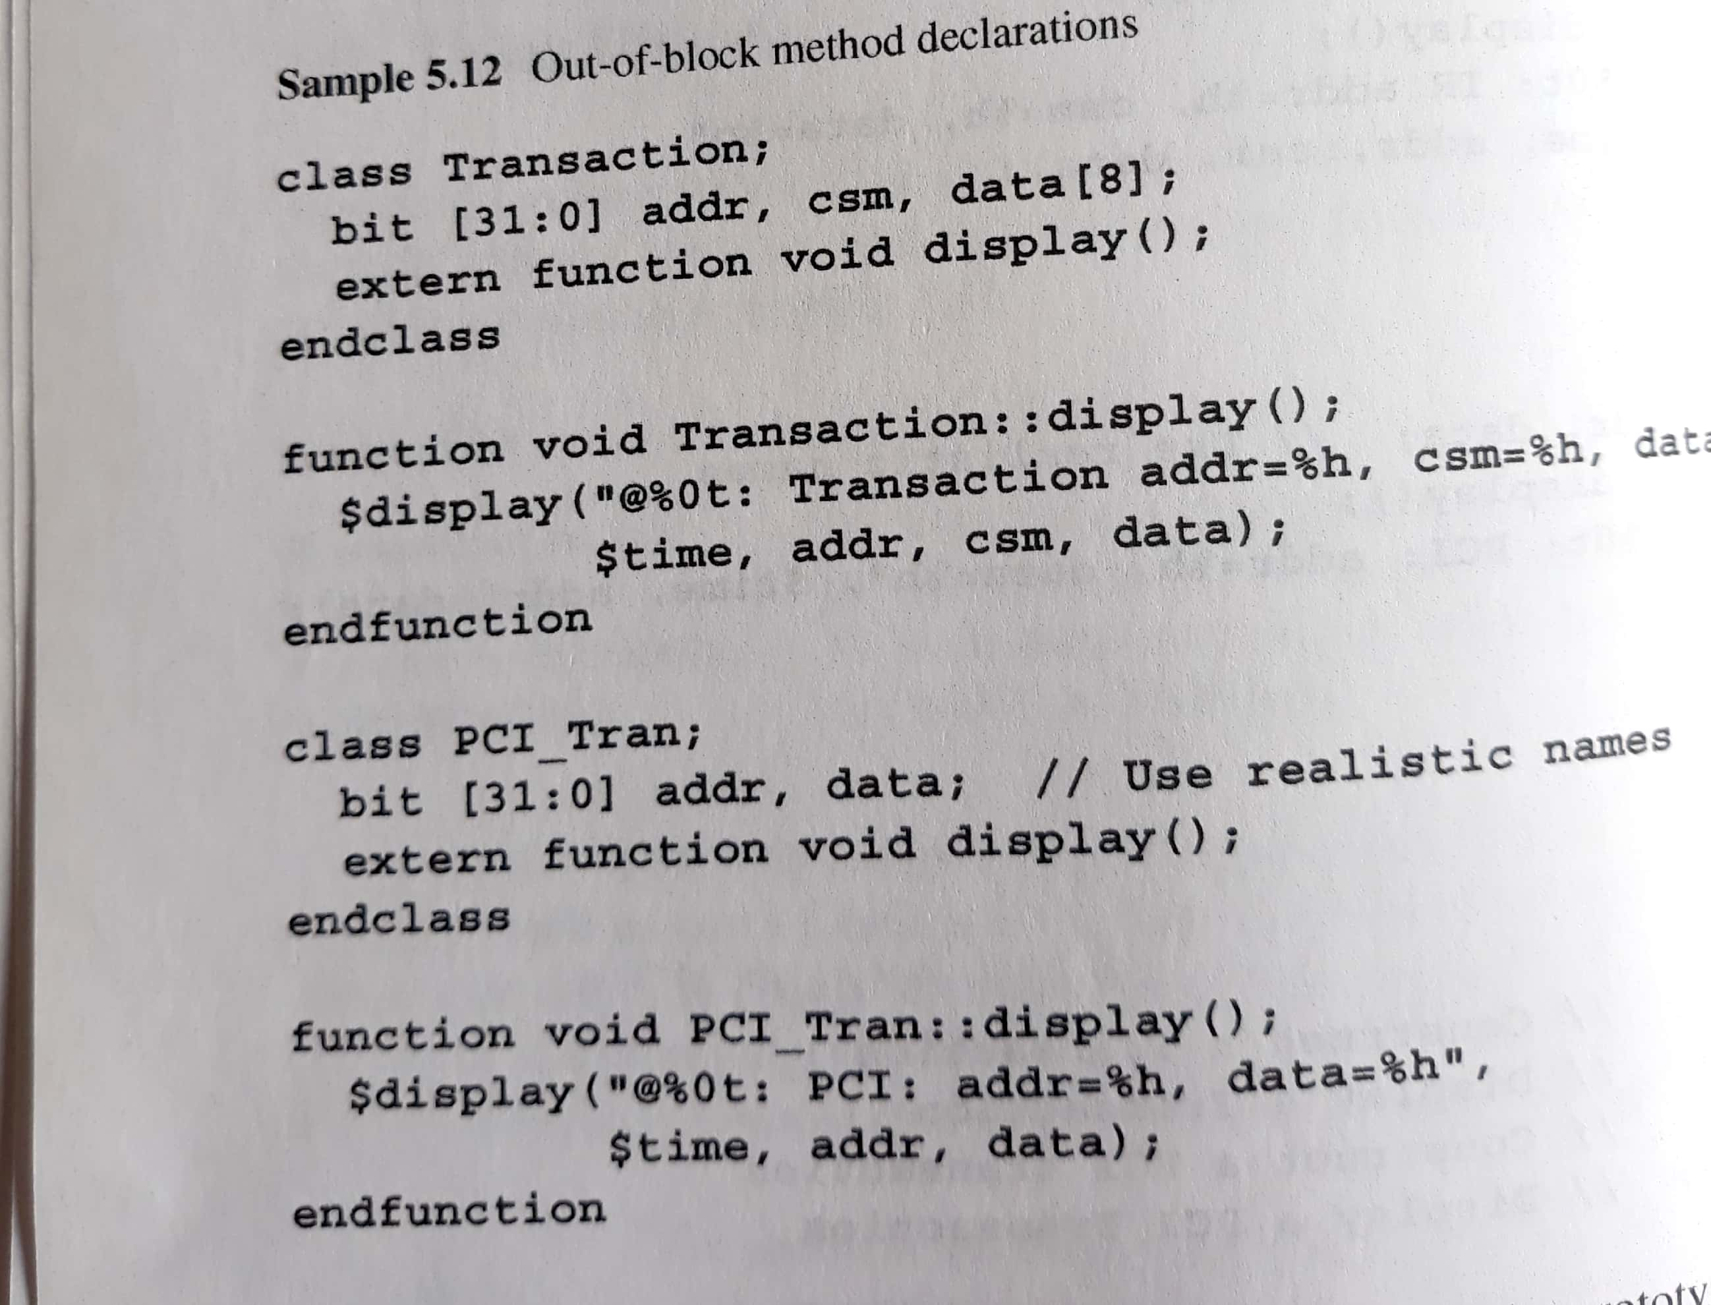
Defining Methods outside of the class(::scope operator)

Slide 21
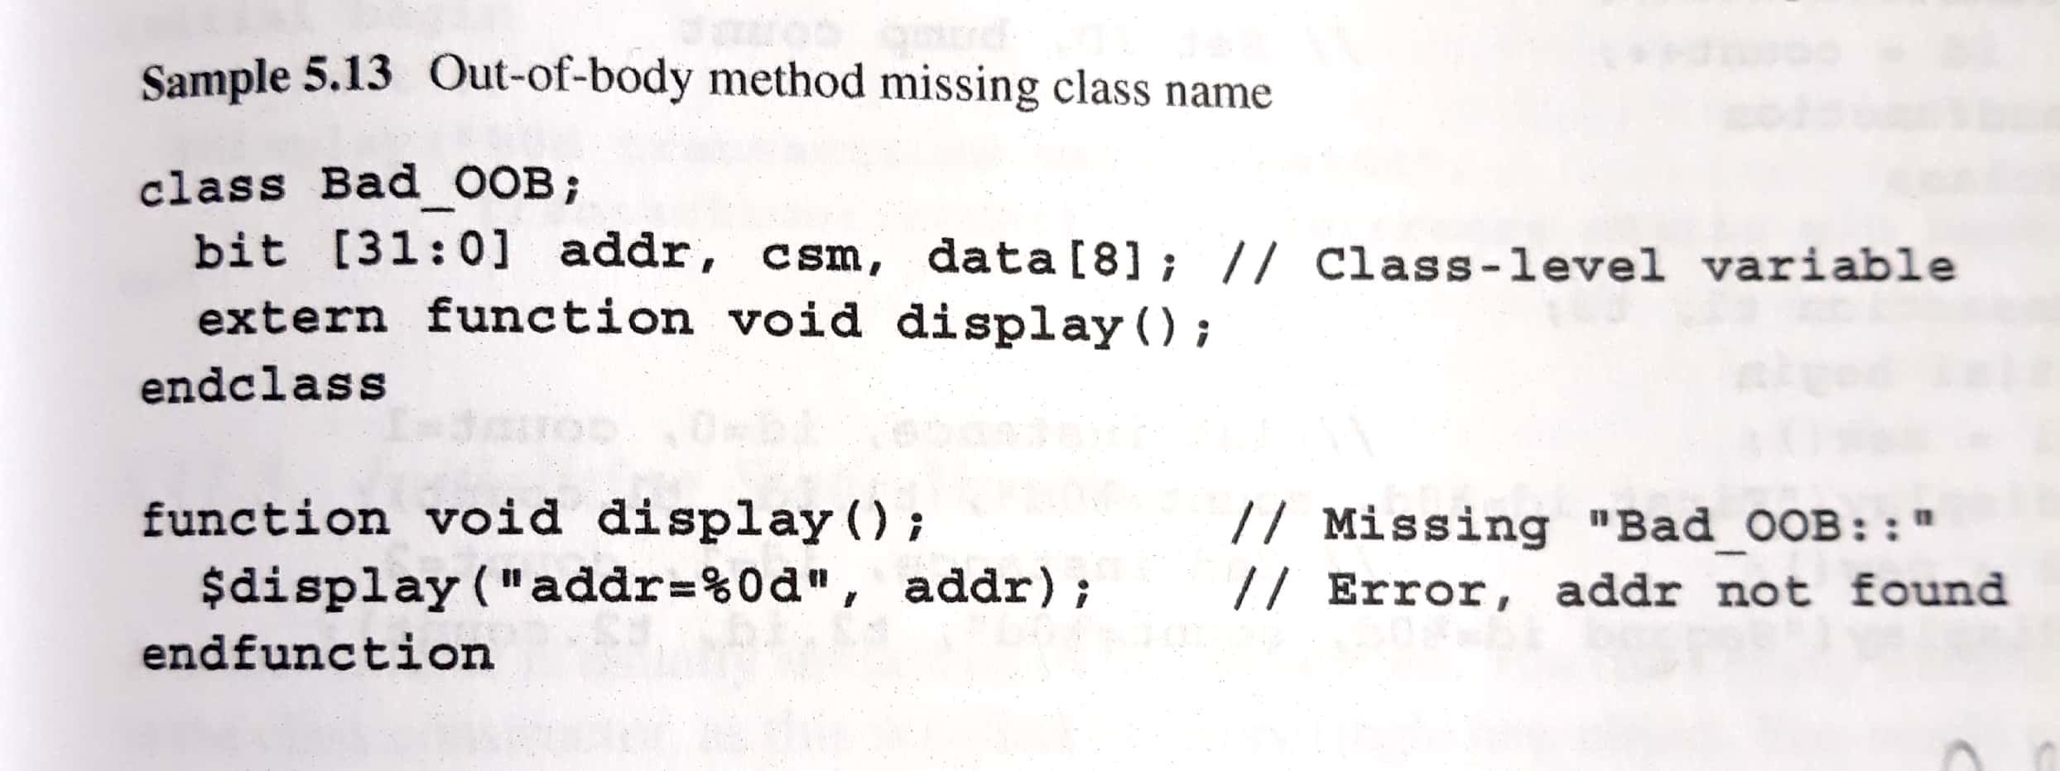

Slide 22
Static variables
A class can have static properties and static methods (functions and tasks).
When a variable inside a class is declared as static ,that variable will be a shared copy in all class instances.
Class members with the keyword static are called as static class members.
static <data_type> <property_name>;

Slide 23
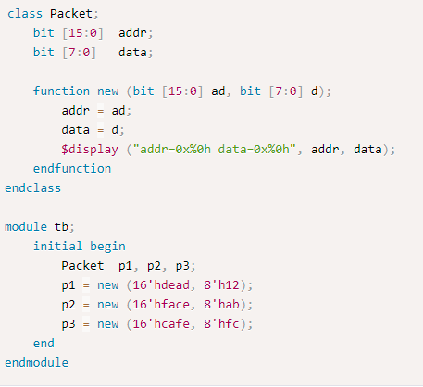
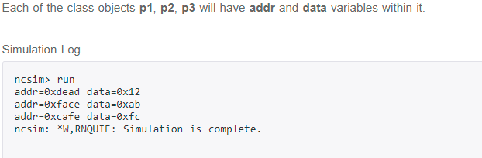
Example code without static variables

Slide 24
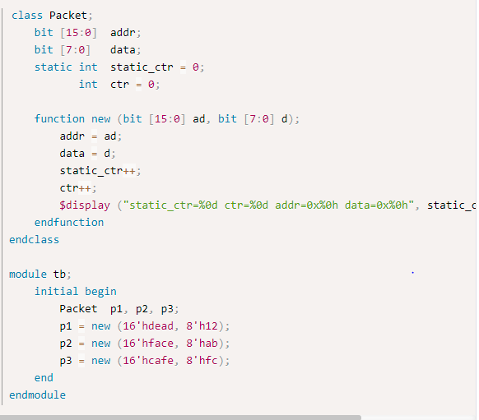
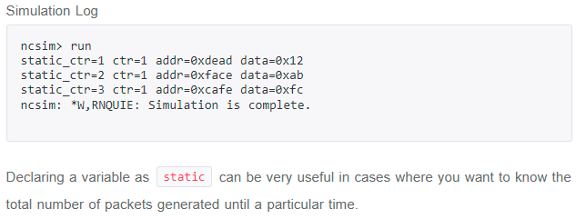
Static Variables

Slide 25
Static Variables
How do I create a variable shared by all objects of a class, but not make it global?
SystemVerilog allows you to create a static variable inside a class
The static variable is associated with the class definition, not the instantiated object
It is often used to store meta-data, such as number of instances constructed
It is shared by all objects of that class
class Transaction;
static int count = 0;
int id;
function new();
id = count++;
endfunction
endclass
Number of objects created
Unique instance id
Set id and bump count
Using a id field can help keep track of transactions as they flow through test

Slide 26
Static Variables
Transaction b1,b2;
initial begin
b1=new; //first instance, id=0
$display(b1.id, b1.count)
b2=new; //second instance, id=1
$display(b2.id, b2.count)
end
First instance id=0, count=1
Second instance id=1, count=2
1,2
There is only one copy of the static variable count regardless of how many BusTran objects are created
The variable id is not static so every BusTran has its own copy

Slide 27
Static methods
Static methods are the same as static properties,
A static method can access only static properties of the class and access to the non-static properties is illegal and lead to a compilation error.
static task/function <method_name>;

Slide 28
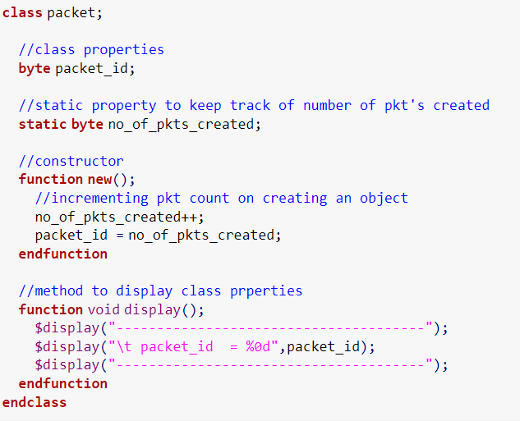
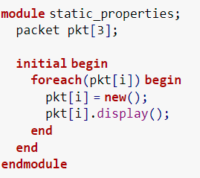

Example code-static method

Slide 29
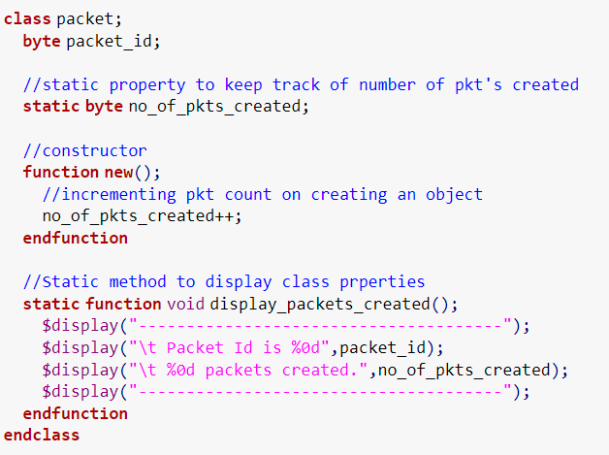
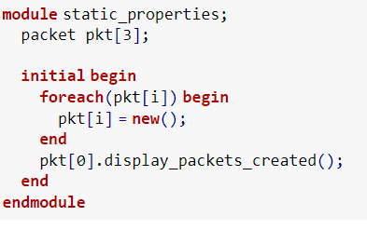
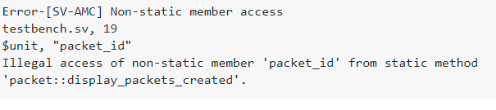
STATIC METHOD TRYING TO ACCESS A NON-STATIC VARIABLE

Slide 30
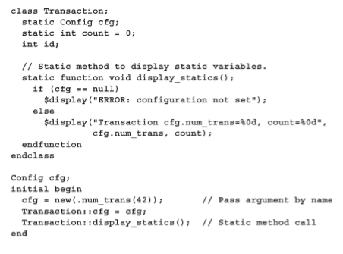
Static methods

Slide 31
Using One Class Inside Another
A class can contain an instance of another class, using a handle to an object
This is similar to Verilog’s concept of instantiation
Done for reuse and controlling complexity
class BusTran;
bit [31:0] addr, src, data[1024], crc;
Statistics stats;
endclass
class Statistics;
time startT, stopT;
static int ntrans=0;
static time total_elapsed_time;
endclass

Slide 32
Using One Class Inside Another
Statistics class example
class Statistics;
time startT, stopT; //Transaction time
static int ntrans=0; //Transaction count
static time total_elapsed_time=0;
function time how_long;
how_long=stopT-startT;
ntrans++;
total_elapsed_time +=how_long;
endfunction
function void start;
startT=$time;
endfunction
endclass

Slide 33
Using One Class Inside Another
Using hierarchical syntax
class BusTran;
bit [31:0] addr, src, data[1024], crc;
Statistics stats;
function new();
stats=new();
endfunction
task create_packet();
// Fill packet with data
stats.start();
// Transmit packet
endtask
endclass
Instantiate the object
Use hierarchical syntax

Slide 34
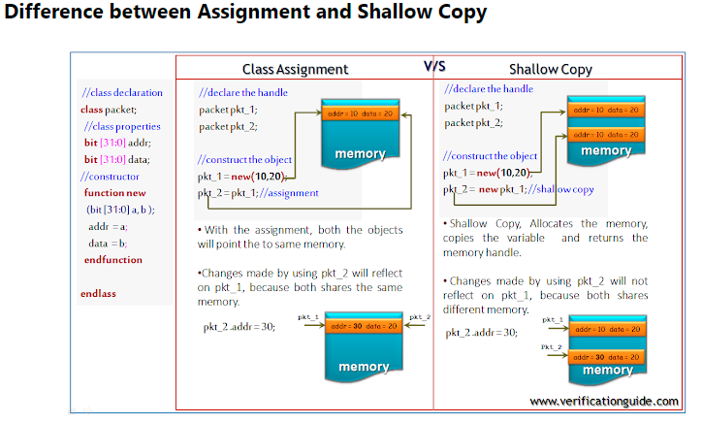
Copying Objects

Slide 35
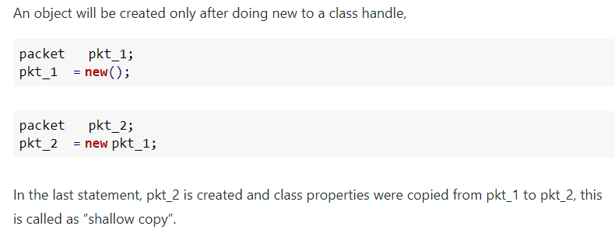
Copying Objects

Slide 36
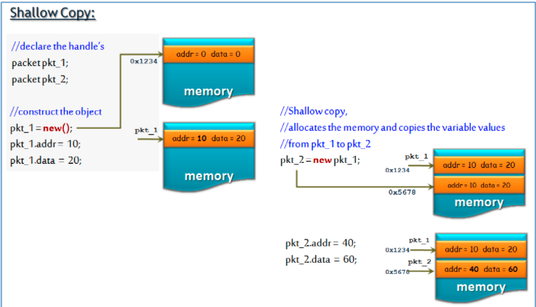
Copying Objects

Slide 37
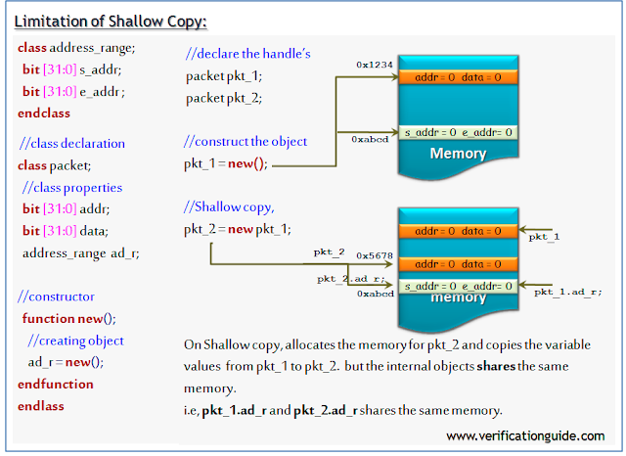
Copying Objects

Slide 38
Deep Copy
SystemVerilog deep copy copies all the class members and its nested class members. In shallow copy, Objects will not be copied, only their handles will be copied.
To perform a full or deep copy, the custom method needs to be added
In the custom method, a new object is created, all the class properties will be copied to a new handle and the new handle will be returned

Slide 39
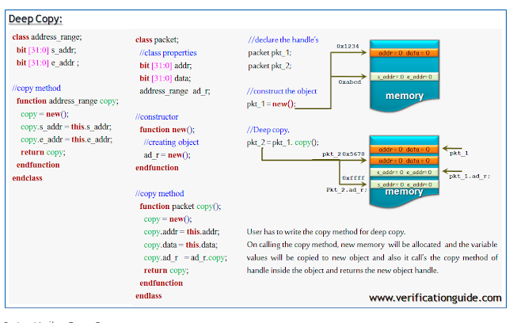
Deep copy

Slide 40
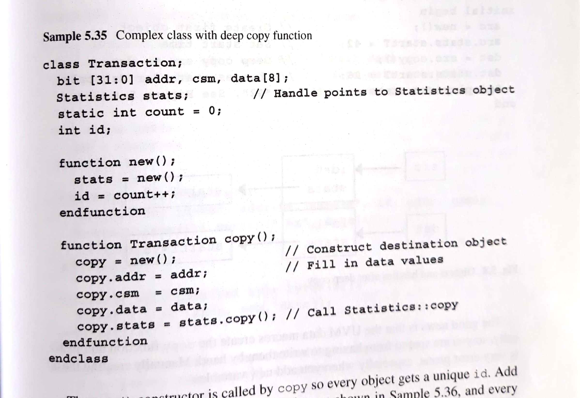
Deep Copy example

Slide 41
Handles
Getting a handle on objects
Shallow copy
BusTran b1,b2;
b1 = new;
b2 = new b1;
Declare two handles
Allocate BusTran object
Shallow copy
First BusTran Object
b1
Copy integers, strings,
instance handles etc.
Second BusTran Object
b2

Slide 42
Handles
Example:
class B ;
integer i = 1;
A a = new;
endclass
class A ;
integer j = 5;
endclass
function integer test;
B b1 = new; // Create an object of class B
B b2 = new b1; // Create an object that is a copy of b1
b2.i = 10; // i is changed in b2, but not in b1
b2.a.j = 50; // change a.j, shared by both b1 and b2
test = b1.i; // test is set to 1 (b1.i has not changed)
test = b1.a.j; // test is set to 50 (a.j has changed)
endfunction
a
a
j=5
j=50
b1
b2
b2
b2
i=1;
a
i=1;
a
i=10;
a
i=10;
a
test=1
test=50
B b1 = new;
B b2 = new b1;
b2.i = 10;
b2.a.j = 50;
test = b1.i;
test = b1.a.j;

Slide 43
Handles
Getting a handle on objects
Class properties and instantiated objects can be initialized directly in a class declaration
Shallow copy does not copy objects
Instance qualifications can be chained as needed to reach through objects b1.a.j
Can write custom code to do a full copy of everything including nested objects
BusTran b1,b2;
b1 = new;
b2 = new;
b2.copy(b1);
Deep copy

Slide 44
Handles
Deep Copy
class A ;
integer j = 5;
endclass
class B ;
integer i = 1;
A a = new;
endclass
function integer test;
B b1 = new; // Create an object of class B
b1.a.j=10; // j is changed in b1
B b2 = new; // Create an object of class B
b2.copy(b1); // Deep copy.
b2.a.j = 50; // change b2.a.j,
test = b1.a.j; // test is set to 5 (b1.a.j has not changed)
test = b2.a.j; // test is set to 50 (b2.a.j has changed)
endfunction
a
a
a
a
j=5
j=10
j=10
j=50
b1
b1
b2
b2
i=1;
a
i=1;
a
i=1;
a
i=1;
a
test=10
test=50
B b1 = new;
b1.j = 10;
B b2=new;
b2.a.j = 50;
b2.copy(b1)
test = b1.a.j;
test = b2.a.j;

Slide 45
Exercise
Write code for the sequence of handles and operations shown
t1
t1
t1
t2
t2
t2
t2
data
data=1
data
data=2
data=1
data=5
t2
t1
t1
class Thing;
int data;
endclass
…
Thing t1, t2; // Two handles
initial begin
t1 = new(); // Construct first thing
t1.data = 1;
t2 = new(); // Construct second
t2.data = 2;
t2 = t1; // Second thing is lost
t2.data = 5; // Modifies first thing
$display(t1.data); // Displays “5”
end

Slide 46
Inheritance
How do I share code between classes?
Instantiate a class within another class
Inherit from one class to another (inheritance/derivation)
Inheritance allows you to ‘add’ extra:
Add extra Properties (data members)
Add extra Methods
Change the behavior of a method
Common code can be grouped into a base class
Additions and changes can go into the derived class
Advantages:
Reuse existing classes from previous projects with less debug

Slide 47
Inheritance
Add additional functionality to an existing class
class Transaction;
bit [31:0] src, dst, data[1024], crc;
endclass
Transaction
src
dst
data
crc
class BadTr extends Transaction;
bit bad_crc;
endclass
BadTr
bad_crc
BadTr bt;
bt = new;
bt.src = 42;
bt.bad_crc = 1;
BadTr = Transaction + bad_crc

Slide 48
Inheritance
Change the current functionality of a class: Single Inheritance
super keyword is used from within the extended class to refer to members of the parent class
It is necessary to use super to access members of a parent class when those members are overridden by the derived class
class Transaction;
bit [31:0] src, dst, data[1024], crc;
function void calc_crc();
crc = src ^ dst ^ data.xor;
endfunction
endclass
Want to access this method
Transaction
src
dst
data
crc
calc_crc
class BadTr extends Transaction;
rand bit bad_crc;
function void calc_crc();
super.calc_crc();
if (bad_crc) crc = ~crc;
endfunction
endclass
BadTr
bad_crc
calc_crc

Slide 49
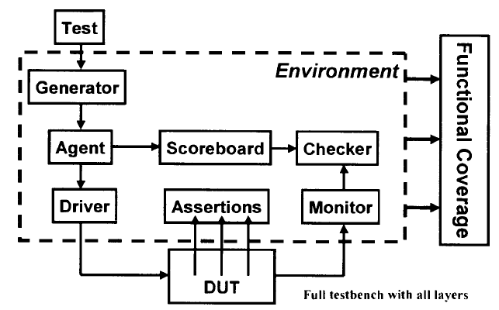
Building a testbench

Slide 50
Layered test bench is created from a set of classes.
Transactions flowing between the blocks are objects.
Generator,Agent, Driver, Monitor, Checker and Scoreboard are all classes(Transactors).They are instantiated inside the environment class.

