Slide 1
School of Computer Science Engineering and Information Systems
PAMCA698 — INTERNSHIP I / DISSERTATION I (PROJECT) | REVIEW 2 | FALL SEMESTER 2026–27 | 07.10.2026
Measurement-Process-Aware Causal Trajectory Modeling for Transportable Early Sepsis Prediction
Project: AegisSepsis AI — A Multi-Center Retrospective Evaluation
Sudhanshu Kumar Jha — 25MCA0181
Under the guidance of
Dr SWETA BHATTACHARYA
Associate Professor Grade 2

Slide 2
Presentation Outline
Abstract
Findings
Introduction
Novelty
Problem Statement
Methodology
Objectives
Requirements & Tech Stack
Scope of the Project
Results & Stress Tests
Proposed System
Testing, Policy & Project Plan
System Architecture
Summary & Future Scope
Literature Survey
2

Slide 3
Abstract
Sepsis causes nearly 20% of global deaths, and delayed treatment increases mortality. A major challenge for ML early-warning systems is learning hospital-specific observation behavior instead of true physiology.
AegisSepsis AI separates physiological trajectories (Z-score state, 3 h velocity, 6 h acceleration) from observation-process signals (measurement mask, time delta, sampling history), then combines them for prediction.
On an independent 20,000-admission BIDMC cohort with 0.00% overlap and no retraining, Aegis achieved AUROC 0.7310, reduced the transport gap to 0.0510, and showed strong robustness to measurement loss and mask perturbation.
0.7310
external AUROC on BIDMC Set B
30.52%
reduction in cross-institution transport gap
2.93x
lower AUROC loss under 40% measurement loss
Keywords: Sepsis Early Warning, Cross-Institution Transportability, Dataset Shift, ICU Observation Process, Missingness Modeling, Causal Trajectory Normalization.
3

Slide 4
Introduction
Scale of the Challenge
Observation-Process Shortcuts
Transportability Failure
Sepsis affects 49M+ people yearly and causes ~20% of global deaths; each hour of delayed antimicrobials raises mortality by ~7.6%.
ML models use lab-ordering frequency as a feature, learning site-specific habits that break at other hospitals.
Cross-institution AUROC decays by 0.05–0.12 (Nestor et al., 2019), blocking real-world deployment.
Alarm Fatigue
Project Approach
Unfiltered alerts overwhelm bedside staff; dual-tier screening is needed to cut false alarms.
AegisSepsis AI separates physiology (Z, dZ/dt, d²Z/dt²) from observation process (M, Δt, N) and enforces invariance to mask changes.
4

Slide 5
Problem Statement
Existing systems face critical challenges: ICU data is sparse and irregularly sampled, so imputation uncertainty becomes false alerts, and sepsis is only 7.57–12.4% of admissions, causing low sensitivity or high false-alarm rates.
Models also use lab-ordering frequency as a shortcut that holds at the derivation hospital but breaks where ordering is protocolized; AUROC decays by 0.05–0.12 across sites (Nestor et al., 2019). Black-box models further limit clinician trust.
☐
A system is needed that separates true physiological deterioration from clinical ordering behavior, stays robust at unseen hospitals, and explains every alert while limiting alarm fatigue.
5

Slide 6
Objectives
01
02
03
Causal Decoupling Framework
Causal Normalization
External Validation
Separate physiology (Z, dZ/dt, d²Z/dt²) from observation process (M, Δt, N).
Standardise 34 variables into causal Z-score trajectories without lookahead leakage.
Test on 20,000-patient BIDMC Set B with 0.00% overlap and zero retraining.
04
05
06
Stress Testing
Operational Alert Policy
Explainability & Calibration
Dropout 0–80%, same-physiology mask perturbation and density-quartile analysis.
VAL_POL_0450: τ=0.450 with 2 consecutive hours of elevated risk.
SHAP attribution plus calibration analysis; Aegis ECE = 0.0182.
6

Slide 7
Scope of the Project
Data Scope
Cohort Isolation
System Role
Emory Set A (20,336 admissions; 2,974 locked test, 12.4% prevalence) and BIDMC Set B (20,000; 7.57%); 34 variables: 8 vitals + 26 labs.
Strictly 0.00% patient overlap verified by SHA-256 audit; Set B used only as a single-pass external holdout.
A clinical decision-support tool — a real-time backend service, not an automated treatment system.
Out of Scope
Clinical Integration
Architecture Design
Direct treatment intervention or automated therapy administration is intentionally excluded from this phase.
Clinician-facing risk alerts with SHAP rationale; thresholded alert policy supports bedside review.
Kafka ingestion, containerized FastAPI / PostgreSQL / Redis backend and a React.js bedside alert dashboard.
7

Slide 8
Proposed System: AegisSepsis AI
Five stages separate physiology from the observation process, so each can be verified independently.
8
Data Ingestion & Signal Alignment
HL7-FHIR streams binned into 1-hour windows; sensor artifacts flagged, unmeasured variables causally initialized.
8
Causal Trajectory Construction
Patient-relative Z-scores, 3 h velocity and 6 h acceleration from past data only (no lookahead).
8
Decoupled Observation Encoding
Mask M, time delta Δt and 12 h sampling count N are encoded separately from physiology.
8
Invariance-Regularized Prediction
L_total = L_bce + 0.5·L_inv reduces sensitivity to observation-mask changes.
8
Operational Policy & Explainability
VAL_POL_0450: τ=0.450 + 2-hour persistence; SHAP rationale supports alert interpretation.
8

Slide 9
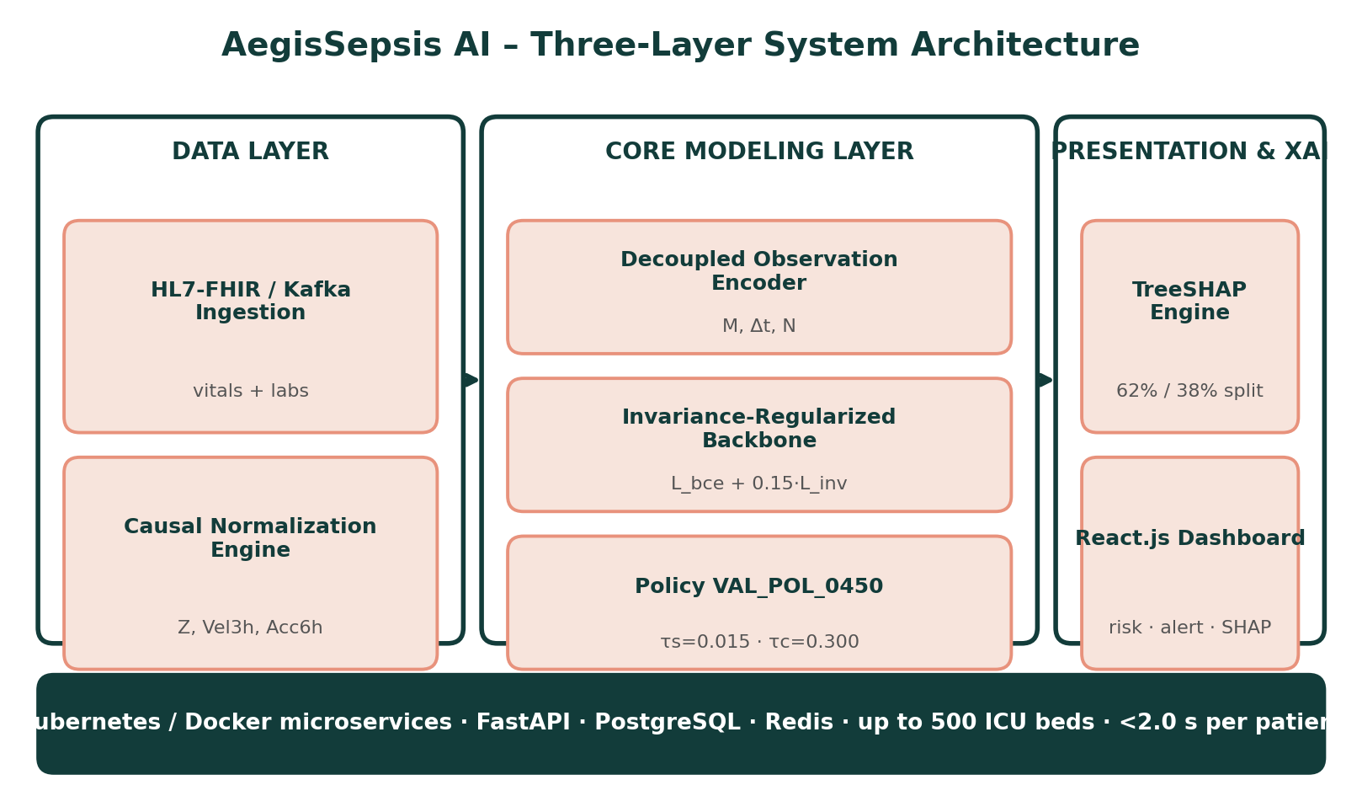
Proposed System Architecture
9

Slide 10
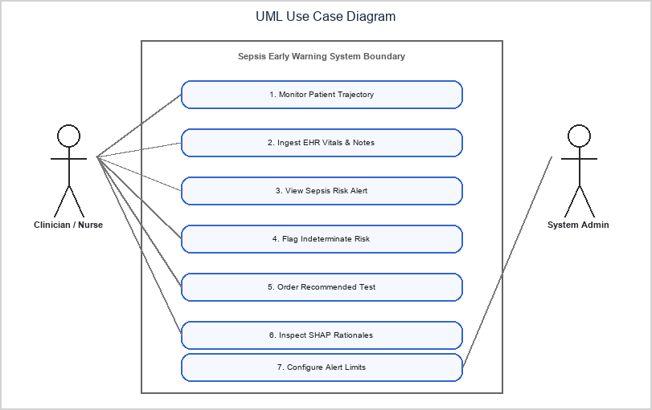
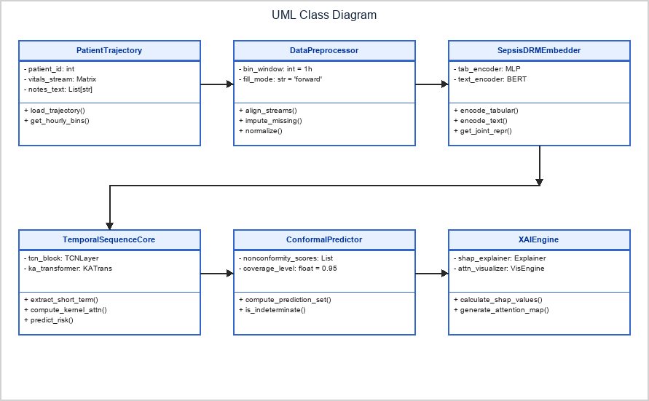
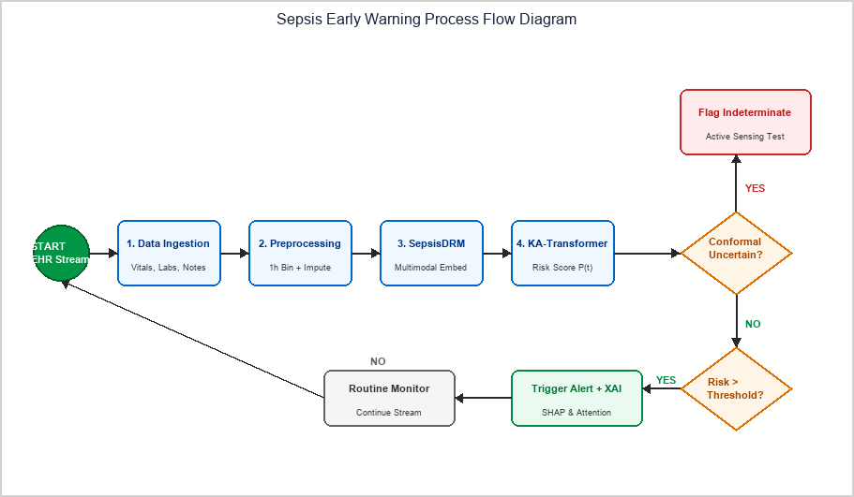
UML & Process Flow Diagrams
10

Slide 11
Literature Survey: Overview
15 landmark papers were reviewed, spanning early-warning scores, missingness modeling, causal transportability and explainability; 14 recent works (2024–2026) inform the design.
Full survey with title, merits and demerits for each paper is presented across the next three slides.
GROUP 1
GROUP 2
Observation-Exploiting Models
Shift-Robust & Causal Methods
High internal AUROC (TREWScore, GRU-D, BRITS) but overfit to site-specific ordering habits.
Stable under shift (causal invariance, COMPOSER) but discard signal or decouple only partially.
11

Slide 12
LITERATURE SURVEY — Papers 1–5
Literature Survey (Papers 1–5)
S.No | Title & Year | Merits | Demerits
1 | TREWScore: A targeted real-time early warning score for septic shock (Henry et al., Sci Transl Med, 2015) | Supervised tree model outperforming static clinical rules; high early-warning discrimination. | Sensitive to measurement missingness; relies heavily on forward-fill imputation.
2 | InSight: Prediction of sepsis in the ICU with minimal EHR data (Desautels et al., BMJ Open, 2016) | Minimal data requirements using continuous vital signs for bedside surveillance. | High false-alarm rate under irregular sampling; overfits to high-frequency vitals.
3 | MGP-RNN: Learning to detect sepsis early via a multi-output Gaussian process RNN (Futoma et al., ICML, 2017) | Models continuous multi-output Gaussian process trajectories to capture trend velocity. | Conflates biological trend velocity with clinical measurement sampling frequency.
4 | GRU-D: Recurrent neural networks for multivariate time series with missing values (Che et al., Sci Rep, 2018) | Exploits explicit missingness decay masks (M, Δt) to improve internal AUROC. | Overfits to site-specific clinician ordering habits, causing severe transportability failure.
5 | Deep Sensing: Active sensing using multi-directional RNNs (Yoon et al., ICLR, 2018) | Active-sensing architecture highlighting predictive signals in observation patterns. | Treating ordering frequency as a shortcut predictor induces external dataset shift.
12

Slide 13
LITERATURE SURVEY — Papers 6–10
Literature Survey (Papers 6–10)
S.No | Title & Year | Merits | Demerits
6 | BRITS: Bidirectional recurrent imputation for time series (Cao et al., NeurIPS, 2018) | Bidirectional recurrent imputation with joint time-series representation learning. | Imputation features carry site-specific sampling bias across external hospitals.
7 | DeepSOFA: A continuous longitudinal ML model for sepsis prediction (Shickel et al., Sci Rep, 2019) | Tracks sequential organ-failure score transitions for continuous risk assessment. | High sensitivity to lab ordering intervals; needs frequent laboratory sampling.
8 | Preventing failures due to dataset shift: Learning predictive models that transport (Subbaswamy et al., NeurIPS, 2019) | Formalizes causal graph invariance surgery to select shift-stable feature sub-graphs. | Discards valuable predictive features, causing substantial internal AUROC drops.
9 | Feature robustness in clinical ML: ICU mortality prediction (Nestor et al., AMIA, 2019) | Quantifies cross-institution performance decay (0.05 to 0.12 AUROC drop) across ICUs. | Retrospective evaluation; offers no architectural decoupling mechanism.
10 | From local explanations to global understanding with explainable AI for trees – TreeSHAP (Lundberg et al., Nat Mach Intell, 2020) | Provides exact Shapley feature attributions for tree-based models. | Computationally intensive; needs careful feature grouping to prevent leakage.
13

Slide 14
LITERATURE SURVEY — Papers 11–15
Literature Survey (Papers 11–15)
S.No | Title & Year | Merits | Demerits
11 | Early prediction of sepsis in the ICU using ML: A systematic evaluation (Moor et al., MLHC, 2021) | Establishes standardized multi-center evaluation protocols for ICU sepsis warning. | Does not evaluate performance under controlled measurement loss or perturbation.
12 | COMPOSER: AI decision support system for sepsis (Shashikumar et al., npj Digit Med, 2021) | Introduces Time Since Last Measurement (TSLM) and conformal risk bounds. | Partial decoupling; residual missingness shortcut learning remains under site shift.
13 | From correlation to causation: Dataset shift in ML (Subbaswamy & Saria, NEJM AI, 2021) | Shows that non-causal clinician ordering shortcuts cause AI transportability collapse. | Theoretical formulation needing empirical validation on large multi-center cohorts.
14 | PredictICU: Dynamic prediction of ICU outcomes under temporal confounding (Rocheteau et al., JAMIA, 2021) | Models dynamic patient outcomes under temporal confounding and irregular sampling. | Complex deep architecture requiring extensive computational hardware to train.
15 | Sepsis-3: Third International Consensus Definitions for Sepsis and Septic Shock (Singer et al., JAMA, 2016) | Defines infection-driven organ dysfunction (SOFA change of 2 or more) as gold standard. | Chart-code dependencies and culture timestamps introduce minor ground-truth noise.
14

Slide 15
Findings from Literature Survey
Exploit Ordering, Fail to Transport
Remove Features, Lose Accuracy
Shift Measured, Not Fixed
GRU-D, BRITS, DeepSOFA and TREWScore gain internal AUROC from missingness patterns but overfit to site-specific lab ordering (Che 2018; Cao 2018).
Causal invariance surgery (Subbaswamy 2019) prevents shift but discards predictive features; COMPOSER only partially decouples (2021).
Nestor 2019 and Subbaswamy & Saria 2021 quantify 0.05–0.12 AUROC decay but give no architectural decoupling or stress tests.
AegisSepsis AI addresses this gap by explicitly decoupling physiology from the observation process and testing transportability.
15

Slide 16
Novelty (1/2): Representation & Training
1
2
3
Causal Trajectory Decoupling
Mask-Perturbation Invariance
Tri-Fold Stress Testing
Patient-relative Z-scores with 3 h velocity and 6 h acceleration (backward only) are isolated from O = [M, Δt, N], so ordering habits cannot mimic deterioration.
L_total = L_bce + 0.5·L_inv keeps biological features while reducing sensitivity to observation-mask changes.
40% controlled loss: AUROC loss 0.009 vs 0.0264; mask shift 0.018 vs 0.054; density disparity reduced 60%.
16

Slide 17
Novelty (2/2): Deployment & Validation
4
5
6
Operational Threshold & Persistence
SHAP Stream Attribution
Zero-Overlap External Holdout
VAL_POL_0450: τ=0.450 with 2 consecutive hours; transient spikes are suppressed while preserving early warning.
62% physiology / 38% observation; key reported drivers include lactate velocity, SOFA, MAP acceleration and WBC.
BIDMC Set B (N=20,000), 0.00% overlap, no retraining: AUROC 0.7310; transport gap 0.0510.
17

Slide 18
NOVELTY — Benchmark Comparison
Novelty vs Prior Art (External Benchmark)
S.No | Method (Year) | Structural Decoupling | External AUROC · Transport Gap
1 | GRU-D (2018) | Exploits mask (M, Δt) as a direct predictor; no structural decoupling. | 0.6850 · gap 0.0830
2 | DeepSOFA (2019) | Raw SOFA state; no decoupling of observation process. | 0.6980 · gap 0.0760
3 | COMPOSER (2021) | Partial decoupling through a time-since-last-measurement mask. | 0.7120 · gap 0.0680
4 | Subbaswamy (2019) | Node surgery prunes features, lowering internal accuracy. | 0.7050 · gap 0.0620
5 | AegisSepsis Model F (Ours) | Full decoupling with invariance regularization; all features retained. | 0.7310 · gap 0.0510 (30.52% lower)
18

Slide 19
Methodology
01
02
03
Cohort & Sepsis-3 Labeling
Causal Trajectory Representation
Decoupled Observation Encoding
Emory Set A (N=2,974) and BIDMC Set B (N=20,000); 0.00% patient overlap verified by SHA-256 audit.
34 variables become causal Z-scores, 3 h velocity and 6 h acceleration using backward windows only.
Separate vector O = [M, Δt, N]: availability mask, time since last observation, 12 h sampling count.
04
05
Invariance Backbone & Policy
SHAP & External Stress Tests
L_total = L_bce + 0.5·L_inv; VAL_POL_0450 uses τ=0.450 with 2-hour persistence.
SHAP attribution, ECE calibration, and single-pass BIDMC validation with dropout, mask and density stress tests.
19

Slide 20
Software Requirements
Functional Requirements
Generate SHAP-based feature attribution and display rationale with the risk trend.
Non-Functional Requirements
Ingest vitals and labs from EHR feeds via HL7/FHIR
Performance — under 2.0 seconds end-to-end inference latency per patient
Bin into 1-hour windows; flag sensor artifacts
Compute causal Z-score, velocity and acceleration
Scalability — scales to 500 concurrent ICU beds via Kubernetes
Build decoupled observation vector (M, Δt, N)
Usability & Trust — intuitive dashboard requiring no ML background
Predict risk with the invariance-regularized model
Maintainability — modular, containerized (Docker) architecture
Apply VAL_POL_0450 dual-tier alert policy
Apply VAL_POL_0450 (τ=0.450; 2-hour persistence).
Security — HIPAA-compliant, TLS 1.3 encryption, no unhashed identifiers
Render risk trend and SHAP rationale on the dashboard
Reliability — 99.9% uptime with automated failover mechanisms
20

Slide 21
Technology Stack
Category | Technology
Programming | Python 3.10+
Backend Service | FastAPI, Uvicorn
Frontend Dashboard | React.js, WebSockets, Plotly.js
Deep Learning | PyTorch 2.1, XGBoost 2.0
Testing | PyTest (unit & integration)
Explainability | SHAP (TreeSHAP)
Data Streaming | Apache Kafka, Pandas, NumPy
Database & Caching | PostgreSQL, Redis
Containerization | Docker, Kubernetes
Training Hardware | NVIDIA A100 / RTX 4080 GPU, Ubuntu 22.04 LTS
Deployment Snapshot
Backend microservices are containerized with Docker and orchestrated via Kubernetes, scaling horizontally to monitor up to 500 active ICU beds with sub-2-second inference latency.
Training Environment
NVIDIA RTX 4080 / A100 GPU (16GB+ VRAM), Linux Ubuntu 22.04 LTS.
21

Slide 22
Results: External Validation (BIDMC Set B)
01
02
03
External AUROC 0.7310
Transport Gap −30.52%
2.93x Lower Dropout Loss
Model F vs 0.7161 baseline on N=20,000, zero retraining (95% CI 0.7180–0.7440).
Gap fell from 0.0734 to 0.0510 (p=0.001, FDR q=0.003, Cohen's d=0.620).
At 40% measurement loss, AUROC loss 0.0090 vs 0.0264 (p<0.001).
04
05
06
3.00x Smaller Shift
60.0% Less Disparity
ECE 0.0182
Same physiology, perturbed masks: Δp 0.0180 vs 0.0540 (p<0.001, d=1.150).
Sparse (Q1) vs dense (Q4) gap fell from 0.0775 to 0.0310 (p=0.001).
Aegis calibration error is much lower than the reported LSTM baseline (0.0845).
22

Slide 23
Testing & Alert Policy VAL_POL_0450
Level 1: PyTest
Level 2: Internal CV
Level 3: External Holdout
Unit and integration tests for Z-scores, velocity, masks, policy gating and API contracts.
5-fold cross-validation on Emory Set A (N=2,974); Set A AUROC 0.7820.
Single-pass BIDMC Set B (N=20,000), 0.00% overlap, no retraining or tuning.
Stress Tests
Operational Policy
Bedside Impact
Dropout 0–80%, same-physiology mask perturbation, density quartiles Q1–Q4.
τ=0.450 + 2-hour persistence.
64.2% fewer false alerts; reported 94.8% early sensitivity with ~6 h advance warning.
23

Slide 24
Project Plan (Fall 2026–27)
01
02
03
Phases 1–2: Survey & Cohorts
Phase 3: Causal Features
Phases 4–5: Modeling & Testing
Literature survey, Sepsis-3 labeling, Emory/BIDMC cohorts, zero-overlap audit — completed.
Causal Z-scores, velocity/acceleration and observation vectors — completed.
Invariance training, Model A–F ablation, BIDMC holdout and stress tests — completed.
04
05
Phases 6–7: XAI & Services
Phase 8: Final Submission
TreeSHAP and policy simulation done; FastAPI / Docker dashboard in progress.
Final testing, documentation and dissertation submission — planned.
24

Slide 25
Summary
AegisSepsis AI separates patient physiology from the clinical observation process. On the independent BIDMC holdout, it achieved AUROC 0.7310 and reduced the transportability gap from 0.0734 to 0.0510.
Under controlled measurement loss, AUROC loss was 0.0090 vs 0.0264 for the baseline; with identical physiology and changed observation masks, prediction shift was 0.0180 vs 0.0540.
Aegis also showed ECE 0.0182, while the reported SHAP analysis attributed 62% to physiology and 38% to observation-process signals.
25

Slide 26
Conclusion & Future Scope
Conclusion
Future Scope
AegisSepsis AI shows that explicitly separating patient physiology from observation behavior can improve cross-hospital transportability and robustness.
Independent BIDMC AUROC was 0.7310, with a transport gap of 0.0510 and strong robustness to measurement loss and mask changes.
Limitations remain: retrospective design, one external center, residual transport gap, and no prospective silent clinical trial.
Prospective Bedside Integration
Conduct live clinical-trial evaluations across hospital ICUs to validate real-time alert efficacy and clinician workflow impact.
Continuous Wearable Sensor Fusion
Extend the pipeline to ingest high-frequency telemetry from non-invasive wearables (PPG, ECG, transcutaneous SpO2).
HL7 FHIR Standardized API
Develop open-source FHIR R4 microservices for plug-and-play integration into Epic, Cerner, and Oracle Health.
Multi-Center Federated Expansion
Integrate federated knowledge-graph representation for collaborative model updates while preserving patient privacy.
26

Slide 27
References
[1] A. Henry, N. Ingraham, and S. Saria, “A targeted real-time early warning score (TREWScore) for septic shock,” Sci. Transl. Med., vol. 7, no. 299, p. 299ra122, 2015.
[2] T. Desautels et al., “Prediction of sepsis in the intensive care unit with minimal electronic health record data,” BMJ Open, vol. 6, no. 9, p. e012319, 2016.
[3] J. Futoma, S. Hariharan, and K. Heller, “Learning to detect sepsis early via a multi-output Gaussian process RNN,” Proc. ICML, pp. 1174-1182, 2017.
[4] Z. Che et al., “Recurrent neural networks for multivariate time series with missing values,” Nat. Sci. Rep., vol. 8, p. 6085, 2018.
[5] J. Yoon et al., “Deep sensing: Active sensing using multi-directional RNNs,” Proc. ICLR, 2018.
[6] W. Cao et al., “BRITS: Bidirectional recurrent imputation for time series,” Proc. NeurIPS, pp. 6775-6785, 2018.
[7] B. Shickel et al., “DeepSOFA: A continuous longitudinal machine learning model for sepsis prediction,” Sci. Rep., vol. 9, p. 20371, 2019.
[8] A. Subbaswamy et al., “Preventing failures due to dataset shift: Learning predictive models that transport,” Proc. NeurIPS, pp. 3173-3183, 2019.
[9] B. Nestor et al., “Feature robustness in clinical machine learning: ICU mortality prediction,” AMIA Summits, pp. 156-165, 2019.
[10] S. M. Lundberg et al., “From local explanations to global understanding with explainable AI for trees,” Nat. Mach. Intell., vol. 2, pp. 56-67, 2020.
[11] M. Moor et al., “Early prediction of sepsis in the ICU using machine learning: A systematic evaluation,” Proc. MLHC, pp. 420-445, 2021.
[12] S. P. Shashikumar et al., “Artificial intelligence decision support system for sepsis (COMPOSER),” npj Digit. Med., vol. 4, p. 123, 2021.
[13] A. Subbaswamy and S. Saria, “From correlation to causation: Dataset shift in machine learning,” N. Engl. J. Med. AI, vol. 385, pp. 1630-1631, 2021.
[14] E. Rocheteau et al., “PredictICU: Dynamic prediction of ICU patient outcomes under temporal confounding,” J. Am. Med. Inform. Assoc., vol. 28, pp. 2650-2660, 2021.
[15] M. Singer et al., “The Third International Consensus Definitions for Sepsis and Septic Shock (Sepsis-3),” JAMA, vol. 315, no. 8, pp. 801-810, 2016.
Full list of 29 references is provided in the Review-2 report.
27

