Slide 1

INSTITUTE OF ENGINEERING AND TECHNOLOGY Lucknow, Uttar Pradesh – 226021
Covid-19 Predictor AI Symptom Analyzer Using Machine Learning
GROUP MEMBERS:
Rajeev Kumar (2100520200054)
Sudhanshu Mishra (2100520200064)
Shourya Suryavanshi (2100520100156)
Supervisor – Dr. Promila Bahadur
Co-supervisor – Er. Deepa Verma

Slide 2
CONTENT
INTRODUCTION
OBJECTIVE AND PROBLEM STATEMENT
METHODOLOGY
MODEL SELECTION & EVALUATION
BENEFITS
UI DEVELOPMENT
RESULT
CONCLUSION

Slide 3

A Machine Learning Approach for COVID-19 Symptom Analysis
This presentation will discuss the project, which leverages machine learning algorithms to analyze user symptoms and provide real-time risk assessments for COVID-19 infection. The project aims to improve healthcare efficiency, aid in early treatment decisions, and help mitigate the spread of the virus by providing a reliable and accessible symptom analysis tool.

Slide 4
Project Objectives and Problem Statement
Objectives
Problem Statement
The primary objective of SymptoSense is to develop an automated system that accurately predicts COVID-19 infection based on user symptoms. The project seeks to achieve this by evaluating and selecting the most efficient machine learning algorithm for symptom analysis.
Limited access to testing resources poses a significant challenge in early detection and management of COVID-19. This project aims to address this challenge by developing a tool that utilizes readily available symptom information to provide reliable risk assessments, reducing dependence on traditional testing methods.

Slide 5
Methodology: A Structured Approach
Model Selection & Evaluation
Data Collection
Multiple machine learning models, including Logistic Regression, Decision Trees, Random Forests, and KNN, will be tested and evaluated using metrics like accuracy, precision, recall, and F1-score. Cross-validation techniques, confusion matrices, and ROC-AUC curves will be employed to ensure model reliability and minimize the risk of false negatives.
The project will utilize a comprehensive dataset consisting of symptom data, demographic information, and COVID-19 test results. This data will be sourced from public health databases and medical research datasets, ensuring a robust foundation for training the machine learning models.
1
2
3
4
UI Development and Deployment
Data Preprocessing
The best-performing model will be deployed via a user-friendly web-based interface using React.JS. Users will input their symptoms, and the system will provide a risk assessment (high, medium, low) regarding COVID-19 infection.
The collected data will undergo rigorous preprocessing to handle missing values, inconsistencies, and outliers. Features such as age, gender, and common symptoms (fever, cough, shortness of breath) will be encoded into a format suitable for machine learning algorithms.

Slide 6
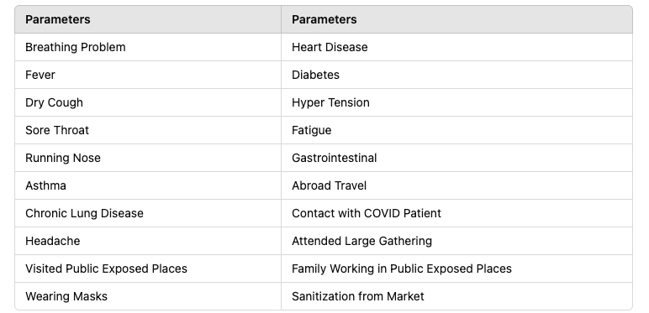
DATASET

Slide 7
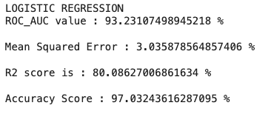
Model Selection & Evaluation
1
Logistic Regression
Logistic Regression is a powerful statistical model that predicts the probability of a binary outcome (e.g., infected or not infected). Our Project utilizes a sigmoid function to map a linear combination of features to a probability . Logistic Regression excels in handling linearly separable data and provides interpretable coefficients that highlight the importance of different features.

Slide 8
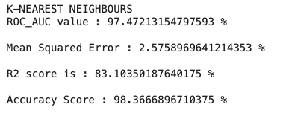
Model Selection & Evaluation
2
K-NEAREST NEIGHBOURS
KNN is a simple and intuitive algorithm that classifies new data points based on their proximity to existing data points with known labels. The algorithm considers the k nearest neighbors to the new data point and predicts the class based on the majority class among those neighbors. While KNN can be effective for simple datasets, it can be computationally expensive for large datasets.

Slide 9
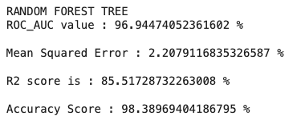
Model Selection & Evaluation
3
RANDOM FOREST
Random Forest is an ensemble learning method that combines multiple decision trees to improve prediction accuracy. It utilizes bagging and random feature selection to create an ensemble of trees that are less likely to overfit the data. Random Forests are robust to outliers and can handle high-dimensional data.

Slide 10
RESEARCHER NAME | RESEARCH PAPER | ACCURACY
[1] Yazeed Zoabi et al. (2021) | Machine learning-based COVID-19 diagnosis | 96.5
[2] Kundapur et al. (2020) | Trend analysis of COVID-19 | Societal and health trends during the pandemic | 96.15
[3] Channappanavar & Perlman (2022) | Cytokine storm and immunopathology | 97.57
[4] Jin et al. (2021) | AI system for COVID-19 diagnosis | 95.78
[5] Chatterjee et al. (2020) | Comprehensive pandemic review | 95.1

Slide 11
UI Development
Technology Used :
HTML
Tailwind CSS
JavaScript
React.JS
API
Python

Slide 12
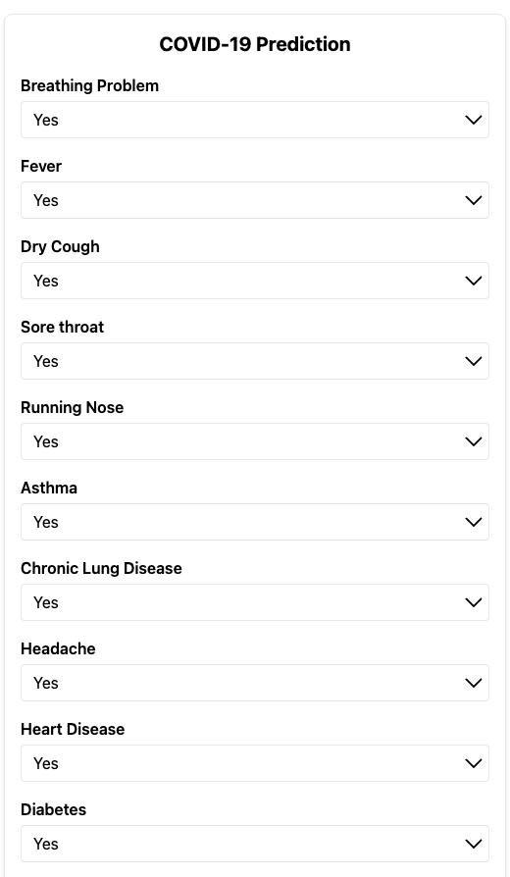
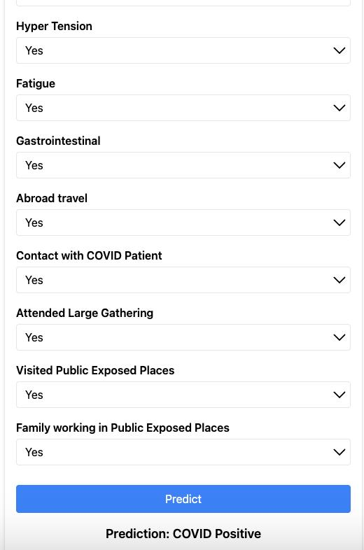
Result

Slide 13





Benefits
Timely Information
Improved Efficiency
SymptoSense provides users with real-time risk assessments, enabling timely treatment decisions and appropriate interventions.
The system reduces dependence on standard testing methods, leading to faster diagnosis and treatment, enhancing healthcare efficiency and minimizing the burden on testing resources.
Early Detection
Accessibility
By enabling early detection of potential COVID-19 infections, SymptoSense contributes to minimizing the spread of the virus and reducing the severity of outbreaks.
SymptoSense provides a user-friendly and widely accessible tool for individuals and medical practitioners, promoting broader awareness and proactive monitoring of potential infections.

Slide 14
Conclusion
The successful completion of the SymptoSense project marks a significant achievement in utilizing machine learning for healthcare advancements. Through rigorous data collection, model refinement, and user-driven improvements, SymptoSense has evolved into a reliable tool for early symptom assessment and decision support. The project’s impact extends beyond the fight against COVID-19, paving the way for future applications in disease detection and healthcare optimization.

Slide 15
THANK YOU!!

