Slide 1
Life Science
Chapters 3 & 4 Genetics

Slide 2
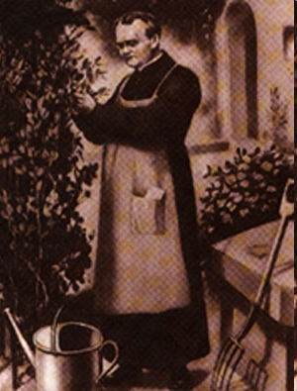
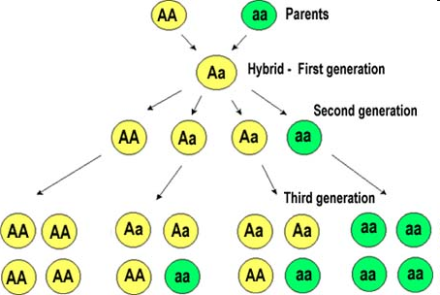

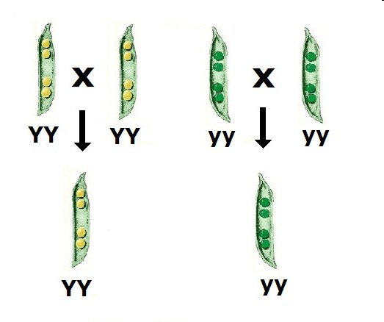
Gregor Mendel
“father of genetics”
experiments using pea plant traits
a. Tall or short plants
b. Round or wrinkled peas
c. Yellow or green peas
d. Smooth or pinched pods
e. Green or yellow pod color

Slide 3
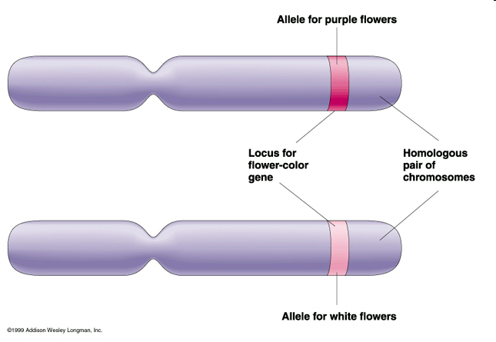
New Terms
Gene: factor that controls a trait
Allele: the different forms of a gene
Purebred: always produces the same trait
Hybrid: an organism w/ two different alleles for a trait – it is heterozygous

Slide 4
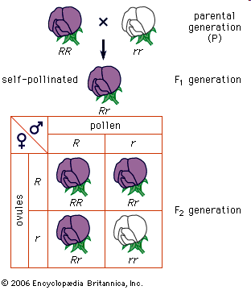
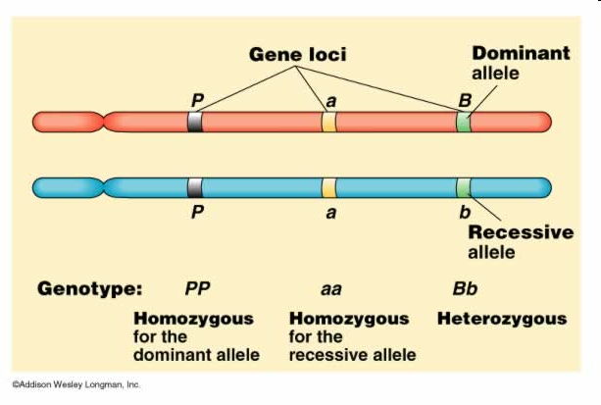
More Terms…
Dominant allele: trait shows up in the organism when the allele is present represented by a Capital letter ie “T” for tall
Recessive allele: trait is masked or covered up unless homozygous represented by a small case letter ie “t” for short
Phenotype: The outward visible trait being shown
Genotype: The genetic makeup of the trait
  Homozygous: both alleles are the same for the trait in question
  Heterozygous: Alleles are different for the trait in questions

Slide 5
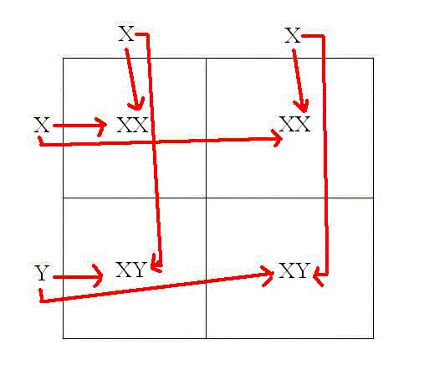
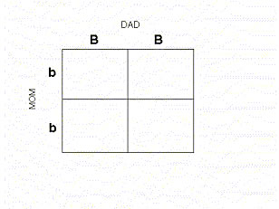
Punnett Square
Way of predicting the possible phenotype & genotype outcomes when parents are crossed
Must be able to determine the genotypes of the parents
Bb
Bb
Bb
Bb

Slide 6
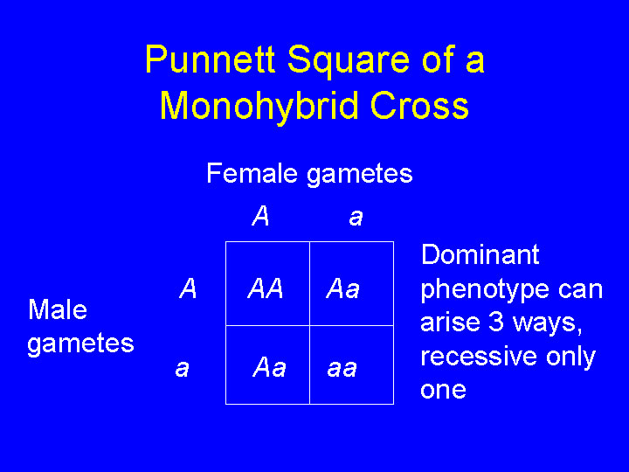
Punnett Square
Way of predicting the possible phenotype & genotype outcomes when parents are crossed
Must be able to determine the genotypes of the parents
In this case, when two hybrids are crossed, the possible outcomes are:
the phenotype ratio is 3:1
3 dominant
1 Recessive
genotype ratio is 1:2:1
1 Homozygus dominant
2 Heterozygus
1 Homozygus recessive

Slide 7
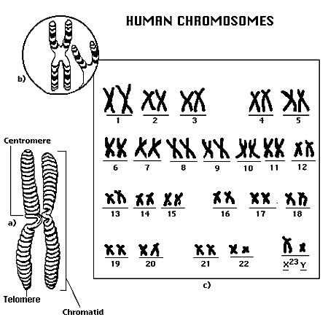
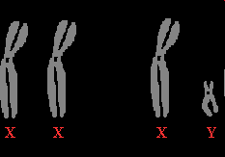
Human Genetics
23 pairs of homologus chromosomes in the human cell: 46 total chromosomes
small sections of each chromosome, genes, are responsible for inheritance
Chromosomes named as numbered pairs
Pair 23 determines sex of individual
Long chromosome X, short chromosome Y
XX is Female, XY is Male

Slide 8
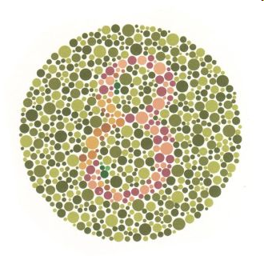
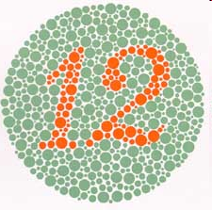
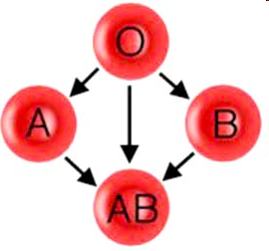
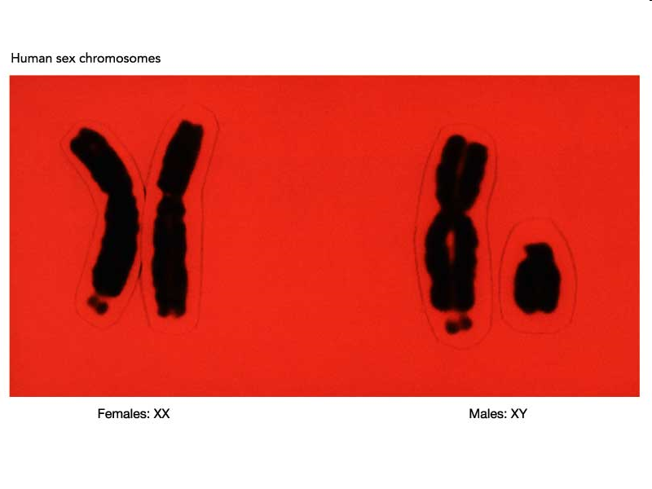
Human Genetics
Sex-Linked Traits
  Because males have only 1 X chromosome, they do not have another X chromosome to hide any recessive traits that might show up.
    1. Color Blindness, male pattern baldness
Genetic diseases and disorders
  i. Problems during mitosis or meiosis and or genetic mutations
  ii. Cystic Fibrosis, Sickle Cell Anemia, Hemophillia, Downs Syndrome
  iii. Dr.s can test for genetic disorders by testing “sloughed” off cells from the fetus found in the amniotic fluid during pregnancies.
Blood Type 3 alleles
  1. A allele and B allele are codominant
  2. O allele is recessive

Slide 9
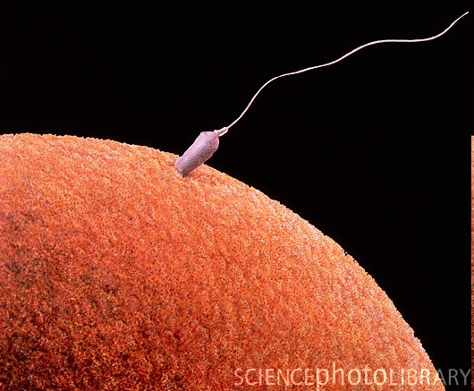
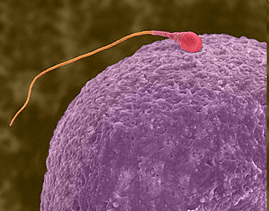
Gamete Formation
Normal chromosome # 23 pairs = 46 total
Diploid – a cell that has both homologus chromosomes ( one from each parent) –2N
Haploid – 1N - has only one of the homologus chromosomes (one from the father or the one from the mother)
  Egg & Sperm cells are haploid so when they combine during fertilization the zygote is once again diploid.

Slide 10
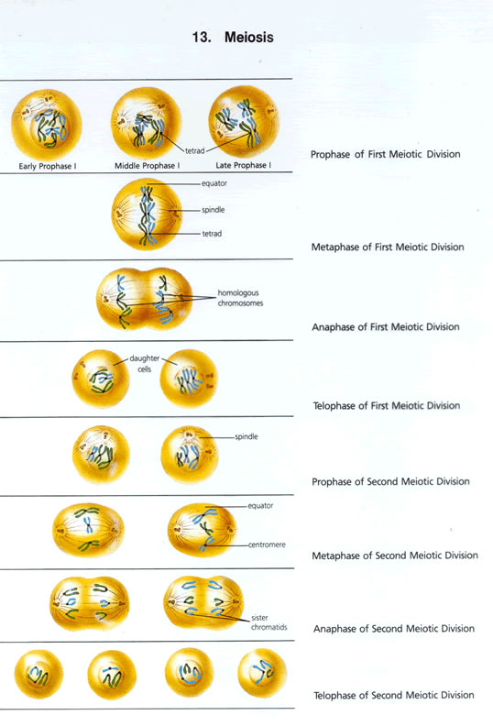
Meiosis – gamete formation
Two phases: Meiosis I and Meiosis II
Meiosis I
i. Prophase I:
  1. Chromatin has duplicated, chromosomes condense and coil.
  2. The pairs of chromosomes stay next to each other forming a “Tetrad”
ii. Metaphase I
  1. Tetrads line up along equator
iii. Anaphase I
  1. Tetrad separates so that each one of the duplicated homologus chromosomes separate to the poles
iv. Telophase I
  1. New nuclear membrane forms around the new nuclei
    a. Chromosomes uncoil becoming chromatin again
    b. Each new cell has only half of theoriginal number of chromosomes

Slide 11
Meiosis – gamete formation
Meiosis II – The two new cells divide
1. Prophase II
  a. Chromatin condenses and forms the chromosome (has two Chromotids and a centromere)
2. Metaphase II
  a. Chromosomes line up on the equator
3. Anaphase II
  a. Centromere dissolves pulling each separated chromatid to the poles
  b. Chromotids pulled to the poles
4. Telophase II
  a. New cells formed- 4 gametes- from the original 1 mother cell.
  b. These 4 gametes have only one of the two homologus chromosomes from the original cell

Slide 12
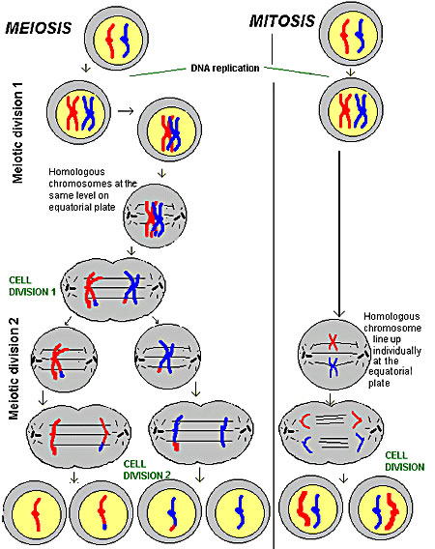
Mitosis vs
Meiosis

