Slide 1


Aradhya
Intelligent Clinical Handoffs. Zero Context Lost.
A secure, AI-powered platform that transforms fragmented patient information into structured, actionable handoffs — so clinicians can act faster, collaborate smarter, and prevent errors before they happen.
Notes:
1

Slide 2


The Problem: Critical Context Dies at Handoff
Every day, hospital patients are handed off between clinicians dozens of times — across shifts, units, and care teams. Each transition is a gap where vital context can fall through the cracks.
🕐 Delayed Interventions
📋 Missed Follow-Ups
Critical findings buried in unstructured notes go unnoticed until it's too late to act.
Unresolved tasks and pending labs are lost between teams with no clear ownership trail.
⚠️ Medical Errors
Fragmented, siloed data forces clinicians to make high-stakes decisions on incomplete information.
The information exists — it's just scattered, unstructured, and impossible to act on in time-sensitive moments.
Notes:
2

Slide 3
Why Current Systems Fail
EHRs and existing tools were built for documentation — not for real-time clinical collaboration or intelligent handoff support. The result is a system that creates data but doesn't deliver insight.
Data Without Context
No Structured Workflow
EHRs display raw records but cannot surface what's urgent, what changed, or what needs action — leaving interpretation entirely to the clinician.
Handoff communication is inconsistent and verbal-dependent. There's no standardized, structured process to ensure continuity of care across teams.
Alert Fatigue
Zero Explainability
Current systems fire too many low-priority alerts, causing clinicians to ignore notifications — including the ones that matter most.
When a flag is raised, clinicians can't see why. Black-box logic erodes trust and slows clinical adoption of automated tools.
Notes:
3

Slide 4
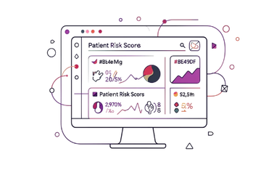

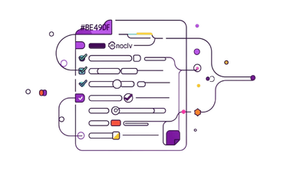
Introducing Aradhya
Aradhya is a secure, intelligent handoff platform that converts fragmented clinical data into structured, explainable, and immediately actionable patient summaries — at every transition of care.
Smart Handoff Dashboard
Intelligent Risk Detection
Task & Alert Engine
A single, prioritized view of every patient — surfacing who needs attention, what's changed, and what remains unresolved.
ML models flag high-risk patterns, abnormal trends, and critical status changes with full clinical explainability.
Structured task tracking ensures no follow-up is lost. Targeted, context-aware alerts reach the right clinician at the right time.
Notes:
4

Slide 5




Core Feature Set
Smart Handoff Dashboard
Risk Detection System
Real-time, role-based views of patient status aggregated from EHR, labs, vitals, and nursing notes. Clinicians see a ranked, prioritized patient list — not a data dump.
Identifies high-risk gaps, deteriorating trends, and abnormal lab patterns using structured clinical rules and ML scoring — with full reasoning transparency per flag.
Task Tracking System
Alert & Notification Engine
Every pending order, follow-up, and care task is captured, assigned, and tracked across shifts. Ownership is explicit — nothing falls through the cracks.
Clinically-filtered, priority-ranked notifications delivered via in-app, SMS, or pager integration. Designed to eliminate alert fatigue while ensuring critical signals are never missed.
Notes:
5

Slide 6
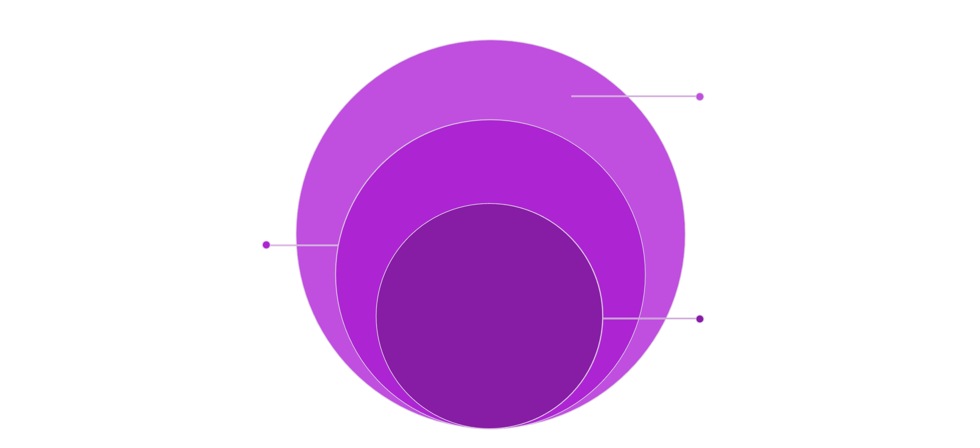
System Architecture & Workflow
Aradhya is built on a modular, cloud-native architecture — integrating with existing EHR systems via FHIR APIs and processing data through a secure intelligence layer before surfacing actionable insights at the point of care.
Action & Audit
Alerts, handoffs, encrypted logs, HIPAA
Data Ingestion
EHR, labs, vitals via FHIR/HL7
Core Intelligence
Risk scoring, NLP, task extraction
Each layer is independently scalable and auditable, enabling rapid deployment in both community hospitals and large health systems without disrupting existing clinical workflows.
Notes:
6

Slide 7




User Workflow: From Shift Start to Safe Handoff
Aradhya guides clinicians through every step of their shift — from receiving a structured handoff summary to closing out tasks before transition.
Secure Sign-In
Review Handoff Summary
Clinician logs in with role-based SSO. Patient panel auto-populates based on unit assignment.
AI-generated patient summaries highlight changes since last shift, open tasks, and risk flags with reasoning.
Act on Alerts
Close & Transfer
Prioritized alerts prompt immediate action — acknowledge, escalate, or delegate with one tap.
Before shift end, clinician reviews outstanding tasks, adds notes, and transfers ownership — fully documented and traceable.
Notes:
7

Slide 8

SECURITY & COMPLIANCE
Tech Stack
Built for Healthcare-Grade Security
Frontend: React.js + JavaScript (responsive, PWA)
Backend: Node.js / Python FastAPI Monolithic
Database: MongoDB + Redis (real-time caching)
ML Layer: Python, langchain, langgraph & HuggingFace NLP
Interoperability: FHIR R4, HL7 v2, SMART on FHIR
Cloud: AWS (HIPAA-eligible services), containerized via Docker/Kubernetes
Aradhya was designed from the ground up with HIPAA compliance, clinical privacy standards, and enterprise security requirements baked into every layer — not bolted on after the fact.
End-to-end encryption — AES-256 at rest, TLS 1.3 in transit
Role-based access control (RBAC) — clinicians see only what their role permits
Full audit logging — every view, alert, and action is timestamped and immutable
HIPAA & HITECH compliant — BAA-ready for enterprise health system deployment
PHI de-identification — anonymization pipelines for analytics and ML training
Notes:
8

Slide 9

Real-World Impact: The Numbers That Matter
80%
Handoff Time Saved
Structured AI summaries cut average handoff duration from 20 min to under 4 min per patient.
3x
Faster Risk Response
Clinicians act on critical alerts 3x faster when context and reasoning are surfaced at the point of care.
60%
Fewer Missed Tasks
Structured task tracking with ownership assignment reduces dropped follow-ups by over half.
$1.2M
Annual Savings / Hospital
Estimated cost avoidance from reduced adverse events, readmissions, and preventable errors.
Notes:
9

Slide 10

What's Next: The Road Ahead
Aradhya's foundation enables a roadmap of high-value capabilities that grow more powerful as data and adoption scale across health systems.
Phase 1 — Now
1
Smart handoff dashboard, risk detection, task tracking, and FHIR integration for acute care units.
2
Phase 2 — 6 Months
Predictive deterioration models, cross-unit transfer workflows, and mobile-native clinician app.
Phase 3 — 12 Months
3
Ambient voice documentation, NLP-powered note summarization, and post-discharge follow-up automation.
4
Phase 4 — 18 Months
Health system-wide analytics, population risk stratification, and payer/ACO integration for value-based care.
Aradhya is actively seeking clinical pilot partners and seed-stage investors to accelerate deployment across the first 5 health systems.
Notes:
10

