Slide 1
IT TICKETS ANALYSIS AND AGENT PERFORMANCE DASHBOARD
An Excel-based Analytical Project
Sudhanshu Tiwari

Slide 2




INTRODUCTION & OBJECTIVES
PROJECT FLOW
Project Context: Analyzed over 97,000+ IT tickets across 5 years to evaluate support performance and identify improvement opportunities.
Goals:
Identify trends in ticket volume, Category, Quarter, Yearly, Monthly,etc.
Evaluate agent performance using satisfaction and resolution metrics
Recommend data-backed investments (training, hiring, or tools)
Strategic Impact:
Guide team management decisions
Drive service quality improvement initiatives Support operational scaling strategies
Optimize resource allocation based on data insights
KEY ANALYTICAL FOCUS AREAS
Ticket Trends
Volume analysis, category patterns, and growth trajectory across years
Resolution Metrics
Time to resolution, efficiency patterns, and impact on satisfaction
Agent Performance
Individual effectiveness, demographic patterns, and best practices
Investment ROI
Data-driven recommendations for maximum impact and operational efficiency
2

Slide 3
DATASET STRUCTURE
DATA OVERVIEW
📁 Datasets Used:
Tickets Sheet: 97,498 records with attributes like ID Ticket, Fecha, Employee ID Agent ID, Request Category, Issue Type, Severity, Priority, Resolution Time (Days), Satisfaction Rate.
Tickets
97,498
Agents
50
IT Agents Sheet: 50 agents with demographic info (Agent ID, Full Name, Year of Birth, Month of Birth, Day of Birth)
Data Cleaning & Preprocessing:
Fixed spelling inconsistencies: "Mayor" → "Major", "Mid" → "Medium", etc.
Confirmed no missing values in any column
🔍 Why This Data is Critical:
DATA ATTRIBUTES
Offers full-cycle visibility from ticket assignment to resolution
Enables agent-level productivity analysis
Identifies bottlenecks, underperformance, and satisfaction drivers Supports KPIs for both operational and strategic planning
TIME SPAN
5 Years (2016-2020)
20 Quarters
Complete data lifecycle
DATA QUALITY
No missing values Standardized categories Consistent naming
3

Slide 4
METHODOLOGY
VISUAL ELEMENTS
Bar Chart
Line Chart
Platform: Microsoft Excel
Techniques Used:
Pie Chart
Functions: AVERAGE, VLOOKUP, IF, INDEX/MATCH, TEXT, RIGHT, LEN, FIND. ARRAY
Combo Chart
Scatter Plot
KPI Cards
Pivot Tables: Built for category-wise volume, agent KPIs, trend charts
Age Calculation: Derived from DOB using TODAY() and DATE()
Custom Grouping: Created Age Buckets with nested IF & ARRAY
INTERACTIVE ELEMENTS
Purpose:
Dynamic Slicers & Timeline:
Discover patterns in performance
Analyze agent efficiency across demographics Build decision-ready dashboard for management Support data-driven investment decisions
Year
Priority
Severity
Category
4

Slide 5
TICKET VOLUME OVER TIME
YEAR-WISE
TICKET VOLUME
13,051
2016
14,915
2017
+14.28% YoY
18,954
2018
+27.08% YoY
KEY INSIGHT
21,490
2019
+13.38% YoY
Business Impact:
Rapid growth signals rising dependency on IT systems
Indicates need for scalable support, better tools, or ticket triaging
29,088
2020
+35.36% YoY
5

Slide 6

TICKET CATEGORY DISTRIBUTION
CATEGORY BREAKDOWN
CATEGORY ANALYSIS
System Issues: 40%
Largest category of tickets (39,002 issues).
Login Access: 30%
Second largest segment (29,193 tickets).
Hardware: 10%
Smallest segment with (9,733 tickets).
Software: 20%
Comprises (19,570 tickets).
Key Insight:
"System" and "Login Access" issues make up nearly 70% of total tickets, indicating areas prime for automation and process improvement.
Automate
Login Access Requests
Self-service portal & password reset
Assign
Dedicated Sub-teams
For high-volume categories
STRATEGIC RECOMMENDATIONS
Monitor
System Stability
Implement proactive monitoring tools
6

Slide 7
RESOLUTION TIME VS SATISFACTION
ACTION ITEMS
Recommendations:
Combine technical training with soft skills coaching
Use satisfaction feedback for root-cause analysis
KEY INSIGHT
Analysis:
Slight trend: As resolution time increases, satisfaction tends to drop
However, it's not strong enough to be the only factor
KEY METRICS
Performance Indicators:
Avg Resolution Time: 4.6 days
Avg Satisfaction Rate: 4.1 / 5
Correlation: -0.041 (Weak Negative)

Slide 8
INVESTMENT RECOMMENDATION
FINAL RECOMMENDATION
KEY INSIGHT
Service Quality Factors:
Customer empathy
Issue ownership
Effective follow-ups
Clear communication
Prioritize Agent Training
Enhance Skills & Service
DATA OBSERVATIONS
Agent Performance Metrics:
Agents with highest resolution time often have lowest satisfaction
Agent 19: Res Time: 5.6 days, Sat: 3.04
Agent 22 & 28: Also below average in both metrics
8

Slide 9
AGENT PERFORMANCE
PERFORMANCE METRICS VISUALIZATION
Key Insights:
Clear segmentation of high vs. low performers.
Top performers: Maintain high satisfaction even with heavy workloads.
Bottom performers: Struggle with both speed and quality.
Performance variation indicates strong scope for knowledge transfer.
🏆 TOP PERFORMERS
⚠ BOTTOM PERFORMERS
Jesus Grajeda (Agent 2): Low Res Time + High Satisfaction + High Volume
Elena Velez (Agent 3): Res Time > 5.3d, Satisfaction < 3.6
Galindo Guadalupe (Agent 15): Consistent high ratings + efficient resolution
Lorena (Agent 22): Consistently low performance across metrics
Segura Garcia (Agent 29): Excellent balance of speed and quality
Nurio Zepeda (Agent 28): High res time, low satisfaction
9

Slide 10
DEMOGRAPHICS IMPACT ON PERFORMANCE
AGE GROUP PERFORMANCE METRICS
Age Analysis: Examining how agent age impacts resolution time, satisfaction, and ticket volume
Key Insights:
Agents 41-50 and 50+ are most efficient with fastest resolution times and highest satisfaction ratings
Agents 30-41 show slowest resolution times and lowest satisfaction ratings despite handling significant volume
Older agents excel; younger need guidance
Interpretation:
Experience boosts efficiency & handling.
Mid-career need support; senior guide juniors.
10

Slide 11
TARGETED TRAINING FOR UNDERPERFORMING AGENTS
🎯 Objective: Identify agents needing improvement and recommend upskilling
PERFORMANCE METRICS
Bottom 10 Agents – Longest Resolution Time:
Resolution time is above 5.2 days, with Agent 39 being the slowest (5.55 days).
Agents 3, 6, 22, and 28 again appear here, showing critical inefficiency in both speed and satisfaction.
Bottom 10 Agents – Lowest Satisfaction Rate:
Satisfaction scores are below 3.9, with Agent 19 performing the worst (3.04).
Multiple agents (3, 6, 22, 28) consistently show low user satisfaction, signaling training needs.
🚨 Critical Cases (Appearing in both lists):
Agents 3, 6, 22, 28 are lagging in both service speed and user satisfaction
11

Slide 12
IMPACT OF TECHNOLOGY INVESTMENTS ON PERFORMANCE
RESOLUTION TIME TREND (2016-2020)
KEY INSIGHTS
2019 Improvement:
New system & routing boost
Agent dashboards improved flow
2016-2018 Period:
Fluctuating res. time (4.55–4.65)
Processes inconsistent, tools weak
2020 Stabilization:
Consistent <4.55 days
Tech adoption = maturity
12

Slide 13
WORKLOAD FORECAST & FUTURE STAFFING NEEDS
Recommendations:
Short-term: Reallocate staff to Oct/Aug peaks.
Long-term: Add 5–10 agents if trend persists.
Automation: Use AI triaging for high-volume requests.
Risk Assessment:
Rising load handled with no staff increase.
Ongoing growth risks burnout & service drop.
Trend Analysis:
Ticket volume doubled (2016–2020) with only 50 agents.
Peak load in Q3–Q4 2020, esp. July & Sept.
13

Slide 14
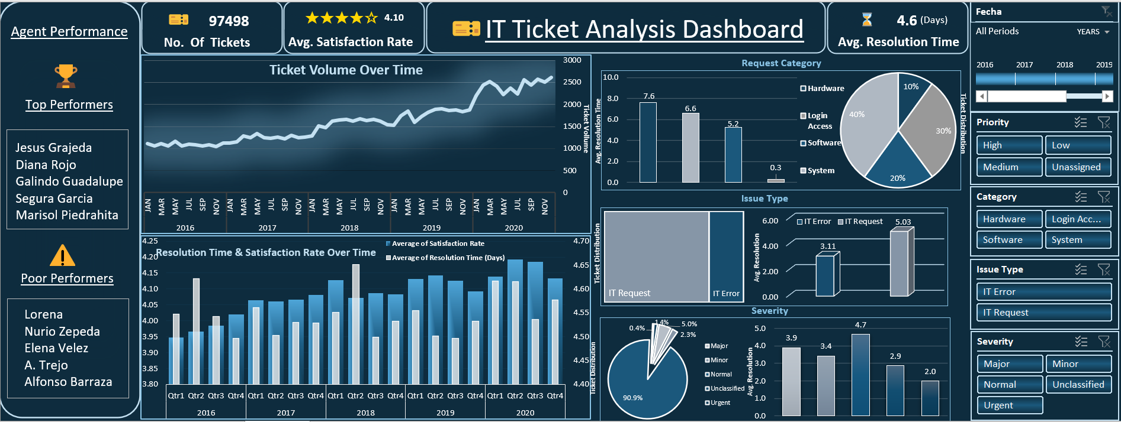
14

Slide 15
KEY METRICS SUMMARY
CONCLUSION
Project Summary: Our Excel-based IT Ticket Analysis has uncovered critical insights about support performance, agent effectiveness, and optimization opportunities across 97,000+ tickets spanning 5 years.
Ticket Growth
123% increase (2016-2020), 29,088 tickets in 2020
Category Distribution
System (40%), Login (30%), Software (20%), Hardware (10%)
Performance Metrics
Avg Res Time: 4.6 days, Avg Satisfaction: 4.1/5
Agent Effectiveness
41-50 age group most efficient (Res Time: 3.99d)
Key Takeaways:
Ticket volume has increased 123% from 2016-2020, requiring proactive planning
Agent performance is uneven with clear top/bottom segments — training more effective than hiring
Technology upgrades post-2018 have improved resolution times 70% of tickets are System and Login related — ideal for automation
Recommended Actions:
Agent Training Program
Focus: Bottom performers (Agents 3, 6, 22, 28)
Implement Automation
Priority: Login Access & System tickets
Mentorship Structure
Using 41-50+ age group agents as guides
15

Slide 16
TOOLS USED
ACKNOWLEDGEMENTS & REFERENCES
DATA SOURCES
Tickets Dataset
97,498 records with complete ticket metadata Source: Internal IT Management System
Microsoft Excel
Primary analysis platform & dashboard creation
PivotTables
For data aggregation & cross-tabulation analysis
Excel Charts
For data visualization & trend analysis
Excel Formulas
AVERAGE, VLOOKUP, IF, INDEX/MATCH, TEXT functions
🎫
👤
IT Agents Dataset
50 agents with demographic & performance data Source: HR Information System
Special Thanks:
CREATED BY
Sudhanshu Tiwari
Vijay Chandra Raj for his guidance
16

