Slide 1


Introduction to Spring Cloud & Netflix-OSS
Sudhanshu Satyam
Email : susatyam@in.ibm.com
Slack : @sudhanshu

Slide 2

Table of Content
Why Microservice ?
Cloud Native principles
Netflix Open Source components
Netflix OSS – Spring Boot
Netflix OSS Microservice Architecture
Let’s Code !!!
References
Questionnaire

Slide 3
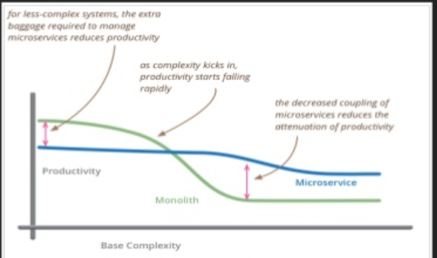
Why Microservice ?
Scalability
High Availability
Velocity : Continuous Delivery
On-Demand Provisioning, loosely coupled
High Performance
Fault Tolerance System
Domain driven design
Containerized development & deployment

Slide 4
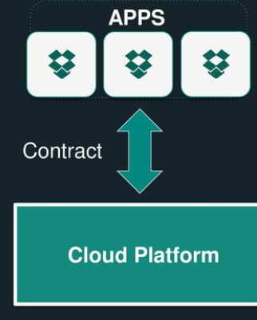
Cloud Native Principles
Principles establish a contact between cloud native apps
and the underlying platforms.
Cloud native apps recognize they are ephemeral and
minimizes dependencies on underlying platform.
The Twelve-Factor App(http://12factor.net) is a popular
and important set of principles.
Twelve Factors include Dependencies, Config, Processes and Disposability.

Slide 5
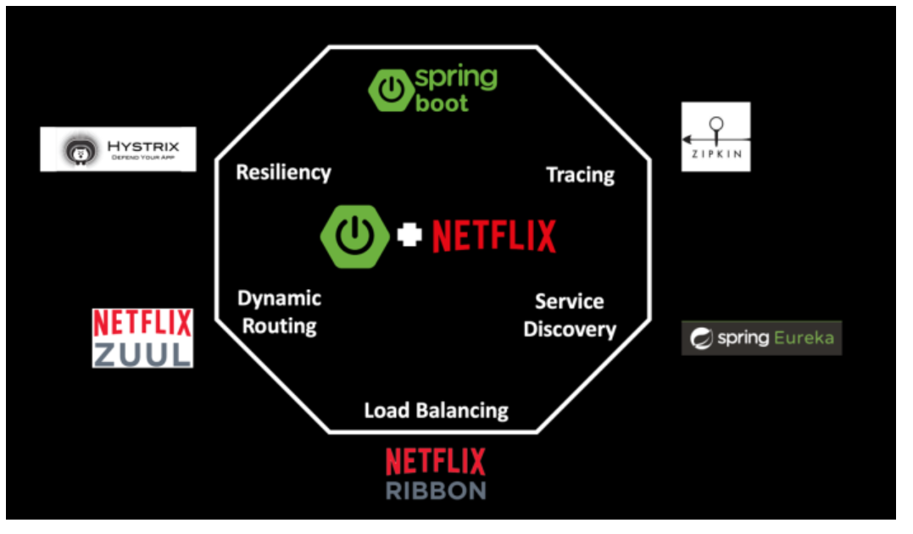
Netflix Open Source
Components
Spring – Eureka : Service Registration and Discovery
Netflix – Zuul : Dynamic Routing and Filters, API-
Gateway/Reverse Proxy creation
Netflix –Ribbon : Client side Load Balancer
Hystrix/Turbine : Circuit Breaker & Fault Tolerance System
Hystrix – Dashboard : Monitoring & Visualization Platform
Zipkin : Tracing, Logging and Monitoring

Slide 6

Netflix OSS – Spring Boot
Create stand-alone Spring application
Declarative Java configuration/ Annotation driven method
decorator
Embedded Tomcat, Jetty or Underflow directly (no need
to deploy WAR files)
Provide opinionated ‘Starter’ POM’s to simplify Maven
configurations
Provide production-ready features such as Metrics, Health Checks & externalized configurations
Absolutely no code generation and no requirement for XML Configurations

Slide 7
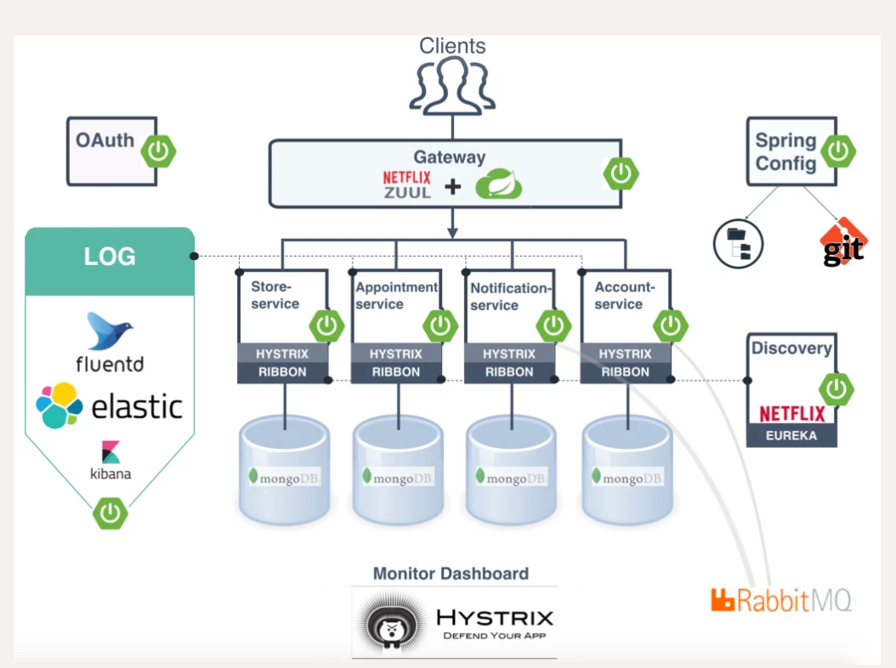
Netflix OSS Microservice Architecture

Slide 8

Let’s Code !!!
Please visit following GitHub URL for Source code reference :
https://github.com/ssatyam2302/springboot-msa-app

Slide 9

References
https://spring.io/projects/spring-cloud-netflix
https://callistaenterprise.se/blogg/teknik/2015/04/10/building-microservices-with-spring-cloud-and-netflix-oss-part-1/#:~:text=To%20support%20the%20business%20services,Edge%20Server%20(Netflix%20Zuul)
https://spring.io/guides/gs/routing-and-filtering/
https://spring.io/guides/gs/circuit-breaker/
https://stackoverflow.com/questions/39349591/what-is-hystrix-in-spring
http://12factor.net/

Slide 10

Thank You

