Slide 1
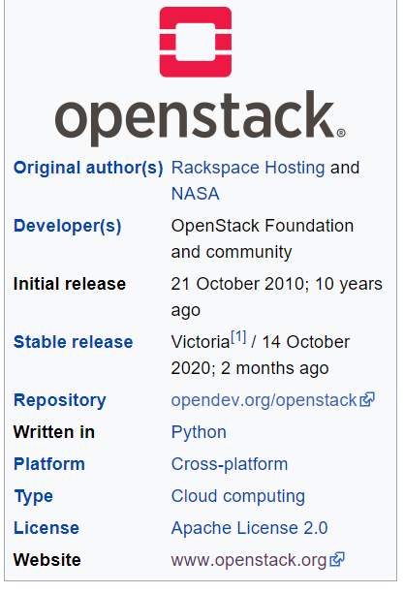

OpenStack Learning Path
Sudhanshu Satyam
Email : susatyam@in.ibm.com
Slack : @sudhanshu
Image Source :
https://en.wikipedia.org/wiki/OpenStack

Slide 2

Content
OpenStack overview
OpenStack components
OpenStack Conceptual Architecture
OpenStack Logical Architecture
OpenStack Services
OpenStack Categorizations
OpenStack Categorizations contn…
OpenStack Services - Core
OpenStack Services - Advanced
OpenStack Learning Path
Image Source :
https://slidemodel.com/templates/table-content-slides-powerpoint/6185-06-table-of-content-globe-2/

Slide 3
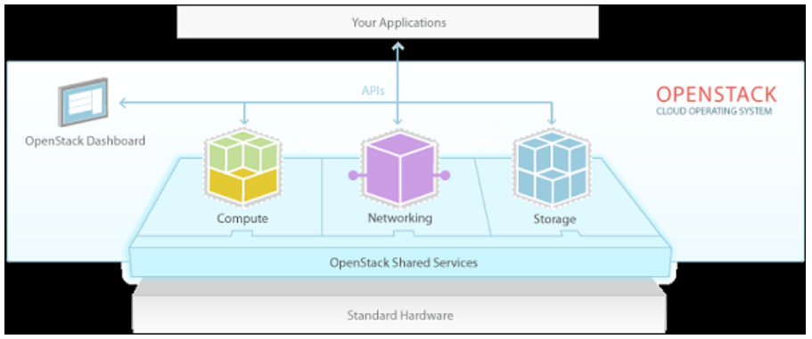
OpenStack
OpenStack is a software for building and managing cloud-computing platforms for public and private clouds. OpenStack is used to deploy virtual machines and other instances that handle different tasks for managing a cloud environment. OpenStack is considered as – Infrastructure as a Service (IaaS).
Image Source :
https://www.tutorialspoint.com/virtualization2.0/virtualization2.0_openstack.htm

Slide 4
OpenStack Components
Compute (Nova): Compute is a Cloud Computing controller designed to manage resources in virtualized environments.
Object Storage (Swift): This is a mountable redundancy storage system. It helps in data replication throughout a data center.
Block Storage (Cinder): Block storage component provides persistent-level storage solutions for using cloud-oriented computing devices.
Networking (neutron): Neutron is an OpenStack networking component that helps in managing all kinds of network-related queries.
Image Source :

Slide 5
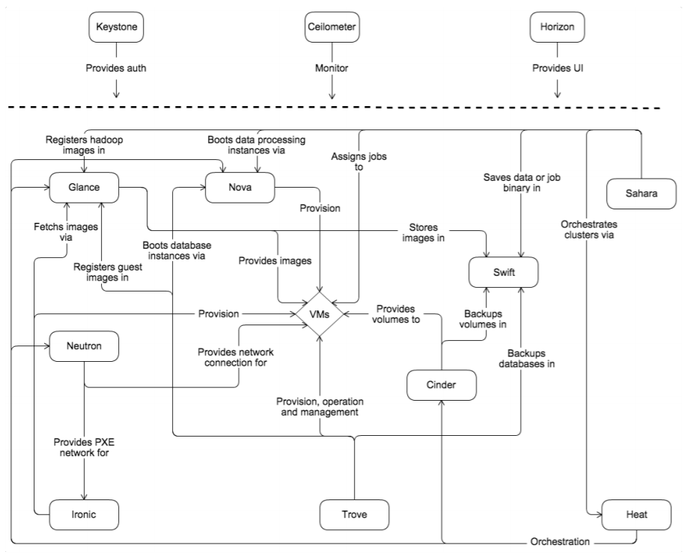
Conceptual Architecture
Image Source : https://docs.openstack.org/install-guide/get-started-conceptual-architecture.html

Slide 6
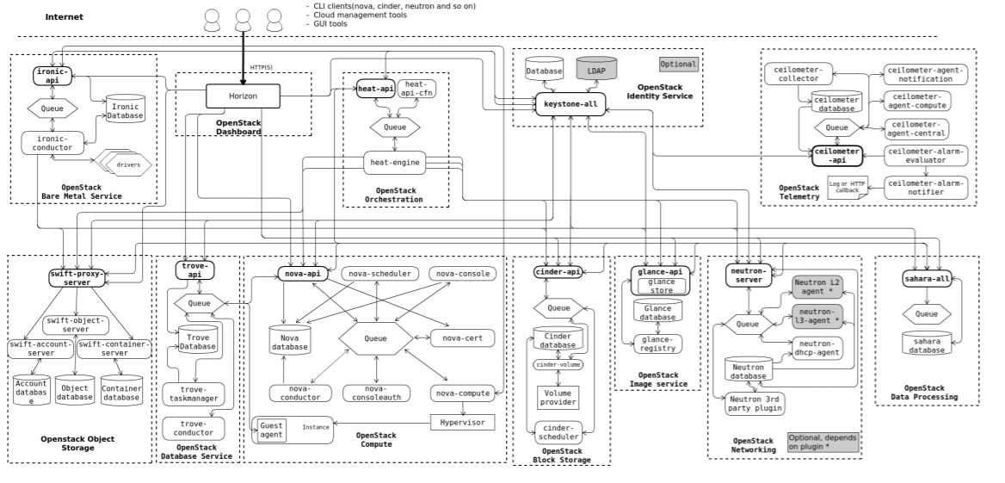
Logical Architecture
Image Source : https://docs.openstack.org/install-guide/get-started-logical-architecture.html

Slide 7
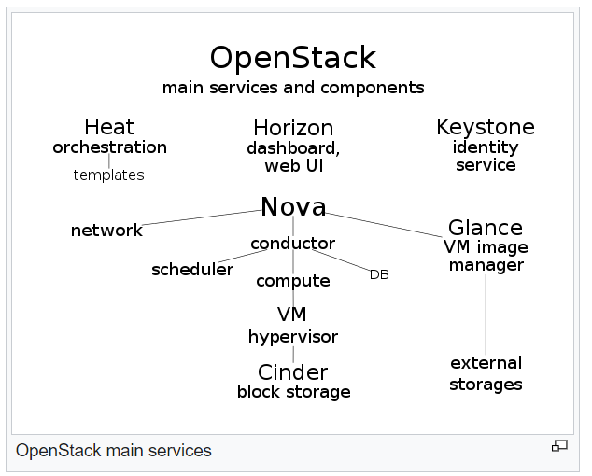
OpenStack Services
Image Source : https://en.wikipedia.org/wiki/OpenStack

Slide 8
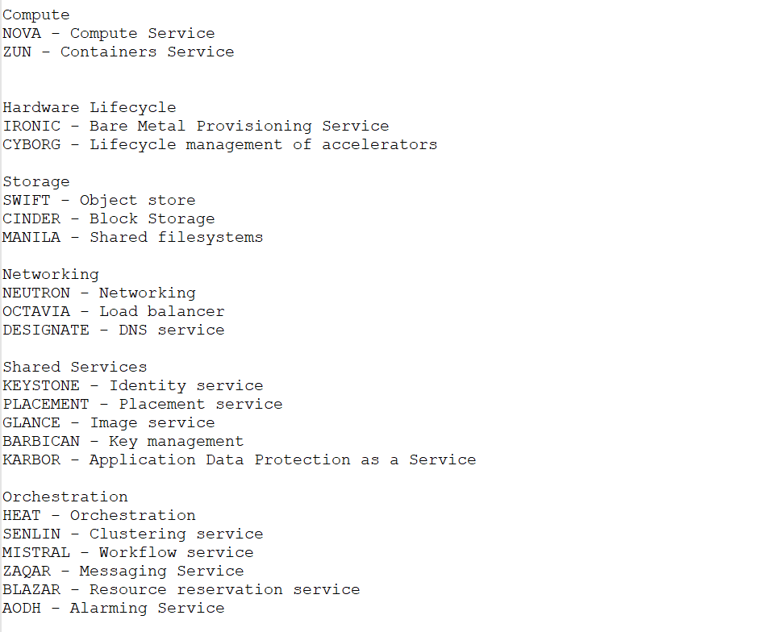
OpenStack Services - categorization

Slide 9
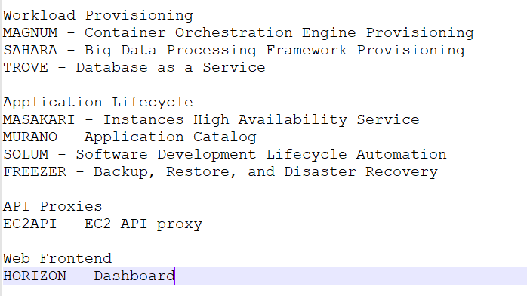
OpenStack Services - categorization

Slide 10
OpenStack Services - Core
Compute (Nova) - OpenStack Compute is a cloud computing fabric controller, which manages pools of computer resources and work with virtualization technologies, bare metals, and high-performance computing configurations.
Image Service (Glance) - OpenStack image service offers discovering, registering, and restoring virtual machine images. Glance has client-server architecture and delivers a user REST API, which allows querying of virtual machine image metadata and also retrieval of the actual image.
Object Storage (Swift) - OpenStack Swift creates redundant, scalable data storage to store petabytes of accessible data. The stored data can be leveraged, retrieved and updated. It has a distributed architecture, providing greater redundancy, scalability, and performance, with no central point of control.
Dashboard (Horizon) - Horizon is the authorized implementation of OpenStack’s Dashboard, which is the only graphical interface to automate cloud-based resources.
Identity Service (Keystone) - Keystone provides a central list of users, mapped against all the OpenStack services, which they can access. It integrates with existing backend services such as LDAP while acting as a common authentication system across the cloud computing system.
Networking (Neutron) - Neutron provides networking capability like managing networks and IP addresses for OpenStack. It ensures that the network is not a limiting factor in a cloud deployment and offers users with self-service ability over network configurations.
Block Storage (Cinder) - OpenStack Cinder delivers determined block-level storage devices for application with OpenStack compute instances. A cloud user can manage their storage needs by integrating block storage volumes with Dashboard and Nova.

Slide 11
OpenStack Services - advanced
Orchestration (Heat) - Heat is a service to orchestrate multiple composite cloud applications through both the CloudFormation-compatible Query API and OpenStack-native REST API, using the AWS CloudFormation template format.
Workflow (Mistral) - Mistral is a service that manages workflows. User typically writes a workflow using workflow language based on YAML and uploads the workflow definition to Mistral via its REST API. Then user can start this workflow manually via the same API or configure a trigger to start the workflow on some event.
Telemetry (Ceilometer) - OpenStack Telemetry (Ceilometer) provides a Single Point Of Contact for billing systems, providing all the counters they need to establish customer billing, across all current and future OpenStack components. The delivery of counters is traceable and auditable, the counters must be easily extensible to support new projects, and agents doing data collections should be independent of the overall system.
Database (Trove) - Trove is a database-as-a-service provisioning relational and a non-relational database engine.
Elastic map reduce (Sahara) - Sahara is a component to easily and rapidly provision Hadoop clusters. Users will specify several parameters like the Hadoop version number, the cluster topology type, node flavor details (defining disk space, CPU and RAM settings), and others. After a user provides all of the parameters, Sahara deploys the cluster in a few minutes. Sahara also provides means to scale a preexisting Hadoop cluster by adding and removing worker nodes on demand.
Bare metal (Ironic) - Ironic is an OpenStack project that provisions bare metal machines instead of virtual machines. It was initially forked from the Nova Baremetal driver and has evolved into a separate project. It is best thought of as a bare-metal hypervisor API and a set of plugins that interact with the bare-metal hypervisors. By default, it will use PXE and IPMI in concert to provision and turn on and off machines, but Ironic supports and can be extended with vendor-specific plugins to implement additional functionality.

Slide 12
OpenStack Services - advanced
Messaging (Zaqar/RabbitMQ) - Zaqar is a multi-tenant cloud messaging service for Web developers. The service features a fully RESTful API, which developers can use to send messages between various components of their SaaS and mobile applications by using a variety of communication patterns. Underlying this API is an efficient messaging engine designed with scalability and security in mind. Other OpenStack components can integrate with Zaqar to surface events to end users and to communicate with guest agents that run in the "over-cloud" layer.
Shared file system (Manila) - OpenStack Shared File System (Manila) provides an open API to manage shares in a vendor agnostic framework. Standard primitives include ability to create, delete, and give/deny access to a share and can be used standalone or in a variety of different network environments. Commercial storage appliances from EMC, NetApp, HP, IBM, Oracle, Quobyte, INFINIDAT and Hitachi Data Systems are supported as well as filesystem technologies such as Red Hat GlusterFS or Ceph.
DNS (Designate) - Designate is a multi-tenant REST API for managing DNS. This component provides DNS as a Service and is compatible with many backend technologies, including PowerDNS and BIND. It doesn't provide a DNS service as such as its purpose is to interface with existing DNS servers to manage DNS zones on a per tenant basis.
Search (Searchlight) - Searchlight provides advanced and consistent search capabilities across various OpenStack cloud services. It accomplishes this by offloading user search queries from other OpenStack API servers by indexing their data into ElasticSearch. Searchlight is being integrated into Horizon[124] and also provides a Command-line interface.
Key manager (Barbican) - Barbican is a REST API designed for the secure storage, provisioning and management of secrets. It is aimed at being useful for all environments, including large ephemeral Clouds.

Slide 13
OpenStack Services - advanced
Container orchestration (Magnum) - Magnum is an OpenStack API service developed by the OpenStack Containers Team making container orchestration engines such as Docker Swarm, Kubernetes, and Apache Mesos available as first class resources in OpenStack. Magnum uses Heat to orchestrate an OS image which contains Docker and Kubernetes and runs that image in either virtual machines or bare metal in a cluster configuration.
Root Cause Analysis (Vitrage) - Vitrage is the OpenStack RCA (Root Cause Analysis) service for organizing, analyzing and expanding OpenStack alarms & events, yielding insights regarding the root cause of problems and deducing their existence before they are directly detected.
Rule-based alarm actions (Aodh) - This alarming service enables the ability to trigger actions based on defined rules against metric or event data collected by Ceilometer or Gnocchi.

Slide 14
OpenStack – Learning Path
OpenStack modules
beginner
intermediate
expert
Cloud computing background
OpenStack architecture and components
OpenStack networking
Object and Block storage
Understanding about Instance lifecycle
Have your own OpenStack instance that could even run on your laptop or pc
Launch VMs and manage their lifecycle
Operate your OpenStack cluster from dashboard
Operate your OpenStack cluster from CLI
Manual Installation in Virtual Machines
Manual Installation on BareMetal Servers
Kolla-Ansible Installation on Virtual Machines
Kolla-Ansible Installation in Physical Servers
Automation of Kolla-Ansible Deployment
Packstack & Devstack
Advanced Certifications

Slide 15

Thank you
Image Source :

